Slide 1
Learning-Based Prediction of Package Power Delivery Network Quality
Yi Cao† , Andrew B. Kahng‡, Joseph Li†, Abinash Roy† Vaishnav Srinivas† and Bangqi Xu‡ ‡UC San Diego, †Qualcomm Technologies, Inc.
Notes:
Good afternoon, everyone. Today I will present our work on learning-based prediction of package power delivery network quality.
This work is in collaboration with Qualcomm.

Slide 2
Outline
Motivation
Learning-based PDN Modeling
Correlation Methodology with Signoff Tool
Experiments
Conclusion and Future Works
Notes:
I will first explain motivation of our work, describe our learning-based PDN modeling methodology followed by our correlation methodology with signoff tool. Then I will show experimental results and conclude the talk.

Slide 3
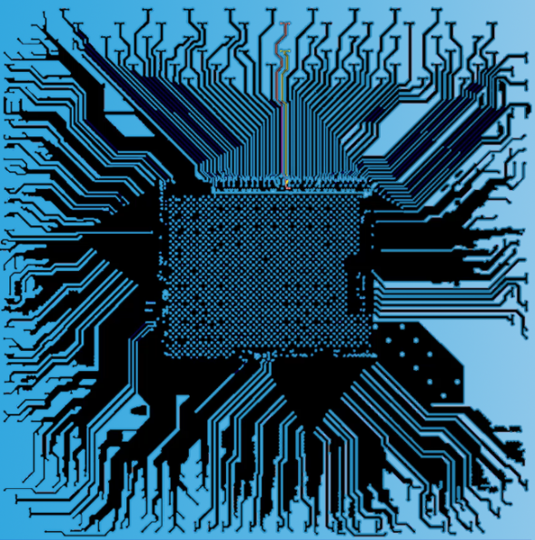
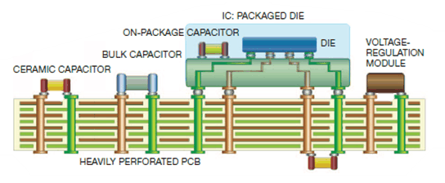
Motivation
Package (PKG) Power Delivery Network (PDN)
Deliver power to critical computing blocks in SoC
Multi-week manual design cycle with optimization
Among RCL components, L (inductance) is the most difficult part to model
Terms: bumps, balls, pinmap
Layers of the PKG
Layers of the PCB
Notes:
Package power delivery network plays an important role in a modern SoC. It is responsible for delivering power to critical computing blocks such as CPU, GPU, NPU and etc. And, crucially, it closely reflects the SOC floorplan !!!
However, since the design and optimization of PKG PDN is still mostly done manually, each iteration of PKG PDN design and optimization can take weeks.
[Click] This is a cartoon of components of, say, a mobile system. The right figure shows how a chip package might look like.
[Click] Among R, C and L components of the PKG PDN, inductance L is considered as the most important and the most difficult to model. Our work focuses on the inductance modeling of PKG PDN.
Note that we typically focus on PDN that is in the [CLICK] core region of the package, over the SOC die itself. In the following discussion, I’ll use the terms bumps to refer to die microbumps, which are the black dots you can see in the core , [CLICK] balls to refer to the package solder balls, and pinmap to refer to the union of these elements of the PDN.

Slide 4
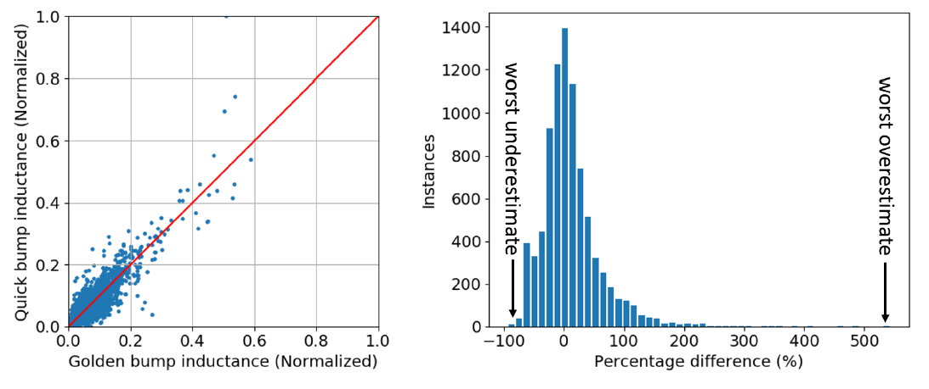
Challenges
Costly pinmap (of μ-bump and solder ball) evaluation
No pre-layout pinmap quality assessment
Expensive manual layout iterations
Discrepancy in tools introduces more iterations
Quick simulation tools used in design phase
Golden extraction tools used for signoff
The 95th percentile of absolute percentage error is 82.6%
Notes:
In conventional PKG PDN design flow, layout engineers are given a pinmap which consists of the locations of microbump and solder ball. And then they are asked to drop metal wires and vias to connect pins that belong to power nets.
But in the conventional flow, there is no pinmap quality assessment before layout. In other words, only after layout is done can we evaluate the quality of the pinmap based on the achieved inductance value. This usually leads to expensive manual layout iterations.
[Click] Moreover, during design phase, using Golden extraction tools is not affordable due to long runtime. Designers usually use Quick simulation tools for first-order estimates of PDN quality. The 95th percentile of error between Quick simulation tools and Golden signoff tools can be up to 82.6%.
These figures show the discrepancy. The left figure shows the Golden signoff tool result on X, versus Quick simulation toolon Y. The right figure shows the percentage error histogram. As I mentioned, such discrepancy introduces more iterations because of incorrect optimization guidance from the Quick tool.

Slide 5
Related Works
Lumped element model
[Tsai96][Mandic14] lump components in the system
E.g., lumped μ-bumps and BGA balls
Not accurate: does not understand distributed nature of PDN
Distributed model & s-parameter model
[Brennan79] propose partial element equivalent circuit with RLC components
[Tsai96] treat PDN as black box and construct S-parameter matrix
Does not scale well as design size increases
Tradeoff between runtime and accuracy!
Question:
What do designers want beyond these?
Answers:
Pre-layout pinmap quality assessment
Better runtime-accuracy tradeoff Pareto
Notes:
Previous works on bump inductance modeling include lumped element models that achieve fast runtime but sacrifice accuracy, since they do not comprehend well the distributed nature of PDN.
[Click] Distributed and s-parameter models include more components in the system to achieve better accuracy, but at the cost of runtime.
[Click] We can observe that all previous works are on the tradeoff Pareto between runtime and accuracy.
[Click] Now our starting question is really: What do designers want beyond these? Our work addresses two answers to this question. The first answer is pre-layout pinmap quality assessment. The second answer is: a better runtime-accuracy tradeoff Pareto.

Slide 6
Our Work
First to propose a modeling methodology to predict post-layout inductance values for each bump at pre-layout stage
Enables early filtering and improvement of pinmaps that would otherwise lead to failure to meet PDN specifications, at pre-layout stage
Apply our methodology to improve post-layout bump inductance prediction
Extend our methodology to correlate bump inductance values from Quick tool to Golden tool
Notes:
So in this work we propose a modeling methodology to predict post-layout inductance values for each bump -- at pre-layout stage -- which enables filtering and improvement of pinmap.
[Click] We apply our methodology to improve bump inductance prediction during design phase compared to Quick tool.
[Click] We extend our methodology to correlate bump inductance values from Quick tool to Golden tool to deliver even better bump inductance prediction.

Slide 7
Outline
Motivation
Learning-based PDN Modeling
Modeling Parameters
Modeling Methodology
Reporting Metrics
Correlation Methodology with Signoff Tool
Experiments
Conclusion and Future Works
Notes:
Now I will describe our learning-based PDN modeling. That is, I will describe the modeling parameters, modeling methodology and reporting metrics that we use.

Slide 8
Modeling Parameters
Three sets of parameters
Use of parameter categories
Parameter Set | Availability
Pinmap-dependent (PiM) | Pre-layout
Design-dependent (Des) | Pre-layout
Layout-dependent (Lay) | Post-layout
Parameter Sets | Model
PiM + Des | Pre-layout bump inductance model
PiM + Des + Lay | Post-layout bump inductance model
PiM + Des + Lay | Quick tool to Golden tool correlation model
Notes:
The modeling parameters that we use can be divided into three categories. The first is Pinmap-dependent parameters (PiM). The second is Design-dependent parameters (Des) and the third one is Layout-dependent parameters (Lay).
Notice that the first two sets of parameters are available at pre-layout stage, while Layout-dependent parameters are only available at post-layout stage.
[Click] We use PiM and Des for pre-layout pinmap assessment model. And, we use all three of PiM, Des and Lay for both post-layout bump inductance modeling, and for the Quick tool to Golden tool correlation modeling.

Slide 9
Modeling Parameters
Index | Parameter | Description | Type
P1 | $$d_{GNDBall}$$ | Distance to closest GND ball | PiM
P2 | $$d_{VDDBall}$$ | Distance to closest VDD ball | PiM
P3 | $$d_{GNDBump}$$ | Distance to closest GND bump | PiM
P4 | $$\#VDDBump[]$$ | Array of #bump from same supply rail within radius of {1,2,3,4} bump pitches | PiM
P5 | $$\#supplyrail[]$$ | Array of #supplyrail within radius of {1,2,3,4} pitches | PiM
P6 | $$\#OtherBump[]$$ | Array of #bump in different supplyrail within radius of {1,2,3,4} bump pitches | PiM
P7 | $$thickness$$ | Thickness of the PKG design | Des
P8 | $$current$$ | Derived per-bump current | Des
P9 | $$\#layer$$ | Number of metal layers used | Des
P10 | $$Util[]$$ | Array of metal utilization within radius of {1,2,3,4} bump pitches | Lay
P11 | $$ViaCnt[]$$ | Array of via count within radius of {1,2,3,4} bump pitches | Lay
P12 | $$TraceCnt[]$$ | Array of track count within radius of {1,2,3,4} bump pitches | Lay
Notes:
This slide summarizes our 12 modeling parameters – Table 1 in the paper.
[Click] P1, P2 and P3 give an estimate of the primary return path length which is critical to loop inductance of a bump.
[Click] P4 and P5 give an estimate of likelihood of bump being grouped together using metal fills.
[Click] P4, P5 and P6 together give an estimate of routing congestion.
[Click] P7 is an indicator of partial and mutual inductance contributed by vias.
[Click] P8 gives the current information on each bump.
[Click] P9 indicates the availability of routing resource in the PKG.
[Click] P10, P11 and P12 indicate routing congestion in the surrounding area of each bump

Slide 10
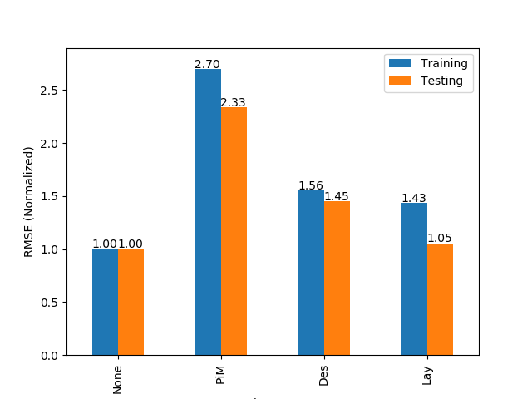
Parameter Importance Analyses
Remove one individual parameter at a time
Remove one parameter set at a time
Up to 135%
RMSE degradation
Up to 170%
RMSE degradation
Notes:
We have studied the importance of each parameter by analyzing the sensitivity of model accuracy to parameters. Our model’s accuracy is the left set of bars, blue is training and orange is testing.
First we remove one individual parameter at a time and we observe that the root mean square error (RMSE) degrades by up to 135%.
[Click] Second, we remove one parameter set (PiM, Des, or Lay) at a time and we observe that RMSE degrades by up to 170%.

Slide 11
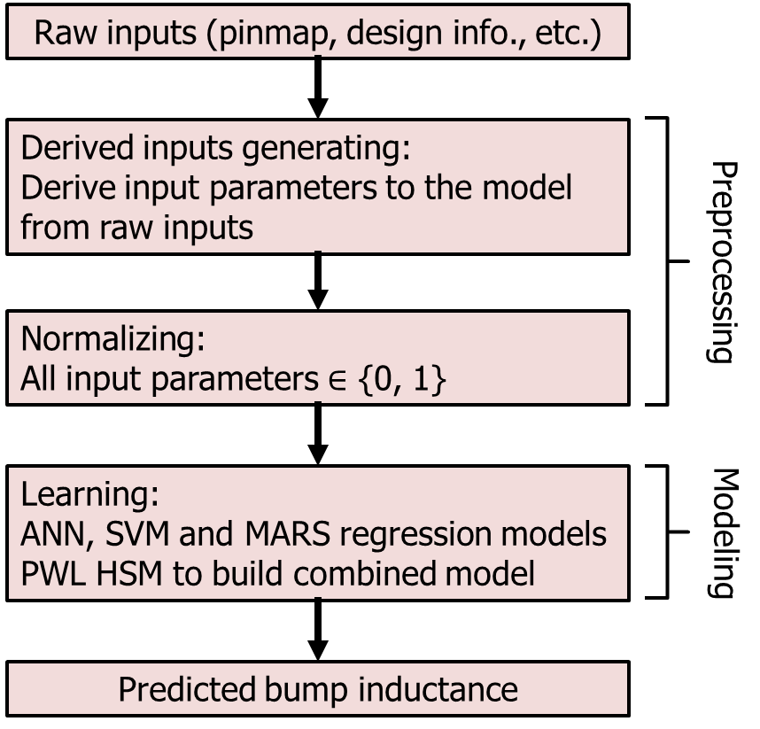
Modeling Flow
Raw inputs include hundreds of pin locations
Need for derived parameters
Modeling techniques
Artificial Neural Network (ANN)
Support Vector Machine (SVM)
Multivariate Adaptive Regression Spline (MARS)
Metamodeling technique
Piecewise-linear (PWL) hybrid surrogate modeling (HSM)
Modeling Flow
Notes:
Now I will describe our modeling flow.
The raw inputs of our modeling problem include hundreds of pin locations. [Click] To make it practical, we generate derived parameters from raw inputs and normalize all parameters between 0 and 1.
[Click] We use ANN, SVM and MARS as our regression techniques. Also, we apply piecewise-linear hybrid surrogate modeling based on ANN output to further improve our model accuracy, as shown below. In other words, based on the range in which the ANN prediction falls, we apply a different, fitted linear combination of the three predictors’ outputs. [Click] And we obtain our predicted bump inductance from this hybrid model.

Slide 12
Reporting Metrics
We use the following metrics to evaluate performance of our models
Notation | Meaning
$$R^{2}$$ | Coefficient of determination
AAPE (%) | Average absolute percentage error
${90}^{th}$-pct Worst Overestimate (%) | 90% percentile value of sorted overestimating percentage errors
${90}^{th}$-pct Worst Underestimate (%) | 90% percentile value of sorted underestimating percentage errors
${95}^{th}$-pct Worst Overestimate (%) | 95% percentile value of sorted overestimating percentage errors
${95}^{th}$-pct Worst Underestimate (%) | 95% percentile value of sorted underestimating percentage errors
Note: We are not able to provide absolute errors due to product confidentiality constraints
Notes:
We use the following metrics to evaluate performance of our models: R-square coefficient, average absolute percentage error, and the 90th and 95th percentile values of sorted overestimating or underestimating percentage errors.
Note that we are not able to provide absolute errors due to product confidentiality constraints.

Slide 13
Outline
Motivation
Learning-based PDN Modeling
Correlation Methodology with Signoff Tool
Experimental Results
Conclusion and Future Works
Notes:
Next, I will talk about our correlation methodology to achieve better correlation between Quick tool and Golden Tool.

Slide 14
Correlation Methodology with Signoff Tool
Use layout information from design to compensate the difference (error) between the Quick tool and Golden tool
Quick tool result
Golden tool result
Derived inputs
(P1 – P12)
Correlation
Model Training
Training
Quick tool result
Derived inputs
(P1 – P12)
Predictive
Correlation Model
Predicted Golden
tool value
Testing
Notes:
As mentioned earlier, the discrepancy between Golden tool and Quick tool often introduces extra design iterations. In this work, we use layout information from design to compensate the discrepancy.
Apart from the derived inputs mentioned before, we also train a correlation model using the Quick tool result as an additional model parameter.
[Click] During testing phase, our model predicts Golden tool value based on the Quick tool result and Derived inputs, thus correlating Quick tool to Golden tool.

Slide 15
Outline
Motivation
Learning-based PDN Modeling
Correlation Methodology with Signoff Tool
Experiments
Design of Experiment
Experimental Results
Conclusion and Future Works
Notes:
Now, I will present our experimental setup, design of experiment and results.
[~1050 / 1550 words]

Slide 16
Experiments
Designs
17 industry PKG designs
2-layer, 3-layer and 4-layer designs
Various bump / ball pitch sizes
Tools
Quick tool: A commercial tool widely used in industry for design phase inductance simulation
Take ~0.5 hours to evaluate each design
Golden tool: A commercial tool widely used in industry for signoff inductance extraction
Take at least 0.5 days to evaluate each design
Question:
What do designers want beyond they have now?
Answers:
Pre-layout pinmap quality assessment
Better runtime-accuracy tradeoff Pareto
Notes:
I will first introduce our experimental setup. All 17 designs that we use are real industry designs. To ensure diversity of our data, the 17 designs have 2, 3, or 4 Package layers with various bump and ball pitch sizes. Also, details of the cross-validation, denoising, training and testing set sizes, and so on are given in Section 4 of the paper. [67 train, 33 test; 3x cross-valid, 10 denoising runs]
[Click] Quick tool is a commercial tool that is widely used in industry for design phase inductance simulation. Golden tool is also a commercial tool, but it is widely used for signoff inductance extraction.
[Click] Remember that we mentioned earlier that we would like to answer the question “What do designers want beyond they have now”. The experiments in the following slides will show the two answers that we give for this question.
I would like to emphasize that Quick tool takes about half an hour to evaluate each design, while Golden tool takes at least half a day to evaluate each design.

Slide 17
Design of Experiment
Pre-layout pinmap quality assessment
Achievable bump inductance model (pre-layout)
Given: PiM and Des parameter sets
Predict: achievable bump inductance
Usage: Pre-layout pinmap filtering
Better runtime-accuracy tradeoff Pareto
Actual bump inductance model (post-layout)
Given: PiM, Des and Lay parameter sets
Predict: actual bump inductance
Golden and Quick Correlation model (post-layout)
Given: PiM, Des, Lay parameter sets and Quick tool inductance value
Correlate: Quick tool result to actual bump inductance
Usage: Better design-phase inductance estimation
Note: actual bump inductance is extracted by Golden tool at post-layout stage
Notes:
Our experiments assess the models in our answers to the designer’s question.
FIRST: Towards pre-layout pinmap quality assessment, we build the (pre-layout) achievable bump inductance model. Our model predicts the achievable bump inductance given the pinmap and design parameter sets. This can be used to filter bad pinmaps before layout.
[Click] SECOND: Towards better runtime-accuracy tradeoff Pareto. We first build an (post-layout) actual bump inductance model. Our model predicts the actual bump inductance given pinmap, design and layout information.
[Click] AND: for those who have access to the Quick tool result, we also build an (post-layout) actual bump inductance model to correlate Quick tool result to Golden tool result. These latter two models aim to provide more accurate design-time bump inductance estimation.

Slide 18
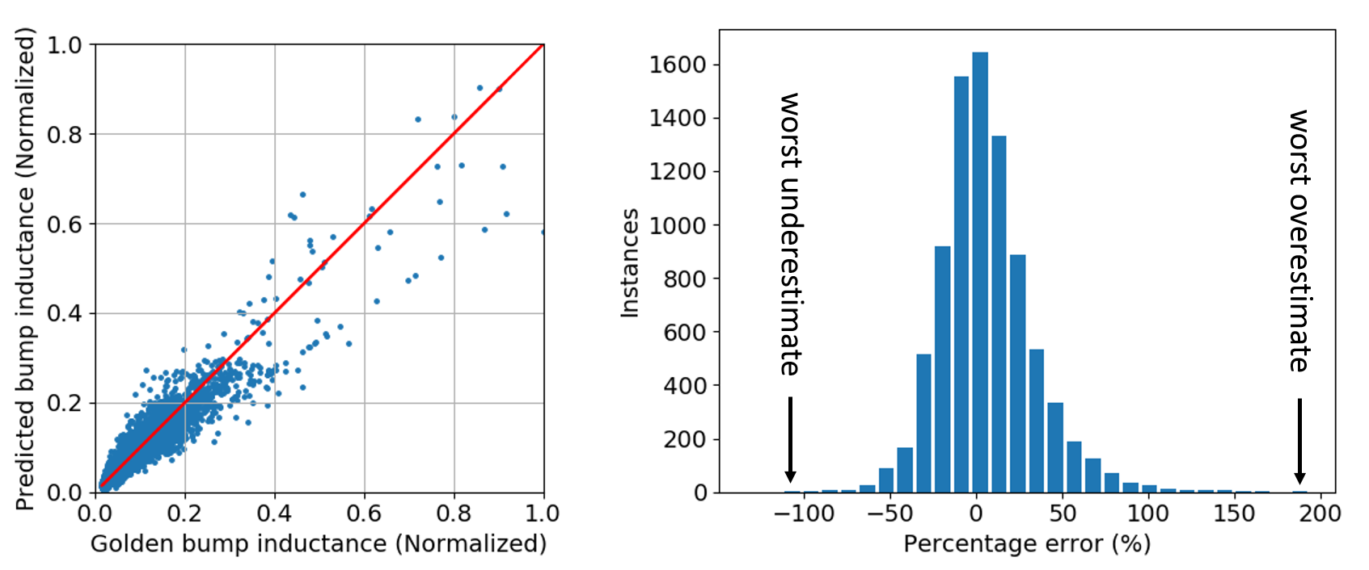
Result: Achievable Bump Inductance Model
Pre-layout pinmap quality assessment
Achieve AAPE of 21.2% and 18.7% for training and testing
→ Enable pinmap filtering based on achievable PDN quality
Metric | Training | Testing
$$R^{2}$$ | 0.89 | 0.90
AAPE (%) | 21.2 | 18.7
${90}^{th}$-pct Worst Overestimate (%) | 54.7 | 46.7
${90}^{th}$-pct Worst Underestimate (%) | -34.6 | -32.4
${95}^{th}$-pct Worst Overestimate (%) | 70.6 | 59.1
${95}^{th}$-pct Worst Underestimate (%) | -43.3 | -37.6
Note: Our model takes 7.5 hours for training and approximately 270 seconds for every 1K data points for inference
Notes:
So: For pre-layout pinmap quality assessment, we build an achievable bump inductance model. Table and plots here show our modeling result. Our model achieves average absolute percentage error of 21.2% and 18.7% for training and testing datasets respectively.
[Click] To the best of our knowledge, this model is the first one that enables pinmap filtering based on achievable PDN quality.

Slide 19
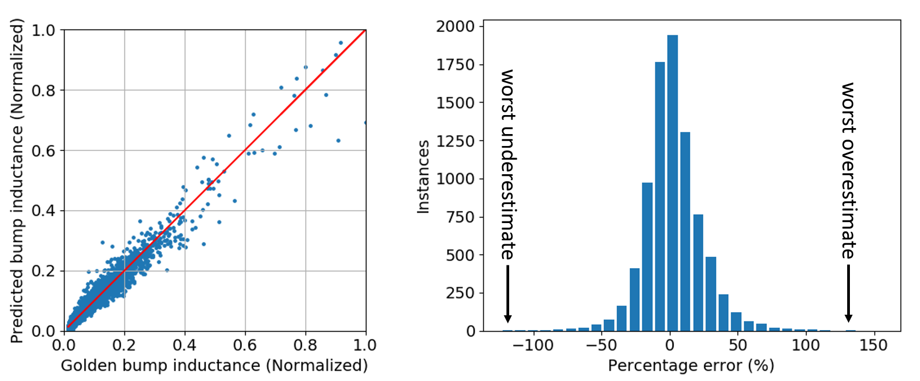
Result: Actual Bump Inductance Model
Better runtime-accuracy tradeoff pareto
Achieve AAPE of 13.5% and 19.3% for training and testing
→ Already better than Quick tool result(!)
Metric | Quick | Training | Testing
$$R^{2}$$ | 0.77 | 0.97 | 0.92
AAPE (%) | 33.2 | 13.5 | 19.3
${90}^{th}$-pct Worst Overestimate (%) | 97.6 | 32.2 | 48.0
${90}^{th}$-pct Worst Underestimate (%) | -56.9 | -24.9 | -32.5
${95}^{th}$-pct Worst Overestimate (%) | 125.1 | 41.2 | 62.9
${95}^{th}$-pct Worst Underestimate (%) | -61.5 | -33.7 | -40.6
Note: Our model takes 7.5 hours for training and approximately 270 seconds for every 1K data points for inference
Notes:
Next, we build a model to push the runtime-accuracy tradeoff Pareto in bump inductance modeling. Table and plots here show our modeling result. We achieve average absolute percentage errors of 13.5% and 19.3% for training and testing dataset. Also, we show the Quick tool result for comparison – in the SECOND COLUMN, here. The rows of this table are the various accuracy metrics that I mentioned earlier. This combines Tables 4 and 5 of the paper, I think.
[Click] We observe that our actual bump inductance model already outperforms the Quick tool by more than 10%.

Slide 20
Result: Golden and Quick Correlation Model
Better runtime-accuracy tradeoff pareto
Comparison between Quick tool and Correlation model
→ Significantly close the gap between Quick tool and Golden tool(!)
Metric | Quick | Corr.
$$R^{2}$$ | 0.77 | 0.95
AAPE (%) | 33.2 | 15.4
${90}^{th}$-pct Worst Overestimate (%) | 97.6 | 48.6
${90}^{th}$-pct Worst Underestimate (%) | -56.9 | -37.1
${95}^{th}$-pct Worst Overestimate (%) | 125.1 | 37.5
${95}^{th}$-pct Worst Underestimate (%) | -61.5 | -28.3
Correlation Model
Quick tool
Correlation Model
Note: Our model takes 7.5 hours for training and approximately 270 seconds for every 1K data points for inference
Notes:
And, we build Golden and Quick Correlation model to further push the runtime-accuracy tradeoff Pareto.
[Click] Compared to the Quick tool alone, our correlation model achieves an average of 17.8% absolute percentage error improvement, which significantly reduces the gap between Quick tool and Golden tool.
The scatter plots below illustrate the correlation model’s improvement (on the RIGHT) versus the Quick tool (on the LEFT).

Slide 21
Outline
Motivation
Learning-based PDN Modeling
Correlation Methodology with Signoff Tool
Experiments
Conclusion and Future Works
Notes:
Now let me conclude.

Slide 22
Conclusion
Pre-layout pinmap quality assessment via achievable bump inductance model
Better runtime-analysis tradeoff by
Learning-based bump inductance model
→ More than 10% better than commercial Quick tool
Correlation model can close the gap between Quick tool and Golden tool
→ 17.8% better than commercial Quick tool
Ongoing / Future works
Enhance model robustness across different technology and testcases
Build Lay parameter predictors for layout guidance
Develop model-based PKG pinmap optimization
Notes:
In this work, we propose learning-based methodology for bump inductance modeling.
Before layout, our achievable bump inductance model provides pre-layout pinmap quality assessment which can be used to filter various pinmap solutions. [Remember: we are trying to reduce the horrible loop with the SOC design, including the SOC floorplan design.]
[Click] To achieve better runtime-analysis tradeoff, we first build a learning-based bump inductance model which, on average, is more than 10% more accurate than Quick tool
[Click] We further develop correlation model to close the gap between Quick tool and Golden tool. Results show that, on average, the correlation model performs 17.8% than Quick tool.
[Click] Our ongoing and future works include enhancing model robustness across different technology and testcases, building layout parameter predictors for layout optimization guidance and developing model-based PKG pinmap optimization.

Slide 23
Thank you!
Notes:
Thank you for your attention.
Are the accuracy numbers good enough? (what do designers require, what can they live with, what is still beneficial even if somewhat inaccurate, etc. ....?)
This is hard to precisely quote as an impedance accuracy. At this stage of the design the key is being able to study pinmaps (bumps/balls) without having to layout the package for each pinmap. This provides the ability to evaluate a large number of floorplans and PCB placement options in a short amount of time. How much accuracy is good enough may vary from cases to case depending on how the relative accuracy of other pinmap options being studied wrt the “best” pinmap given the constraints. I think we started with a goal of +/- 10-20%, but I think the fidelity vs accuracy question needs to be understood better with more case studies. This could be a good item for a journal (along with the router work).
Where does this work fit in ---- i.e., what is the big picture + roadmap of why we are doing this?
I think this fits into our vision of a Unified Planning Tool. It is a first step in a quick evaluation of a pinmap without layout (to extract). Aid for rapid floorplanning studies + co-design with pkg/pcb that removes manual layout from the loop. The router extends this to improve the fidelity/accuracy of our current model to help achieve the same goal – pinmap+floorplan co-optimization.

Slide 24
Backup
Notes:
Are the accuracy numbers good enough? (what do designers require, what can they live with, what is still beneficial even if somewhat inaccurate, etc. ....?)
[VS]: This is hard to precisely quote as an impedance accuracy. At this stage of the design the key is being able to study pinmaps (bumps/balls) without having to layout the package for each pinmap. This provides the ability to evaluate a large number of floorplans and PCB placement options in a short amount of time. How much accuracy is good enough may vary from cases to case depending on how the relative accuracy of other pinmap options being studied wrt the “best” pinmap given the constraints. I think we started with a goal of +/- 10-20%, but I think the fidelity vs accuracy question needs to be understood better with more case studies. This could be a good item for a journal (along with the router work).
Where does this work fit in ---- i.e., what is the big picture + roadmap of why we are doing this? (here, it may be helpful to revisit the original "what do designers want that they don't have today" and explain how this and other steps (autorouter, pinmap optimizer, SOC floorplan optimizer) form a long-term research trajectory.
[VS]: I think this fits into the yellow blob as a first step in a quick evaluation of a pinmap without layout (to extract). Aid for rapid floorplanning studies + co-design with pkg/pcb that removes manual layout from the loop. The router extends this to improve the fidelity/accuracy of our current model to help achieve the same goal – pinmap+floorplan co-optimization.

Slide 25
Bump Inductance Extraction
(Golden tool)
Output s-parameter for each bump
Use Matlab to obtain total loop inductance at target frequency
Only loop inductance is available
(Quick tool)
Output inductance report (includes each bump)
Includes self inductance and total loop inductance
Notes:
What specific packages and what specific settings used in the packages (e.g., ANN) ? Please find some details of the modeling part below. Parameters not mentioned below imply default parameters are used in each individual package / modeling tool.
For ANN, we are using JMP and the ANN has one hidden layer of 20 neurons (having more layers / neurons causes overfitting, which was experimentally verified).
For SVM, we are using sklearn package and it is SVM regression with RBF kernel.
For MARS, we are using pyearth package and we allow a max degree of interaction of three and a maximum terms of 100 (usually only have ~50 terms in the trained model).
For HSM, we are using linear regression model from sklearn pacakge.
--- runtimes of data (feature) extraction, model training, model inference (somehow needs to be grounded against scale -- e.g., for a design with around XXX bumps and YYY balls, extracting features takes ..... minutes).
Please find the runtime information below:
Feature extraction time: 4717 seconds (~1.2 hours) (for 8.5K bumps from 17 designs)
Modeling training time: ~7.5 hours (for 8.5K bumps from 17 designs)
Model inference time: ~270 seconds (for every 1K bumps)

