Slide 1


A Cross-Layer Methodology for
Design and Optimization of Networks in
2.5D Systems
Ayse Coskun¹, Furkan Eris¹, Ajay Joshi¹, Andrew B. Kahng^{2,3},
Yenai Ma¹, Vaishnav Srinivas²
¹ECE Department, Boston University, Boston, MA, USA;
²ECE and ³CSE Departments, UC San Diego, La Jolla, CA, USA
Email: fe@bu.edu
ICCAD 2018
This work was funded by NSF grants CCF-1149549, CCF-1564302, and CCF-1716352.

Slide 2
Motivation
2.5D integration technology is gaining popularity in the design of computing systems.
  Heterogeneous integration of multiple technologies [DARPA CHIPS].
  IP reuse [DARPA CHIPS].
  Reduced overall system cost [Kannan et al., MICRO’15].
  Greater system performance within thermal constraints [Eris et al., DATE’18].
2.5D System.

Slide 3
Motivation
Cores, GPUs, ASICS, etc. (chiplets) can be placed on interposer creating very large systems.
How should we connect these chiplets?
Intra-Chiplet Local-Mesh Network (Left-Top)
Unified-Mesh Network (Left-Bottom)
Inter-Chiplet Global-Mesh Network (Right).
2.5D System.
Notes:
Our system is a homogenous system with 16 identical cores on each of the 16 chiplets.

Slide 4
High-Level Problem and Prior Work
Problem: How should we connect chiplets in 2.5D systems together?
Prior work tackles the problem on three separate levels:
  1) Logical Layer [Kannan et al., MICRO’15][Akgun et al., ICCD’16]
  2) Physical Design Layer [Eris et al., DATE’18][Liu et al., DATE‘14]
  3) Circuit Layer [Stow et al., ICCAD’17][Karim et al., ECTC’13]
Notes:
Take notes on each of these works!!!!!

Slide 5
Flawed Top-Down Logic
Logical Layer
Physical Layer
Circuit Layer
Design for high IPC => High-radix low-diameter networks.
Long wires =>
High Latency, high power.
Repeaters => Expensive active interposer technology.
Notes:
On the logical layer, using high-radix low-diameter networks for inter-chiplet communication gives us the best IPC.
High-radix low-diameter networks require long wires, limiting the network performance, and hence the overall system performance.
Using repeaters on long wires to improve performance would necessitate active interposer technology, which increases the system cost.
If we adopt a top-down approach, an architecture analysis of network topologies tells us that high-radix, low-diameter networks should be used for inter-chiplet networks, as they provide the best overall system performance (in instructions per cycle). However, in the physical layer, realization of high-radix, low-diameter networks requires long wires, which can limit the network performance and, hence, the overall system performance. Using repeaters on long wires to improve performance would necessitate active (rather than passive) interposer technology. Since active interposers are more expensive than passive interposers, the system cost equation changes and the top-down intuition is flawed.

Slide 6
Flawed Bottom-Up Logic
Circuit Layer
Physical Layer
Logical Layer
Low cost => Passive Interposer for repeaterless non-pipelined links.
Short wires =>
High link performance, low latency.
Low-radix, high-diameter networks => Low IPC.
Notes:
If we adopt a top-down approach, an architecture analysis of network topologies tells us that high-radix, low-diameter networks should be used for inter-chiplet networks, as they provide the best overall system performance (in instructions per cycle). However, in the physical layer, realization of high-radix, low-diameter networks requires long wires, which can limit the network performance and, hence, the overall system performance. Using repeaters on long wires to improve performance would necessitate active (rather than passive) interposer technology. Since active interposers are more expensive than passive interposers, the system cost equation changes and the top-down intuition is flawed.

Slide 7
Flawed Bottom-Up Logic
Circuit Layer
Physical Layer
Logical Layer
Low cost => Passive Interposer for repeaterless non-pipelined links.
Short wires =>
High link performance, low latency.
Low-radix, high-diameter networks => Low IPC.
We develop a cross-layer co-optimization methodology that optimizes inter-chiplet network design jointly across logical, physical, and circuit layers.
Notes:
If we adopt a top-down approach, an architecture analysis of network topologies tells us that high-radix, low-diameter networks should be used for inter-chiplet networks, as they provide the best overall system performance (in instructions per cycle). However, in the physical layer, realization of high-radix, low-diameter networks requires long wires, which can limit the network performance and, hence, the overall system performance. Using repeaters on long wires to improve performance would necessitate active (rather than passive) interposer technology. Since active interposers are more expensive than passive interposers, the system cost equation changes and the top-down intuition is flawed.

Slide 8
Executive Summary
We develop a cross-layer co-optimization methodology that optimizes network design jointly across logical, physical, and circuit layers.
Our methodology optimizes a given 2.5D network for performance, cost, and wirelength, while ensuring that it is thermally safe.
We obtain up to 90% performance benefit over a 2D system at 16% lower manufacturing cost.
Compared to our prior work, we obtain up to 16% performance improvement at the same cost, or up to 18% lower cost at the same performance.

Slide 9
Outline
Motivation and Prior Work
Cross-Layer Co-Optimization
  “Gas Station” Links
Methodology
Results
Executive Summary

Slide 10
Logical Layer
We consider several Global, Local, and Unified networks.
Global-Local topology means a double-level topology.
  Global topology is used for inter-chiplet communication: Global-Butterfly, Global-Butterdonut, Global-Mesh.
  Local topology is used for intra-chiplet communication: Local-Mesh, Local-Cmesh.
Unified topology means a single-level logical topology.
  Unified-Mesh, Unified-Cmesh.
Intra-Chiplet Local-Mesh Network (Left-Top)
Inter-Chiplet Global-Mesh Network (Right)
Unified-Mesh Network (Left-Bottom).

Slide 11
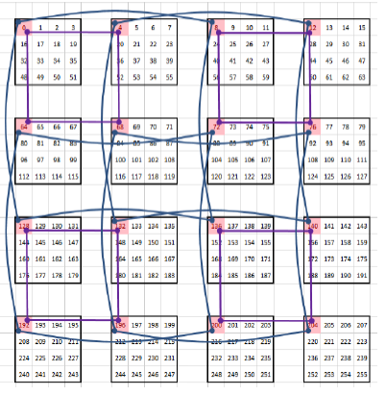
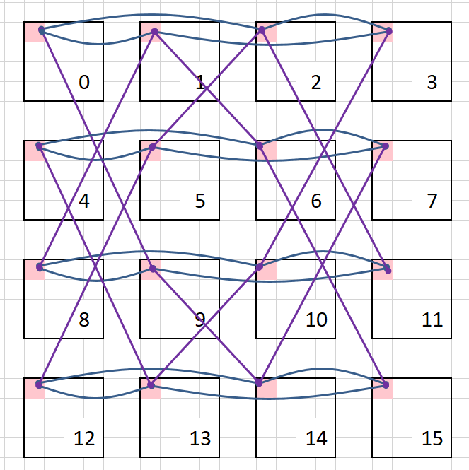
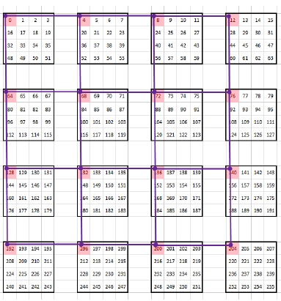
Logical Layer: Global Networks
Global-Local topology means a double-level topology.
  Global topology is used for inter-chiplet communication: Global-Butterfly, Global-Butterdonut, Global-Mesh.
  Local topology is used for intra-chiplet communication: Local-Mesh, Local-Cmesh.
Global-Butterfly
Global-Butterdonut
Global-Mesh

Slide 12
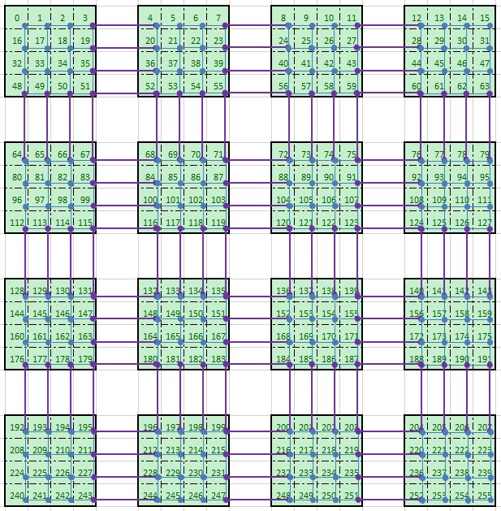
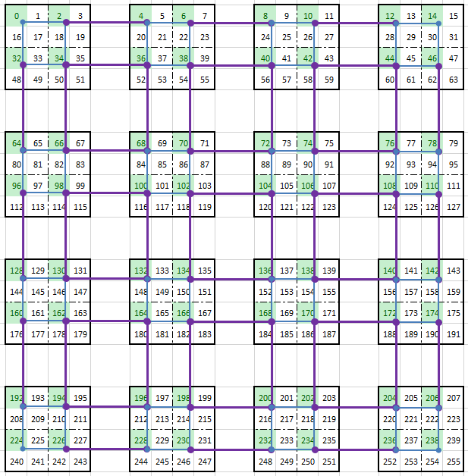
Logical Layer: Unified Networks
Unified topology means a single-level logical topology.
  Unified-Mesh, Unified-Cmesh.
Unified-Mesh
Unified-Cmesh

Slide 13
Physical Layer
Illustration of the extra microbump area required per chiplet.
    We account for microbump overhead into area and cost models.
    We assess achievable physical wiring distances between microbumps.
Notes:
Microbumps consume area, without infinite area they become a resource we must account for.

Slide 14
Physical Layer (contd.)
We construct an MILP that takes the placement of chiplets, the logical network, and the microbump density and outputs the optimal routing solution.
We constrain all link latencies to a maximum link latency.
Our placement and routing also takes “gas station” hops into account.
  We route from the source chiplet to intermediate chiplets.
Too Long
Not Enough Bumps
Correct
Notes:
We construct an MILP that takes the placement of chiplets, the logical network, and the microbump density and outputs the optimal routing solution.
We construct the MILP with the capability to minimize maximum length, maximum total length or a weighted sum of the two.
In this work we search for the minimum maximum link length, giving us a maximum latency. We constrain all link latencies to this maximum link latency.
By performing placement and routing:
Accurate assessments of link lengths.
Feasible choices for link types.
Our placement and routing also takes “gas station” hops into account.
We route from the source chiplet to intermediate chiplets.

Slide 15
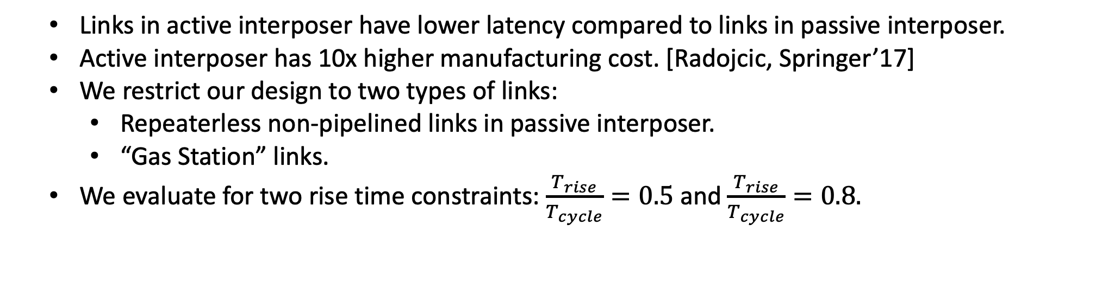
Circuit Layer
  Links in active interposer have lower latency compared to links in passive interposer.
  Active interposer has 10x higher manufacturing cost. [Radojcic, Springer’17]
  We restrict our design to two types of links:
    Repeaterless non-pipelined links in passive interposer.
    “Gas Station” links.
  We evaluate for two rise time constraints: $\frac{T_{rise}}{T_{cycle}}=0.5$ and $\frac{T_{rise}}{T_{cycle}}=0.8.$
FF
Rt
Rw/N
Rw/N
Rw/N
Rw/N
Rt
FF
Co
Cbump
Cesd
Cw/N
Cbump
Cesd
Co
Cw/N
Cw/N
Cw/N
Cw/N
Ci
RC model for repeaterless non-pipelined links.

Slide 16
“Gas Station” Links
Passive interposer link options with 1 as the proposed method for pipelining.
For long distance communication, we need to either:
  Use repeatered and pipelined link designs that need active interposer, which is expensive.
  Sacrifice latency and signal integrity with passive interposer to reduce cost.
  [Radojcic, Springer’17]

Slide 17
“Gas Station” Links
Driver
Receiver
Rt
Rw/N
Rw/N
FF
Rw/N
Rw/N
Rt
FF
FF
Cbump
Cbump
Cesd
Co
Co
Cbump
Cesd
Cbump
Cesd
Cesd
Cw/N
Ci
Cw/N
RC model for “gas station” link.
“Gas station” link:
  Allows signals to get recharged in intermediate chiplets and enables pipelining.
  Achieves low-latency reliable communication.
  Enables us to use passive interposer.

Slide 18
Cross-Layer Co-Optimization
We jointly design the network across logical, physical, and circuit layers.
We optimize for system performance, manufacturing cost, and network latency.
We search for thermally feasible placement and routing options.
By considering all layers simultaneously we have a more complete and correct assessment of the design space.
Our cross-layer methodology outputs:
  Logical topology of the network.
  Placement and routing of chiplets on the interposer.
  Circuit design choice of the links that form the network.

Slide 19
Outline
Motivation and Prior Work
Cross-Layer Co-Optimization
  “Gas Station” Links
Methodology
Results
Executive Summary

Slide 20
Methodology Overview
Our methodology takes three steps:
Precompute performance, manufacturing costs, link latencies, and objective function values for all input combinations.
Sort the table based on objective function values from low to high.
Search for a valid placement option that meets thermal and routing constraints for each table entry in the sorted order.

Slide 21
Methodology Step 1
Precompute performance, manufacturing costs, link latencies, and objective function values for all input combinations.

Slide 22

Methodology Step 2
2) Sort the table based on objective function values from low to high.

Slide 23
Methodology Step 3
3) Search for a valid placement option that meets thermal and routing constraints for each table entry in the sorted order.

Slide 24
Methodology Step 3
3) Search for a valid placement option that meets thermal and routing constraints for each table entry in the sorted order.

Slide 25
Methodology Step 3
3) Search for a valid placement option that meets thermal and routing constraints for each table entry in the sorted order.

Slide 26
Outline
Motivation and Prior Work
Cross-Layer Co-Optimization
  “Gas Station” Links
Methodology
Results
Executive Summary

Slide 27
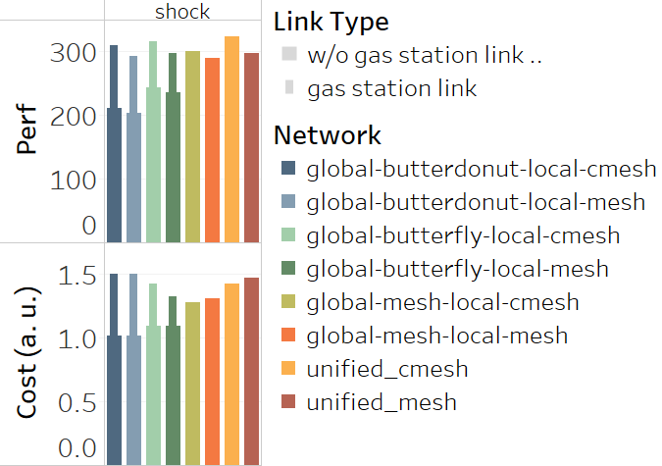
Results: Without Gas Station Link
This figure shows maximum achievable performance for various networks and the corresponding cost while running shock.
Unified networks have highest performance and highest cost, especially when “gas station” is not considered.
(IPS)
Results for shock.

Slide 28
Results: With Gas Station Link
This figure shows maximum achievable performance for various networks and the corresponding cost while running shock.
Unified networks have highest performance and highest cost, especially when “gas station” is not considered.
“Gas station” links can improve performance of Global-Butterfly and Global-Butterdonut network by 20%-45%, which requires long inter-chiplet links in interposer.
(IPS)
Results for shock.

Slide 29
Results: Cost-Effective High-Performance Option
This figure shows maximum achievable performance for various networks and the corresponding cost while running shock.
Unified networks have highest performance and highest cost, especially when “gas station” is not considered.
“Gas station” links can improve performance of Global-Butterfly and Global-Butterdonut network by 20%-45%, which requires long inter-chiplet links in interposer.
A cost-effective high-performance solution is Global-Mesh-Local-Cmesh.
(IPS)
Results for shock.

Slide 30
Results: Unified Networks in General Case
(IPS)
Results for all benchmarks.
The trends seen in shock can be seen in other benchmarks as well.
Unified networks have highest performance, but also highest cost.

Slide 31
Results: Global-Butterdonut/Butterfly General Case
(IPS)
Results for all benchmarks.
Global-Butterdonut and Global-Butterfly benefit from “gas station”.
This benefit comes with up to 2x manufacturing cost.

Slide 32
Results: Global-Mesh Networks General Case
(IPS)
Results for all benchmarks.
A cost-effective high-performance solution is Global-Mesh-Local-Cmesh.

Slide 33
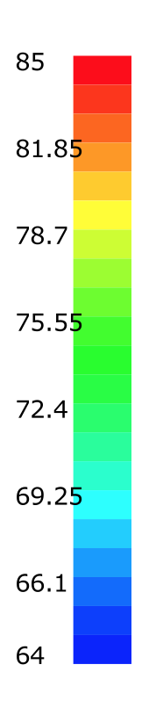
Heat Maps for cholesky
DATE2018 Output Perf. Optimized
Approach | DATE 2018 | ICCAD 2018 | ICCAD 2018 | ICCAD 2018 | ICCAD 2018
Specifics | Perf. optimized. | Perf. optimized, limited to Unified-Mesh. | Perf. optimized, limited to cost of solution (a). | Cost optimized, with at least perf. of (a). | Perf optimized.
Perf. w.r.t. 2D | 1.8x | 1.8x | 1.25x | 1.8x | 2x
Cost w.r.t. 2D | 0.55x | 0.9x | 0.55x | 0.8x | 0.85x
Notes:
d) [ICCAD 2018] cost optimized solution with equal or greater performance with solution (a). Cost is 1.4x of previous predicted cost in [DATE 2018].
e) [ICCAD 2018] performance optimized solution. We achieve 90% performance overhead to a 2D system. Compared to (b) we achieve 60% performance and 16% lower cost.

Slide 34
Heat Maps for cholesky
ICCAD Output Limited to Unified-Mesh
In (b) when we have correct microbump overhead in our models we see cost jump from 0.55x to 0.9x.
The shape of the floorplan has to change because of correct latency evaluation of long wires.
Approach | DATE 2018 | ICCAD 2018 | ICCAD 2018 | ICCAD 2018 | ICCAD 2018
Specifics | Perf. optimized. | Perf. optimized, limited to Unified-Mesh. | Perf. optimized, limited to cost of solution (a). | Cost optimized, with at least perf. of (a). | Perf optimized.
Perf. w.r.t. 2D | 1.8x | 1.8x | 1.25x | 1.8x | 2x
Cost w.r.t. 2D | 0.55x | 0.9x | 0.55x | 0.8x | 0.85x
Notes:
d) [ICCAD 2018] cost optimized solution with equal or greater performance with solution (a). Cost is 1.4x of previous predicted cost in [DATE 2018].
e) [ICCAD 2018] performance optimized solution. We achieve 90% performance overhead to a 2D system. Compared to (b) we achieve 60% performance and 16% lower cost.

Slide 35
Heat Maps for cholesky
ICCAD Output Limited by DATE2018 Cost
In (c) we evaluate using ICCAD approach, limited by the cost of DATE2018 output.
Performance drops from 1.8x to 1.25x.
Size of the interposer has to become much smaller because of the cost constraint and microbump area overhead no longer considered free.
Approach | DATE 2018 | ICCAD 2018 | ICCAD 2018 | ICCAD 2018 | ICCAD 2018
Specifics | Perf. optimized. | Perf. optimized, limited to Unified-Mesh. | Perf. optimized, limited to cost of solution (a). | Cost optimized, with at least perf. of (a). | Perf optimized.
Perf. w.r.t. 2D | 1.8x | 1.8x | 1.25x | 1.8x | 2x
Cost w.r.t. 2D | 0.55x | 0.9x | 0.55x | 0.8x | 0.85x
Notes:
d) [ICCAD 2018] cost optimized solution with equal or greater performance with solution (a). Cost is 1.4x of previous predicted cost in [DATE 2018].
e) [ICCAD 2018] performance optimized solution. We achieve 90% performance overhead to a 2D system. Compared to (b) we achieve 60% performance and 16% lower cost.

Slide 36
Heat Maps for cholesky
ICCAD Output Cost Optimized
In (d) we evaluate using ICCAD approach, optimizing for cost, no longer limiting ourselves to Unified-Mesh.
Cost drops from 0.9x to 0.8x but still is not at DATE2018 predicted level of 0.55x.
Approach | DATE 2018 | ICCAD 2018 | ICCAD 2018 | ICCAD 2018 | ICCAD 2018
Specifics | Perf. optimized. | Perf. optimized, limited to Unified-Mesh. | Perf. optimized, limited to cost of solution (a). | Cost optimized, with at least perf. of (a). | Perf optimized.
Perf. w.r.t. 2D | 1.8x | 1.8x | 1.25x | 1.8x | 2x
Cost w.r.t. 2D | 0.55x | 0.9x | 0.55x | 0.8x | 0.85x
Notes:
d) [ICCAD 2018] cost optimized solution with equal or greater performance with solution (a). Cost is 1.4x of previous predicted cost in [DATE 2018].
e) [ICCAD 2018] performance optimized solution. We achieve 90% performance overhead to a 2D system. Compared to (b) we achieve 60% performance and 16% lower cost.

Slide 37
Heat Maps for cholesky
ICCAD Output Perf. Optimized
Approach | DATE 2018 | ICCAD 2018 | ICCAD 2018 | ICCAD 2018 | ICCAD 2018
Specifics | Perf. optimized. | Perf. optimized, limited to Unified-Mesh. | Perf. optimized, limited to cost of solution (a). | Cost optimized, with at least perf. of (a). | Perf optimized.
Perf. w.r.t. 2D | 1.8x | 1.8x | 1.25x | 1.8x | 2x
Cost w.r.t. 2D | 0.55x | 0.9x | 0.55x | 0.8x | 0.85x
Notes:
d) [ICCAD 2018] cost optimized solution with equal or greater performance with solution (a). Cost is 1.4x of previous predicted cost in [DATE 2018].
e) [ICCAD 2018] performance optimized solution. We achieve 90% performance overhead to a 2D system. Compared to (b) we achieve 60% performance and 16% lower cost.

Slide 38
Outline
Motivation and Prior Work
Cross-Layer Co-Optimization
  “Gas Station” Links
Methodology
Results
Executive Summary

Slide 39
Executive Summary
We develop a cross-layer co-optimization methodology that optimizes network design jointly across logical, physical, and circuit layers.
Our methodology optimizes a given 2.5D network for performance, cost, and wirelength, while ensuring that it is thermally safe.
We obtain up to 90% performance benefit over a 2D system at 16% lower manufacturing cost.
Compared to our prior work, we obtain up to 16% performance improvement at the same cost, or up to 18% lower cost at the same performance.

Slide 40
Backup

Slide 41
Rise Time Constraint (0.8)
Relaxing rise time restrictions allows links to have longer lengths. This increases the performance of networks that require longer links such as Global-Butterfly and Global-Butterdonut.
We observe up to 50% performance boost in Global-Butterdonut while running blackscholes.

Slide 42
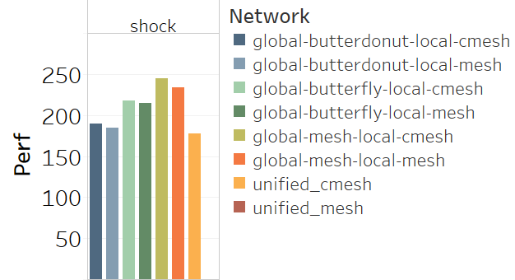
Low-Cost Bound
This figure shows the maximum achievable performance for various networks within the cost budget of a 2D system.
Unified-Mesh is not possible at the cost budget.
Global-Mesh networks perform best at a tight cost budget.
”Gas station” links are not possible at a low cost budget.
Unified-Cmesh shows low performance due at a tight cost budget.
Global-Butterdonut suffers in performance due to not being able to utilize “gas station” links.

Slide 43
Low-Cost Bound (2)
Global-Mesh networks on average give the best performance.
Unified-Cmesh suffers the most from the cost budget.

