Slide 1
Using Machine Learning to Predict Path-Based Slack from Graph-Based Timing Analysis
Andrew B. Kahng^{+$}, Uday Mallappa$ and
Lawrence Saul⁺
UC San Diego $ECE & ⁺CSE Department
Notes:
Thank you for the introduction. My talk is on “Using Machine Learning to Predict Path-Based Slack from Graph-Based Timing Analysis”.

Slide 2
Outline
Preliminaries
Modeling Features
Modeling Methodology
Experiments
Conclusions
Notes:
In this presentation, I will first explain our motivation, and describe our work. Then, I will describe our modeling features and modeling methodology. Then I will show the experimental results and conclude my talk

Slide 3
Static Timing Analysis
Graph traversal problem to estimate transition and arrival time at each node
Advanced nodes: Multi-corner multi-mode timing scenarios → Long runtimes
Needed in every iteration of place, route and optimization
Avoid loops in the flow
Avoid overdesign that wastes power and area
Accuracy versus Runtime tradeoff
Accurate path-based analysis (PBA)
Fast graph-based analysis (GBA)
Notes:
The nature of timing analysis is a graph traversal: We represent netlist as a graph, with pins of the cells as nodes and nets connecting these pins as edges of the graph.
In advanced nodes, with many modes and many corners, timing analysis is runtime intensive.
Since timing analysis is evaluated multiple times in a design cycle, this constitutes for a significant portion of design convergence time.
Like every analysis, there is a tradeoff between accuracy and runtime.
Today, designers use faster and pessimistic analysis for major portion of the optimization cycle and turn on “accuracy mode” during final signoff stage.
Such an approach is sub-optimal and we aim to address this fundamental accuracy-runtime tradeoff of static timing analysis.

Slide 4
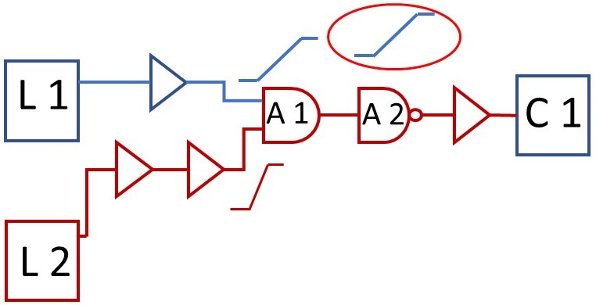
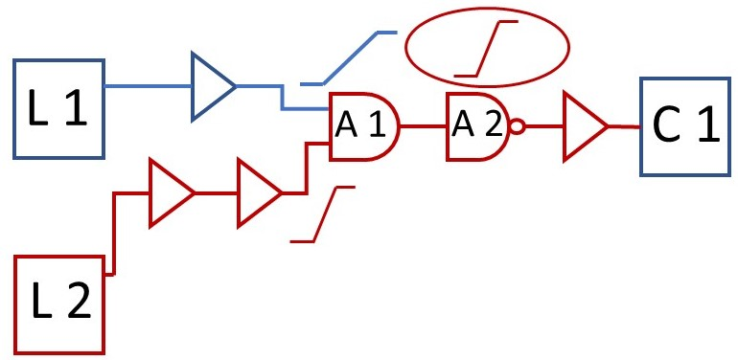
Timing Analysis in GBA & PBA Modes
Worst transition propagation and pessimistic arrival time estimation
Faster but inaccurate, leading to overdesign
Path-specific transition propagation and derived arrival time estimation
Runtime intensive as Launch-Capture logic cone grows in size
GBA
PBA
Notes:
Let us consider a simple circuit with 2 timing paths with a common endpoint.
The red timing path is the path of interest. For this path, if we look at the transition propagation through A1.
As shown in the left figure, one way is to propagate the worst of the two transition values (blue) and evaluate downstream arrival time values.
This is referred as GBA mode. The timing graph needs to store just one transition per node in such an approach.
The other way, as shown the right figure, is to propagate the path-specific red transitions thru A1. This is referred as PBA mode.
PBA mode needs to store and retrieve transition values for many combinations of paths.
Though accurate, this process is runtime intensive as number of stages in L-C cone increases.

Slide 5
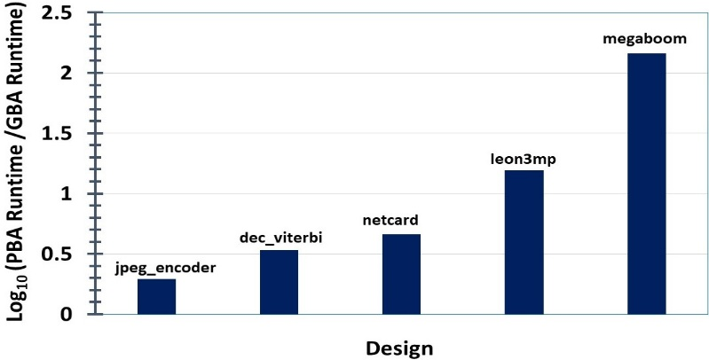
PBA-GBA (Accuracy vs. Runtime)
GBA
PBA
Arrival Time of 1.803ns
Arrival Time of 1.693ns
PBA-GBA divergence of 110ps (path-consistent)
Accuracy versus
Runtime tradeoff
Runtime difference as high as 15X for the leon3mp design with 100K flops
Notes:
Here is a motivating example to explain runtime versus accuracy tradeoff in STA.
Upper-left picture is a timing report in GBA mode and the upper-right picture is a timing report for the same path in PBA mode.
Notice that we are comparing identical timing arcs of a path. We term such a comparison as “path-consistent”
We can see that GBA is pessimistic by110ps, which we term as “PBA-GBA divergence”.
However, PBA is runtime intensive as shown in the figure on bottom. Therefore, it is a tradeoff between accuracy and runtime.

Slide 6
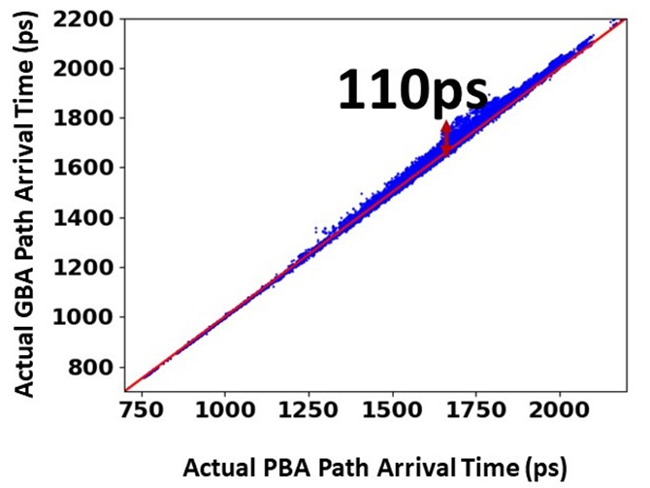
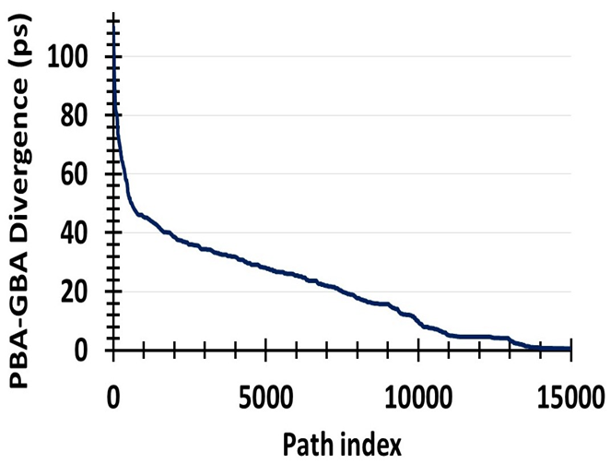
PBA-GBA divergence (global picture)
PBA-GBA divergence values (sorted from high to low)
Actual GBA versus Actual PBA path arrival time
(megaboom: 350K flops and 990K instances, 1.2ns clock period)
Notes:
Let us look at the global picture with regard to PBA-GBA divergence.
Picture on the left shows PBA-GBA divergence for timing paths of a public benchmarked design with ~1 M instances.
Another way to represent this is with a scatter plot on the right; which is a plot of GBA versus PBA arrival time values.
Both these pictures indicate that there are paths which tend to experience more PBA-GBA divergence, than others.

Slide 7
Cost of PBA-GBA Slack Divergence
GBA SLACK | PBA SLACK | IMPACT
POSITIVE (+) | POSITIVE (+) | Reduces the ability to exploit available timing slack during power optimization
NEGATIVE (-) | POSITIVE (+) | Fixing of false violations → schedule, area and power
NEGATIVE (-) | NEGATIVE (-) | Over-ﬁxing of timing violations → schedule, power and area.
Notes:
So, what is the cost of PBA-GBA divergence to design metrics?
We mention that GBA is always more pessimistic compared to PBA. This leads to the following three PBA-GBA divergence scenarios.
In the first scenario, there are timing paths which have positive GBA slack and positive PBA slack, which reduces the ability to exploit timing slack during power optimization in GBA mode.
In the second scenario, say GBA slack of a timing path is negative and PBA slack is positive, This results in fixing of false violations that eventually impacts schedule and increases area and power.
In the last scenario, consider a timing path for which the GBA slack is negative and PBA slack is negative, where over-fixing of timing violations happens and schedule, power and area is impacted.

Slide 8
Previous Work
Learning-based methods to predict STA outcomes
Han et al. DATE14: miscorrelation between STA tools
Kahng SLIP15: prediction of SI from non-SI
Onaissi DAC11: determine dominant corner set
Bian DAC17: STA in presence of on-chip variations
Runtime improvement for timing analysis
TAU Workshop: STA accuracy and runtime
Huang SLIP15: speedup timing analysis using MapReduce
Silva: identify single corner that has worst delay
Our work: Predict PBA outcomes from GBA results !
Notes:
Previous works include learning-based techniques that predict STA outcomes.
There are also many algorithm and data structure-centered methods to improve STA runtime.
However, our work is the first to predict “expensive” PBA slacks from “less-expensive” GBA results.

Slide 9
Our Contributions
Identify electrical and structural features of the circuit that affect PBA-GBA slack divergence
Develop bigram-based predictive model that can capture PBA-GBA slack divergence
Generate artiﬁcially generated timing paths that can train our predictive model
Demonstrate accuracy and robustness of our models on a variety of testcases and use cases
Notes:
In this work, given timing reports in GBA and PBA mode, we identify electrical and physical features that helps us model PBA-GBA divergence
We demonstrate a two phase modeling based on bigrams of timing path that can capture this divergence.
We also generate artificially synthesized circuits that can help in model training.
Our model is accurate and robust across public benchmarked testcases.

Slide 10
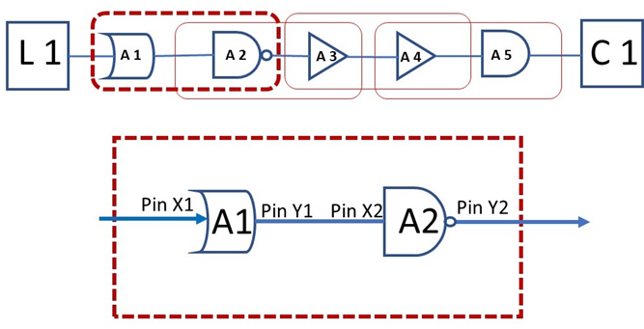
Framework: Bigram-Based Modeling
Stage-wise or path-wise (lumped)
Lumped Model
Shield stage-speciﬁc details
Very large space of features
Difﬁcult to debug outlier stages
Bigram-based
(n = 2) representation
In a given path, transition divergence will be translated into arrival time divergence only for the next stage.
→ Bigrams are a Natural Choice !
Notes:
PBA-GBA divergence of a timing path can be estimated either stage-wise or path-wise.
Figure on the left shows a bigram-based (n = 2) representation of a timing path
In our observation, lumped model suffers from many disadvantages such as listed here on the right.
Since, PBA-GBA transition divergence of current stage gets translated into arrival time divergence only
for the next stage, bigram becomes a natural choice !

Slide 11
Outline
Preliminaries
Modeling Features
Modeling Methodology
Experiments
Conclusions

Slide 12
Modeling Features
List of Modeling Features for each bigram unit
transition time of the ﬁrst cell
transition time of the second cell
arrival time of ﬁrst cell
transition time ratio (TR ratio) of ﬁrst cell
arrival time of second cell
drive strength of ﬁrst cell
drive strength of second cell
functionality of ﬁrst cell
functionality of second cell
fanout of ﬁrst cell
load capacitance of ﬁrst cell
accumulated transition time ratio of ﬁrst cell
propagation delay of second cell
Notes:
For a bigram-unit as shown on the right, we identify these 13 features that can influence PBA-GBA divergence.
These cover both physical and electrical features of a timing path.

Slide 13
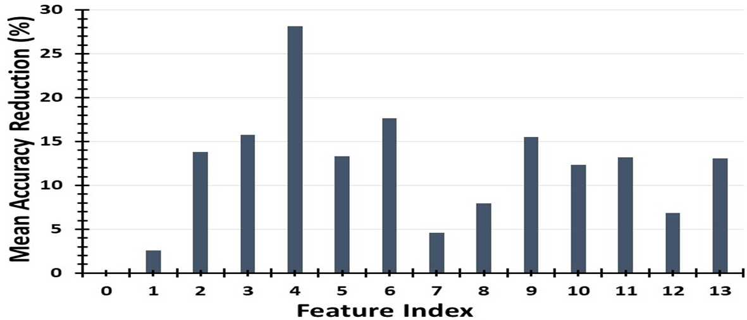
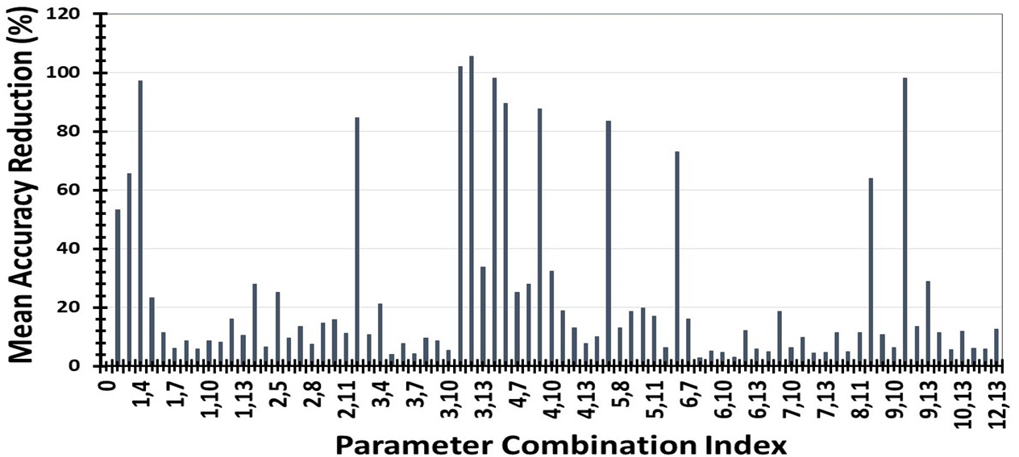
Feature Importance
Dropping “TR ratio” reduces the model accuracy by 27%
Dropping any feature pair that includes “TR ratio” corresponds to peaks
Notes:
We show sensitivity of model accuracy to features.
We observe that “transition time ratio”, which measures the imbalance between various inputs of the cell, is the most important among all features.
Dropping this feature alone reduces model accuracy by 27% as shown in picture on the left.
Also, dropping any feature combination that includes transition time ratio corresponds to peaks of picture on the right.

Slide 14
Outline
Preliminaries
Modeling Features
Modeling Methodology
Experiments
Conclusions

Slide 15
Modeling Flow
Need Non-linear techniques can capture complex interactions between features
➔ Classification and Regression Trees !!!
Notes:
In our modeling flow,
We extract predetermined features from timing reports and train model based on the extracted features.
In the testing phase, our model predicts PBA timing for new datapoints (not seen in the training phase), using their GBA timing reports.
Since linear modeling cannot capture complex interactions between features, we explore various non-linear techniques that capture
these complex interactions between these features.
We have chosen Classification and Regression Trees (supported by our results) and visualization aid that these trees provide.

Slide 16
Model Definition
Bigram-based Two Stage Model
$$∆{TR}_{bg}=f\left({TR}_{gba}, {{AT}_{gba},{TR_rat}_{gba},R}_{w}, {{Acc_TR_rat}_{gba}, C}_{L , } LE, DR, G \right)$$
Model2
Transition Time
Prediction
Arrival Time
Prediction
Model1
$$∆{AT}_{bg}=f\left(∆{TR}_{bg}, {TR}_{gba}, {{AT}_{gba},{TR_rat}_{gba},R}_{w}, {{Acc_TR_rat}_{gba}, C}_{L , } LE, DR, G \right)$$
Notes:
We propose two models (highlighted in yellow), one to predict transition time divergence and the second one to predict
PBA-GBA divergence in arrival time.
The first model feeds into the second.

Slide 17
Reporting Metrics^
Arrival Time (ps)
Actual GBA
actual_* metric
Model PBA
model_* metric
Actual PBA
We use lumped metrics such as 99th percentile value of divergence, mean absolute value of divergence, and worst-case divergence
Notes:
For a given timing path, GBA arrival time is always equal or higher than actual PBA arrival time.
We term this difference between these values (represented by top and bottom orange bar) as “actual_*” metrics. This is an indicator of pessimism in GBA mode.
We represent model predicted PBA arrival time with the middle orange bar. We expect model PBA bar to be as close as possible to the bottom bar.
We evaluate model performance by measuring the reduction of model_* metric as compared to actual_* metric.
Once we evaluate this metric for each path, we use lumped metrics like mean, 99th percentile and worst metrics to measure model accuracy.
^I should point a typo in the CAMERA version, where the labels got interchanged. My apologies about that

Slide 18
Outline
Preliminaries
Modeling Features
Modeling Methodology
Experiments
Conclusions

Slide 19
Design of Experiments
Knobs
number of stages in a timing path;
standard cell types in the path;
launch and capture ﬂop-types;
aggressor cell types;
load cap range;
transition (slew) time values;
clock period values.
Artificial Circuits
Design Name | # Instances | # Flip-flops
megaboom | 990K | 350K
leon3mp | 450K | 100K
netcard | 303K | 66K
dec_viterbi | 61K | 26K
jpeg_encoder | 40K | 4K
Real Designs
Notes:
We generate several artificial timing paths that can be used for training phase of modeling.
Input to this flow is a configuration file that contains several electrical and physical knobs of a design enablement.
Along with artificial circuits which are used for training purpose, we use five public benchmark designs, to demonstrate our model usefulness.

Slide 20
Model Setup
28nm FDSOI foundry technology libraries
Five public benchmark designs along with artificial circuits
Three experiments
Accuracy versus Robustness
Reference
Evaluation
Actual GBA
Model PBA
Actual PBA
Actual PBA
Notes:
Now, I summarize my model setup.
All our experiments use 28nm foundry technology enablement.
We perform three experiments to demonstrate our model usefulness.
As shown on the left, we ﬁrst compare actual GBA arrival time values with actual PBA results using a commercial timer, while maintaining path consistency.
We then compare Model PBA versus Actual PBA, as shown on the right.
Blue band in both the plots represents divergence from actual PBA.
Reduction of blue band width on the right, as compared to its width in the left plot signiﬁes availability of timing slack for design optimization.

Slide 21
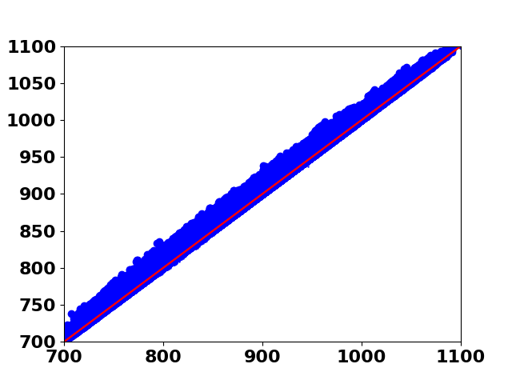
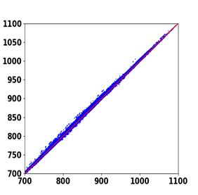
Experiment 1: Accuracy
70% for training and 30% for testing
netcard design
Predicted PBA Arrival (ps)
Actual GBA Arrival (ps)
39.59ps
19.90ps
Actual PBA Arrival (ps)
Actual PBA Arrival (ps)
Notes:
Our first experiment evaluates modeling accuracy.
For each of our five public benchmarked designs, we split the timing paths randomly into 70/30 ratio.
Here, for the NETCARD example, we see that model predictions reduce worst divergence of PBA-GBA from 39.59ps to 19.90ps.
This is indicated by the red arrow.
Also, the mean value of divergence decreases from 6.70ps to 1.52ps

Slide 22
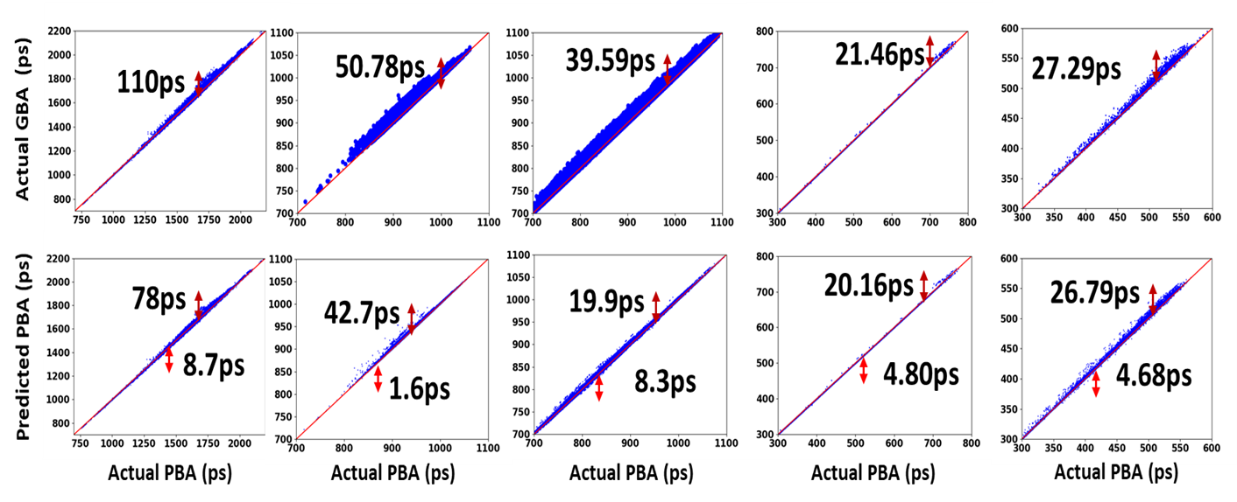
Experiment 1: Accuracy
megaboom
leon3mp
netcard
dec_viterbi
jpeg_encoder
Actual GBA (ps)
Predicted PBA (ps)
Actual PBA (ps)
Notes:
Figure 12 of the paper shows the results of experiment one for all five testcases.

Slide 23
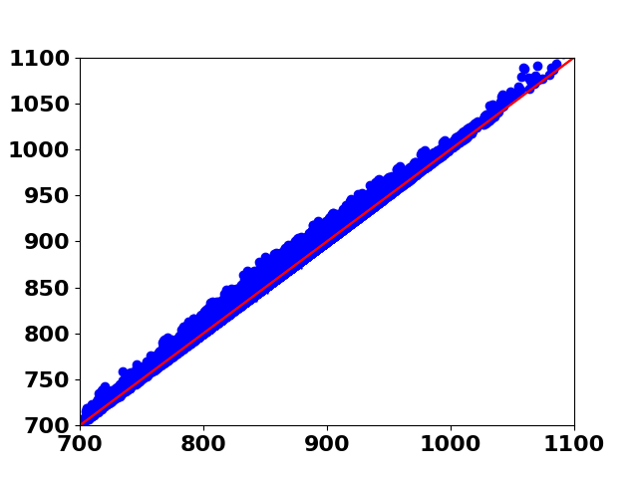
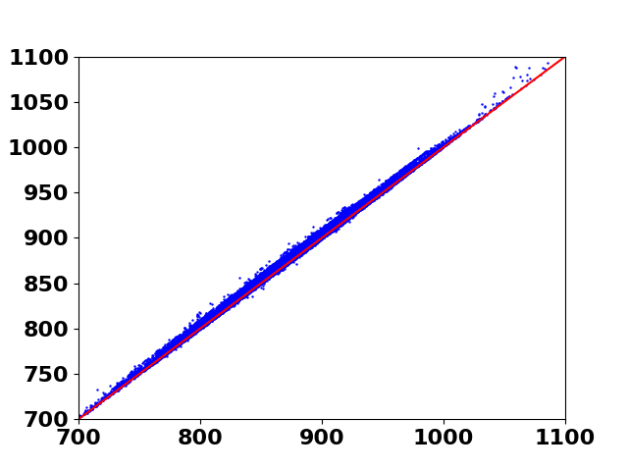
Experiment 2: Robustness
Timing paths from a post-CTS database for training, and test the model on a post-routed database of the same design.
netcard design
Actual GBA Arrival (ps)
Predicted PBA Arrival (ps)
33.56
29.63ps
Actual PBA Arrival (ps)
Actual PBA Arrival (ps)
Notes:
The second experiment validates our modeling robustness.
We use datapoints from the clock tree synthesized database for training and test on the post-routed database of the same design.
Such a use case can aid in optimization during routing from model trained on its CTS database.
Here, for the NETCARD example, we see that model predictions reduce worst divergence of PBA-GBA from 33.56ps to 29.63ps.
The mean divergence reduces from 4.29ps to 2.49ps

Slide 24
Experiment 2: Robustness
megaboom
leon3mp
netcard
dec_viterbi
jpeg_encoder
Actual GBA (ps)
Predicted PBA (ps)
Actual PBA (ps)
Notes:
Figure 13 of the paper shows the results of experiment two for all five testcases.

Slide 25
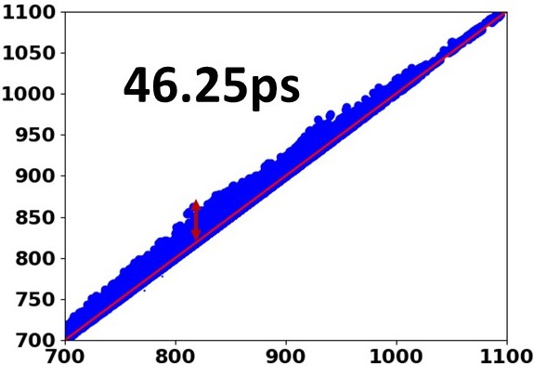
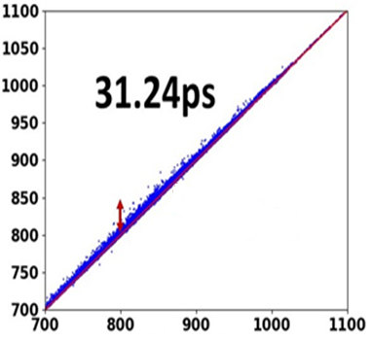
Result 3: Robustness
Artiﬁcial designs and a sample from a real design (30%) for training, and test on (70%) datapoints of the same real design.
netcard design
Actual GBA Arrival (ps)
Predicted PBA Arrival (ps)
Actual PBA Arrival (ps)
Actual PBA Arrival (ps)
Notes:
The goal of this experiment is to validate the span of our artiﬁcial testcase development methodology.
Model is trained with artiﬁcially generated testcases along with a sample of data points (30%) from a real design, and
tested on unseen 70% data points of the same design.
Here, for the NETCARD example, we see that model predictions reduce worst divergence of PBA-GBA from 46.25ps to 31.24ps.
The mean divergence reduces from 7.21ps to 2.78ps

Slide 26
Result 3: Robustness
megaboom
leon3mp
netcard
dec_viterbi
jpeg_encoder
Actual GBA (ps)
Predicted PBA (ps)
Actual PBA (ps)
Notes:
Figure 14 of the paper shows the results of experiment three for all five testcases.

Slide 27
Outline
Preliminaries
Modeling Features
Modeling Methodology
Experiments
Conclusions

Slide 28
Conclusions
First to apply machine learning techniques to model PBA-GBA divergence
Artificial circuit generation methodology for potential availability during an initial, “bootstrap” training phase of modeling
Model based on decision trees along with electrical and physical features of stage bigrams in timing paths
We assess potential beneﬁts of our model using 28nm FDSOI foundry technology
Model-predicted PBA arrival times reduce mean, 99th percentile and max divergence metrics by at least 26.6%, 13.4% and 11.7%, respectively as compared to reference PBA-GBA divergence metrics
Notes:
In summary, we are the first to apply machine learning techniques to model PBA-GBA divergence in endpoint arrival times, addressing an important
accuracy-runtime tradeoff in static timing analysis.
We present artificial circuit generation methodology that aims to cover real design space for a given design enablement.
We identify electrical and physical features of a circuit that can influence PBA-GBA divergence.
Using these features, we use decision trees approach to model this divergence.
All our experiments use 28nm FDSOI foundry technology and implementations of public testcase designs
In our results, model-predicted PBA arrival times reduce mean, 99th percentile and max divergence metrics by at least 26.6%, 13.4% and 11.7 %
respectively.

Slide 29
Future Work
Integrate our models with an academic sizer and optimizer
Obtain practical benefits from improved accuracy-runtime tradeoff
Richer artiﬁcial testcases that can span the space of timing paths in real designs
We see outlier stages (bigrams) that are very different from any artificial training data)
Reduction of optimism in PBA slack prediction
But: Optimism not viewed as harmful in current use context!
Better use of multiple GBA paths to a given endpoint
Multiple GBA paths give more information, but our approach does not derive benefit from them!
Notes:
A number of ongoing and future works remain.
To demonstrate the benefit from reducing pessimism, we are seeking to integrate our predictive models with an academic sizer and optimizer.
We are seeking to improve our artificial circuits that can span the space of real designs.
Reduction of pessimism is another important work to be pursued. Though model calibration flow and available budget of arrival time gain vs slack gain could mitigate the effect of optimism, we are seeking to continue our work in this direction.
Additionally, translating path-consistent predictions to endpoint-consistent predictions with a better use of multiple GBA paths is an important work to pursue.

Slide 30
Acknowledgments
Dr. Tuck-Boon Chan
Dr. Siddhartha Nath
Support: NSF, DARPA, Qualcomm, Samsung, NXP, Mentor Graphics, and the C-DEN center.
Notes:
We thank Dr. Tuck-Boon Chan and Dr. Siddhartha Nath for valuable guidance, and we thank our lab’s funding sources.

Slide 31
Thank You
Notes:
Thank you very much for your attention

