Slide 1
Reducing Time and Effort in IC Implementation: A Roadmap of Challenges and Solutions
Andrew B. Kahng
CSE and ECE Departments
UC San Diego
http://vlsicad.ucsd.edu
Notes:
Thank you for the kind introduction. Why do we care about “No Humans”, and Time, and Effort? Because these are central to how we will solve today’s crises of IC DESIGN.

Slide 2
Agenda
Challenges and Solutions
Notes:
This talk is more a “Path Forward” than an explicit “Roadmap” – but like a roadmap, it is framed by Difficult Challenges and Potential Solutions.

Slide 3
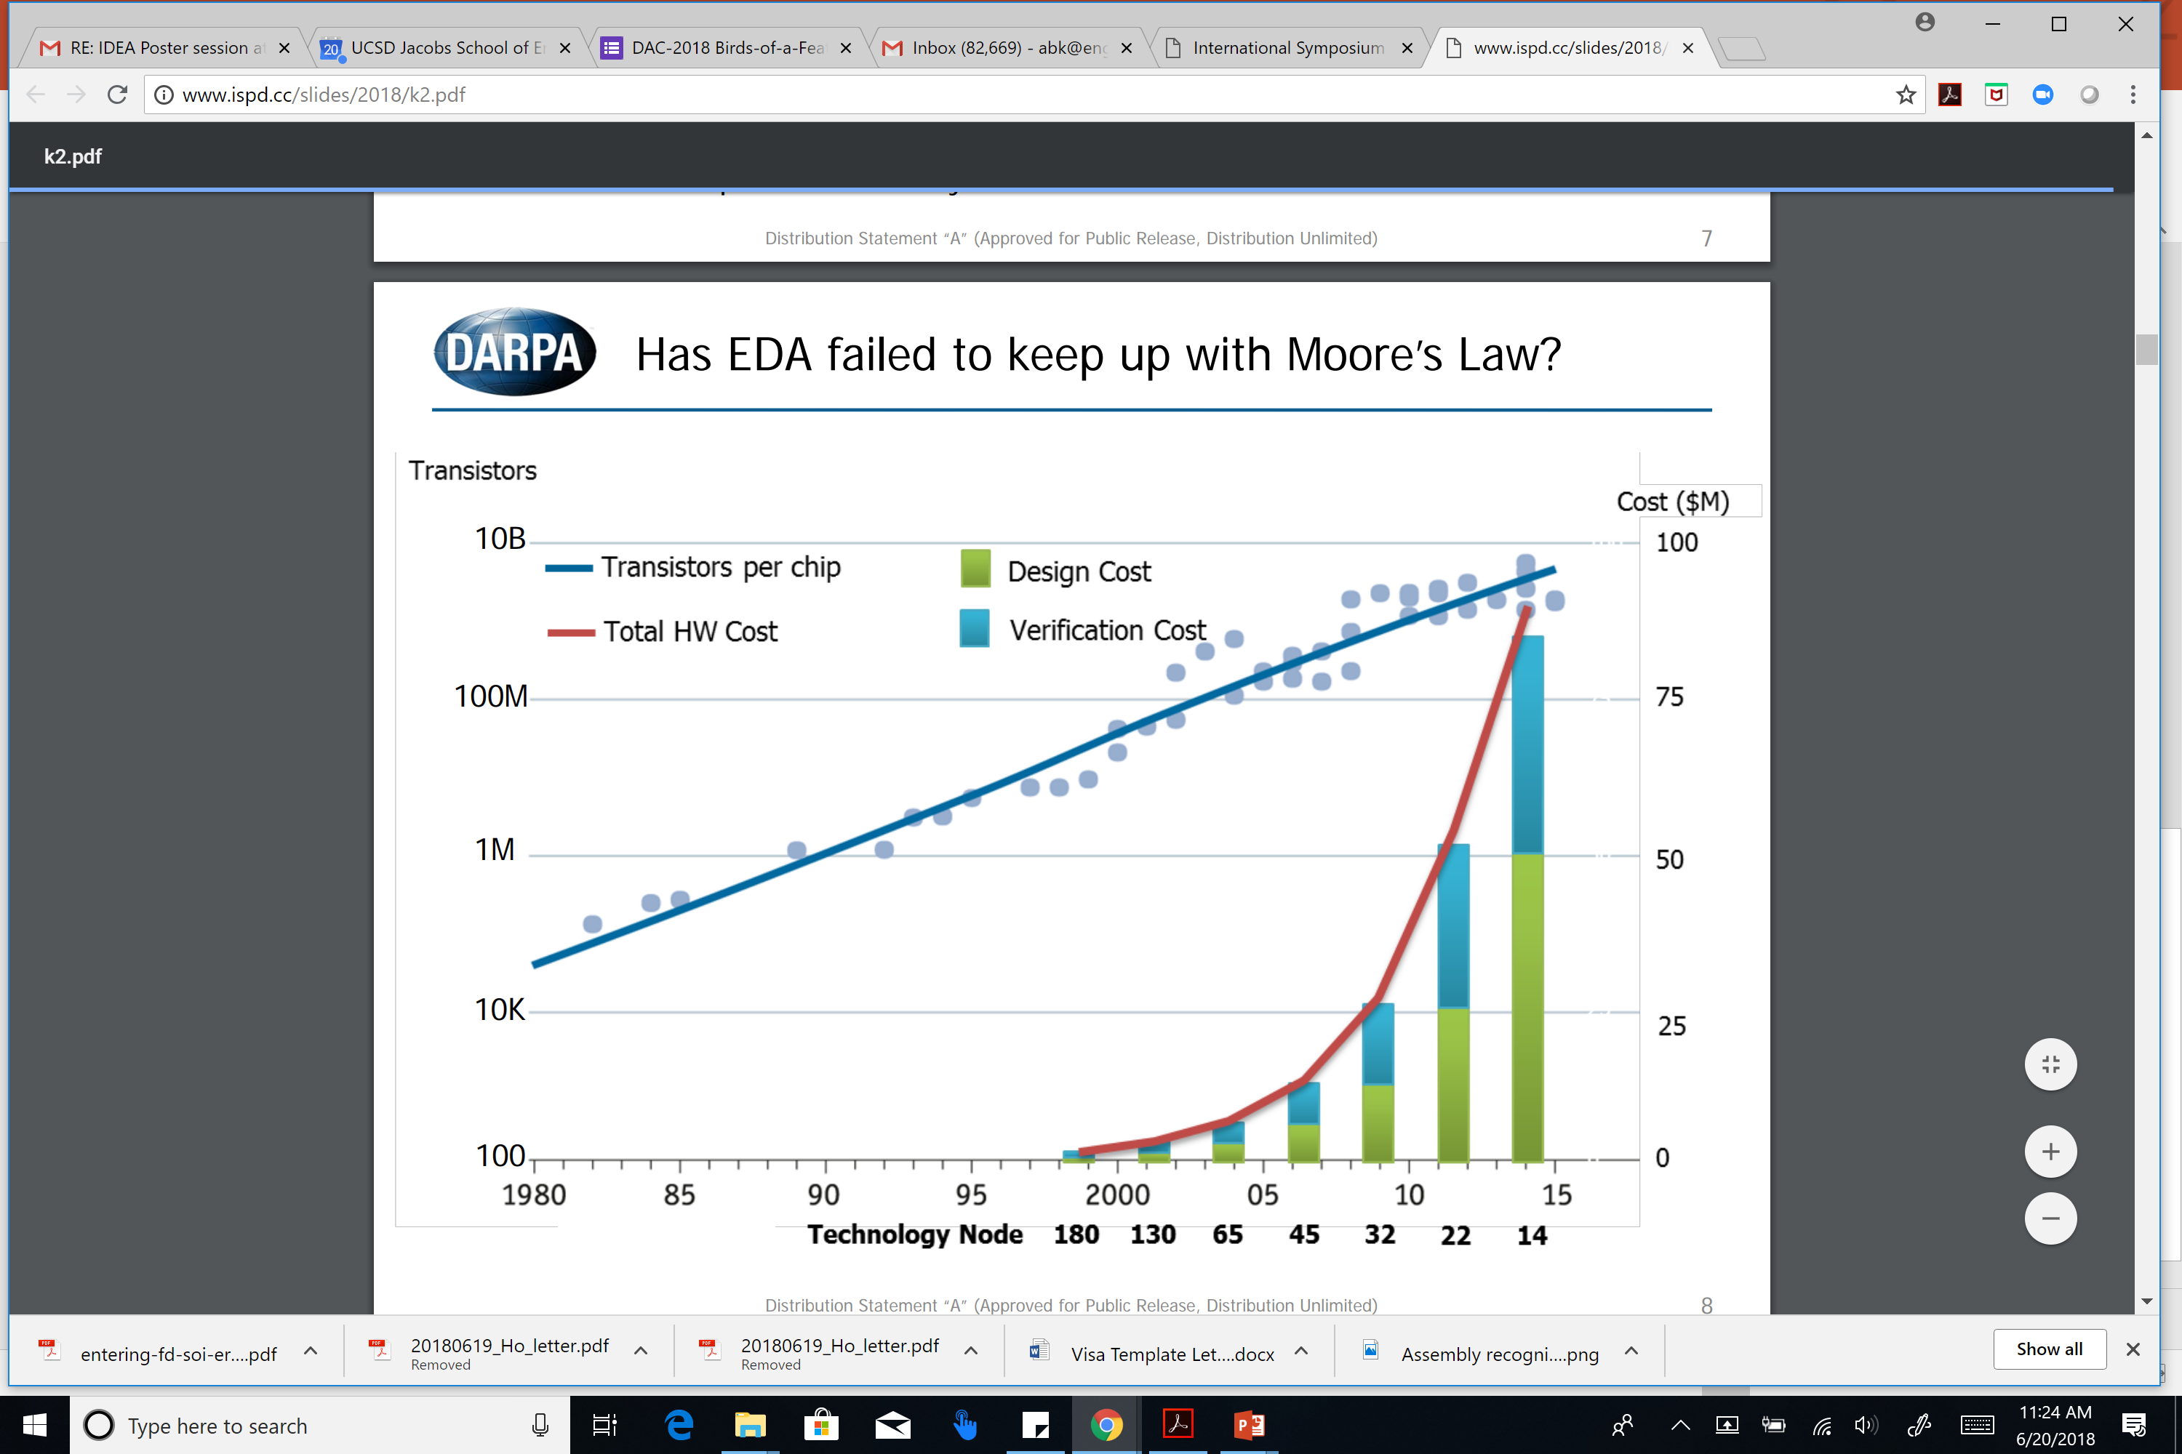
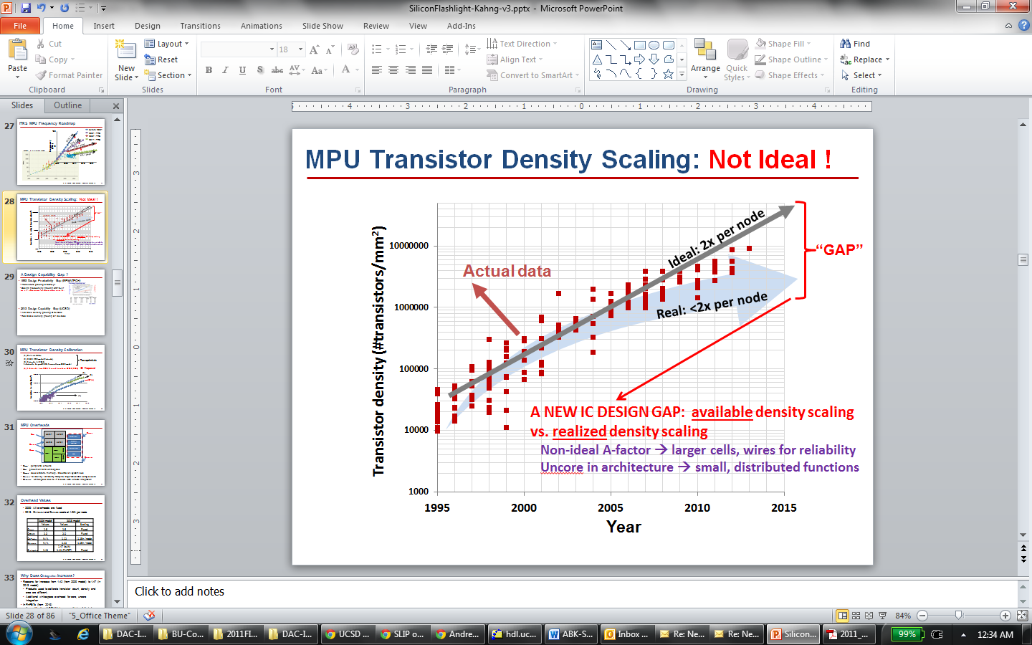
Challenge 1: Non-Scaling of Cost, Quality
Design cost: not scaling
  Root cause: Uncoupled design, process roadmaps!
  Figure: A. Olofsson, ISPD-2018 keynote
Quality: also not scaling
  Design Capability Gap
  Available density: 2x/node
  Realizable density: 1.6x/node
  Figure: UCSD / 2013 ITRS
Notes:
Challenge 1 is the non-scaling of design cost.
Design COST is engineers, licenses, schedule – AND RISK. Andreas Olofsson of DARPA showed this slide at ISPD in March. And he’s right: Wafer cost pretty much always ends up at a nickel or a dime per square millimeter in any process. But this curve at the right means that the cost of designing that square millimeter is out of control. This happens when nothing really ties EDA to Moore’s Law scaling itself.
{CLICK] Compounding this is non-scaling of QUALITY. With every new technology node, yes, you CAN print twice as many transistors in a square millimeter as before – which is AVAILABLE DENSITY … BUT, you CANNOT fit twice as many USEFUL transistors into a given area, going from node to node – and that’s REALIZABLE DENSITY. This DESIGN CAPABILITY GAP goes back well over a decade.

Slide 4
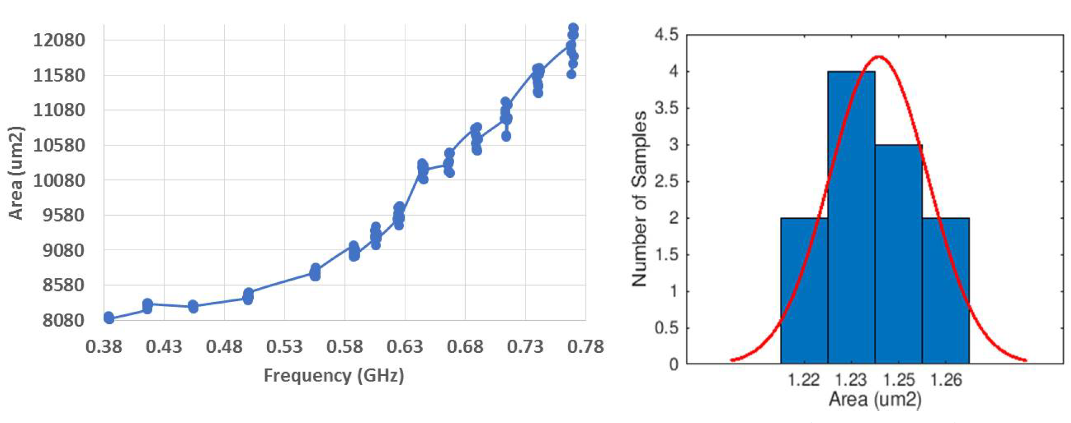
A Root of Evil: Unpredictability
Intractable optimizations → heuristics piled on heuristics
“Noise” or “Chaos” when EDA tools “try hard”
Unpredictability → added margin and schedule
  14nm PULPino: Δarea = 6% from Δfreq = 10MHz !
HARMFUL impacts on Schedule, Quality, Cost
Notes:
The root of EVIL: why we have such quality, schedule, risk issues today: is fundamentally that Design is NOT Predictable !
With so many heuristics, our tools and flows become chaotic when they have to “try hard”.
This is for a small block in foundry 14nm enablement. The LEFT figure has target frequency on the X Axis. The post-P&R area on the Y Axis can change by [CLICK] 6% when target frequency changes by epsilon near maximum possible frequency. And the statistics are Gaussian.
If design is unpredictable, then we have a SCHEDULE problem. Or, if we MUST finish on schedule, then we MUST put GUARDBANDS around the design target. And then we have a QUALITY AND COST problem.
ALSO If tools and flows are CHAOTIC when we ask for BEST-POSSIBLE RESULTS, then a design team that wants predictable results has to aim low.
AND so we’re stuck in what I call a “Local Minimum” of quality, methodology and tooling. 3:00

Slide 5
Challenge 2: “Local Minimum” of SOC Design
# Partitions ↓
Design Flexibility↑
Predictability↓
Margins↑
# Iterations↑
Achieved
Design Quality↓
Turnaround Time↑
We’re in a “local minimum” of design technology, methodology, quality
Notes:
Challenge 2: we’re in a local minimum of tools, methodology, and QOR.
And WHY did we evolve to today’s SOC Design METHODOLOGY? Here is my personal “theory”…
[Click] With unpredictable optimizers, designers want as close to flat as possible – just a few big blocks. So EDA developers keep piling on more heuristics to turn around those bigger and bigger blocks in a day. And then designers want to close the design quality gap – so they ask for as much flexibility and knobs as possible to drive those tools in some magical way. A P&R tool today can have more than ten thousand, command-option combinations.
[Click] This leads to poor predictability in design, [Click] which then leads to more iterations and [Click] essentially turnaround time gets longer. [Click] Poor predictability also means more guardbands. [Click] So ACHIEVED design quality gets worse. We need to flip these arrows.
And we ARE in this “local minimum” of tools, methodology, and QOR today.

Slide 6
Solution 1: A New Design Paradigm
Design Flexibility↓↓
# Partitions ↑↑
!
Predictability↑
Margins↑↓
!
# Iterations↓↓
Achieved
Design Quality↑
!
Single-pass
Turnaround Time↓↓
Mindsets
  Tools should not return unexpected results
  Achieve predictability from the user’s POV
  Use cloud/parallel to recover solution quality
  Focus on reducing time and effort
 Quality
 Schedule
 Cost
Machine Learning MUST be central to this …
Notes:
So here’s the proposed SOLUTION 1. What if we had many more small subproblems in the design methodology?
To INCREASE the number of partitions, we need new placement, global routing and optimization algorithms. And new RTL partitioning and optimizations.
[Click] What if we REDUCED design flexibility by giving freedoms FROM CHOICE of power distribution, clock structure, non-default wiring rules, and so on?
[Click] These would give us better predictability, [Click] leading to fewer iterations and ideally single-pass design.
[Click] Less turnaround time. [Click] Better predictability and fewer iterations mean less guardbands. [Click] -- improving the ACHIEVED quality.
[click] **IF** we can achieve this, we win on quality, schedule and cost. The mindset should be that tools and flows NEVER get unexpected results. The USER must see predictability -- whatever goes on under the hood.
We’ll lose quality, but win time, with partitioning and methodology restrictions. But we’ll win quality back with cloud and parallel optimization.
The focus is all on time and effort.
*** Oh and by the way: MACHINE LEARNING has to be CENTRAL to this. [5:50 ?]

Slide 7
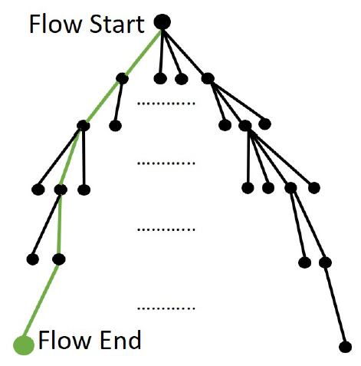
Solution 2: ML for Time, Effort Reduction
  Four Stages of Machine Learning
  Mechanization and Automation
  Orchestration of Search and Optimization
  Pruning via Predictors and Models
  From Reinforcement Learning through Intelligence
  Huge space of tool, command, option trajectories through design flow
Notes:
Indeed, Solution 2 called out in the paper is MACHINE LEARNING for time and effort reduction.
The need to reduce time and effort come from dealing with this: the HUGE space of trajectories through the design flow – what’s your choice of RTL, constraints, floorplans, tool commands and options, and so on.
[CLICK] As we grapple with this, the path forward will have four main stages – FROM mechanization and automation TO intelligence -- of how time and effort reductions will be achieved by machine learning.
For the rest of this talk, I’ll try to give some examples and thoughts on this future of ML for time and effort reduction.

Slide 8
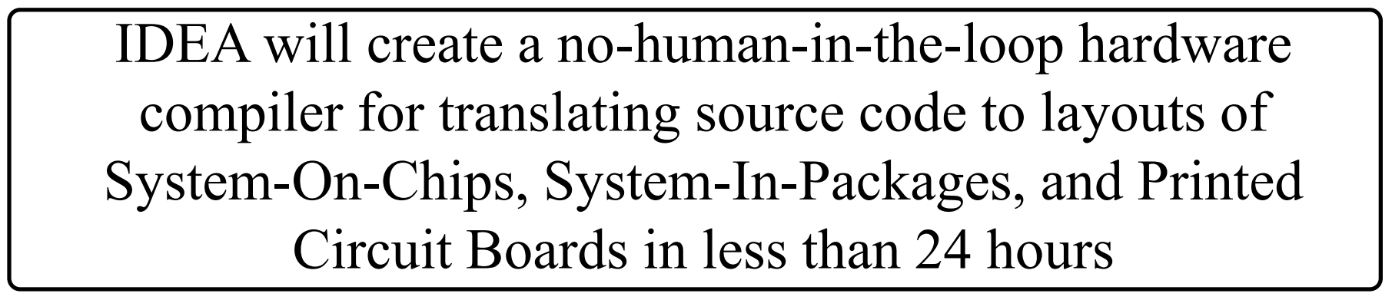
Agenda
Challenges and Solutions
ML for Time and Effort Reduction
A. Olofsson, DARPA
ISPD-2018 keynote
Notes:
I should add that ever since early last year, thanks to DARPA,, when folks talk about time and effort reduction, this is the new aiming point: NO humans, and 24-hour turnaround.

Slide 9
Stage 1. Mechanization and Automation
Create “robot IC design engineers”
  Observe and learn from humans
  Search for command sequences in design tools
  Path to “no humans” requires understanding of why, where humans are needed…
Path forward is through pain points
  Automation of manual DRC violation fixing
  Automation of manual timing closure steps
  Placement of memory instances in P&R block
  Package layout automation
Notes:
STAGE 1 mechanization is: Robots and CPUs don’t get tired!
Many time-consuming, error-prone, trial-and-error steps! → learn by literally watching expert humans, become as good as, then better…
The path to “no human in the loop” → requires understanding of why and where humans are needed in the loop today.
Basically, the path forward is through manual, repetitive pain points that today cost days or weeks of schedule: DRC fix, timing closure, placement of memory instances, package layout …
Automation of manual DRC violation fixing
P&R tools cannot handle latest rule decks, unavoidable lack of routing resource in high-utilization block, etc.
Automation of manual timing closure
After routing and optimization, several thousand violations of maxtrans, setup, hold constraints exist
Engineer fixes 200-300 DRVs by hand, per day
Package layout automation
How to assess post-routed quality (e.g., bump inductances) of SOC floorplan and die-package pin map?
Required for: pin map, power delivery optimization
Requires: automation/estimation of manual package routing

Slide 10
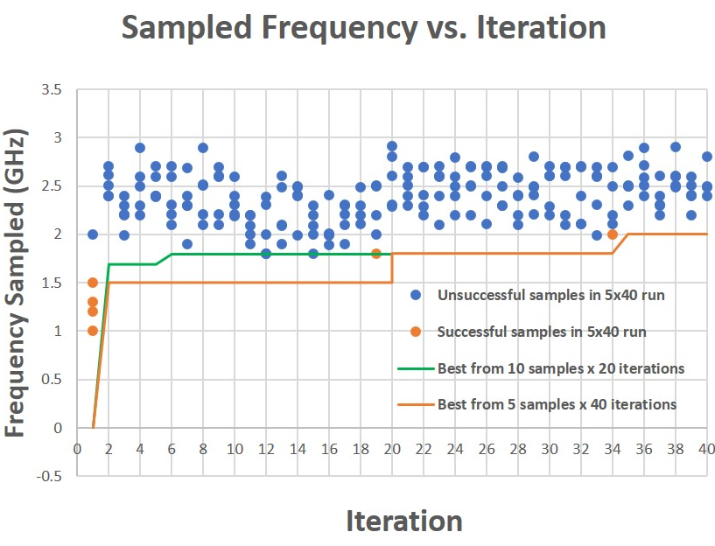
Example: Multi-Armed Bandit
Multi-Armed Bandit Problem: Given slot machine with N arms, maximize reward obtained using T pulls
  Well-studied in context of Reinforcement Learning
IC Design: “arm” = target frequency; “pull” = run flow
Tool Outcomes (Area, Power, WNS/TNS)
Arms to Sample
SAMPLER
Parallel Tool Runs
Constraints
Samples per Arm
Max Frequency
vlsicad.ucsd.edu/MAB
Notes:
Here’s a Reinforcement Learning example framed as a multi-armed bandit. The Multi Armed Bandit Problem is: Given a slot machine with N arms, maximize total reward obtained using T pulls (iterations). This requires trading off “Exploration” (learning the distribution of payout from a given arm), and “Exploitation” (sampling from a given arm’s distribution).
In Resource-Limited IC Design with license and schedule constraints, each “arm” is a design target and flow configuration. Each “pull” is a run of the tool flow with that target.
My lab’s automated scripts are on the web. We throw a small block into the hopper and a best implementation meeting constraints is found without human intervention. The system executes runs in parallel up to the license budget, and can only make M sets of runs within the overall schedule.
You can see that the algorithm samples from a narrower band of target frequencies as it progresses. [9:30]
The Multi-Armed Bandit algorithm samples from frequencies greater than the fmax previously obtained, in proportion to the probability that it returns the highest “reward”. We see that the algorithm samples from a narrower band of target frequencies as it progresses.

Slide 11
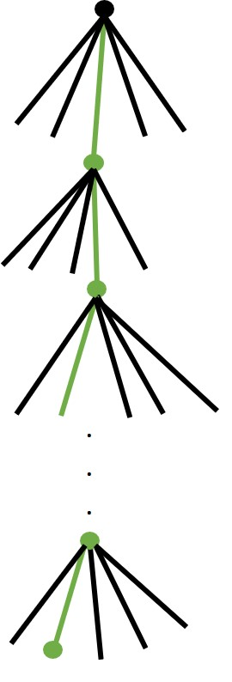
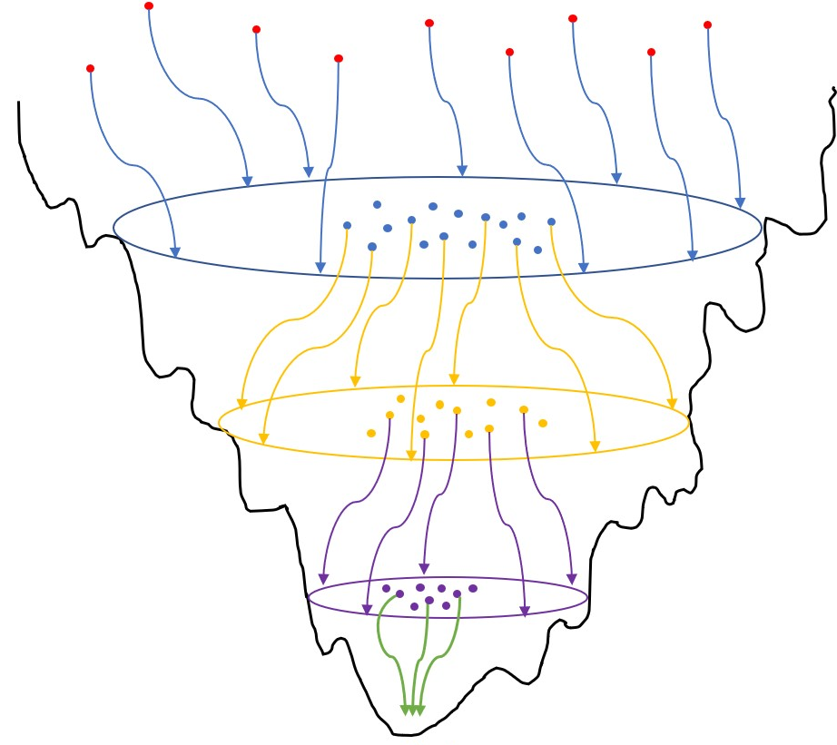
Stage 2. Orchestration of Search, Optimization
How to optimally orchestrate N robot engineers (s.t. risk, resource limits)
  Concurrent search of N flow trajectories
  Explore, identify good flow options efficiently
  Constraint: compute and license resources
Example: “Go with the winners”
  Launch multiple optimization threads
  Periodically identify promising thread
  Clone promising thread and terminate others
Example: “Adaptive multi-start”
  Best solutions are central to other good solutions: “big valley”
  Adaptively choose start points for next iteration
Notes:
Once we have robots, STAGE TWO is how to optimally orchestrate N robot engineers – or, more generally, a design RESOURCE LIMIT of licenses, servers, and TIME. This has to be part of future design enablement. We’ve applied various strategies for this kind of parallel search.
CLICK Go With The Winners launches multiple optimization threads. Then for each optimization stage, it periodically identify the most promising thread. It then clone the promising thread and terminate others and continues.
CLICK Adaptive Multistart exploits an inherent big valley structure in optimization cost landscapes. Often, the best local minimum is structurally central to all other local minima. So, AMS identifies promising configurations in it current iteration and adaptively – in some ways “genetically” -- chooses better start points for the next optimization iteration.

Slide 12
Stage 3. Modeling and Prediction
Prediction of tool- and design-specific outcomes over longer and longer subflows
  Wiggling of longer and longer ropes
Enables pruning and termination → avoid wasted design resources
  Better outcome within given resource budget
Complementary requirement: New heuristics and tools that are inherently more predictable and modelable.
  No more chaos !
Notes:
The THIRD stage is predicting the outcome of longer and longer subflows, which enables
PRUNING of unpromising design trajectories, and better design space exploration WITHIN RESOURCE LIMITS.
There is a complementary need: new algorithms and tools that are inherently more predictable !!! Ward Vercruysse [= CAD manager for UltraSPARC III at Sun …] was complaining about “Design Flow are Chaos Machines” in 1996. Let’s finally kill this problem.
There are MANY future Ph.D. theses just here alone.

Slide 13
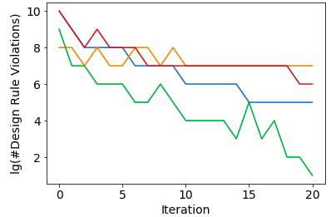
Example: Predicting Doomed Runs
Example: long P&R runs end up with too many post-route DRVs
Approach: track and project metrics as time series
Markov decision process (MDP): terminate “doomed runs” early
Shown: 4 example progressions of #DRVs (commercial router)
Notes:
A small example from today is: predicting WHETHER A TOOL RUN IS GOING TO FAIL.
The OBVIOUS application is the detailed router, which usually defaults to, say, 20 iterations and can take many days of runtime. (And this generalizes to doomed flows, doomed floorplans, and so on.)
Can we IDENTIFY which runs – which are like TIME SERIES - are DOOMED TO FAIL? (The tools’ own auto-stop options aren’t so good at this, by the way…)
Here, the number of DR violations is on the Y-AXIS. The iteration count is on the X-AXIS. Can we LEARN to kill the red and orange runs early, but let the green run finish?

Slide 14
Markov Decision Process = “Strategy Card”
State space from Fibonacci binning
Actions – GO or STOP
Rewards at each state – e.g., small negative reward for non-stop state, large positive reward for stop with low #DRVs, etc.
Automatically trained MDP “strategy card”: Yellow = GO, Purple = STOP
Notes:
This is like playing BLACKJACK – after each router iteration, we can “HIT” with another iteration, or “STAY” by killing the router job.
Based on a simple state space of binned violation count, and the change in DRVs since a previous iteration, we can fit a POLICY in a Markov Decision Process model, based on past experience with the tool. This policy tells us whether to GO (YELLOW) or STAY (PURPLE) – just like a blackjack strategy card.
WE CAN SEE THAT from a little over 1000 logfiles, the program comes up with REASONABLE strategies:
(1) STOP when the number of violations is really large (on the right) [CLICK]
(2) And, GO when the number of violations is moderately large but with a strongly negative slope.

Slide 15
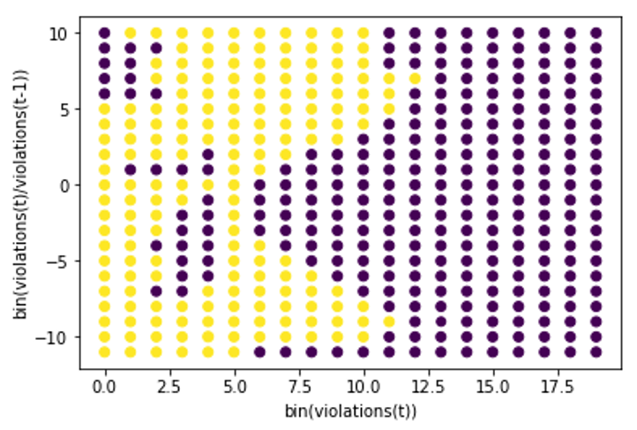
Strategy Card “Completion”
TYPE 1 Prediction Error: MDP STOPs a run that will eventually succeed
TYPE 2 Prediction Error: MDP predicts GO at each iteration, but run fails
Errors | Training (1200 logfiles) |  |  | Testing (3442 logfiles)
N = 200 | Training Error | #TYPE 1 | #TYPE 2 | Testing Error | #TYPE 1 | #TYPE 2
1 STOP | 29.17% | 251 | 99 | 38.3% | 1317 | 3
2 consec STOPs | 10.5% | 27 | 99 | 9.0% | 307 | 3
3 consec STOPs | 8.5% | 3 | 99 | 4.6% | 154 | 3
Notes:
We can programmatically fill up the missing parts to get a complete strategy card here.
Then, there are two types of prediction errors. Type ONE is where the policy stops a run that actually would have succeeded (our definition of success is that you end up with no more than 200 DRVs). Type TWO is where the policy allows a run to go on but that run eventually fails.
Our policy is too sensitive – it’s very quick to signal STOP. But if we wait until it signals us to STOP three times in a row, then the error rate is around 4% over our testing set of over 3400 logfiles, and a very large fraction (over three quarters) of tool iterations can be saved for the doomed runs that it flags.

Slide 16
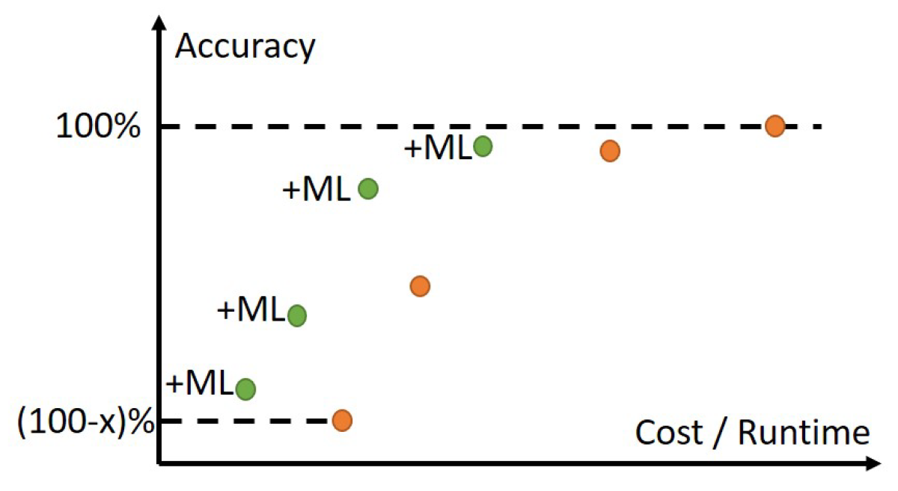
Also: Improve Analysis Correlation (Accuracy)
ML shifts the Accuracy-Cost
Tradeoff Curve (for free) !
Notes:
Another important context for modeling and prediction is in the ANALYSIS realm, where the ORANGE dots show the traditional COST (X-axis) versus ACCURACY (Y-axis) tradeoff curve, for instance, going from 3D field solvers at the top right to piecewise analytic models to first-order estimates, etc. Methodologists, DTCO folks, library teams, signoff teams, design engineers all figure out how to pick and choose from the orange points during IC design.
But OUR works have focused on using Machine Learning to create GREEN tradeoff points: essentially, getting off the ORANGE curve and gaining accuracy for FREE. This is ALSO a type of improved modeling and prediction that leads to fewer loops, and less margins.

Slide 17
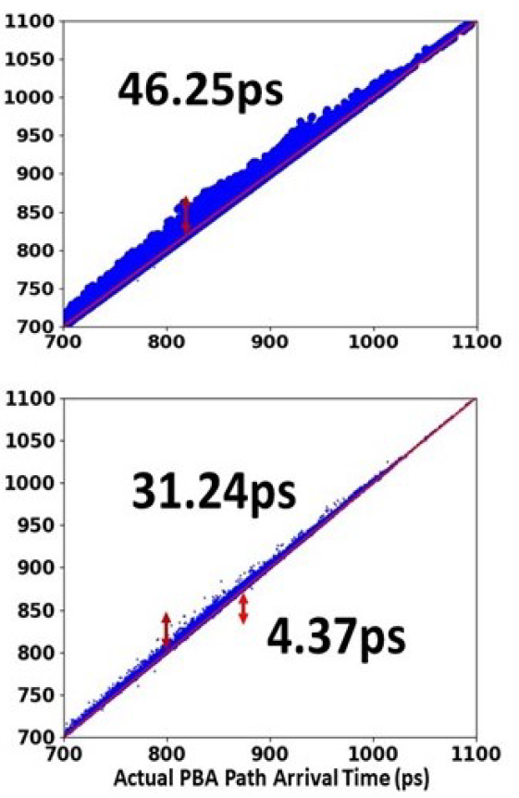
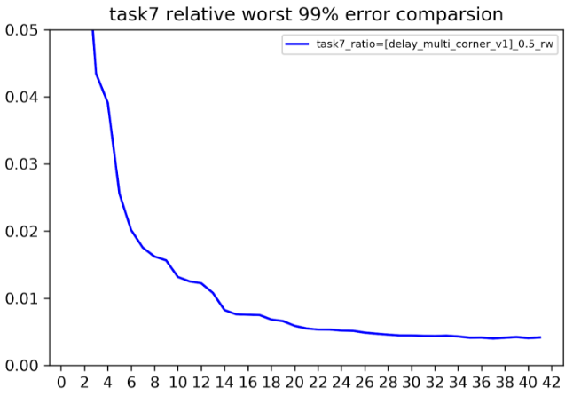
Examples: PBA-lite / K Corners Suffice ?
14 corner analyses →
<1% path delay error at non-analyzed corners
Reduced GBA pessimism vs. PBA
Notes:
The LEFT image: High-dimensional regression reduces pessimism of graph-based timing analysis relative to much more expensive path-based analysis, “for free”.
The RIGHT image is matrix completion: predicting timing at corners that we don’t actually analyze. Relative delay error is on the y-axis (the red line is 1% error), and number of corners analyzed is on the x-axis. Our hope is to run STA at a bounded number of corners, like 14, and be able predict path delays to within a percent at every other corner!

Slide 18
Stage 4. Learning → “Intelligence”
Many challenges on the road ahead…
Latency of IC design tools/flows
  Can’t “play the IC design game” 100M times in 3 days
“Small data” context
  Data points are expensive
  Huge implementation space
  Tool versions, design versions, technology all changing (pictures of cats and trees don’t change)
  Open: bridging real (top-secret!) and artificial (fake!) – e.g., with “eye charts”
Model parameters identified using domain expertise
Notes:
Of course, there is a long road ahead before CONSCIOUSNESS.
You can’t play “IC design” as many millions of times in an hour as you can “chess”.
There’s a “small data” problem: not as many CPU design databases out there as there are pictures of cat faces. Generative approaches (fake, but real – and anonymization and obfuscation) -- and what my group calls “eye charts” -- will be needed.
Tools have millions of lines of code, and flow scripts have thousands of lines of Tcl – so modeling and optimizing is tough even if we ignore version, platform, design and other confounding factors. Can we EVER hope find model parameters without very strong domain expertise or new openness of EDA, or SHARING of modeling know-how? [17:30]

Slide 19
Agenda
Challenges and Solutions
ML for Time and Effort Reduction
METRICS 2.0
Notes:
So let me turn to how we get from a bunch of one-off existence proofs to an entire INDUSTRY achieving this time and effort reduction TOGETHER.

Slide 20
ML in IC Design Requires Infrastructure !
Support for ML in IC design
  Standards for model encapsulation, model application, and IP preservation when models are shared
Standard ML platform for EDA modeling
  Enablement of design metrics collection, tool/flow model generation, design-adaptive tool/flow configuration, prediction of tool/flow outcomes
  This recalls “METRICS” http://vlsicad.ucsd.edu/GSRC/metrics
Modelable algorithms and tools
  Smoother, less chaotic outcomes than present methods
Datasets to support ML
  Real designs, Artificial designs and “Eyecharts”
  Shared training data – e.g., analysis correlation, post-route DRV prediction, optimal sizing
  Plus challenges and incentives: “Kaggle for ML in IC design”
Notes:
The last section of the paper, Section 4, points out the need for INFRASTRUCTURE.
I feel that THESE challenges are really key. A big question here is how training effort, data sets, models, abstractions of PDK information, etc. will in practice be contributed toward this long-term health of the semiconductor ecosystem.
CLICK. We need serious efforts across the industry academia to solve these questions: can trained models be shared? Can model forms (where you fit your own coefficients or synapse weights) be shared? What about a generic model of ICC2 or Innovus?
CLICK. Can we collect flex, lsf, logfile data in some common, standard way?
[CLICK] And we need training and validation data PLUS engagement of bright minds and energy !!!

Slide 21
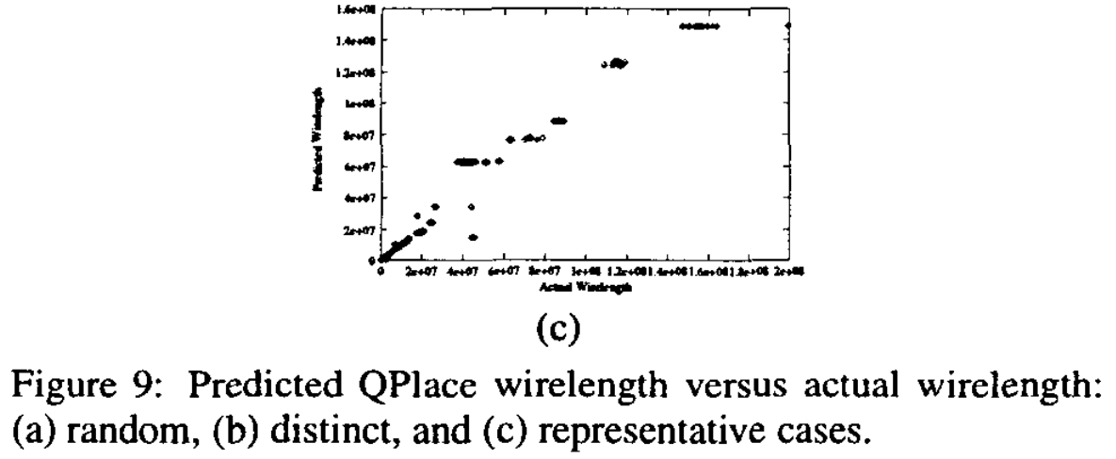
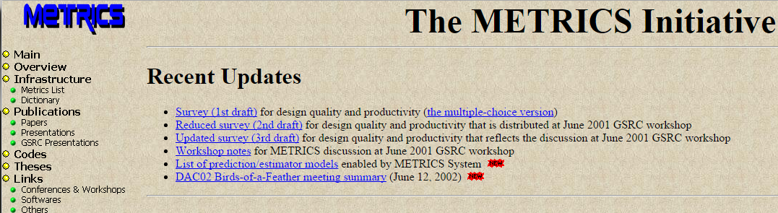
(This is “METRICS” !)
[DAC00, ISQED01]
METRICS (1999; DAC00, ISQED01):
“Measure to Improve”
  Goal #1: Predict outcome
  Goal #2: Find sweet spot (field of use) of tool, flow
  Goal #3: Dial in design-specific tool, flow knobs
http://vlsicad.ucsd.edu/GSRC/metrics
Notes:
Back in the late 1990s, my group tried to establish a METRICS infrastructure for the EDA and IC industries – all design activity would be measured, all data would be mined, and we’d be able to predict tool outcomes, find sweet spots or field of use for tools, and make design-specific tuning of tools.
Back then, designers didn’t really want big brother watching them – but today, anything that might help is welcome.
Proprietary logfiles? We published a standard METRICS list and dictionary.
Methods and Models as IP? All codes and scripts were open sourced – and they still are?
EDA vendor sensitivity? [[CLICK]] Back then: It was fine to say exactly how we predicted Cadence QPlace wirelength from netlist and utilization – and this even got a best paper award.
Use of Oracle 8i back then becomes Splunk today. Data mining is now called Machine learning. But this is still what the field needs.

Slide 22
Original METRICS Architecture
Instrumentation of design tools:
  Wrapper scripts to extract data from outputs and logfiles,
  Callable API codes that allow direct interaction from within the design tools
METRICS server: central data collection (Oracle8i)
Data mining process: analyzes existing data to improve existing design flow (CUBIST, etc.)
Notes:
This is the original METRICS architecture. Wrappers around design tools to collect outputs and logfiles, with transmitter APIs (especially in our own UCLA // UCSD open-source tools).
METRICS server, which was Oracle8i back then – servlets, enterprise java beans …
Data mining process – back then, we heavily used an academic classifier called CUBIST.
This can all be done much more smoothly and powerfully today ! Imagine what modern techniques might be able to discover and enable!

Slide 23
Lessons Learned From METRICS
Collaboration and support from EDA needed
  Constantly changing behaviors, logfile outputs, etc. best handled through direct integration with METRICS API
Common METRICS vocabulary essential
  Same semantics of crosstalk delay, vertical overcongestion, etc. across similar tools
Must be able to adapt/evolve: recalibrate to new process, specialize to particular type of design, etc.
METRICS should seamlessly integrate with and drive the design flow itself
Good news today:
  (1) This is critical to do. (2) Social barriers are gone. (3) Many commodity building blocks for METRICS 2.0. (4) Open source is a viable path to all of this.
Notes:
Looking back, here are some lessons we learned from METRICS.
Logfiles and tool behaviors are always changing – if EDA vendors would talk to a standard METRICS API, that would be best.
Common vocabulary – crosstalk delay, vertical overcon – should mean the same damn thing across tools. I mean come on…
All that data and learning has to be amortizable – in new processes, for special classes of SOCs, etc.
And back then, we were thinking “management console” more than “in-built driver of an AUTONOMOUS tool flow” – but today’s goal is AUTONOMY.
The GOOD NEWS: the industry understands this is critical; designer social barriers are gone; doing a METRICS 2.0 today with splunk and cloud etc. is much easier; and if one Ph.D. student could build METRICS as you see it, then I’d bet an open source community could build METRICS 2.0 and really make it hum.

Slide 24
Agenda
Challenges and Solutions
ML for Time and Effort Reduction
METRICS 2.0
Conclusion
Notes:
So let me conclude. [22:40]

Slide 25
Developing a Real Roadmap to NHIL, 24h TAT
Roadmap =
  Quantified, measurable requirements
  + Potential solutions
  + Mapping between requirements and solutions
  All laid out over a concrete time horizon
Toward no-human-in-loop, 24-hour TAT autonomy:
  (Robots → orchestration → pruning → … → intelligence)
  What’s NEVER going to be autonomously designed?
  How do we measure progress of time, effort reduction?
  Should we measure “tool transparency”, “design capability ramp”, “new-node normalization factor”?
  ML, “sharing” vs. vendor-customer-academia dynamics
  Overcoming “small, expensive data” challenges
Please join in this quest (or, don’t block it!)
Roadmap
  Robots
  Orchestration of robots in cloud
  Pruning via predictors and models
  Intelligence + many specific “todos”
  Other facets: enablement, openness, standards, sharing, …
Please help to achieve (or, don’t block) this !
Notes:
A technology roadmap has quantified requirements, plus potential solutions, plus a MAPPING between requirements and solutions, ALL laid out in time.
As our field develops its roadmap toward no-human, 24-hour autonomy …
Well, I’ve told you about the Stages from robots to eventual intelligence…
BUT: What’s NEVER going to be autonomously designed? Like the next Snapdragon?
How do we benchmark and measure progress?
Should new criteria such as tool transparency and chattiness, or design capability ramp, be roadmapped?
Will folks who think “data is the new oil” block machine learning and necessary OPENNESS AND SHARING of models and techniques?
Those “small data” challenges I mentioned.
So: PLEASE JOIN IN THIS QUEST – or at least, don’t block it.

Slide 26
THANK YOU !
Support from NSF, Qualcomm, Samsung, NXP, Mentor Graphics and the C-DEN center is gratefully acknowledged.
Thanks to OxSigen LLC (Steve Fenstermaker, David George and Bart Thielges) and Dr. Stefanus Mantik for creating the first realizations of METRICS (1996-2002). And thanks to Kurt Keutzer and Richard Newton for “Measure, to Improve”.
Notes:
Before ending, I would really like to thank two sets of folks: Kurt Keutzer and Richard Newton asked me to take on “Measure, to Improve” in the first MARCO GSRC center. And the folks at OxSigen LLC along with Stefanus Mantik are the real heroes of METRICS – 1.0.
THANK YOU FOR YOUR ATTENTION.

