Slide 1
A Study of Optimal Cost-Skew Tradeoff and Remaining Suboptimality in Interconnect Tree Constructions
Kwangsoo Han, Andrew B. Kahng, Christopher Moyes
UC San Diego CSE and ECE Departments
Alex Zelikovsky
Georgia State University Computer Science Department
Notes:
Thank you for the introduction. The main point of this work is to revisit the bounded-skew and – more generally – the cost-delay and cost-skew tradeoffs -- for interconnect trees. By formulating ILPs to find optimal solutions, we find that there is a surprising amount of suboptimality still left on the table by current heuristics.

Slide 2
Outline
Background and Related Work
Flow-based Integer Linear Program (ILP)
Experimental Setup and Results
Appendix: Optimal 1-D Cost-Skew Tradeoff
Conclusion
Notes:
Let me begin with some background.

Slide 3
Background and Motivation
Power-sensitive modern designs (mobile, IoT, …)
Lack of new BEOL materials → Poor scaling of wire resistance and capacitance
→ New focus on the cost of interconnect trees in advanced nodes
Clock distribution strongly affects both power and performance
Cost-skew tradeoff is particularly important in buffered clock tree construction
➔ Many works have studied the bounded-skew routing tree problem
Notes:
Modern designs such as mobile and IoT are very power sensitive.
And, new materials for back-end-of-line interconnect causes poor scaling of RC parasitics.
[CLICK] This bring up a new challenge on reducing interconnect tree cost in advanced node.
[CLICK] Also, clock distribution strongly affects both power and performance. Especially, cost-skew tradeoff is very important in buffered clock tree construction.
[CLICK] So, a lot of works have studied the bounded-skew routing tree problem.

Slide 4
Bounded-Skew Routing Tree (BST) Problem
Objective: Minimum cost (wirelength)
Input: A set of points $P$
Subject to:
Skew bound $B$ → Max pathlength – min pathlength < $B$
Source point
Sink points
Steiner points
Bounded-Skew Spanning Tree
Bounded-Skew Steiner Tree
Notes:
We can formulate the BST problem as follows.
Given a set of points with their x, y locations, one of which is a prescribed SOURCE, the objective is to construct a minimum-cost tree. There is one constraint, the skew bound, which is max minus min pathlength from the prescribed root.
This BST problem is usually formulated in [CLICK] the spanning or [CLICK] the Steiner contexts.
Left figure shows an example of spanning tree, in that any two points should be directly connected.
And right figure shows the Steiner tree example, which includes Steiner points.
Our work applies to both problems.

Slide 5
Related Works
Cost-delay tradeoffs
Prim-Dijkstra algorithm tradeoffs tree cost and maximum source-sink pathlength [Alpert95]
Heuristics to find minimum-cost shortest-paths Steiner tree [Rao92, Cong93]
Methods for shallow-light tree construction [Cong92, Elkin15, Chen17]
Bounded-skew tree constructions
Deferred-merge embedding for zero-skew tree constructions [Boese92, Chao92, Lim93]
Extension of DME with bottom-up merging step to construct bounded-skew tree [Tsao02]
Optimal tree constructions
FLUTE: optimal rectilinear Steiner minimum tree for instance with up to ~9 pins [Chu08]
Linear programming to find Steiner routing trees with upper-and lower-bounded path delays within a prescribed topology [Oh96]
How much is left on the table?
Notes:
The related literature falls roughly into three areas.
First is cost-delay tradeoffs.
Our 1995 Prim-Dijkstra algorithm blends the Prim and Dijkstra constructions to construct a tree with good tradeoff between wirelength and pathlength.
Other works study the rectilinear Steiner arborescence problem, which seeks a min-cost shortest-paths Steiner tree.
Cong et al. and Rao et al. proposed heuristics on this problem in 1993 and 1992 respectively.
Recently, Chen et al. proposed Steiner shallow-light tree construction method, which is called SALT.
[CLICK] A second category is bounded-skew tree constructions.
Several works proposed the DME method for zero-skew tree constructions.
Then, Tsao et al. improved DME to construct trees under general skew constraints.
[CLICK] The last category is optimal tree constructions.
FLUTE generates optimal rectilinear Steiner minimum tree for instance with up to ~9 pins.
Oh et al. used linear programming to find upper and lower bounded path delays for given tree topology.
Although many works proposed a lot of methods,
[CLICK] We still do not know how much is left on the table, especially in BST problem.
So, we focus on optimal bounded-skew tree solutions to assess suboptimality of existing heuristics.

Slide 6
Our Contributions
Formulate BST problem as flow-based integer linear program
First-ever study of optimal cost-skew tradeoffs
Evaluate state-of-the-art academic tools and quantify remaining suboptimality
Solve restricted 1-D BST problem in dynamic programming
Shed light on questions about optimal skew budgeting across levels of a tree
Notes:
We formulate BST problem as flow-based integer linear program.
This is the first-ever study of optimal cost-skew tradeoffs.
[CLICK] We evaluate the state-of-the-art academic tools and quantify the remaining suboptimality.
[CLICK] In the appendix, we solve the restricted 1-D BST problem using dynamic programming. This gives additional insights on optimal skew budgeting problem.

Slide 7
Outline
Background and Related Work
Flow-based Integer Linear Program (ILP)
Experimental Setup and Results
Appendix: Optimal 1-D Cost-Skew Tradeoff
Conclusion
Notes:
Now, I will explain our flow-based integer linear program.

Slide 8
Definitions
Create graph $G=(V, E)$
Spanning tree: $G$ is a complete graph
Steiner tree
Use half-integer grid of $P$
$P⊂V$
Source $p_{1}=v_{1}$
Sinks $\left\{p_{2}…p_{\left|P\right|}\right\}=\left\{v_{2}…v_{\left|P\right|}\right\}$
Additional non-terminal vertices $\left\{v_{\left|P\right|+1}…v_{\left|V\right|}\right\}$
Each vertex has four incoming and four outgoing edges
$e_{jk}$: a directed edge from vertex $v_{j}$to vertex $v_{k}$
$c_{jk}$: cost of $e_{jk}$
$$p_{1}$$
$$p_{2}$$
$$p_{3}$$
$$p_{4}$$
$$p_{5}$$
$$v_{k}$$
$$e_{jk}$$
$$v_{j}$$
$$p_{6}$$
$$p_{8}=v_{8}$$
$$p_{7}$$
Notes:
First, some definitions.
Give a set of points, we generate routing graph G, which is a collection of vertices and edges.
In BST spanning tree problem, G is a complete graph.
[CLICK] In Steiner tree context, it is a little bit different. Let me explain with this an example.
[CLICK] Given a set of points P, we create half-integer grid of P as shown in the right figure.
This half-integer grid is required to guarantee our Steiner tree solutions are optimal.
In this grid, every crossing point is a vertex.
[CLICK] So, point set P is a subset of V.
We assumes p_1 is source and the same as v_1. Also, p_2 to pp are the sinks and same as v_2 to v_p.
Then, the remaining vertices are non-terminal vertices.
[CLICK] Each vertex has four incoming and outgoing edges.
[CLICK] e_jk means a directed edge from vertex v_j to v_k and c_jk is the cost of the edge.

Slide 9
Flow-based ILP
Objective
$$\min{\sum_{e_{jk}∈E}{λ_{jk}⋅c_{jk}}}$$
c: cost e: edge f: flow
⇒ Minimize cost
For each path from source ($v_{1}$) to sink ($p_{i}=v_{i}$) terminal
$$λ_{jk}≥f_{jk}^{i}$$
⇒ Edge $e_{jk}$ is taken when there is a flow
$$\sum_{j}{f^{i}jk}−\sum_{j}{f^{i}kj}=\left\{\begin{aligned} \#\#1 if v_{k}=source \left(v_{1}\right) \\ −1 if v_{k}=sink \left(v_{i}\right) \\ 0 otherwise \end{aligned}\right.$$
⇒ Flow conservation (= connection)
+ more constraints to support skew bound
Notes:
The objective is to minimize total cost.
Lambda_jk is a binary indicator of whether e_jk is finally selected or not in the solution.
[CLICK] Then, we apply the below constraints for each source-to-sink path INDIVIDUALLY in the solution.
This constraint is to make sure Lambda_jk is one when there is a flow on edge e_jk in the path to SOME terminal.
[CLICK] These constraints are for flow conservation in each path from source to sink i.
For each vertex j, if v_j is a source there is one outgoing flow. If it is sink, one incoming flow.
Otherwise, it is zero.
[CLICK] We have more constraints to enforce the skew bound - next.

Slide 10
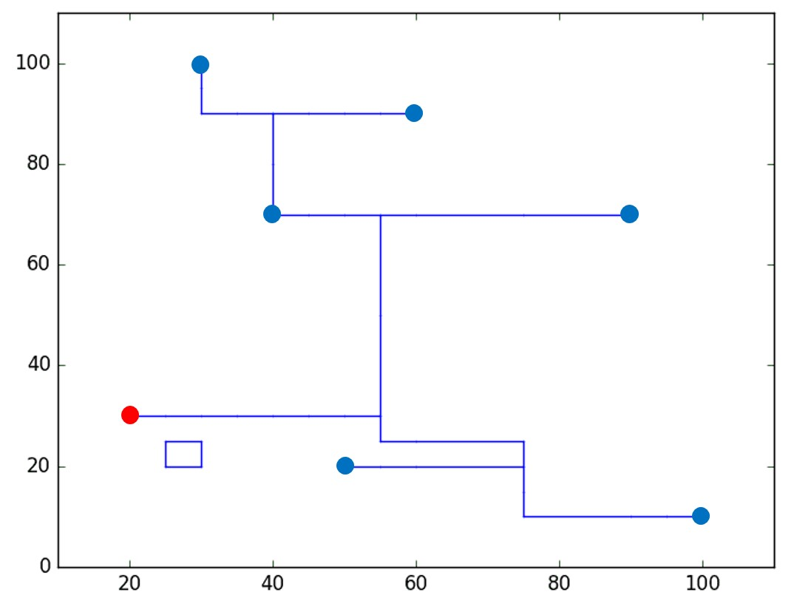
Skew Bound Constraints
For each path to $p_{i}$
$$L ≤\sum_{e_{jk}∈E}{c_{jk}⋅f_{jk}^{i}≤L+B }$$
⇒ Cost of each path within {L, L + B} L: lower bound, B: target skew
Invalid Solution with Cycle
Flow conservation constraints are satisfied
Cost of creating cycle < cost of detouring to leaf terminals to satisfy target skew
Cycle
Notes:
Since we are considering each source-to-sink path separately, we can get each pathlength easily.
Then, this constraint just makes sure the pathlength is within target skew range.
Here, L is the lower bound which is an input parameter. This could cause suboptimality depending on how the L value is given.
[CLICK] Unfortunately, this could give us invalid solutions with cycles.
Right figure shows an example solution. Based on the constraints I just explained, we cannot avoid this cycle.
This satisfies flow conservation and skew bound.
[CLICK] This happened when the cost of creating cycle is smaller than the cost of detouring to leaf terminals to satisfy target skew.
Thus, we need more constraints to avoid this issue and I will explain it on next slide.

Slide 11
Cycle Correction
New: $d_{j}^{i}$ pathlength from $v_{1}$ to $v_{j}$for path to $p_{i}$
Additional constraints to compute $d_{j}^{i}$
$d_{j}^{i}=d_{k}^{i}$ + $c_{kj}$ if $f_{kj}^{i}=1$
$$\left\{\begin{aligned}\#\#d_{j}^{i} =0 if v_{j}=source \left(v_{1}\right) \\ d_{j}^{i}≥L if v_{j}=sink \left(v_{i}\right) \\ d_{j}^{i}≤L+B otherwise \end{aligned}\right.$$
$$d_{j}^{i}+U⋅\left(1−f_{kj}^{i}\right)≥d_{k}^{i}+c_{kj}$$
$$d_{j}^{i}−U⋅\left(1−f_{kj}^{i}\right)≤d_{k}^{i}+c_{kj}$$
Notes:
We define new variable d^i_j, which represent the pathlength from the source to vertex j for the path to sink p_i.
With this variable, we can keep pathlength from source to any intermediate, non-terminal vertex j within skew bound.
[CLICK] This d^i_j variable should satisfy the following constraints.
If vertex j is source, d^i_j is zero. If vertex j is sink, d^i_j should be larger than lower bound L.
Otherwise, d^i_j should be smaller than the upper bound L + B.
[CLICK] Then, we need additional constraints to compute d^i_j.
If vertex k is a neighbor of vertex j, then d^i_j is equal to the sum of d^i_k and the cost of e_kj if there is flow from vertex k to j.
The bottom two constraints achieve this.
U is a big constant so that the constraints are always met when there is no flow from vertex k to j.

Slide 12
Constraints for Runtime Improvement
Chief drawback of using ILP → poor scalability
Idea: find flow variables that cannot coexist
$m_{ji}$: Manhattan distance from $v_{j}$ to $v_{i}$
For each point $p_{i}$
$$if m_{1j}+m_{ji}>L+B$$
$f_{jk}^{i}=0, f_{kj}^{i}=0$
⇒ Sum of Manhattan length via non-terminal vertex $v_{j}$ > upper bound on pathlength
$if m_{1j}+m_{jj′}+m_{j^{′}i}>L+B$
$and{ m}_{1j′}+m_{j′j}+m_{ji}>L+B$
$f_{jk}^{i}+f_{j^{′}k^{′}}^{i}=1, f_{kj}^{i}+f_{j^{′}k^{′}}^{i}=1$
$f_{jk}^{i}+f_{k^{′}j^{′}}^{i}=1, f_{kj}^{i}+f_{k^{′}j^{′}}^{i}=1$
⇒ Similarly, consider
for two non-terminal
vertices $v_{j}$ and $v_{j^{′}}$
Notes:
Although our formulation can find optimal solution, the chief drawback of using ILP is poor scalability.
Thus, we add some more constraints for speedup.
[CLICK] The idea is to find flow variables that cannot coexist.
We define m_ji as Manhattan distance from vertex j to i.
[CLICK] Again, we apply this constraints for each path.
The first equation means that the Manhattan distance from source to sink i through vertex j is larger than the upper bound.
So, in this condition, we can set all incoming and outgoing flows to the vertex j as zero.
[CLICK] Similarly, we can consider two intermediate vertices j and j’.
If this Manhattan length is larger than the upper bound, any combinations of incoming and outgoing flows going through vertices j and j’ cannot coexist.

Slide 13
Outline
Background and Related Work
Flow-based Integer Linear Program (ILP)
Experimental Setup and Results
Appendix: Optimal 1-D Cost-Skew Tradeoff
Conclusion
Notes:
Now, I will show our experimental setup and results.

Slide 14
Experimental Setup
Implemented in C++ and ILP solver is CPLEX 12.6.1
Testcase generation
Limited condition: |$P$| < 16, |$V$| < ~140, |$E$| < ~550
50 testcases for each |$P$| = {8, 10, 12, 14, 16}
Terminals are randomly distributed
Run flow-based ILP
$M$ = maximum source-to-sink Manhattan length
Skew bound $B$ = $M⋅\{0.3, 0.5, 0.7, ∞\}$
Lower bound $L= M−B$
Evaluations of several state-of-the-art academic tools
Bounded-skew DME (BST-DME)
Steiner shallow-light tree (SALT)
Prim-Dijkstra (PD)
Notes:
This is implemented in C++ and we used CPLEX as our ILP solver.
[CLICK] Even with the constraints for runtime improvement, our tool can find solutions under limited condition. So, the number of terminals is limited to be smaller than 16. Also, based on our study, we constrain number of vertices and edges to be smaller than 140 and 550 respectively.
[CLICK] Under this limitation, we create 50 instances for each number of terminals 8, 10, 12, 14 and 16.
Terminals are randomly distributed.
[CLICK] We run our flow-based ILP for Steiner tree construction with four skew bounds.
We cannot use a fixed skew bound for all instances. So, we use max source-to-sink Manhattan length as reference.
Then, we set three skew bounds as 0.3, 0.5 and 0.7 times of this reference length. And one is unbounded.
[CLICK] Last, we assess three academic tools. Bounded-skew DME, Steiner shallow-light tree and Prim-Dijkstra methods.

Slide 15
Setup for Comparison with State-of-the-art Tools
Metrics for evaluation
Normalized cost: cost / min-cost from ILP-based Steiner tree
Normalized skew: skew / min-skew from ILP-based Steiner tree
Sweep input parameters to obtain several solutions for each tool
How to compare
Select three representative solutions {min-cost solution, min-skew solution, “median” solution in between}
Compute average normalized cost and skew
Notes:
Each instance could have very different cost and skew values. So, we use normalized cost and skew values as metrics for evaluation.
The denominator is the min-cost and min-skew from our ILP-based Steiner tree.
[CLICK] For academic tools, we sweep input parameters to obtain enough solutions that shows cost-skew tradeoffs.
Academic tools give a lot of solutions with different input parameter values. And, it could be noisy if we select all the solutions.
So, we select three representative solutions instead. Min-cost solution, min-skew solution and median solution in between.
Then, we compute average normalized cost and skew across all 50 instances that have the same number of terminals.

Slide 16
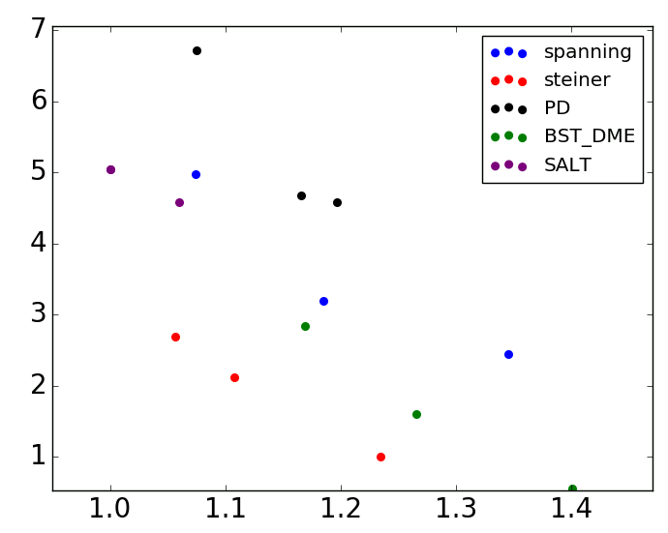
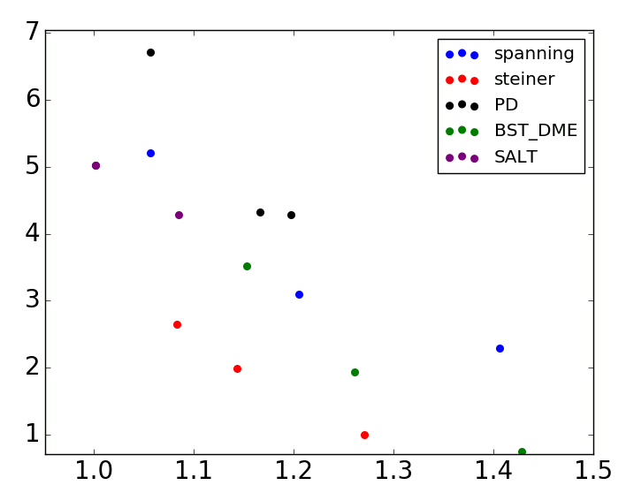
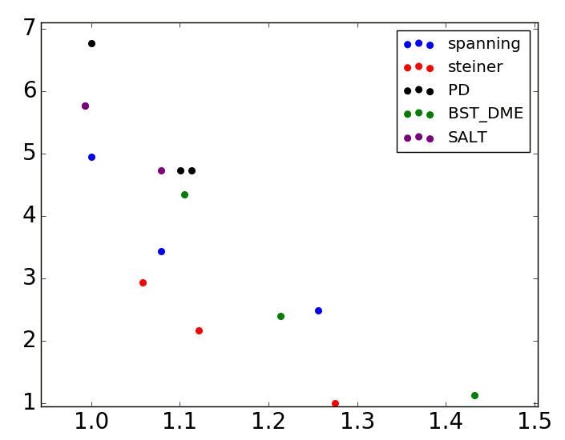
Study of Cost-Skew Tradeoff (1)
#terminals = 8
ILP-based Steiner tree dominates all other tools
BST-DME:
Up to ~16% suboptimal in cost at iso-skew
~50% suboptimal in skew at iso-cost
SALT and PD: large-skew solutions with up to ~3X suboptimality
Normalized skew
#terminals = 8
#terminals = 12
#terminals = 16
Normalized skew
~16%
~12%
~50%
~13%
~50%
~50%
Normalized cost
Normalized cost
Normalized cost
Normalized cost
Notes:
This figure shows the results for 8-terminal instances. X-axis is the normalized cost and Y-axis is the normalized skew.
Red curve represents our ILP-based Steiner tree solutions and Blue curve is for our spanning tree solutions.
Green is for BST-DME. Black is for Prim-Dijkstra and purple is for SALT.
As we expected, we have smaller skew tree solution with larger cost.
[CLICK] The right two figures show the results for 12 and 16 terminal instances. Overall trend looks similar.
[CLICK] In all testcases, our ILP-based Steiner tree dominate all other tools.
[CLICK] Compared to our ILP-based Steiner tree, we evaluate the suboptimality of BST-DME. From our experiment, BST-DME is up to ~16% suboptimal in cost at iso-skew.
[CLICK] Also, It is ~50% suboptimal in skew at iso-cost. This implies there are still a lot of room for improvement.
[CLICK] Also, SALT and PD shows ~3X suboptimality in terms of skew. This is because both SALT and PD does not directly optimize skew.

Slide 17
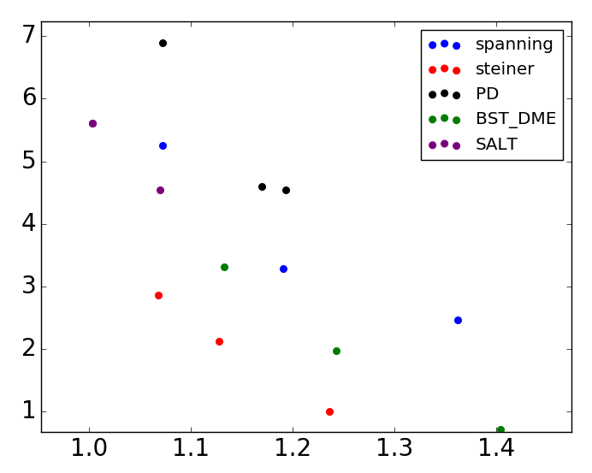
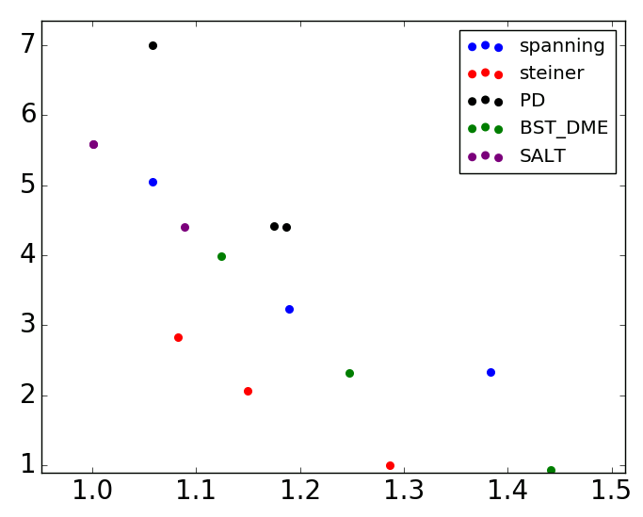
Study of Cost-Skew Tradeoff (2)
ILP-based spanning tree
Larger cost than SALT, and larger skew than BST-DME
As #terminals increases, comparable or better cost and skew solutions than SALT and BST-DME
#terminals = 8
#terminals = 10
Normalized skew
#terminals = 12
#terminals = 14
#terminals = 16
Normalized skew
Normalized cost
Normalized cost
Normalized cost
Notes:
Let me say a bit more about the ILP-based spanning tree.
Below figures show the results for all five different terminal nets.
[CLICK] In general, our ILP-based spanning tree in BLUE shows larger cost than SALT (MAROON) and larger skew than BST-DME (GREEN).
[CLICK] But, as the terminal size increases from EIGHT in top-left to 16 in bottom-right, our spanning tree solution is actually comparable to SALT and BST-DME. This implies the optimal spanning tree solution could be a good candidate for high-fanout nets.

Slide 18
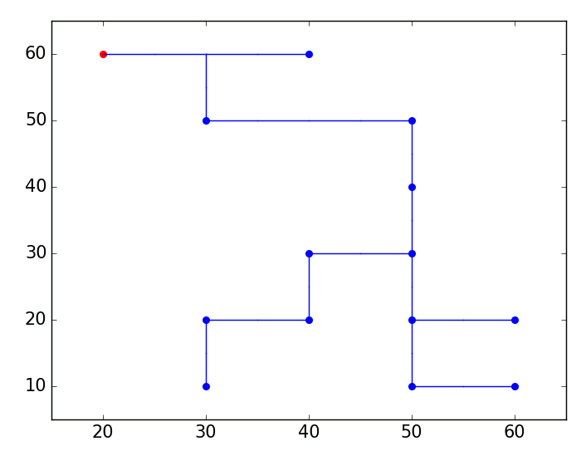
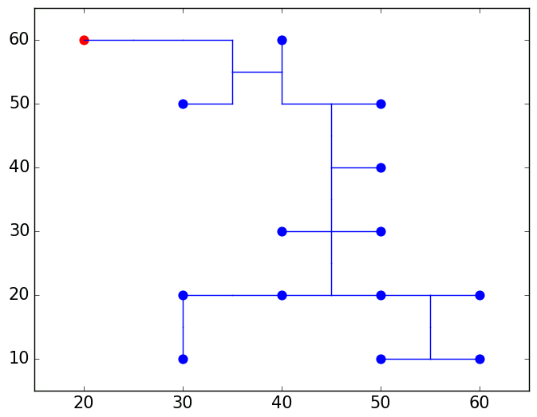
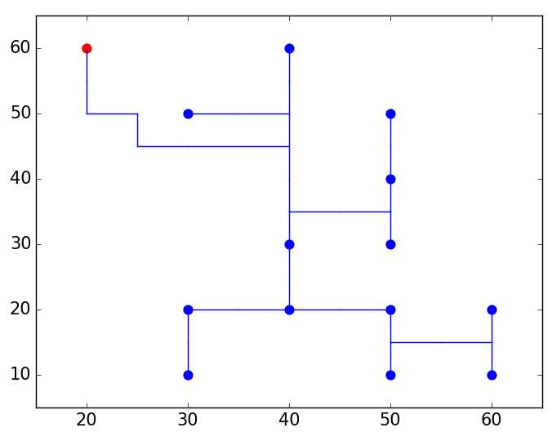
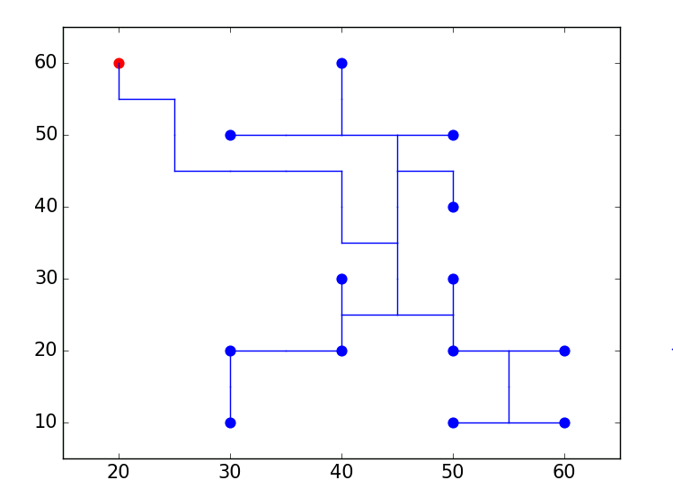
Example: 14-terminal Instance
B = $∞$, cost = 150, skew = 80
B = $0.7⋅M$ (63), cost = 160, skew = 60
B = $∞$, cost = 150, skew = 80
B = $0.5⋅M$ (45), cost = 175, skew = 40
B = $0.3⋅M$ (27), cost = 195, skew = 20
Notes:
This figure shows an example routing solution from our ILP-based Steiner tree construction method.
Red dot is the source and blue dots are sinks. Target skew is unbounded in this case. So, this is a Steiner minimum tree.
Cost is 150 and skew is 80.
[CLICK] Now, right figure shows the routing solution for tightened target skew of 63. Cost is increased to 160 and skew is reduced to 60.
[CLICK] With further tighten skew to 45, we obtain this lower-left solution. Now cost is 175 and skew is 40.
[CLICK] then, we even down the target skew to 27 and got this lower-right solution.

Slide 19
Runtime
#variables and #constraints
The number of variables is $O(\left|V\right|⋅\left|P\right|)$
The number of constraints is $O(\left|V\right|⋅\left|P\right|)$
Runtime
ILP-based spanning tree: average runtime = 0.32 sec and max runtime is 4 sec
ILP-based Steiner tree:
Runtime is more sensitive to skew bound than #terminals
Runtime (s)
Notes:
Now, I will talk about runtime of our method.
Both the number of variables and constraints are proportional to the number of vertices multiplied by the number of points.
[CLICK] Our ILP runs very fast for spanning tree construction. It takes 0.32 sec on average and maximum 4 sec.
[CLICK] Here, I show the runtime for Steiner tree construction. X-axis indicates terminal size and Y-axis is the runtime in log scale. From this results, we can see the runtime is more sensitive to skew bound than the terminal size.

Slide 20
Possible Suboptimality Fixed $L$
Possible suboptimality with fixed lower bound $L$
Select 10 sample instances to study impact of $L$ on suboptimality
Vary $L=\{M−B, M\}$ and compare the best cost to the one from fixed $L=M−B$
Only one out of ten instances is suboptimal by 2.8%
Notes:
As I briefly mentioned in previous slide, variable L is an input to our ILP formulation and could give some suboptimal solution.
So, here, we do some experiments how much the suboptimal could be.
We first select 10 sample instances. Then, given a fixed target skew B, we vary the L from M-B to B and compare the best cost to the one we used.
From this experiment, one out of ten instance shows suboptimality by 2.8%.

Slide 21
Outline
Background and Related Work
Flow-based Integer Linear Program (ILP)
Experimental Setup and Results
Appendix: Optimal 1-D Cost-Skew Tradeoff
Conclusion

Slide 22
1-D Bounded Skew Tree (BST) Algorithm
Objective: Find non-dominated BSTs (cost, skew)
Observation: Each optimal BST is comprised of a root with (at most) two subtrees that are optimal BSTs.
➔Use dynamic programming. Each subproblem is a (smaller) optimal BST which can be used to build (larger) optimal BSTs.
Notes:
So, to gain additional insight into the bounded-skew problem, we also studied a more tractable version, namely, the restriction to ONE DIMENSION.
[CLICK] Our objective is to find the set of non-dominated bounded skew trees with respect to cost and skew.
[CLICK] We note that an optimal bounded skew tree can be composed from subtrees which are also optimal bounded skew trees.
[CLICK] This motivates the creation of a dynamic programming algorithm in order to find optimal bounded skew trees.

Slide 23
Decomposition of BST with skew = 1
p₁=(2,0)
3
I₁=(5,0)
2+1
3
p₂=(1,0)
I₂=(3,0)
I₃=(8,0)
1
1
1
1
1
1
p₂=(1,0)
p₃=(2,0)
p₂=(1,0)
p₃=(2,0)
p₄=(4,0)
p₅=(7,0)
p₆=(9,0)
Red “+1” = wasted wire (preserves skew)
I₁=(5,0)
2+1
3
I₂=(3,0)
I₃=(8,0)
I₂=(3,0)
1
1
1
1
1
1
1
1
p₂=(1,0)
p₃=(2,0)
p₄=(4,0)
p₅=(7,0)
p₆=(9,0)
p₂=(1,0)
p₃=(2,0)
p₄=(4,0)
Notes:
[CLICK] Here we show how a large optimal bounded skew tree is comprised of small optimal bounded skew trees.
The ordered pairs such as (Two comma Zero) are coordinates on the x-axis, e.g., x = 2, y = 0.
This is an optimal tree over 9 consecutive points on the integer lattice, with
[CLICK] The first subtree is contained in the red box.
[CLICK x2] Note that it is necessary to waste one unit of wire in order to preserve the skew bound.
[CLICK] The left child is also an optimal BST and as we continue looking at the remaining left children of each subtree, we see that each is an optimal subtree. [CLICK until end of slide]

Slide 24
Recursive Formulation
2 children
Create two 4-dimensional arrays M and S
M[l][sh][s][B]: cost of optimal tree
Over vertices from [sh, sh+l]
With root location s and skew bound B
S[l][sh][s][B]: (cost of optimal tree, single child of source)
Over vertices from [sh, sh+l]
With root location s and skew bound B
Root of optimal tree must have one child
Introduced to improve runtime by a factor of n
Base Case: for 1 < i <= n, initialize a tree of 0 cost and 0 skew rooted at p_{i}.
M[1][i][i][j] = 0 for i = 2,3,…,n for j = 1,2,…,B
S[1][i][j][k] = (|j – 1|, j) for i = 2,3,…,n for j = -n,…,n for k = 1,2,…,B
p₁=(5,0)
1
1
1
p₂=(3,0)
p₃=(4,0)
p₄=(6,0)
(a)
1 child
p₁=(3,0)
2
I₁=(5,0)
1
1
1
p₂=(3,0)
p₃=(4,0)
(b)
p₄=(6,0)
Notes:
Our algorithm begins by creating two four-dimensional arrays, M and S.
[Click] M will maintain the optimal cost of a tree given four parameters.
l: The length of the window of sinks from which we are constructing a tree over.
sh: The starting point of this window.
s: the source location.
B: the skew bound.
[CLICK] Figure (a) shows an example with l=4, s=3, sh=2 and B=1.
[CLICK] S maintains the optimal cost of a tree such that the root has only one child. It is indexed in a similar manner.
[CLICK] Figure (b) shows an example of what such a tree looks like.
The base case for each of these arrays is a tree rooted at each sink.
[CLICK] These are the recurrences for such trees.

Slide 25
Recursive Formulation
Recurrence:
M[l][sh][s][B] =
min(S[L][sh][s - sh][B] + S[l-L][sh + l][s - sh - l][B] for l = 1,2,…,L, M[l][sh][s][B])
Each tree can be split into left (l) and right (L- l) halves
S already has optimal solutions for these subproblems
Once this step is complete
Also, check if any solution is dominated by enforcing the root of the tree have a single child
S[L][sh][s][B] =
min(M[l][sh][ch][B] + |s – ch + sh| for ch = 1,…,l)
Searches for the best location to add the child of the root
If we know this location, then we can find the best tree in constant time
Notes:
The recursive formulation for M splits the set of sinks in half so that larger problem becomes a smaller problem [CLICK].
We consider every possible window size such that each tree is constructed over a window of size at least one. Some shifting will be necessary in the right subtree to ensure that the correct subtree is found in S.
[CLICK] Once this is complete, we will also need to see if a better solution could be obtained by having only one child from the root.
This is easily accomplished by iterating over all previous solutions and adding the distances between the two sources.
The S matrix [CLICK] searches for the best tree with one child from the root.
This is accomplished by finding the minimum over all previously computed trees with respect to source location and adding the distance from the source location of the subtree to the source of the new tree.

Slide 26
Constructing M[9][5][0][1]
p₁=(5,0)
p₁=(5,0)
3
2
I₃=(8,0)
I₁=(3,0)
1
1
1
1
1
p₅=(7,0)
p₆=(9,0)
p₂=(1,0)
p₃=(2,0)
p₄=(4,0)
S[5][1][4][1]
S[4][5][0][1]
Red “+1” = wasted wire
(preserves skew)
I₁=(5,0)
2+1
3
I₂=(3,0)
I₃=(8,0)
1
1
1
1
1
p₂=(1,0)
p₃=(2,0)
p₄=(4,0)
p₅=(7,0)
p₆=(9,0)
M[9][5][0][1]
Notes:
Here we show how to combine two subtrees in S in order to create a final optimal tree for M.
We would consider all possible l = 1,2,3 up to 8 for the left subtree and 8,7, down to 1 for the right subtree.
I show the best choice for l, 4. Note that we could have chosen l to be 5 or 6 as the subtree would remain the same.
[CLICK x2] We can merge these trees together by adding the respective values in the S matrix.
But note that we will have to add one additional unit of skew to the edge from the source to the left subtree in order to preserve the skew bound.

Slide 27
Observations
Skew tends be preserved in high levels of the tree
In some cases, wasted wire is necessary in order to maintain a balanced tree
Cost-skew tradeoff curve steeper for small skew
Other insights
Clustering impact on cost (MBFFs)
Tree cost vs. #sinks
Optimal skew allocation across levels
Notes:
We observe that skew tends to be preserved in higher levels of the tree and then used up in lower levels of the tree.
That is, internal nodes at high levels in the tree tend to have low skew, but internal nodes and sinks tend to have high skew.
We also observe that it is more expensive to decrease skew if skew is already low rather than to decrease skew when skew is high.
Figures 6 and 7 in the paper are examples of insights from our 1-dimensional study: [LEFT] cost decreases as sparse pointsets are more clumped (shown on the top left), [RIGHT] the growth rate of optimal BSTs with instance size (still an open question, as far as I know),
And the optimal allocation of skew across levels.

Slide 28
A Comment
This should be the “golden age of SLIP”
Floorplan evaluation and optimization
Routability and “doomed runs” prediction
Technology modeling for product pathfinding
Die-Package-Board (interconnect) co-optimization
(ML) Prediction is also “optimization objective” !!!
Related:
MALENDA
(tomorrow)
And: (see News at vlsicad.ucsd.edu)
Notes:
Before I conclude, let me give a quick comment.
This really should be the golden age of System-Level Interconnect Prediction.
SLIP should be working on and delivering solutions to major challenges: ……
Professor Li’s keynote tells us about ML.

Slide 29
Outline
Background and Related Work
Flow-based Integer Linear Program (ILP)
Experimental Setup and Results
Appendix: Optimal 1-D Cost-Skew Tradeoff
Conclusion
Notes:
I will conclude my talk.

Slide 30
Conclusion
Optimal cost-skew tradeoffs for generated testcases with number of terminals from 8 to 16
Observe significant remaining suboptimality of several state-of-art academic tools
BST-DME: Up to 16% suboptimal in cost at iso-skew ~50% suboptimal in skew at iso-cost
SALT and Prim-Dijkstra: Up to 3x larger skew at iso-cost
Future works
Scalability study and improvement of the flow-based ILP formulation
Extensions of our suboptimality study to the cost-radius tradeoff
Benchmark suite generation with known optimal solutions
Notes:
In this work, we formulate flow-based ILP and find optimal cost-skew tradeoffs for our generated testcases.
[CLICK] With optimal cost-skew tradeoffs, we evaluate state-of-the-art academic tools.
Our observation shows there is still significant room for improvement.
BST-DME is up-to 16% suboptimal in cost at iso-skew and around 50% suboptimal in skew at iso-cost.
SALT and Prim-Dijkstra methods show up to 3x larger skew at iso-cost.
[CLICK] Our future works include as follows.
First, we need more scalability study and improvement of the current flow-based ILP formulation.
Second, we can extend our suboptimality study to the cost-radius tradeoff.
Third, we can generate benchmark suite with known optimal solutions.

Slide 31
Thank you!
Notes:
Thank you for your attention.

