Slide 1
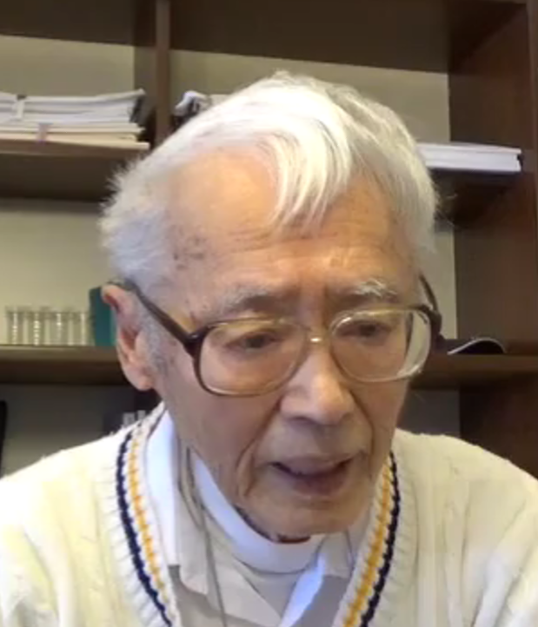
Professor T. C. Hu
ISPD-2018 Lifetime Achievement Commemoration
Notes:
Welcome to Session 6 of ISPD, which honors Professor T. C. Hu with ISPD’s Lifetime Achievement Award.

Slide 2
Influence of Professor T. C. Hu’s Works on Fundamental Approaches in Layout
Andrew B. Kahng
CSE and ECE Departments
UC San Diego
http://vlsicad.ucsd.edu
Notes:
It’s my privilege to be able to present a small part of Professor Hu’s contributions to Physical Design.

Slide 3
Professor T. C. Hu
Introduced combinatorial optimization, and mathematical programming formulations and methods, to VLSI Layout
Many works reflect unique ability to combine geometric, graph-theoretic, and combinatorial-algorithmic ideas
  1961: Gomory-Hu cut tree
  1973: Adolphson-Hu cut-based linear placement
  1985: Hu-Moerder hyperedge net model
  1985: Hu-Shing α-β routing
Applications of duality: flows and cuts, shadow price → Professor C.-K. Cheng in next talk
Notes:
Professor Hu brought many combinatorial and mathematical programming frameworks to VLSI Layout. In this, he was often far in advance of the field.
We can see in many results the combination of geometry, graph theory and algorithms, and combinatorial algorithms: Multiterminal maximum flows, linear placement, hypergraph modeling, detailed routing.
Professor Cheng will review several works with applications of duality in the next talk.

Slide 4
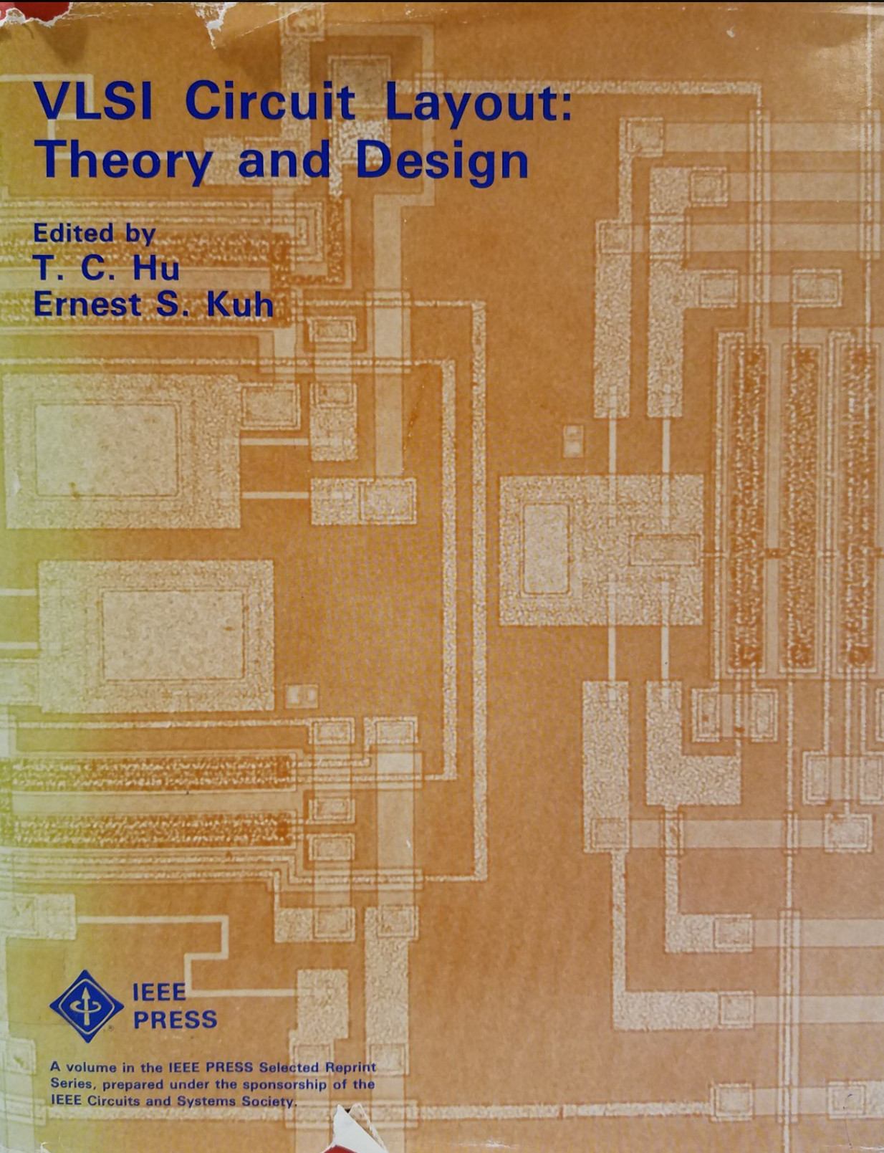
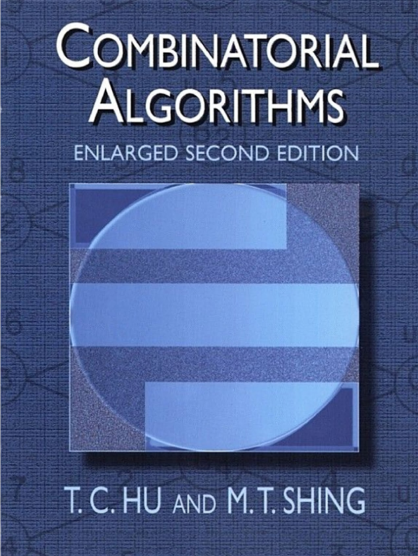
Professor T. C. Hu
Notes:
These books have influenced generations of students.
This is the copy from my lab.

Slide 5
A Few Examples
Tentative Assignment / Competitive Pricing
Optimal Linear Ordering
Hyperedge Net Model
The Prim-Dijkstra Tradeoff
The Discrete Plateau Problem and Finding a Wide Path
Notes:
Today, let me mention just a few examples of how Professor Hu’s ideas can be found throughout physical design.

Slide 6
A Few Examples
Tentative Assignment / Competitive Pricing
Optimal Linear Ordering
Hyperedge Net Model
The Prim-Dijkstra Tradeoff
The Discrete Plateau Problem and Finding a Wide Path
Notes:
Since at least 1986, Professor Hu wanted to apply TACP in layout.

Slide 7
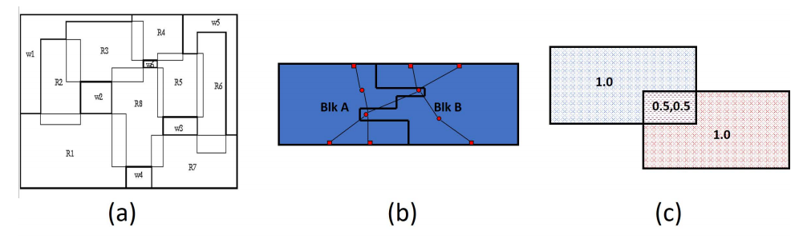
TACP and Shadow Price (1)
TACP: tentative assignment and competitive pricing
Application: Fixed-outline floorplanning
  Fixed die, fixed block aspect ratio
  ≠ classical “packing” that minimizes whitespace, etc. !!!
  Seeks “perfect” rectilinear floorplanning: zero whitespace
    Irregular block shape
    Overlapping blocks
Notes:
Fixed-outline floorplanning is motivated by the modern fixed-die concept. The aspect ratio of the floorplan is fixed. But the aspect ratios for the blocks can vary. Proposed in the ISPD-2000 “Classical Floorplanning Harmful” papera perfect rectilinear floorplanning formulation. It seeks zero-whitespace in a fixed-die regime.
Professor Hu proposed the tentative assignment and competitive pricing concept in 1980. Blocks can have irregular shapes, and can even overlap with each other. The figure below shows fixed-die floorplanning. The middle figure shows two blocks with irregular shapes, and the third figure shows block overlapping. For example, two blocks with equal amounts of cell area could be placed into adjacent disjoint regions, with each block having depth = 1 in its respective region. An alternative would be to place each block with uniform depth = 1/2 into the union of the two regions.

Slide 8


TACP and Shadow Price (2)
Shadow price in linear programming duality
  Primal-dual iterations in global routing
  Local density in global placement
    Global density
    More recent: constraint-oriented local density
$$min f\left(v\right)=W\left(v\right)+λ⋅D(v)$$
$$min f\left(v\right)=W\left(v\right)+Σ_{i}λ_{i}⋅D_{i}(v)$$
Better cell spreading, better wirelength!
Notes:
The concept of competitive pricing in a TACP iteration is based on the shadow price in linear programming duality. Column generation and shadow price have been applied to VLSI global routing, with primal-dual iterations being widely studied around 20 years ago.
Shadow price has also been used in global placement. The top equation shows the classical analytical global placement objective, the bottom equation shows the recent onstraint-oriented local density objective. In the equations, W(v) is the approximated total half-perimeter wirelength, and D(v) represents the density cost. These two terms are connected using a Lagrangian multiplier λ. The new local-density function comprehends local density at per-bin granularity. It accelerates cell spreading for overflowed bins to resolve cell overlapping, while preserving the wirelength elsewhere.

Slide 9
A Few Examples
Tentative Assignment / Competitive Pricing
Optimal Linear Ordering
Hyperedge Net Model
The Prim-Dijkstra Tradeoff
The Discrete Plateau Problem and Finding a Wide Path

Slide 10
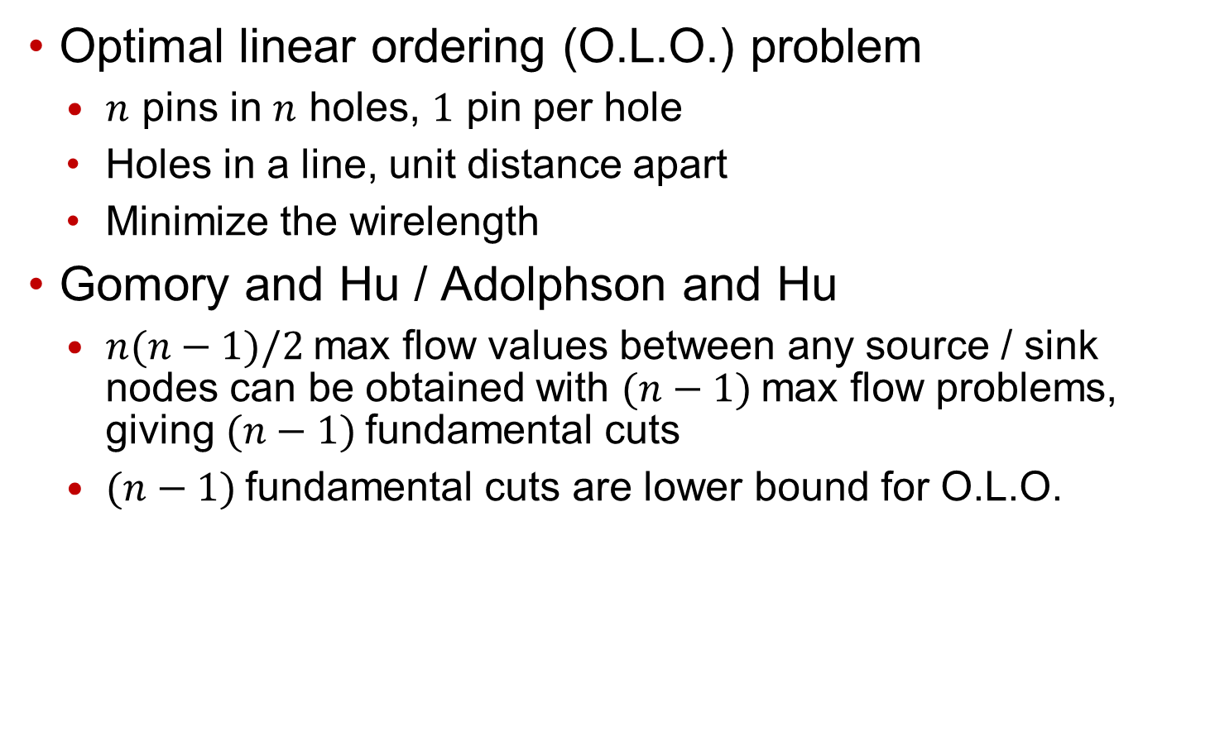
Linear Placement
Optimal linear ordering (O.L.O.) problem
  $n$ pins in $n$ holes, $1$ pin per hole
  Holes in a line, unit distance apart
  Minimize the wirelength
Gomory and Hu / Adolphson and Hu
  $n(n−1)/2$max flow values between any source / sink nodes can be obtained with $(n−1)$max flow problems, giving $(n−1)$fundamental cuts
  $(n−1)$fundamental cuts are lower bound for O.L.O.
The min-cut defines an ordered partition that is consistent with an optimal vertex order in the linear placement problem.
Notes:
Placement is a fundamental problem in many applications. The module placement problem is one of the classical problems of VLSI layout. A special case of the problem is the optimal linear ordering (O. L. O.) problem, where n pins should be placed in n holes. All holes are in a line, and are unit distance apart. The problem can be described using a graph. Each node represents a pin, and each edge represent a wire. Each edge can be associated with a capacity representing the number of connections between its two nodes.
Gomory and Hu show that n(n − 1)/2 max flow values between any two source, sink nodes can be obtained with only n−1 max flow problems, giving n−1 “fundamental cuts”.
Adolphson and Hu [1] show that the sum of the values of the n − 1 fundamental cuts is a lower bound on the total wirelength of the O.L.O. problem. The key theorem is shown here. In 1987, Professor Cheng showed that (n-1) cuts is the solution to the O.L.O. problem if the Gomory-Hu cut tree is a chain.
“Optimal Linear Ordering,” D. Adolphson and T.C. Hu, Mathematical Programming,
Vol. 4, No. 1, 1973, pp. 108 – 109.

Slide 11
Minimum Cuts in Placement
Recursive min-cut
  [Cheng87]: universal application to VLSI placement
  Capo: top-down, min-cut bisection
  Feng Shui: general purpose mixed-size placer
Duality between max flows and min cuts
  [Yang96]: flow-based balanced netlist bipartition
  MLPart: multilevel KL-FM/ flat KL-FM / flow-based partitioning
Notes:
This slide shows min-cuts in placement. Cheng87 present the universal application of the recursive min-cut approach to VLSI placement. In later years, min-cut has been often applied in conjunction with analytic methods. Capo uses a top-down, min-cut bisection algorithm. It seeks to decompose a given placement instance into smaller instances by subdividing the placement region, assigning modules to subregions and inducing corresponding netlist sub-hypergraphs. Feng Shui also use recursive min cuts and it is capable of general purpose mix-size placer.
Yang96 applies the duality between maximum flows and minimum cuts. They use maximum flow to find a balanced minimum cut in a netlist hypergraph. Their work models the circuit netlist by a flow network, and heuristically achieves a balanced bipartition using repeated max-flow min-cut computations. MLPart examines the time-quality tradeoff continuum from multilevel KL-FM partitioning, to flat KL-FM partitioning, to flow-based approaches, to implicit enumeration (branch-and-bound) within the top-down placement framework. Since the number of cell rows in a standardcell block is often smaller than the number of cells per row, the “one-dimensional” linear placement problem is of special interest even within top-down placement of a “two-dimensional” layout.

Slide 12
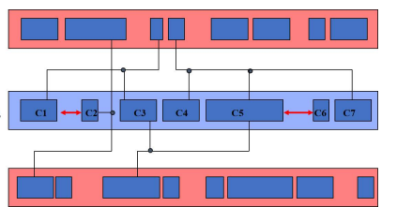
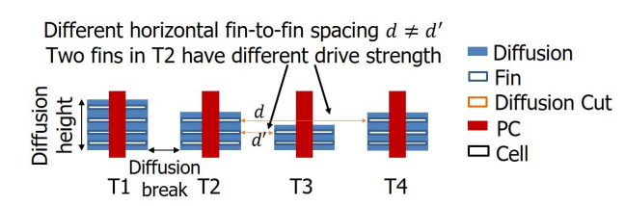
Linear Placements Today
Single-row placement
  Variable cell width
  Fixed row length with free sites
  Fixed cell ordering
Multi-row placement
  Local layout effect-aware
  Reorderable cells
  Support of multi-height cells
Notes:
Other academic children and grandchildren of Professor Hu – Paul Tucker, Igor Markov, and many others – have worked on linear placement.
Today there is a tremendous interest in linear placement-related problem formulations and results in the physical design literature. This is a consequence of increasingly intrusive manufacturing-induced placement constraints, such as minimum implant area, avoidance of OD notches, etc..
The work of Paul Tucker in 1999 proposed a single-row placement formulation that differs from classical linear placement in three ways: first, cells have variable width; second, each row has fixed length with free sites; and third, cell ordering is fixed. The objective is to legalize all cells while minimizing the wirelength. The blue rows in the right figure shows an example row placement, with intra-row and inter-row nets. In the figure, C1, . . . ,Cn gives the fixed left-to-right order of cells. For each legal position of each cell, a minimum-cost constrained prefix placement can be obtained. A ‘clumping’ technique exploit the convexity of the wirelength objective.
Lately, linear placement goes beyond ordered single-row placement, to multi-row detailed placement considering layout-dependent effects. For example, this figure shows that the diffusion height difference between neighboring transistors cause performance variation. This led to recent work on double-row dynamic programming-based approach, supporting cell reordering, and double-height cells.

Slide 13
A Few Examples
Tentative Assignment / Competitive Pricing
Optimal Linear Ordering
Hyperedge Net Model
The Prim-Dijkstra Tradeoff
The Discrete Plateau Problem and Finding a Wide Path

Slide 14
Net Modeling
“Multiterminal Flows in a Hypergraph”, Hu and Moerder, 1985
Challenging question:
  How should a hyperedge of a hypergraph be modeled by graph edges in a graph model of the hypergraph?
  Applications for analytic placement, for exploiting sparse-matrix codes for layouts
New hyperedge net model - p pin nodes and one star node to represent a p-pin hyperedge
Notes:
[CLICK] This paper from Hu and Moerder addresses a challenging VLSI layout problem
[CLICK] How should a hyperedge …. ?
[CLICK] The answer to this has applications for analytic placement and for exploiting sparse matrix codes for layouts
[CLICK] A new hyperedge net model is proposed. It consists of p pin nodes and one star node to represent a p-pin hyperedge

Slide 15
Example Transformation
Transform netlist hypergraph
  Add one star node for each signal net
  Connect star node to each pin node (via a graph edge)
  Sparse, symmetric + exactly captures true cut cost
Star model: [Brenner01], BonnPlace [Brenner08]
Example circuit with 5 modules
and 3 nets
Equivalent hypergraph model
Notes:
[CLICK] A given netlist hypergraph is transformed into an equivalent hypergraph model by
[CLICK] adding one star node for each signal net
[CLICK] And then, connecting the star node to each of the net’s pin nodes
[CLICK] Here’s an example of a circuit with 5 modules and 3 nets
[CLICK] The equivalent hypergraph looks like this
Theorem: exactly captures true cut cost
Star model used since this work – for example, famously used in BonnPlace

Slide 16
A Few Examples
Tentative Assignment / Competitive Pricing
Optimal Linear Ordering
Hyperedge Net Model
The Prim-Dijkstra Tradeoff
The Discrete Plateau Problem and Finding a Wide Path
Notes:
As you heard yesterday, it is 25 years since Professor Hu’s Prim-Dijkstra Tradeoff paper appeared.

Slide 17
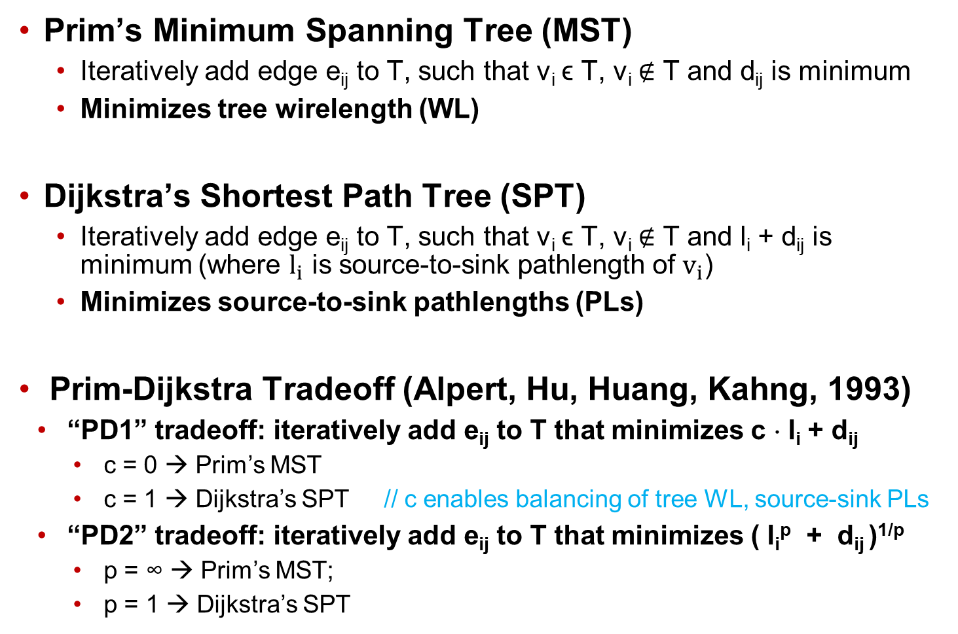
The Prim-Dijkstra Tradeoff
Prim’s Minimum Spanning Tree (MST)
  Iteratively add edge e_{ij} to T, such that v_{i} ϵ T, v_{i} ∉ T and d_{ij} is minimum
  Minimizes tree wirelength (WL)
Dijkstra’s Shortest Path Tree (SPT)
  Iteratively add edge e_{ij} to T, such that v_{i} ϵ T, v_{i} ∉ T and l_{i} + d_{ij} is minimum (where $l_{i}$ is source-to-sink pathlength of $v_{i}$)
  Minimizes source-to-sink pathlengths (PLs)
Prim-Dijkstra Tradeoff (Alpert, Hu, Huang, Kahng, 1993)
“PD1” tradeoff: iteratively add e_{ij} to T that minimizes c ⋅ l_{i} + d_{ij}
  c = 0 → Prim’s MST
  c = 1 → Dijkstra’s SPT // c enables balancing of tree WL, source-sink PLs
“PD2” tradeoff: iteratively add e_{ij} to T that minimizes ( l_{i}^{p} + d_{ij} )^{1/p}
  p = ∞ → Prim’s MST;
  p = 1 → Dijkstra’s SPT
Notes:
Prim’s algorithm constructs a MST by adding an edge e_ij to the growing tree such that the edge cost is minimum. This minimizes the tree WL.
Dijkstra’s algorithm adds edges to the growing tree to minimize the sum of edge cost and source-to-sink pathlength. This results in shortest-path tree.
If we notice the labels, we see that they are quite similar. This is 0 times li and this 1 times li.
This was leveraged to create the Prim-Dijkstra algorithm. This algorithm adds an edge by minimizing the weighted combination of edge cost and source-to-sink pathlength.
alpha = 0 gives Prim’s MST, and alpha = 1 gives Dijkstra’s SPT
alpha enables trading off WL and PL
Alternative: Lp norm sum which was called “PD2” in the original paper.

Slide 18
Prim-Dijkstra Construction
Prim’s Minimum Spanning Tree (MST)
Minimizes wirelength
But large pathlengths to nodes 3,4,5
5
4
Prim-Dijkstra (PD) tradeoff
0
5
3
4
1
2
Dijkstra’s Shortest Path Tree (SPT)
Minimizes source-sink pathlengths
0
3
But large tree
wirelength!
5
1
2
4
Directly trades off the
Prim, Dijkstra constructions
0
3
1
2
Notes:
Here’s an example. Prim’s MST gives a tree with minimum WL, but results in large PLs to some sinks
Whereas Dijkstra’s SPT minimizes source-to-sink pathlengths, but gives a large tree WL
The Prim and Dijkstra objectives are blended together to tradeoff between WL and PL, as seen in this example.
Tunable parameter alpha enables easy tradeoff.

Slide 19
PD Tradeoff: 25 Years of Impact
Widely used
  In EDA for timing estimation, buffer tree construction and global routing
  In flood control, biomedical, military, wireless sensor networks, etc.
Simple and fast – O(n log n)
Alpert et al., DAC06: PD is practically ‘free’
Yesterday: “PD Revisited”
  Iterative repair of spanning tree
  Detour-aware Steinerization
  Better WL, PL tradeoff
Notes:
The PD algorithm has been widely used in EDA and other domains, as is evident from the numerous paper- and patent-citations.
In EDA, this has been used for timing estimation
argue that the PD WL is sufficiently close to minimal
concludes that PD obtains the best tradeoff between WL and PL compared to other spanning tree constructions such as BRBC [23], KRY [52]

Slide 20
A Few Examples
Tentative Assignment / Competitive Pricing
Optimal Linear Ordering
Hyperedge Net Model
The Prim-Dijkstra Tradeoff
The Discrete Plateau Problem and Finding a Wide Path

Slide 21
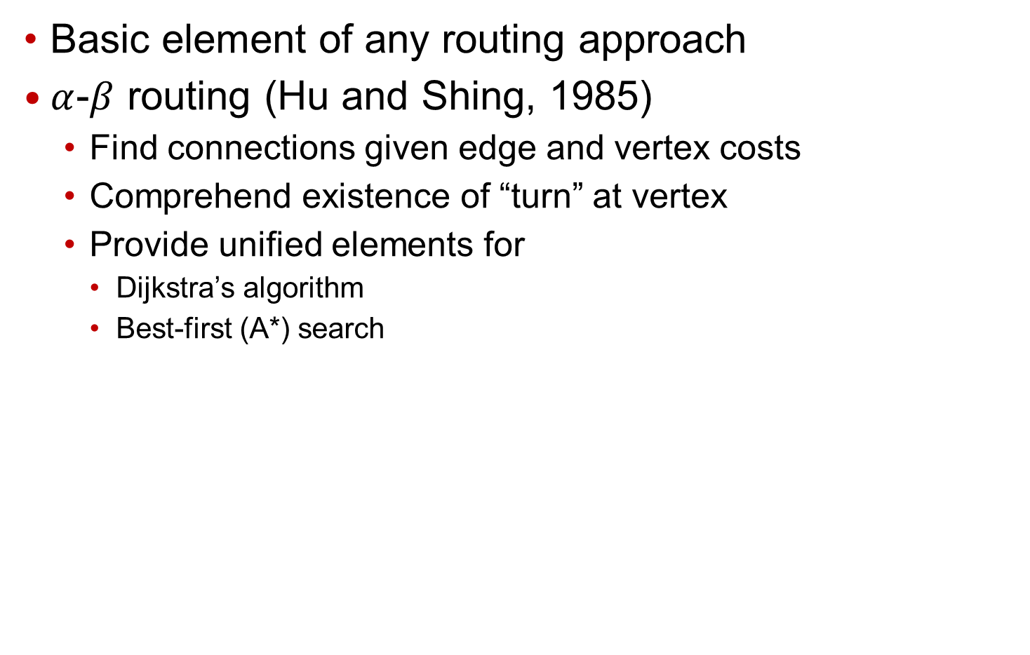
Connection Finding
Basic element of any routing approach
$α$-$β$ routing (Hu and Shing, 1985)
  Find connections given edge and vertex costs
  Comprehend existence of “turn” at vertex
  Provide unified elements for
    Dijkstra’s algorithm
    Best-first (A*) search
Notes:
Connection-finding is a fundamental element of any routing approach.
[Click] In Prof. Hu’s alpha-beta routing work, they develop algorithm to find connections given edge and vertex costs. [Click] It also solves a “history-dependence” problem which was left unaddressed in previous works. Basically their algorithm comprehend the cost of having a “turn” at vertex. [Click] Moreover, alpha-beta routing provides unified elements for Dijkstra’s algorithm and best-first search (A* search).

Slide 22
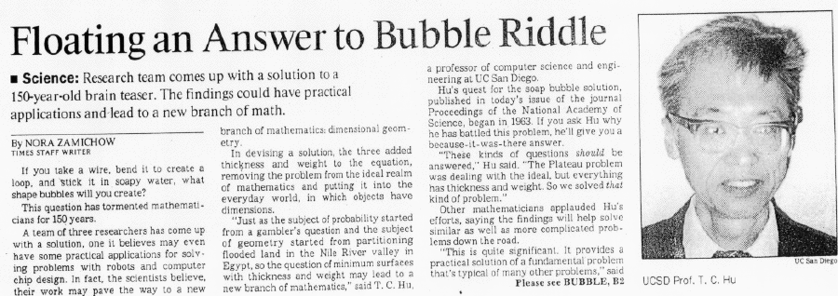
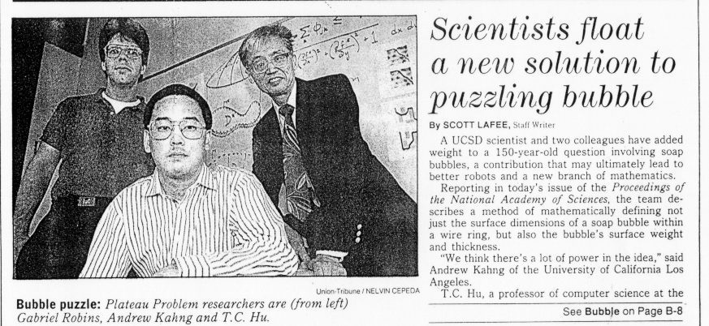
Proc. Nat. Acad. Sci., October 1992
Discrete version of Plateau’s minimum-surface problem
Solved using duality of cuts and flow
Notes:
Here is Professor Hu in 1992.
This is an idea he had since 1963 – that is, a discrete version of the 150 year-old minimum surface problem could be solved using the duality of cuts and flows.
Here is me in a picture with Professor Hu and Gabriel Robins – three academic generations – back when I had long hair.

Slide 23
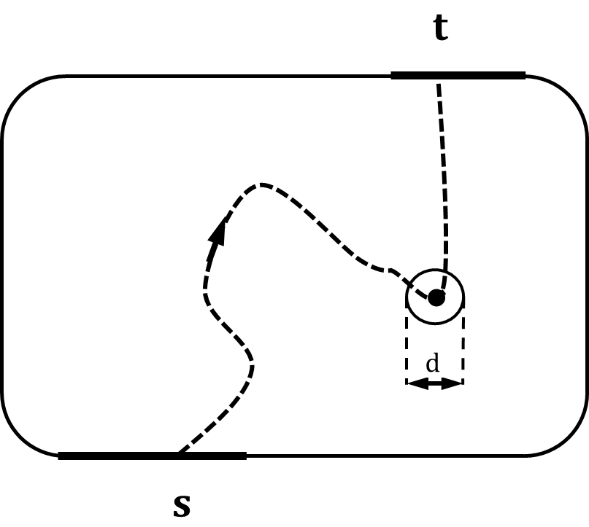
Towards Robust (Wide) Path Finding
Robust path finding problem
  Source-destination routing with prescribed width
  Seek minimum-cost path that has robustness (width) = d
  E.g., a mobile agent with finite width
Notes:
In 1993, similarly the question was asked: if a robot or a Mars rover has non-zero width, how do you a minimum-cost WIDE path in a general environment?
That is, we want a minimum-cost, source-destination path with prescribed width. The width is shown as “d” in the figure below, which indicates the diameter of the robot.

Slide 24
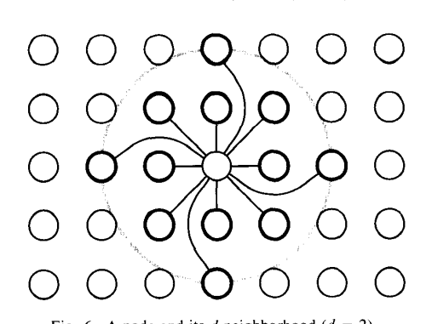
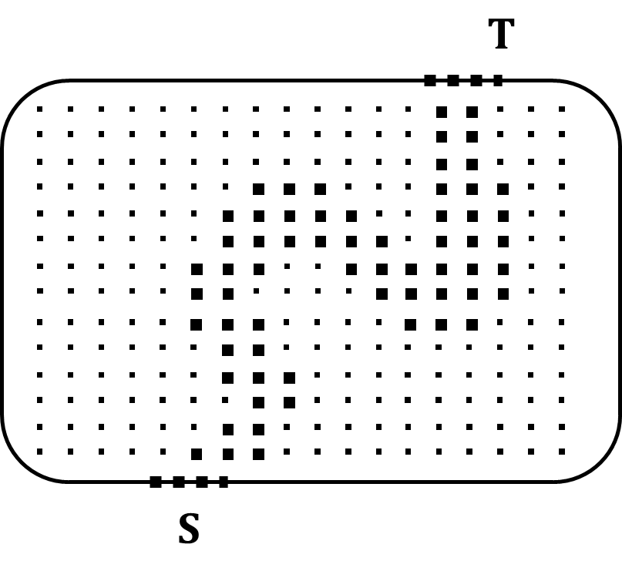
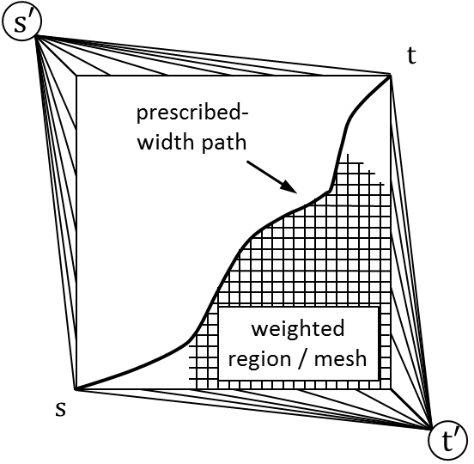
Network Flow Approach
Discretize routing environment
A minimum cut in flow network
  Contain all vertices and edges on a robust path
  Correspond to a maximum flow by duality
  Return a robust path
Notes:
Prof. Hu et al. exploit the duality between cuts and flows to find a minimum-cost robust path between given source and terminal nodes s and t.
By connecting every vertex to every other vertex within distance D, it is impossible to separate the left from the right by removing nodes and edges of a path with width less than D.
A path having enough width WILL disconnect the network.
[Click] SO… A minimum cut between s and t contains all vertices and edges on a robust path. By the duality between cuts and flows, we can find this path with a max-flow computation.

Slide 25
Applications Today
Relevant to many difficult problems
  Bus routing, bus feedthrough determination, etc.
IC package routing
  Per-net PI/SI requirement
  Need traces of various width
  Wide path finding (with multiple commodities) can be useful
Notes:
Today, wide paths are relevant to many difficult and time-consuming connection formulations. Such formulations include top-level bus routing, bus feedthrough determination, etc.
[Click] Here is a picture showing package routing, which could be attacked using multicommodity flows for WIDW path finding.

Slide 26
Conclusion
Notes:
In conclusion …

Slide 27
Professor Hu’s 96 Ph.D. Descendants
G. Thomas
A. Smith
W. T. Torres
A. Zaki
G. Robins
M. Alexander
D.R. van Baronaigien
L. Hagen
T. Zhang
K-C. Tan
Y. Koda
L. Bolotnyy
A. M. Eren
K.D. Boese
C. Taylor
G. Xu
G. Pruesse
C.J. Alpert
V. Maffei
P. Evans
S. Muddu
K. Chawla
D. Adolphson
K. Wong
C-W.A. Tsao
R. Layer
S. Adya
J. Sawada
D.J. Huang
N. Brunelle
A Ramani
B. N. Tien
S. Chow
K. Masuko
G. Viamontes
M. Weston
I. Markov
K-H. Chang
A. Williams
B. Liu
S. Krishnaswamy
F. Ruskey
B. Bultena
S. Mantik
R. Cochran
S. Plaza
T. C. Hu
A. Erickson
Y. Chen
N. Abdullah
J. Roy
A. Mamakani
S. Reda
K. Nepal
D. Papa
M.-T. Shing
V. Irvine
Q. Wang
K. Dev
D. Lee
X. Xu
X. Zhan
M. Kim
J. Chen
P. Gupta
J. Hu
Y. S. Kuo
M.R. Kindl
P. Sharma
S. Hashemi
H. J. Garcia
M.M. Cordeiro
S. Muddu
R. Azimi
S-J. Su
C. H. Park
J. Lee
K. E. Moerder
Y-H. Hsu
R. O. Topaloglu
L. Cheng
C-C. Jung
K. Samadi
R. Ghaida
K. Jeong
A. A. Kagalwalla
A. B. Kahng
S. Kang
T. Chan
L. Lai
S. Nath
M. Gottscho
P. A. Tucker
J. Li
S. Wang
W. Chan
Y. Badr
Notes:
Let me say that today, Professor Hu has 96 Ph.D. descendants in 4 generations. There are many familiar names here.
I would not be here without Professor Hu’s having been my advisor, and cannot find words to thank him for this.

Slide 28
Thank you, Professor Hu.
Notes:
Thank you, Professor Hu.

