Slide 1
Machine Learning Applications in Physical Design: Recent Results and Directions
Andrew B. Kahng
CSE and ECE Departments
UC San Diego
http://vlsicad.ucsd.edu
Notes:
[START YOUR STOPWATCH !!!]
Thank you for the kind introduction and the invitation to give this talk.

Slide 2
Agenda
Crises…
Notes:
So, I will start with the crises that we’ve been living through for the past decade or more.

Slide 3
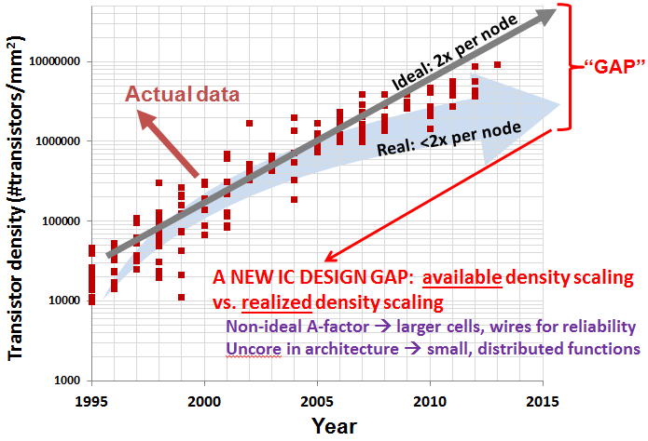
IC Industry Crises: Cost, Quality of Design
Can’t afford to design chips (tools, people, time, risk)
Return on investment for new technology is poor
  $$M to move to new node (28nm → 14nm →10nm → 7nm → …)
  Benefit from new node: ~20% power, speed, area (less, today)
Design Capability Gap
  Available density grows at 2x/node
  Realizable density grows at 1.6x/node
  UCSD / 2013 ITRS
Notes:
For the SEMICONDUCTOR INDUSTRY, the CRISIS is that design simply COSTS TOO MUCH.
Cost means engineers, schedule, risk. Even at 28nm, a new node brought only 20% power, performance, area. Today, going from 10nm to 7nm, or 7 to 5, the benefit is significantly less – and customers get only one, maybe two, of these wins.
What we realized some years ago, and put into the ITRS roadmap, is that with every new technology node, yes, you COULD print twice as many transistors in a square millimeter as you before – this is AVAILABLE DENSITY … BUT, you CANNOT fit twice as many USEFUL transistors into a given area, going from node to node. That is REALIZABLE DENSITY. This gap is a DESIGN CAPABILITY GAP.
THIS IS PART OF THE “NOT KEEPING UP” THAT ANDREAS MENTIONS.

Slide 4
IC Design Crises: Unpredictability, Schedule
Many steps in long “design flow” → can we predict outcome?
Many chicken-egg loops → convergence point? how to initialize?
Nearly all problems are NP-hard
  Min-cut hypergraph bisection, Quadratic assignment, Multicommodity flow, Max-weight independent set, Multi-vehicle TSP, k-colorability, …
Huge “n”→ metaheuristics piled on metaheuristics
Suboptimality is expensive
  10% of {power, speed, area} is half of benefit from new node
Iteration is expensive
  Moore’s Law: 1 week = 1 percent
Conservatism (“margin”) is expensive
  But: “oops” (didn’t fit, didn’t route, too slow) is unacceptable
Notes:
The DESIGN CRISIS itself – why DESIGN is so risky – is a crisis of Unpredictability and Time (or SCHEDULE).
There are MANY steps in the tool flow. We can’t see the failure that’s just around the corner.
There are MANY chicken-egg loops – How do we predict where they will converge?
All of our optimization problems are hard, with huge “N”.
At the same time: just 10% suboptimality is more than half the benefit of a new technology.
Loops are death – because Moore’s Law says that 1 week is 1 percent.
If you don’t want unexpected failure, you want to put margins into your design strategy – but then you’re stuck: OOPS it didn’t fit kills your schedule, OOPS my chip is big or slow or power-hungry kills your company.
(good news – I don’t have to convince you … Andreas just did.)

Slide 5
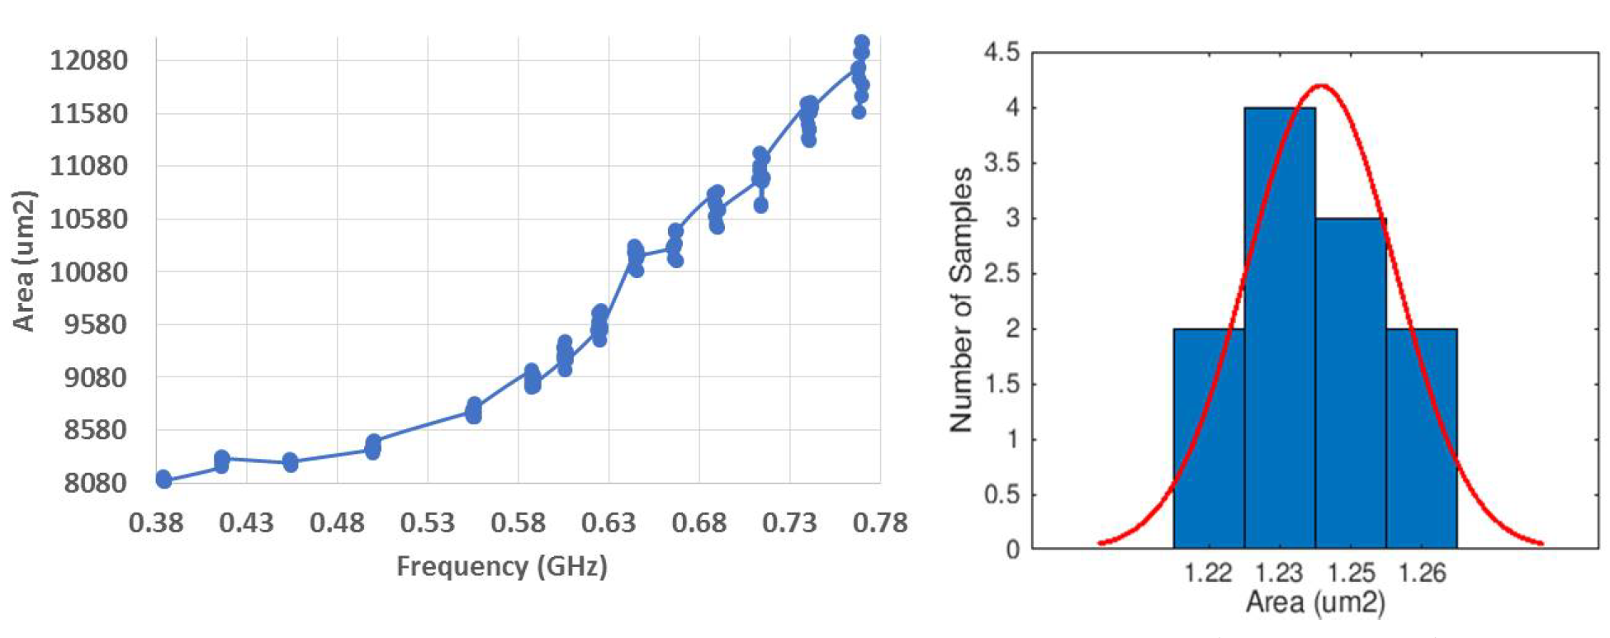
Unpredictability of Design
Intractable optimizations → heuristics piled on heuristics
“Noise” or “Chaos” when EDA tools “try hard”
Unpredictability → added margin and schedule
  14nm PULPino: Δarea = 6% from Δfreq = 10MHz !
Challenges: Schedule, Quality, Cost
Notes:
Here is WHY design is so unpredictable.
One basic reason is that with so many heuristics, tools become unpredictable when they “try hard”.
The LEFT figure shows that post-P&R area can change by 6% when target frequency changes by epsilon near maximum frequency. And the statistics are Gaussian.
If design is unpredictable, then we have a SCHEDULE problem. Or, if we MUST finish on schedule, then we MUST put GUARDBANDS around the design target. And then we have a QUALITY AND COST problem.

Slide 6
“The Last Semiconductor Scaling Levers”
Quality
  Improved design tools and methods
  Reduced margins
Schedule
  1 week = 1%
Cost
  IC design is expensive (engineers, tools, spins, …)
Notes:
Here are what I call the new (and, final) levers for scaling. [Click] The first lever is QUALITY. Beyond device scaling, better design quality can be achieved with improved design tools and methods, and reduced guardbanding and margins. [Click] The second lever is SCHEDULE. Remember, 1 week is 1 percent. Can I find RTL issues such as global bus timing problems in one hour instead of two weeks? Can I prevent doomed runs from continuing or from ever being launched? [Click] The third lever is COST. We need to reduce cost of IC design infrastructure, and the cost and difficulty of the IC design process itself.
This is “design-based equivalent scaling” writ large. It is also consistent with what Andreas’ keynote just told us … [[Silicon Compilers 2.0, 24-hour TAT, no humans….

Slide 7
Agenda
Crises…
… and a Vision
Notes:
So let me balance crisis with a vision.

Slide 8
Unpredictability of Design
Intractable optimizations → heuristics piled on heuristics
“Noise” or “Chaos” when EDA tools “try hard”
Unpredictability → added margin and schedule
  14nm PULPino: Δarea = 6% from Δfreq = 10MHz !
Notes:
Let me show you this picture again.
If our heuristics and tools are CHAOTIC when we ask for BEST-QUALITY RESULTS, what does this mean?
→ If designers want predictable results, they have to aim low. AND THIS IS WHY WE ARE STUCK IN TODAY’S METHODOLOGY.

Slide 9
Today’s SOC Design
# Partitions ↓
Design Flexibility↑
Predictability↓
Margins↑
# Iterations↑
Achieved
Design Quality↓
Turnaround Time↑
Notes:
WHY did we evolve to today’s SOC Design METHODOLOGY? Here is my “theory”…
[Click] With unpredictable optimizers, designers want as close to flat as possible – just a few big blocks, if possible. So EDA tools keep piling on more heuristics to turn around those bigger and bigger blocks in a day. And then designers want to close the design quality gap – so they ask for as much flexibility as possible in design. A P&R tool today has thousands, perhaps more than ten thousand, commands and options.
[Click] This leads to poor predictability in design, [Click] which then leads more iterations and [Click] essentially turnaround time gets longer. [Click] Poor predictability also means more guardbands. [Click] The ACHIEVED design quality gets worse and the DESIGN CAPABILITY GAP gets larger.
To close the design capability gap, we need to flip these arrows.

Slide 10
Vision for Future SOC Design
Design Flexibility↓↓
# Partitions ↑↑
!
Predictability↑
Margins↑↓
!
# Iterations↓↓
Achieved
Design Quality↑
!
Single-pass
Turnaround Time↓↓
Mindsets
  Tools should not return unexpected results
  Achieve predictability from the user’s POV
  Use cloud/parallel to recover solution quality
  Focus on reducing design time, design effort
 Quality
 Schedule
 Cost
Machine Learning will be a key piece of this …
Notes:
What if we had many more small subproblems in the design methodology?
To INCREASE the number of partitions, we need new placement, global routing and optimization algorithms. New RTL partition and co-optimization would be needed.
[Click] What if we REDUCED design flexibility by giving freedoms FROM CHOICE of RTL, power distribution, clock distribution, global buffering, non-default wiring rules, etc.?
[Click] These would give us better predictability, [Click] which leads to fewer iterations and ideally single-pass design.
[Click] Then turnaround time is minimized. [Click] Another benefit of better predictability and fewer iterations is fewer guardbands. [Click] Improving the ACHIEVED design quality SHRINKS the design capability gap.
[click] *** THIS IS AN IMPORTANT SLIDE: **IF** we can achieve this, we will improve quality, schedule and cost. With our tools and flows, we should never get unexpected results. Designers should see predictable flows, not “chaos machines”. Cloud and parallel can help us. And the focus is all on time and effort.
*** For some years – and you can trace this back to the METRICS initiative and Stefanus Mantik’s Ph.D. thesis at UCLA – I have believed that ML (20 years ago we called in “data mining”) will be a key piece of this.

Slide 11
Agenda
Crises…
… and a Vision
Machine Learning in PD
Notes:
So my talk today is about Machine Learning in Physical Design.

Slide 12
Machine Learning in Physical Design
Problem types solved with Machine Learning
Classification
Regression
Dimensionality reduction
Structured prediction
Anomaly detection
Past ML applications in EDA literature
Yield modeling (anomaly detection, classification)
Lithography hotspot detection (classification)
Identification of datapath-regularity (classification)
Noise and process-variation modeling (regression)
Performance modeling for analog circuits (regression)
Design- and implementation-space exploration (regression)
ML in PD: modeling, prediction, correlation, …
Notes:
Machine Learning encompasses statistical analysis, clustering, classification, dimensionality reduction, regression, and other problem types and techniques.
Applications in EDA have focused on process and yield modeling, and analog circuit design – more at circuit or device analysis level, and less on chip synthesis or design space exploration levels.
There are many BASIC YET HIGH-VALUE opportunities here – modeling and prediction of tools, flows and designs – and improvement of analysis correlations.
And, these are NEAR-TERM opportunities ……. [FLIP]

Slide 13
Near-Term Opportunities
Modeling and Prediction
  Predict tool outcome = F(design, constraints, tool config)
    How to run tool “optimally” for given design and design goals?
    Avoid “failed runs” → reduce iterations in design flow
    Dream: one-pass design flow
Analysis Correlation
  Model analysis errors (crude vs. golden analyses)
    Reduced guardbands and pessimism → better design quality
Optimization (ML models = objective functions!)
  ML models = objective functions for higher-level optimization
  Better use of resources (tools, schedule, engineers) + better tools
  Project-level prediction, adaptive scheduling
Later: “Taxonomy and Roadmap”
Notes:
….. -- IN *AND* AROUND EDA and design methodology.
IN MY VIEW, FIRST, we need Modeling and Prediction: how to run a tool in the right way, what will the tool do if I press the button, should I even press the button on the router?, and so on.
SECOND, there is the use of ML to SHIFT the time vs. accuracy tradeoff in ANALYSIS or ESTIMATION – CAN MACHINE LEARNING basically predict analysis errors, so that we can improve accuracy while still saving time? This saves GUARDBAND!
THIRD, models become objectives for optimization and lead to better tools, or even better project management.
BEFORE I FINISH, I will try to sketch a taxonomy and roadmap for ML in physical design // 10:00 ?
(DARPA Moon Shot: schedule and effort reductions…)

Slide 14
Agenda
Crises…
… and a Vision
Machine Learning in PD
Modeling and Prediction
Notes:
What do I mean by tool and flow modeling and prediction? I have a few examples.

Slide 15


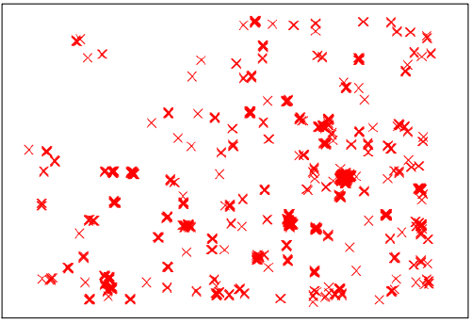
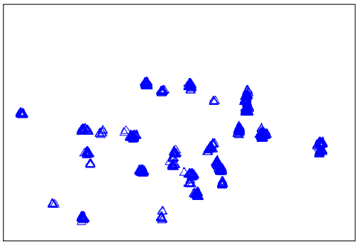
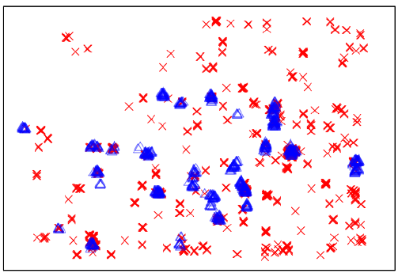
Example 1: Interface Between Global-Detailed Route
7nm P&R: global route (GR) congestion map does not correlate well with post-route (actual) DRC violations (DRVs)
Many false-positive overflows in GR congestion map
False positives do not correspond to actual DRVs
GR Overflows
Actual DRVs
GR-based prediction can mislead routability optimizations!!!
Notes:
My FIRST EXAMPLE of tool prediction focuses on the miscorrelation between global routing congestion and actual DRCs. Red crosses are at global routing, and blue triangles are actual post-route DRVs. So there are many false positives in the congestion map, which misleads routability optimizations. If you think about it: false positives cause unnecessary iterations back to placement, but false negatives cause doomed detailed routing jobs.
[SKIP: Even predicting the divergence between global route and detailed route is a VERY valuable OPEN PROBLEM for a P&R tool company.]

Slide 16
Too Many Expensive Iterations
Conventional closure
  Iteratively fix design before signoff
  Go back to placement or synthesis or FP if QOR is hopeless
  Costly iterations and TAT (7-day P&R runs…)
TECHNOLOGY
DESIGN RULES
CONSTRAINTS
RTL DESIGN
SYNTHESIS
ISPD17: ML-based DRV predictor
X
PLACEMENT
X
G/D ROUTING
X
Iteration with space padding,
NDR modifications, density screens ...
ANALYZE QOR (AREA, WIRELENGTH,
TIMING, #DRCs, YIELD)
Notes:
In a conventional closure methodology, the designer needs to close the design by fixing timing, DR violations, and maintain a reasonable cost. Violations in the design closure increase the uncertainty and delay the schedule. (click), causing these loops of density screen and NDR tweaking, etc.
My student’s work reported at ISPD last year aimed to prevent these loops using machine learning.

Slide 17
Insight From Layout Studies
Initial prediction from GR overflows and cell/pin density map
Red DRV-hotspot likely a False Negative due to low cell-pin density
Larger windows , buried nets (, NDRs, FFs, etc.) added to model inputs
Standard cells
Actual DRV
False-negative
Layout windows
Non-buried net
Sparse pins/cells
Dense pins/cells
Notes:
The ML prediction effort started with R&D expertise, and layout studies in sub-14nm design. (click) The central box is a DRC hotspot but an early SVM-based model predicts it to be a non-hotspot == A FALSE NEGATIVE !!! [CLICK] ACTUAL DRVs are in BLUE.
Basically, the prediction is misled by the sparse region below, even as high density on the right can cause DRCs. We use multiple sizes of windows to extract information to capture the neighbor behavior. Connections to distant pins may worsen DRCs, so we also have a “non-buried nets” parameter to comprehend this. NDRs, FFs, power mesh, and many other parameters were added.

Slide 18
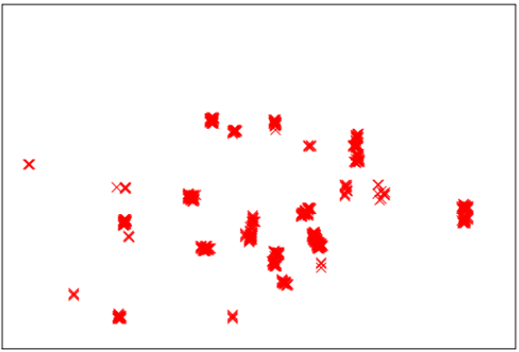

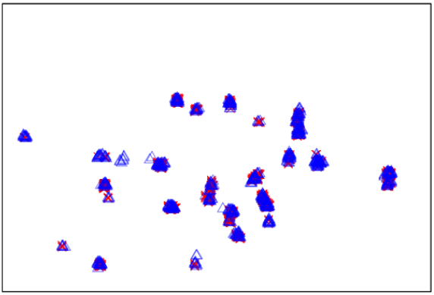
Improved Learning-Based Predictor
Captures all true-positive clusters
Maintains low false-positive rate
Learning-based Prediction
Actual DRVs
(a)
(b)
(c)
Notes:
This illustrates how our learning-based predictor can better capture all the true-positive clusters – top-ranked predictions match actual DRVs -- while maintaining a low false-positive rate.

Slide 19
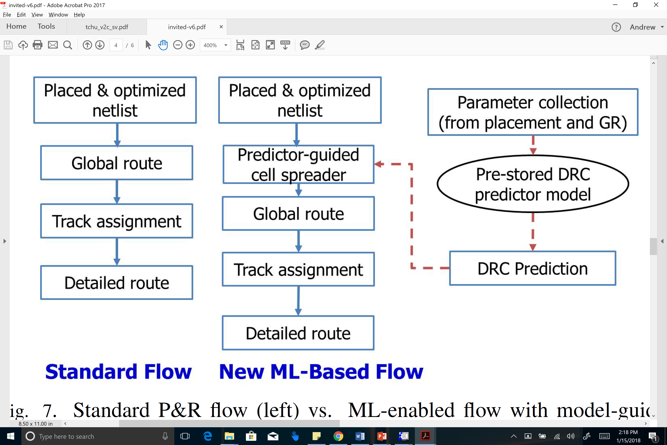
ISPD17: Model-Guided Routability Opt
New: True-Positive rate = 74%, False-Positive rate = 0.2%
Previous: True-Positive rate = 24%, False-Positive rate = 0.5%
Notes:
The paperwith Synopsys at the last ISPD showed how MACHINE LEARNING helps. This slide compares a STANDARD flow, with a new ML-BASED flow that uses the prediction of post-route DRCs to guide cell spreading before actual routing. The true-positive rate of DRC prediction became MUCH BETTER, while the false-positive rate became MUCH LESS.

Slide 20
Example 2: Local CTS Optimization Moves
Iterative local moves to minimize skew variation across corners
  Displacement {N, S, E, W, NE, NW, SE, SW} by 10μm x one-step sizing
  Displacement by 10μm x one-step sizing on child buffer
  Reassign to a new driver (i) at the same level, (ii) within bounding box of 50μm x 50μm
10μm
10μm
...
...
...
...
...
...
...
...
...
...
...
...
...
(1)
(2)
(3)
Each move is expensive (legalization, ECO routing, RC extraction, STA)
Each buffer has many candidate moves
DAC-15: learning-based model
Notes:
My SECOND EXAMPLE is for buffered clock tree improvement to reduce skew variation – it was joint work with Samsung.
In this POST-CTS optimization: (Click!) We use three types of local moves. (Click!) we could displace the target buffer in eight directions and size the buffer. (Click!) we could displace the target buffer and size its child buffer. (Click!) or we could re-assign the target buffer to a new driver.
(Click!) However, each move will need placement legalization, ECO routing, RC extract and timing analysis – about FIVE MINUTES IN THE P&R TOOL !!!. And each buffer can have around a HUNDRED candidate moves. It is impossible to try all the moves. Then which move is the best? (Click!) AGAIN, MACHINE LEARNING CAN HELP!
*** Note that we are actually predicting what a complex P&R tool and ECO step will do !

Slide 21
DAC15: CTS Outcome Prediction
Predict driver-to-fanout latency change due to local moves
Local move
Analytical models
Routing: FLUTE, STST
Cell delay: Liberty LUTs
Wire delay: Elmore, D2M
Delta delays
Each attempt is a local move
114 buffers
45 candidate moves for each buffer
Learning-based model identifies best moves for more buffers with less #attempts
Learning-based model
Delta delays
Notes:
We’ve used Machine Learning to predict driver-to-fanout latency change due to local moves.
(Click!) For each local move, (Click!) we first use analytical models to predict the delta delays. We use FLUTE and single trunk Steiner tree to estimate routing pattern change. We use Liberty LOOKUP TABLES to estimate cell delay change. We use Elmore delay and D2M model to estimate wire delay change. NO OFFENSE TO ANYONE, BUT THERE IS A WISDOM OF THE CROWD HERE … BUNCH OF INDIVIDUALLY BAD PREDICTORS COMBINE TO MAKE A GOOD PREDICTOR.
(Click!) We then feed the estimated delta delay values from analytical models to our machine-learning based model.
(Click!) This figure shows the accuracy comparison between analytical models and our learning-based model. There are 114 buffers and each buffer has 45 candidate moves. The X-axis is number of attempts on each buffer. Each attempt is a local move. Y-axis is the percentage of buffers identified to have the best move.
(Click!) The learning-based model, which is the blue trace, can identify best moves for more buffers with less number of attempts. For 90% of cases, I can identify THE BEST move with FIVE candidates. This met a threshold of usability in real design.
[[Parameter list:
Delays based on {FLUTE tree, single-trunk Steiner tree} × {Elmore delay, D2M}
Number of fanout cells
area and aspect ratio of the bounding box which contains driving pin and fanout cells]]

Slide 22
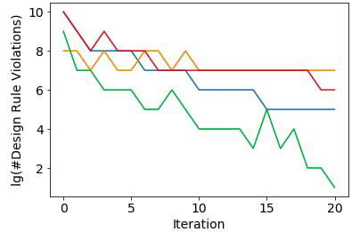
Example 3: Prediction of Doomed Runs?
Some P&R runs end up with too many post-route DRVs
Approach: track and project metrics as time series
Markov decision process (MDP): terminate “doomed runs” early
Shown: 4 example progressions of #DRVs (commercial router)
  Stopping red, yellow runs early would save resources and schedule !
Notes:
A third example: PREDICT WHETHER A TOOL RUN IS GOING TO FAIL.
The OBVIOUS application is the detailed router, which usually defaults to, say, 20 iterations and can take many days of runtime. (And this generalizes to doomed flows, doomed floorplans, and so on.)
Can we IDENTIFY which runs – which are like TIME SERIES - are DOOMED TO FAIL? IMPORTANTLY, Routing tools today have “auto-stop” options, but they do not work well ! (In other words, today’s tools cannot predict themselves very well!)
Here, the number of DR violations is on the Y-AXIS. The iteration count is on the X-AXIS. Can we LEARN to kill the red and orange runs early, but let the green run finish?

Slide 23
Markov Decision Process = “Strategy Card”
State space from Fibonacci binning
Actions – GO or STOP
Rewards at each state – e.g., small negative reward for non-stop state, large positive reward for stop with low #DRVs, etc.
Automatically trained MDP “strategy card”: Yellow = GO, Purple = STOP
Notes:
This is like playing BLACKJACK – after each router iteration, we can “HIT” with another iteration, or “STAY” my killing the router job.
Based on a simple state space of binned violation count, and the change in DRVs since a previous iteration, we can fit a POLICY in a Markov Decision Process model, based on past experience with the tool. This policy tells us whether to GO (YELLOW) or STAY (PURPLE) – just like a blackjack strategy card. A strategy automatically derived from 1400 logfiles of an industry tool looks like THIS before REFINEMENT. Some of these states may have never been seen, so the strategy doesn’t address them …
WE CAN SEE THAT THE STRATEGY IS 'reasonable’:
MDP suggests STOP when the number of violations at t=T is really large (right half of the card), and suggests GO when the number of violations are small.
MDP also suggests GO when the number of violations are moderately large (bins 3-5) but with a negative slope.
// However, if the slope is constant (purple island near (3,0)), MDP suggests STOP.

Slide 24
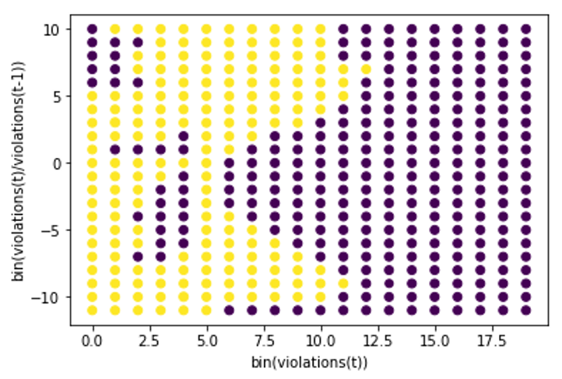
Strategy Card “Completion”
Notes:
We can programmatically fill up the missing parts :
-- large violations and positive slope should be stopped (PURPLE)
-- small violations and large positive slope should be stopped - AND SO ON.
-- very large #violations should be stopped
-- everything else should be “GO”

Slide 25
Promising Initial Studies
TYPE 1 Prediction Error: MDP STOPs a run that will eventually succeed
TYPE 2 Prediction Error: MDP predicts GO at each iteration, but run fails
Training data: 1200 logfiles from PROBE experiments
Testing data: 3442 logfiles from ARM Cortex M0 floorplan experiments
Substantial #iterations saved for doomed runs (398 / 3442 cases)
Latest P&R tools have increased #iterations → larger benefit in future ?
Errors | Training (Total = 1200) |  |  | Testing (Total = 3442)
N = 200 | Total Training Error | #TYPE 1 Errors (wrong STOP prediction) | #TYPE 2 Errors (no STOP) | Total Training Error | #TYPE 1 Errors (wrong STOP prediction) | #TYPE 2 Errors (no STOP)
1 STOP | 29.66% | 251 | 99 | 35.2% | 1317 | 3
2 consecutive STOPs | 10.5% | 27 | 99 | 8.3% | 307 | 3
3 consecutive STOPs | 8.5% | 3 | 99 | 4.2% | 154 | 3
Notes:
There are two types of prediction errors here. Type ONE is where the policy stops a run that actually would have succeeded (our definition of success is that you end up with no more than 200 DRVs). Type TWO is where the policy allows a run to go on but the run eventually fails.
We find that if the policy is oversensitive – it’s very quick to stop the run. But if we wait until it tells us to stop three times in a row, then the error rate is around 4% over our testing set, and a very large fraction (over three quarters) of tool iterations can be saved for these doomed runs.

Slide 26
Agenda
Crises…
… and a Vision
Machine Learning in PD
Modeling and Prediction
Analysis Correlation
Notes:
Let me turn to another class of ML targets: analysis correlation. [17:00]

Slide 27
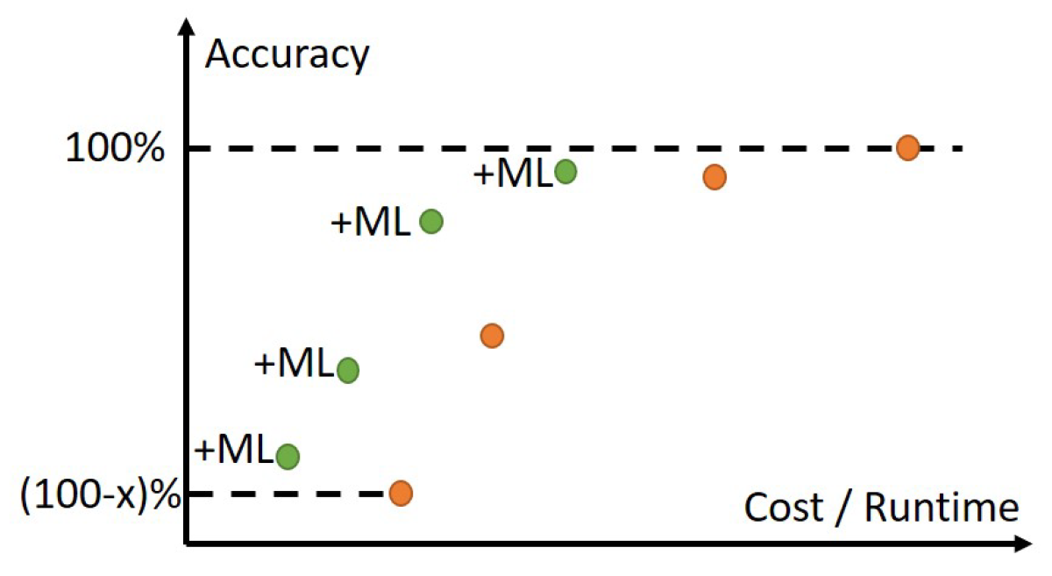
ML Shifts the Accuracy-Cost Tradeoff Curve!
Notes:
The ORANGE dots show the traditional COST (X-axis) versus ACCURACY (Y-axis) tradeoff curve, as we go from 3D field solvers at the top right to piecewise analytic models to first-order estimates, etc. Very smart design methodologists, DTCO folks, library teams, signoff teams, design engineers all figure out how to pick and choose from the orange points during IC design.
What we have been working on for a number of years is how to create Machine Learning-based GREEN tradeoff points: essentially, getting off the ORANGE curve and gaining accuracy for FREE.
The bigger the “x” is in the range of orange dots, the bigger the potential benefit …

Slide 28
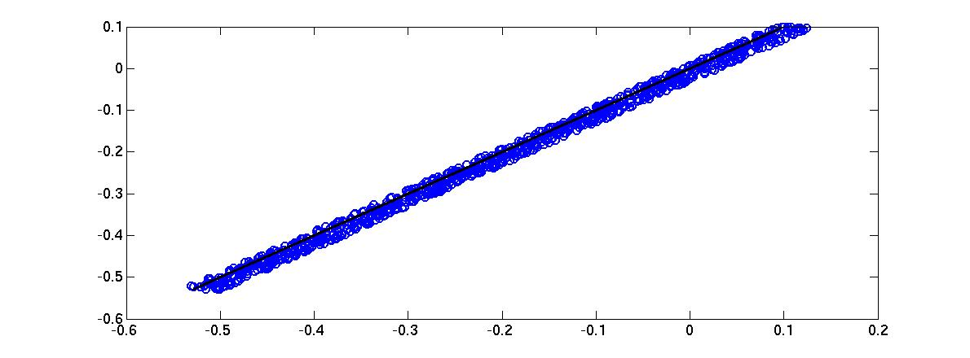



Example 4: ML-based Timer Correlation
Outliers
(data points)
INCREMENTAL
If
error > threshold
DATE-2014
(+ SLIP-2015)
New
Designs
Train
Validate
MODELS
(Path slack, setup time, stage, cell, wire delays)
Test
Artificial
Circuits
Real
Designs
ONE-TIME
BEFORE
AFTER
T₂ Path Slack (ns)
ML Modeling
31 ps
123 ps
~4$×$reduction
T₁ Path Slack (ns)
Notes:
MODEL TRAINING is on data from small artificial circuits, minimizing both mean-squared error and range of errors.
Validation is on artificial circuits and real designs; the blue dotted box is a one-time effort.
New designs can have circuit configurations that expose errors in current fitted models. So, with any slack error above a threshold, we use the outlier datapoints to refine our models. This “incremental modeling” flow is in the red-dotted box.
The end result – FOUR X reduction in timer miscorrelation – is shown in the bottom plots.
[[Parameter list:
(i) incremental delay in non-SI mode; (ii) transition time in non-SI mode; (iii) clock period; (iv) resistance; (v) coupling capacitance; (vi) ratio of coupling-to-total capacitance; (vii) toggle rate; (viii) number of aggressors; (ix) ratio of the stage in which the arc of the victim net appears to the total number of stages in the path; (x) logical effort of the net’s driver; and (xi), (xii) the differences in max (respectively, min) arrival times1 of the signal at the driver’s output pin for the victim and its strongest aggressor.2]]

Slide 29
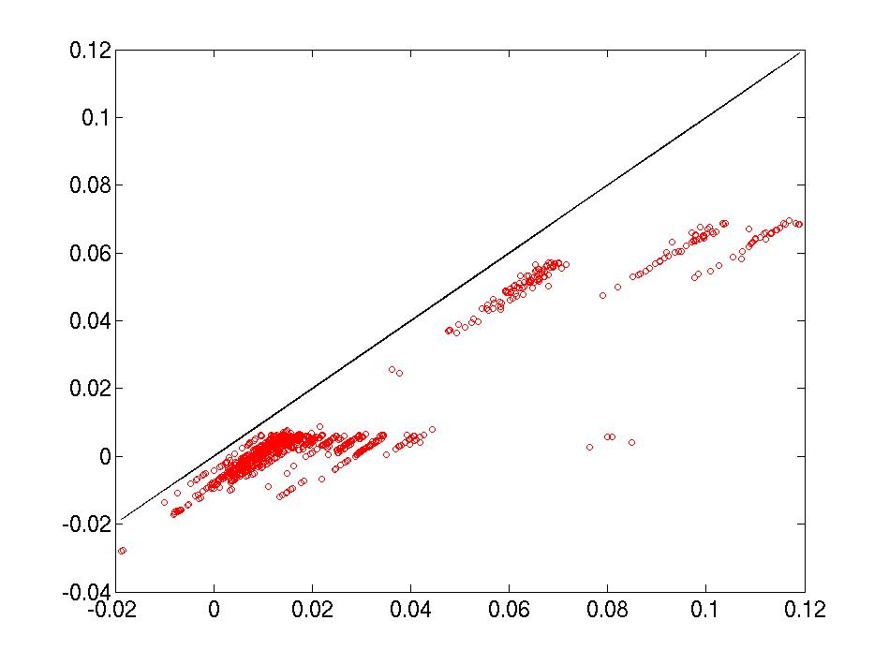
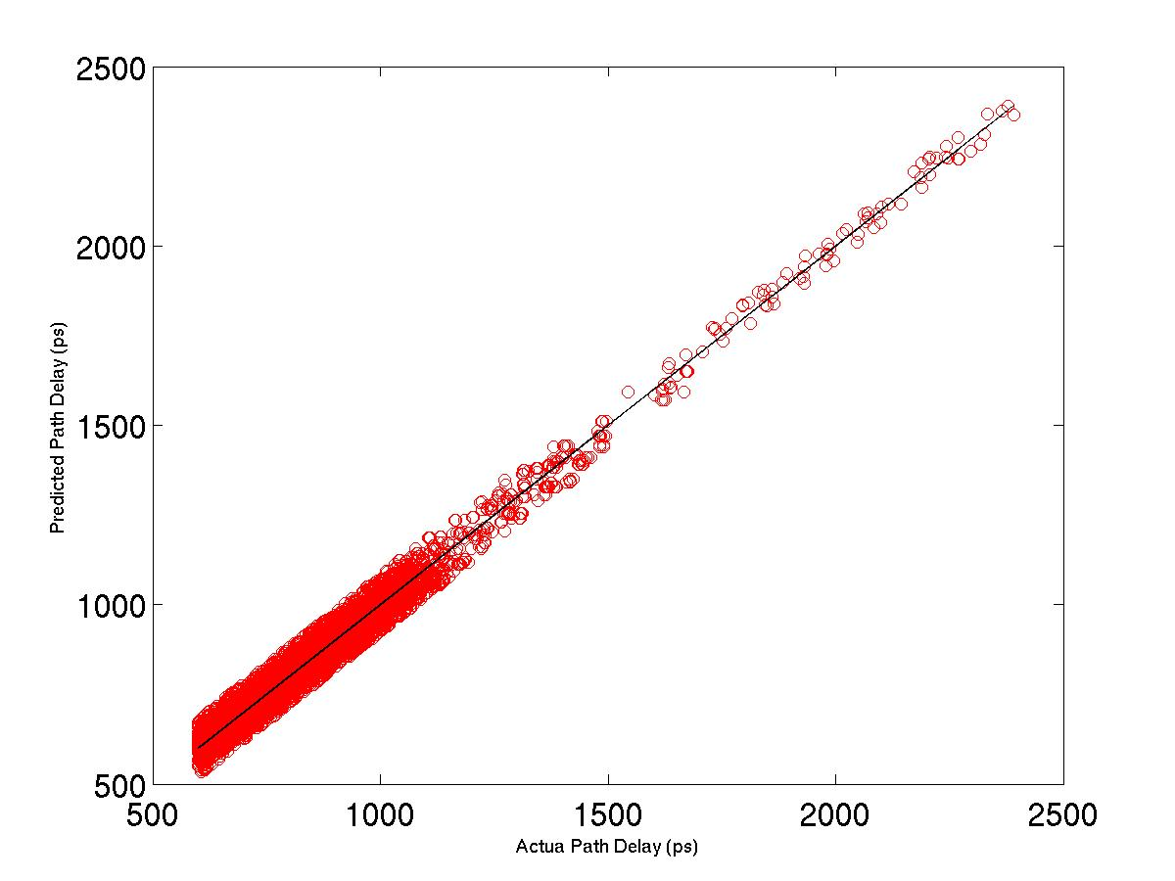
“SI for Free” with Machine Learning
Timing Reports in SI Mode
Timing Reports in Non-SI Mode
Machine learning of incremental transition time, delay due to SI
Accurate SI-aware path delays, slacks
Create Training, Validation and Testing Sets
ANN (2 Hidden Layers,
5-Fold Cross-Validation)
SVM (RBF Kernel, 5-Fold Cross-Validation)
HSM (Weighted Predictions from ANN and SVM)
Save Model and Exit
Non-SI Path Slack (ns) ($)
BEFORE
AFTER
Predicted Path Delay (ps)
81ps
Worst absolute error = 8.2ps
Average absolute error = 1.7ps
ML Modeling
8.2ps
SI Path Slack (ns)
($$$)
Actual Path Delay (ps)
Notes:
To achieve “SI for Free” in the SLIP-2015 work, students ran STA tools in both SI and non-SI modes, then divide their reports into training, validation, and testing sets. We apply artificial neural networks with 2 hidden layers and 5-fold cross-validation. We also use SVM with a radial basis function kernel and 5-fold cross-validation. Hybrid surrogate modeling finds the best weighted hybridization of the predictions from ANN and SVM. [UNIVERSAL TECHNIQUE]
Finally we save the model and exit.
The final model quality is quite good. [20:00]
The non-linear modeling techniques such as ANN are helpful in capturing complex interactions between parameters.
with worst-case absolute error of 8.2ps and average absolute error of 1.7ps.

Slide 30
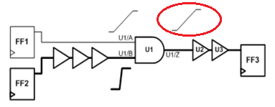
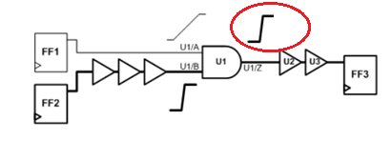
Example 5: Predicting PBA from GBA?
PBA (Path-Based Analysis) is less pessimistic than GBA (Graph-Based Analysis)
But, more expensive runtime !
Question: Can we predict PBA timing from GBA timing?
  → Better optimization in P&R&Opt, less expensive STA
GBA Mode
PBA Mode
Notes:
One next step mentioned in this afternoon’s paper is predicting expensive path-based analysis from cheaper graph-based analysis. As shown here, GBA propagates worst slews that might not apply to a given specific path. PBA eliminates this pessimism. This is the distribution of PBA slack – GBA slack for NETCARD in 28nm – the GBA pessimism can be more than a stage delay.
The question: CAN WE PREDICT PBA TIMING FROM GBA TIMING?

Slide 31
Costs of GBA vs. PBA Pessimism
GBA Actual Slack | PBA Actual Slack | Impact
POSITIVE | POSITIVE | Power recovery can’t exploit usable slack
NEGATIVE | POSITIVE | Schedule, Area, Power wasted fixing false timing violations
NEGATIVE | NEGATIVE | Schedule, Area, Power waste from over-fixing
PBA Actual Slack | PBA Predicted Slack (Model) | Impact
HIGH | LOW | Power recovery can’t exploit all of usable slack
LOW | HIGH | Masking of real violations
Notes:
This pessimism has harmful effects no matter how it occurs.
For example, if GBA says NEGATIVE slack when PBA slack is actually POSITIVE, [CLICK] we waste time and chip resource on fixing false timing violations.
[CLICK] Or we have waste from over-fixing.
[CLICK] And our PBA prediction must be accurate. If it is too low, we waste opportunity to recover power. If it is too high, we can mask real timing violations.

Slide 32
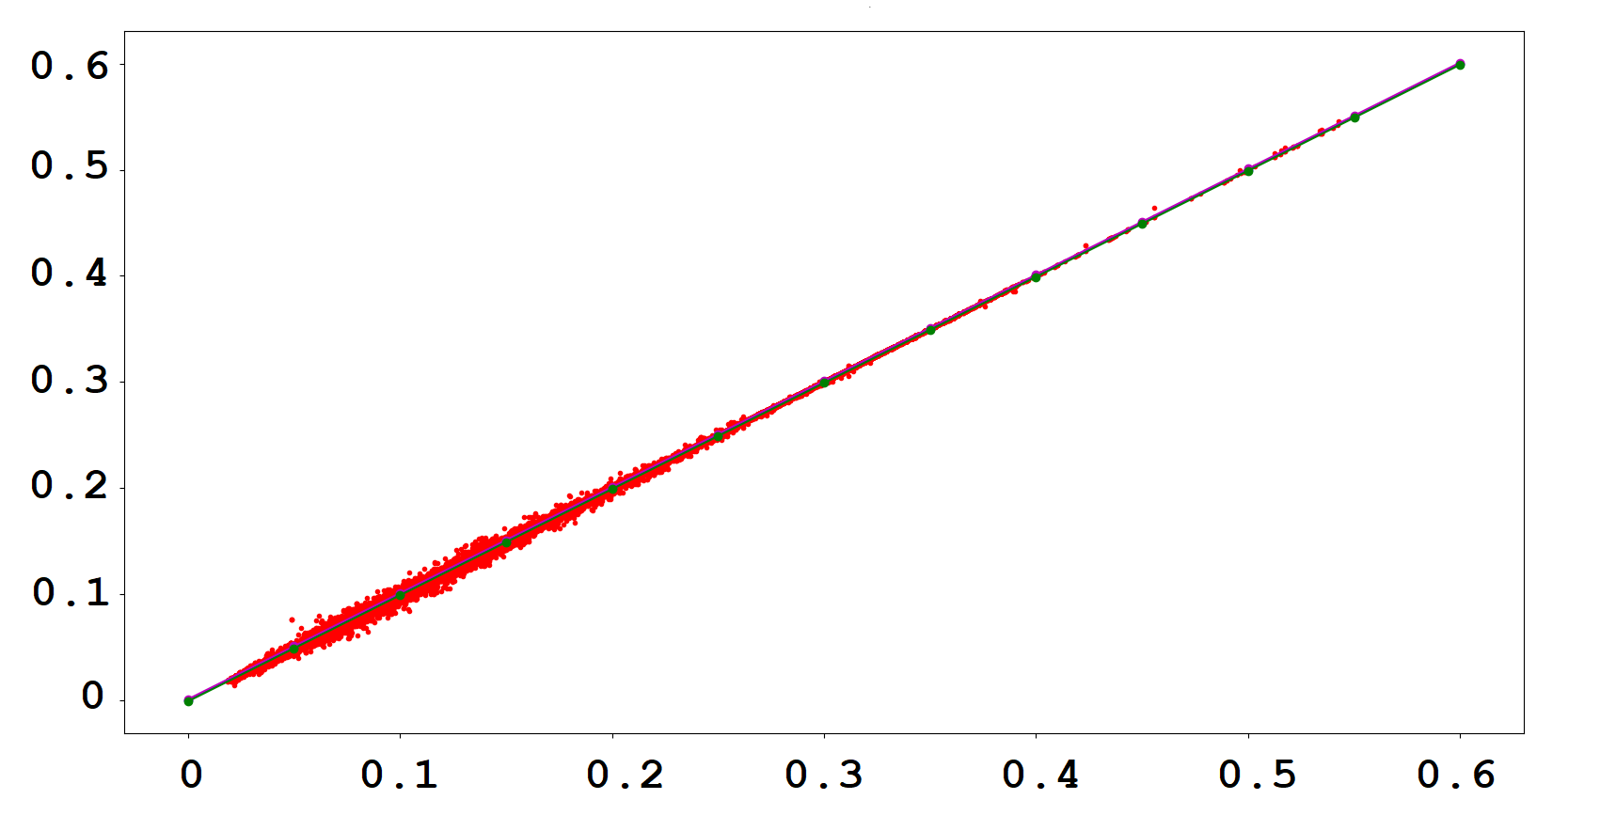
Promising Initial Studies
Early model with MARS (multiple adaptive regression splines): 90% of predicted PBA slacks within 5ps
Also: random forest classifier for 2-stage “bi-grams”
Testcase: netcard, 28nm FDSOI
BI-GRAM DELAY w/RANDOM FOREST CLASSIFIER
PREDICTED PBA DELAY (ns)
ACTUAL PBA DELAY (ns)
Bi-gram =2-stage unit in timing path
Notes:
This example shows that even a simple application of multiple adaptive regression splines can make good progress on this ML application. 90% of predicted PBA slacks are within 5ps of actual PBA slacks.
The image on right is delay value (Difference in arrival times) comparison of predicted PBA vs Actual PBA for each bigram unit. Random forest classifier (which is ensemble based classifier) predicts PBA arrival time for each bigram unit of a timing path. Line Y=X (in green) is the ideal expectation. Data points on either side of the line are mis predictions.

Slide 33
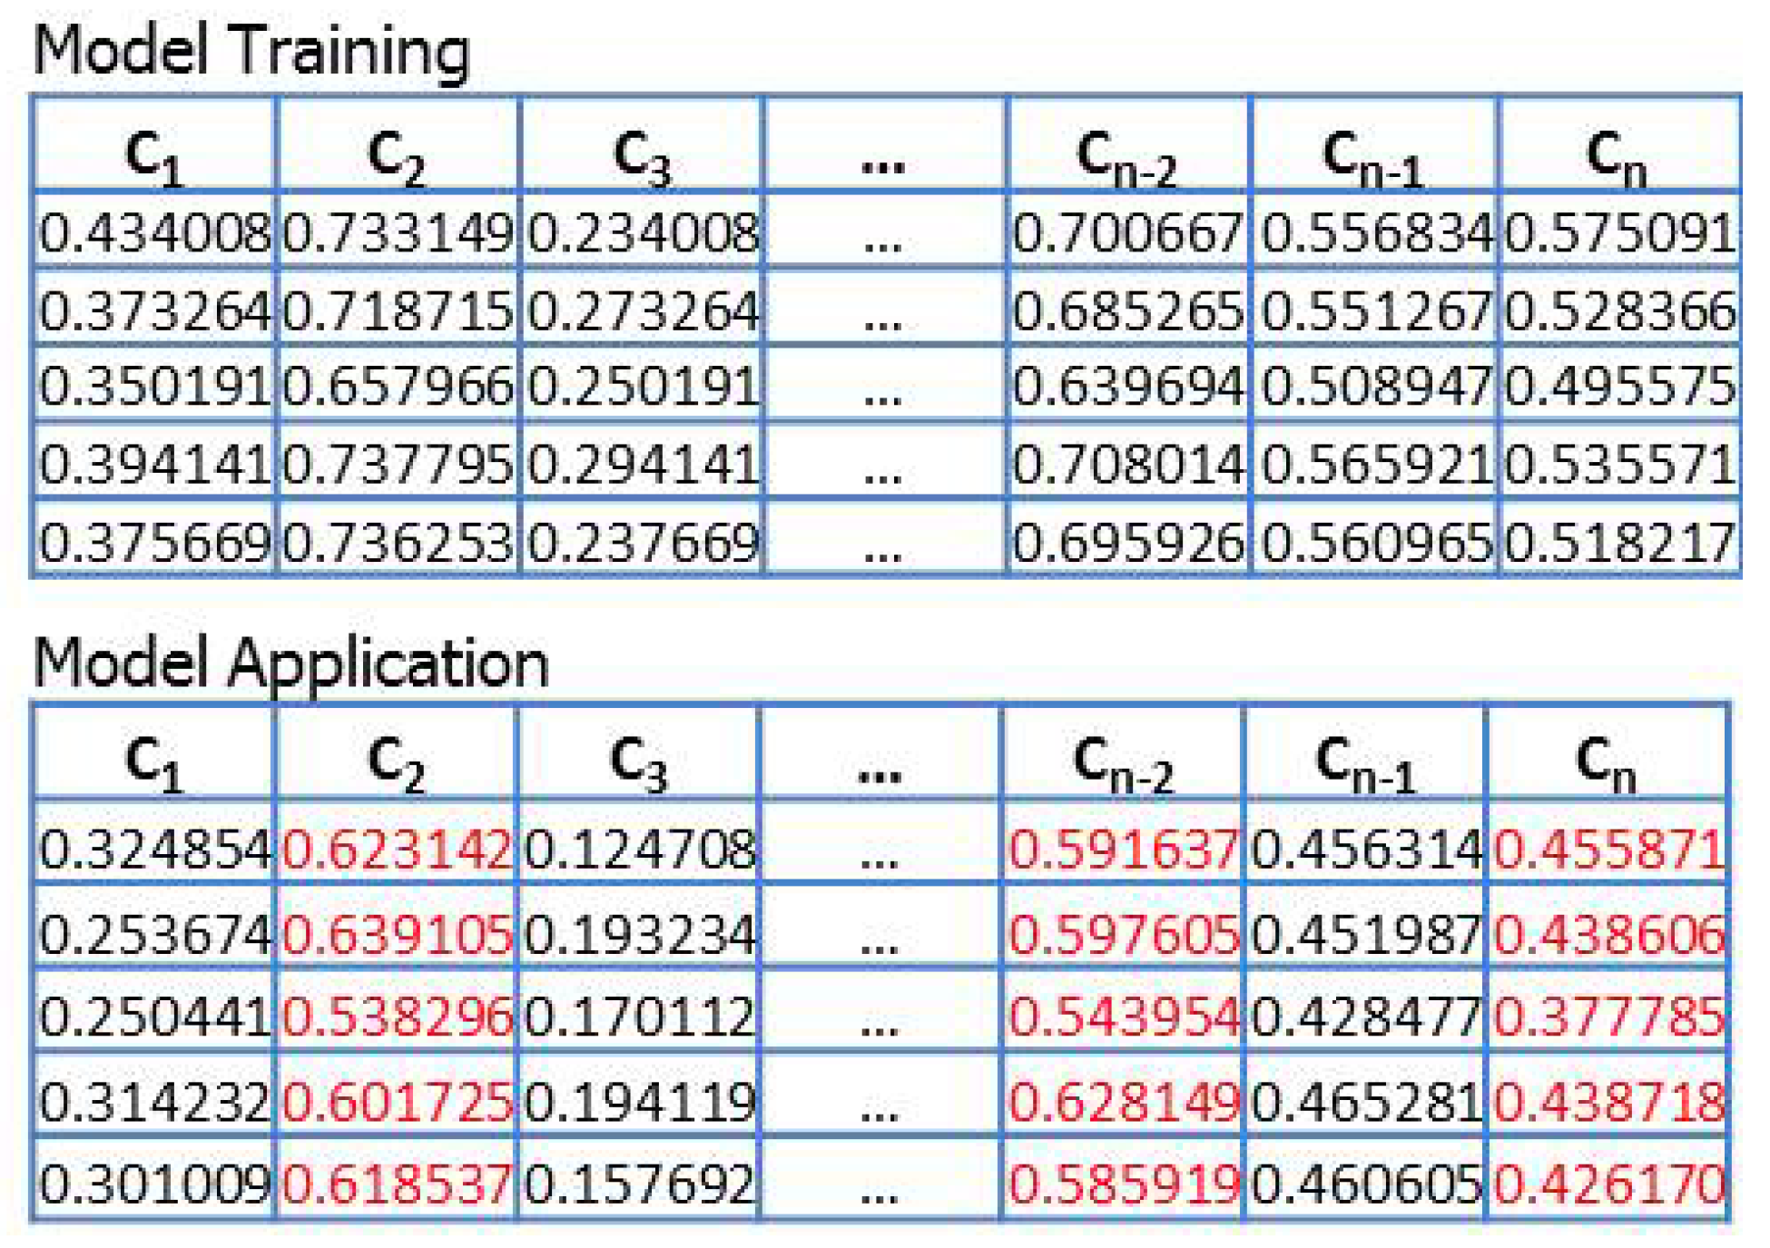
Example 6: Reduce Corners in STA, Opt !
Want benefits of STA at N corners, using just M << N corners
  “Missing Corner Prediction” (“matrix completion”) saves runtime, licenses
  Avoids optimistic timing that is caught at detailed signoff, causing iteration
Notes:
Here’s EXAMPLE NUMBER SIX : SAVING RUNS OF STA when the design must meet timing at hundreds of mode-corner combinations.
The goal is: Find M corners for timing analysis that allow prediction of timing – such as worst endpoint slacks – at the remaining N – M corners.
This cartoon shows how we would TRAIN a model using timing reports at all N corners. Then, we can APPLY the model to predict the RED values without running the timer (!). So, P&R and Optimization steps don’t have to be driven by only a few pessimistically chosen corners. We could say what models need to be available first in the design enablement. This is yet another application that my students are trying to make headway on… [23:00]

Slide 34
Agenda
Crises…
… and a Vision
Machine Learning in PD
Modeling and Prediction
Analysis Correlation
Optimization
Notes:
Remember: analysis models can become optimization objectives: building that stack of models is the only way that we will achieve all these dreams of system-level design space exploration….
SIMPLE EXAMPLE: PREDICTING PG MESH QUALITY OR BUMP INDUCTANCE BEFORE PACKAGE ROUTING → CAN DRIVE SOC FLOORPLAN OR BUMP/BALL MAP OPTIMIZATION.
I don’t have time to give any details ….
But, there is huge value in better USE of design resources – tools, people, servers – and potential improvement of the tools when they are optimizing the right things.
[[[At the level of design centers with hundreds of engineers and thousands of servers, there is even bigger value in PROJECT-LEVEL PREDICTION and MODEL-BASED ADAPTIVE SCHEDULING.]]]

Slide 35
Example 7: Design Cost Optimization
Predictive models == Optimization objectives
Enables schedule, resource optimizations up to enterprise level
Usage (Across Three Projects)
A2 (3)
A5 (1)
A3 (3)
Datacenter capacity
A2 (1)
A4 (3)
A5
(1)
Current servers
A4 (1)
A4 (2)
A4 (1)
A5
(2)
A4 (1)
A3 (1)
A3 (1)
A3 (2)
A4
(2)
A5 (2)
A3 (1)
A2 (1)
A3 (2)
A2 (2)
A3 (3)
A4
(3)
A4 (3)
A1 (2)
A1 (2)
A2 (2)
A1 (3)
A4 (2)
A3
(2)
A4 (2)
A4 (3)
A1 (1)
A1 (1)
A2 (1)
A2 (2)
A1 (3)
A4 (1)
A2 (3)
A2
(3)
A3 (3)
A5
(3)
A5
(3)
20 22 24 26 28 30 32 34 36 38 40 42
Work Weeks
TODAES 2017: Schedule Cost Minimization, Resource Cost Minimization ILPs
  “How do I pack 12 tapeouts into my design center during Q4?
Notes:
3 years ago we worked with Qualcomm’s Bangalore Design Center management to find “big data” and “optimization” opportunities. There’s 14 tapeouts before Christmas. You have only 2100 servers. One chip has a late-breaking RTL bug. What do you do? So we built a few solvers to see if we could help: minimize schedule cost subject to resource constraints and delay penalty functions, or minimize resource costs subject to schedule constraints, etc.
And we found very significant cost, headcount, and schedule savings.
[[See the TODAES 2017 paper for details…]]

Slide 36
Agenda
Crises…
… and a Vision
Machine Learning in PD
Modeling and Prediction
Analysis Correlation
Optimization
A Roadmap
Notes:
In the last 10 minutes, let me sketch a ROADMAP for ML in PD [26:00] -- 20 slides left, in 14 minutes !!!

Slide 37
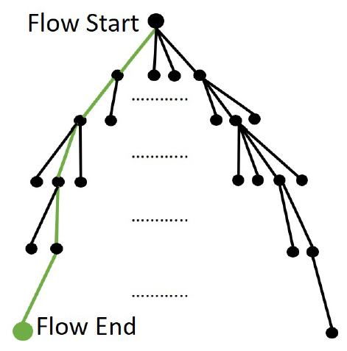
Four Stages of ML Insertion in IC Design
  Mechanization and Automation
  Orchestration of Search and Optimization
  Pruning via Predictors and Models
  Reinforcement Learning and Intelligence
  Huge space of tool, command, option trajectories through design flow

Slide 38
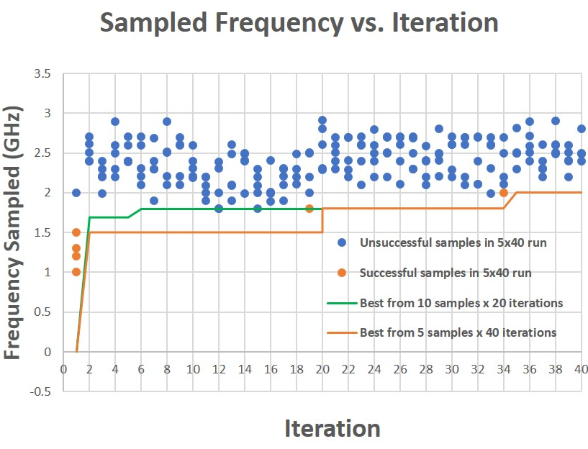
1. Mechanization and Automation
Create “robot IC design engineers”
  Observe and learn from humans
  Search for command sequences in design tools
Multi-Armed Bandit Problem: Given slot machine with N arms, maximize reward obtained using T pulls
  Well-studied in context of Reinforcement Learning
IC Design: “arm” = target frequency; “pull” = run flow
Tool Outcomes (Area, Power, WNS/TNS)
Arms to Sample
SAMPLER
Parallel Tool Runs
Constraints
Samples per Arm
Max Frequency
DAC-18 session: “The Road to No-Human-in-the-Loop IC Design” (UCSD, Qualcomm, Synopsys)
Notes:
Robots and CPUs don’t get tired!
Many time-consuming, error-prone, trial-and-error steps! → learn by watching expert humans, become as good as, then better…
For “No Human In The Loop”, this looks doable – for example, with reinforcement learning.
The Multi Armed Bandit Problem is: Given a slot machine with N arms, maximize total reward obtained using T pulls (iterations). This requires trading off “Exploration” (learning the distribution of outcomes from a given arm), and “Exploitation” (sampling from a given arm’s distribution)
In Resource-Limited IC Design with license and schedule constraints, each “arm” is a design target and flow configuration. Each “pull” is a run of the tool flow with that target.
In my lab, this has been fully automated. We throw a small block into the hopper and a best implementation meeting constraints is found without human intervention. The system executes runs in parallel up to the license budget, and can only make M sets of runs within the overall schedule.
The Multi-Armed Bandit algorithm samples from frequencies greater than the fmax previously obtained, in proportion to the probability that it returns the highest “reward”.
[[With each invalid sample obtained at an arm, the probability of obtaining a valid sample decreases, and hence]] We see that the algorithm samples from a narrower band of target frequencies as it progresses.
If you want scripts, send me an email.
In order to utilize robot engineer, we need strategies to efficiently explore good flow options (in physical design). Traditional depth-first search or breadth-first search may not work here because they are compute and license resource hungry. [Click] Therefore, we need better exploration strategy meaning better balance between quality of result and cost. [Click] One of such strategy can be “go with the winner” (GWTW). As illustrated in the figure here, it launches multiple optimization threads. Then for each optimization stage, it periodically identify the most promising thread. It then clone the promising thread and terminate others.

Slide 39
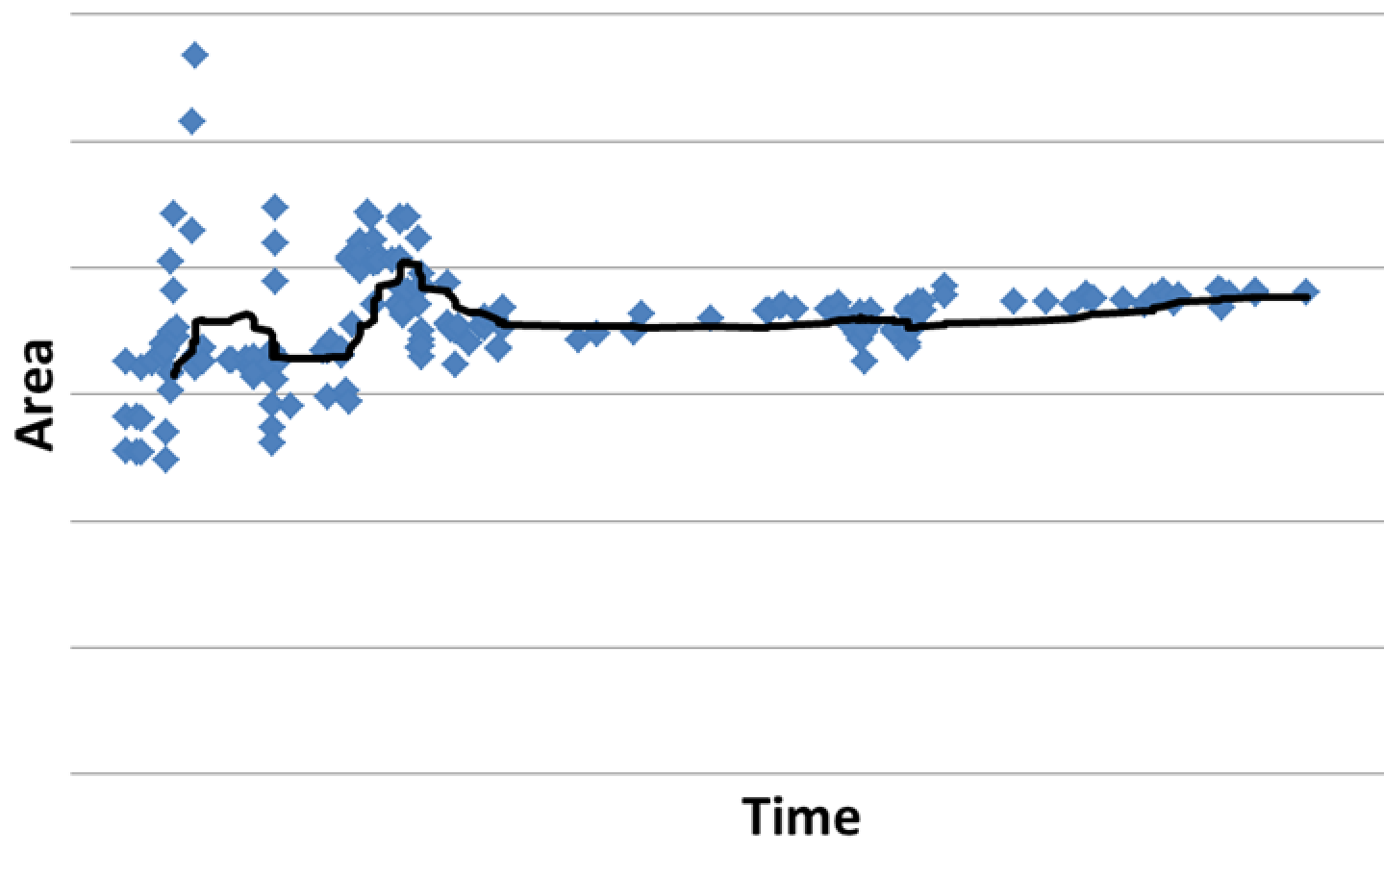
1. Mechanization and Automation
Create “robot IC design engineers”
  Observe and learn from humans
  Search for command sequences in design tools
Multi-Armed Bandit Problem: Given slot machine with N arms, maximize reward obtained using T pulls
  Well-studied in context of Reinforcement Learning
IC Design: “arm” = target frequency; “pull” = run flow
Notes:
At left, as we saw yesterday morning, Dr. Hill’s design team went through some months of effort and eventually closed at some area budget … At a high level, these pictures are similar. When will a team of robot engineers beat the trajectory on the left?

Slide 40
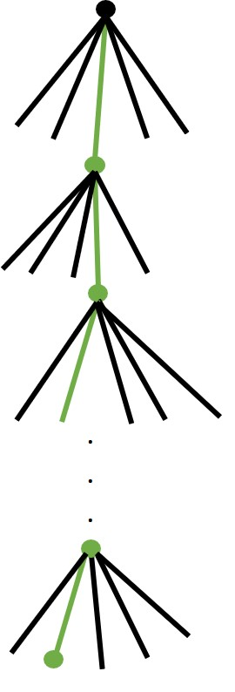
2. Orchestration of Search and Optimization
How to optimally orchestrate N robot engineers?
  Concurrent search of N flow trajectories
  Explore, identify good flow options efficiently
  Constraint: compute and license resources
Goal: best QOR within resource, risk limits
Example strategy: “Go with the winners”
  Launch multiple optimization threads
  Periodically identify promising thread
  Clone promising thread and terminate others
Notes:
How to optimally orchestrate N robot engineers – or, more generally, a design resource of people, licenses, servers, and TIME? The answer will depend on the design enablement.
And, we’ve proposed a couple of strategies for this… I’M GOING TO SKIP HERE AND THE NEXT SLIDE
order to utilize robot engineer, we need strategies to efficiently explore good flow options (in physical design). Traditional depth-first search or breadth-first search may not work here because they are compute and license resource hungry. [Click] Therefore, we need better exploration strategy meaning better balance between quality of result and cost. [Click] One of such strategy can be “go with the winner” (GWTW). As illustrated in the figure here, it launches multiple optimization threads. Then for each optimization stage, it periodically identify the most promising thread. It then clone the promising thread and terminate others.

Slide 41
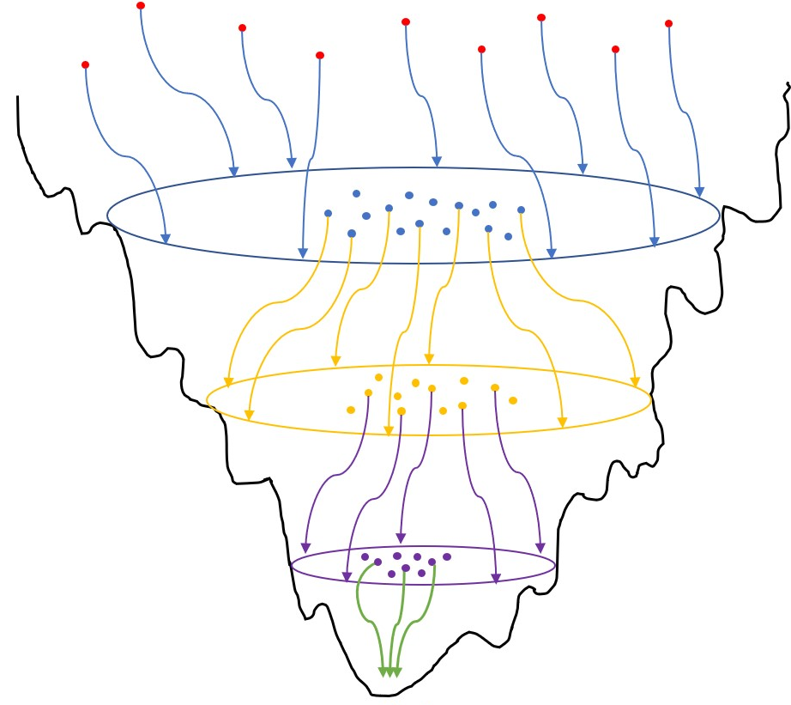
Another Example: “Adaptive Multi-Start”
Optimization cost landscapes often have “big valley” structures
  Best local minima are central to all other local minima
Adaptive Multi-Start (AMS)
  Identify promising configurations in current iteration
  Adaptively choose better start points for next optimization iteration
Notes:
SKIP.
Another candidate strategy can be Adaptive Multistart (AMS). It exploits the inherent big valley structures in the optimization cost landscapes. For many optimization problems, we can observe that the best local minima is central to all other local minima. [Click] AMS identifies promising configurations in the current iteration and adaptively choose those promising configurations as better start points for next optimization iteration. THIS IS FROM 24 YEARS AGO – BUT IT’S NOW MY FIFTH MOST-CITED PAPER

Slide 42
3. Pruning via Predictors and Models
Prediction of tool- and design-specific outcomes over longer and longer subflows
  Wiggling of longer and longer ropes
Notes:
Remember how I can predict what will happen after 5 minutes of a complex ECO step for clock trees?
Other work with Samsung predicted at the FLOORPLAN stage which timing endpoints on embedded memories would fail after DVD-aware timing analysis --- a VERY long rope.
Predicting the outcome of longer and longer subflows allows earlier pruning of unpromising design trajectories, and better design space exploration within available resource budgets.
There is a complementary need: new algorithms and tools that are inherently more predictable !!!
In order to utilize robot engineer, we need strategies to efficiently explore good flow options (in physical design). Traditional depth-first search or breadth-first search may not work here because they are compute and license resource hungry. [Click] Therefore, we need better exploration strategy meaning better balance between quality of result and cost. [Click] One of such strategy can be “go with the winner” (GWTW). As illustrated in the figure here, it launches multiple optimization threads. Then for each optimization stage, it periodically identify the most promising thread. It then clone the promising thread and terminate others.

Slide 43
Example 8: Prediction of SRAM Timing Failure
Multiphysics effects (IR drop, thermal, etc.) affect timing closure
Floorplanning with SRAMs is complicated
  P&R blockages
  Unpredictable post-P&R timing
Goal: Early prediction of post-P&R slack (“doomed floorplans”) to save schedule
But estimating post-P&R timing at floorplan stage is challenging:
  Wire delay estimate has no spatial embedding information
  Gate delay estimate has no buffering information
Notes:
For those of you counting, this is Example 8. … At advanced nodes, timing closure of modern systems-on-chip or SOCs is complex and timing-consuming as there are multiple analyses and design fixes. These analyses include closing the loop across various physics such as crosstalk, IR, temperature, etc. As a result, design turnaround time increases.
Floorplanning with SRAMs further complicates this problem because SRAMs create placement and routing blockages for standard cells. SRAMs may also induce split-rail designs and complex subflows, which can make timing unpredictable at the post-P&R stage.
Therefore, early prediction of post-P&R slack can significantly reduce design cost and turnaround time. But, timing estimation is challenging at the floorplan stage. Why? Because wire delay must be estimated without any information of spatial embedding and gate delay must be estimated without information on buffering.
So, no tool today predicts post-P&R slack at an early design stage.

Slide 44
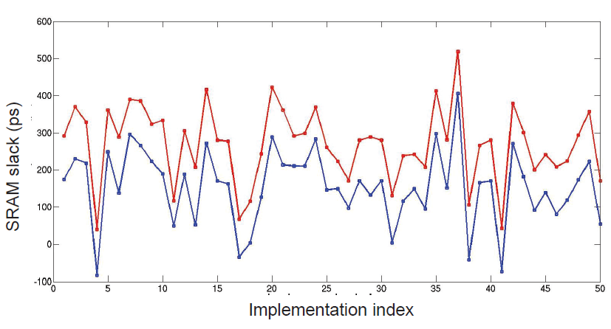
Multiphysics Analysis is Difficult to Predict
IR drop, thermal, reliability, crosstalk, etc.
ASP-DAC 2016 (UCSD, Samsung): Can we predict “risk map” for embedded memories at floorplan stage?
SRAM Slack (ps)
Implementation Index
Notes:
But again: predicting multiphysics slack at early design stages seems challenging. In this plot, on the x-axis we index 50 different implementations of the same design in which we vary the clock periods and transition time constraints. The red line shows SRAM slack without IR and the blue line shows SRAM slack with dynamic IR. Modeling such a non-uniform trend is difficult. But we achieved some encouraging results.

Slide 45

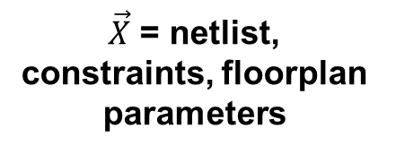


Floorplan Pathfinding with Machine Learning
Filter bad floorplans (e.g., embedded memory placements, power plans) comprehending downstream PD flow
Model f estimates combined effects of netlist, constraints, placement, CTS, routing, optimization, STA
Gate Netlist
Constraints
Floorplan, Powerplan
Placement
Extraction, Timing
Modeling Scope
Clock network synthesis
Routing
Costly Iteration
Extraction, Timing, Verification
Slack (w/, w/o IR)
Signoff
Notes:
If our goal is to predict post-P&R and multiphysics slack values at the floorplan stage, the modeling must comprehend effects of placement to routing, extraction, STA, etc.
Our approach is to derive an approximation function “f” that comprehends the combined effects of the netlist, constraints, P&R stages, tool noise, etc.
Parameter
Range of Value(s)
Aspect ratio 0.8~1.2
Utilization (std cells) 40%~70%
PDN stripe width 0.5~3.5μm
PDN stripe pitch 7~40μm
SRAM spacing (channel width) 6~24μm
Buffer screen width 10~16μm
Routing metal layers 7, 8
Memory placement {Face-to-face, face-to-back}
Clock period THEIA = 3.0~4.0ns nova = 3.2~4.2ns artificial = 2.0ns
Max transition 200~280ps
Max fanout 8~10
Threshold voltage mixes {LVT}, {LVT, RVT}, {RVT}
Clock buffer sizes {X32}, {X32, X24}, {X32, X24, X16}
NDRs on clock net 1W1S, 2W2S, 3W3S, 3W2S, 2W3S

Slide 46
Modeling Techniques and Flow
Parameters from netlist sequential graph
Parameters from floorplan context, constraints
Slack reports from P&R, multiphysics STA
Ground Truth
LASSO with L1 regularization
SVM with RBF kernel
ANN with 1 input, 2 hidden, 1 output layer
Boosting with SVM as weak learner
Combine using weights
Save model and exit
Notes:
We extract modeling parameters from netlist, netlist sequential graph, floorplan context and constraints. We obtain ground truth from P&R and multiphysics STA reports. We normalize all our data points to the zero-one interval.
We use one linear – LASSO with L1 regularization – and three nonlinear – SVM with RBF kernel, ANN with one input, one output and two hidden layers, and Boosting with SVM as weak learner.
We combine the predictions from each of these models using weights (this is the hybrid surrogate modeling technique that was also used to predict signal integrity-aware timing – we feel it’s contributed to success in many of our projects). Also, when actual negative slack values are predicted as positive in a data point, we retrain our model by increasing the weight for the data point by Five X. We perform five-fold cross-validation during our training phase for each of the modeling techniques.

Slide 47
Floorplan Pathfinding Model
False negatives = 3%
  Pessimistic predictions → floorplan change that is actually not required
False positives = 4%
  Model incorrectly deems a floorplan to be good
Actual
Pass
Fail
Pass
False positives
Predicted
584
42
Fail
31
384
False negatives
Notes:
Here, we show the confusion matrix of our predictions of multiphysics slack on the test set. False negatives are 3% of the data points -- that is, our model suggests a floorplan needs to be changed when it is actually not required. False positives are 4% of data points, that is, our model deems a floorplan to be good when it is actually leads to at least one timing failure on SRAMs.
For the data points with positive slack, our recall is 95% for 93% precision. For the data points with negative slack, our recall is 90% for 92.5% precision.

Slide 48
3. Pruning via Predictors and Models
Prediction of tool- and design-specific outcomes over longer and longer subflows
  Wiggling of longer and longer ropes
Prune, terminate → avoid wasted design resources
  Better outcome within given resource budget
Implicit: improved predictability and modelability of heuristics and tools
Notes:
BACK TO THIS SLIDE …… [[Remember how I can predict what will happen after 5 minutes of a complex ECO step for clock trees?
Other work with Samsung predicted at the FLOORPLAN stage which timing endpoints on embedded memories would fail after DVD-aware timing analysis --- a VERY long rope. ]]
Predicting the outcome of longer and longer subflows allows earlier pruning of unpromising design trajectories, and better design space exploration within available resource budgets.
There is a complementary need: new algorithms and tools that are inherently more predictable !!!
In order to utilize robot engineer, we need strategies to efficiently explore good flow options (in physical design). Traditional depth-first search or breadth-first search may not work here because they are compute and license resource hungry. [Click] Therefore, we need better exploration strategy meaning better balance between quality of result and cost. [Click] One of such strategy can be “go with the winner” (GWTW). As illustrated in the figure here, it launches multiple optimization threads. Then for each optimization stage, it periodically identify the most promising thread. It then clone the promising thread and terminate others.

Slide 49
4. Reinforcement Learning and “Intelligence”
Many challenges on the road ahead…
Latency and unpredictability of IC design tools/flows
  Can’t “play the IC design game” 100M times in 3 days
“Small data” challenge with a big-data problem
  Data points are expensive
  Huge implementation space
  Tool versions, design versions, technology all changing (pictures of cats and trees don’t change)
Model parameters come from domain experts today
Open: bridging real (top-secret!) and artificial (fake!)
  My group: many years of “eye chart” papers
Notes:
Of course, there is a long road ahead.
EDA and IC design has a “small data” problem along with a “big data” problem – there aren’t as many CPU design databases out there as pictures of cat faces. Tools are millions of lines of C++, and flows are scripted with thousands of lines of Tcl – so modeling and optimizing in this space is tough – even if we ignore version, platform, design and other confounding factors.
There are also culture issues. EDA companies historically don’t spend time modeling their tools – it’s more of a testcase and regression suite culture. So, I think it will be big semi companies who drive ML into both the EDA industry and IC design methodology.
This is not a piece of cake, but fortunately many folks see the ROI and are investing seriously in this.
The paper also gives a kind of laundry list of TODOs: specific challenges and needs.

Slide 50
Todo List: “Last Mile” Robots
Automation of manual DRC violation fixing
  P&R tools cannot handle latest rule decks, unavoidable lack of routing resource in high-utilization block, etc.
Automation of manual timing closure
  After routing and optimization, several thousand violations of maxtrans, setup, hold constraints exist
  Engineer fixes 200-300 DRVs by hand, per day
Placement of memory instances in a P&R block
Package layout automation
  How to assess post-routed quality (e.g., bump inductances) of SOC floorplan and die-package pin map?
  Required for: pin map, power delivery optimization
  Requires: automation/estimation of manual package routing
Notes:
For example:
I don’t think Anthony or Leon or Andreas would disagree…
[35:00]

Slide 51
Todo List: Improving Analysis Correlation
Prediction of the worst PBA path
Prediction of the worst PBA slack per endpoint, from GBA analysis
Prediction of timing at “missing corners”
  Predict other impacts (e.g., transition times, ..) of an ECO as well
Closing of multi-physics analysis loops
  Early priorities: vectorless dynamic IR drop, power-temperature loops
Continued improvement of timing correlation and estimation !
  Faster and better always helpful !
Notes:
Imagine if timing analysis and design closure were cheaper, faster, and more accurate – shifting that cost-vs-accuracy curve, for free with machine learning?
Would this be design enablement that gives a competitive advantage to a foundry?
CLICK: Closing of long “multi-physics” analysis loops – timing to current to IR drop to timing, timing to current to power to temperature to timing , etc. --- is also essential to save margin. THESE are a couple of early priorities.

Slide 52
Todo List: Predictive Models of Tools, Designs
Predict convergence point for P&R, non-uniform PDN
Estimate PPA response of block to floorplan context
Estimate useful skew impact on post-route WNS,TNS
“Auto-magic” determination of netlist constraints for given performance and power targets
  Key opportunity: exactly ONE netlist is passed into place-and-route – how to generate this best netlist?
Predict best “target sequence” of constraints through layout optimization phases
Predict “most-optimizable” cells during design closure
Predict divergence (detouring , timing/slew violations) between trial/global route and final detailed route
Predict “doomed runs” at all steps of design flow
Notes:
As I said, my friends in the fabless companies get VERY excited by this list, especially the items in blue. For example, where does the chicken-egg dependency of the PDN and place-and-route converge? How will block PPA change if you change shape or floorplan context?
And if they get excited, you know the EDA companies are trying to work with them on these. And, so are foundries. I don’t think anyone will argue with this.
Companies would cut 7-figure checks on the spot if any of these were real.

Slide 53
Todo List: And More…
Infrastructure for machine learning in IC design
  Standards for model encapsulation, model application, and IP preservation when models are shared
Standard ML platform for EDA modeling
  Enablement of design metrics collection, tool/flow model generation, design-adaptive tool/flow configuration, prediction of tool/flow outcomes
  This recalls “METRICS” http://vlsicad.ucsd.edu/GSRC/metrics
Modelable algorithms and tools
  Smoother, less chaotic outcomes than present methods
Datasets to support ML
  Artificial circuits and “eyecharts”
  Shared training data – e.g., timer correlation, post-route DRV prediction, optimal sizing
Notes:
I feel that THESE challenges are really key. A big question here is how training effort, data sets, models, abstractions of foundry PDK information, etc. will in practice be contributed toward this long-term support of a healthier semiconductor ecosystem.
We need serious efforts across the industry and research community to solve these questions.

Slide 54
Agenda
Crises…
… and a Vision
Machine Learning in PD
Modeling and Prediction
Analysis Correlation
Optimization
A Roadmap
Conclusion
Notes:
So let me conclude.

Slide 55
Conclusion
Many high-value opportunities for ML in physical design
  Analysis correlation → less margin, improved design QOR, faster convergence
  Predictive modeling of tools/flows and designs → fewer loops, less wasted effort, less pessimism, better design optimization, better resource management
Roadmap
  Robots
  Orchestration of robots
  Pruning via predictors and models
  Intelligence + many specific “todos”
Other facets: enablement, standards, openness,…
I hope that many of you will join this quest !!!
Notes:
EDA and IC designers MUST use ML in the drive to scale Quality, Schedule and Cost.
Correlations of analysis across more tools, for increasingly complex analyses (CCS, LVF), will prevent loops and overdesign.
Predictive modeling of tools, flows and designs again reduce iterations and waste, and allow us to do the best we can within a budget of WEEKS cross PEOPLE cross LICENSES and SERVERS. At a tactical level – how do you model the latest pin extension and min area rules so that pre-route optimization actually works well …. WE HAVE MANY problems to solve – including that stack of models that gets us to project- and enterprise-level optimizations.
I mentioned a “roadmap” of stages of ML in physical design – plus many specific todo’s. And we will need to overcome issues such as standards and openness.
I hope that many of you will join this quest !!!

Slide 56
THANK YOU !
Support from NSF, Qualcomm, Samsung, NXP, Mentor Graphics and the C-DEN center is gratefully acknowledged.
Notes:
THANK YOU FOR YOUR ATTENTION.

Slide 57
BACKUP

Slide 58
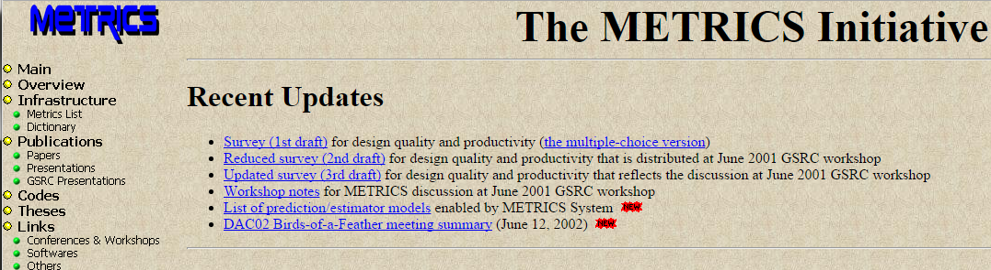
(This is “METRICS” !)
[ISQED01]
METRICS (1999; ISQED01): “Measure to Improve”
  Goal #1: Predict outcome
  Goal #2: Find sweet spot (field of use) of tool, flow
  Goal #3: Dial in design-specific tool, flow knobs
http://vlsicad.ucsd.edu/GSRC/metrics
Notes:
Machine Learning in EDA has actually been on my mind for about 20 years. Back in the late 1990s, my group proposed a METRICS infrastructure for the EDA and IC industries – all design activity would be measured, all data would be mined, and we’d be able to predict tool outcomes, find sweet spots or field of use for tools, and make design-specific tuning of tools. Neither EDA nor design engineers wanted this at the time. So this has really come full circle for me.

Slide 59
Patterning and Margins for Wires (“BEOL”)
Self-aligned multiple patterning + Cutmask
Make a “sea of wires”
Make “cuts”
Cut shapes and locations determine dummy wires and
end-of-line extensions of wire segments
Final layout ≠ Target layout
  → Timing and power not the same as originally designed !
  → Need more margin !
cut
extension
Target layout
1D wires
Cut masks
Final layout
dummy fill
Notes:
Let’s look at today’s Back End Of Line (METAL LAYERS).
Self-aligned multiple patterning is used for tight-pitch wires in 10nm and below. The TARGET layout is on the LEFT.
NEXT, the patterning starts with a “sea of wires”, SHOWN HERE.
Then, the final patterns are determined by a CUT PROCESS.
[CLICK] Compared to the original layout, the final layout will depend on where the cuts are inserted. There can be end-of-line extensions, and also dummy segments that were not in the original design. These affect timing and performance, so we need MORE MARGIN.

Slide 60
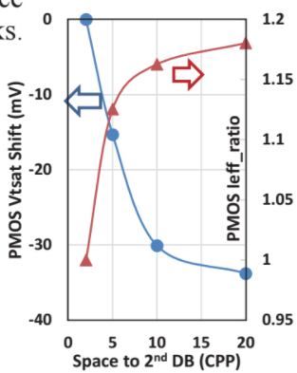
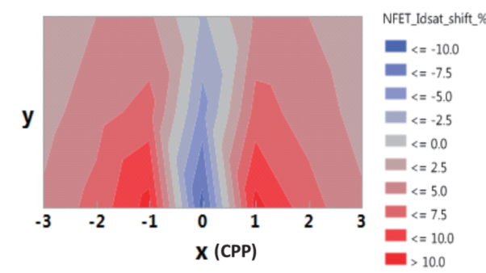
Patterning and Margins for Gates (“FEOL”)
Neighbor diffusion effect (NDE)
  Diffusion step = neighboring diffusion area height change
  Transistor drive strength and leakage prop. to horizontal fin spacing
2nd Diffusion Break (DB)
  Vt shift as a function of spacing to the 2nd diffusion break
Gate Cut (GC)
  Idsat shifts as a function of gate-cut distance to DUT
Worst corner has to consider NDE + 2nd DB + GC
  → More margin added besides PVT (!)
1st DB
2nd DB
Diffusion height
Diffusion
Diffusion break
DUT
Fin
PC
Gate cut
Gate Cut (GC) Effect
Notes:
WHAT ABOUT the 7nm node?
At 7nm and below, there is more FRONT END OF LINE from variability that was previously ignorable. There is Neighbor diffusion effect, , caused by the diffusion step which is the change in height of adjacent diffusion as shown in the figure. Like – 3-fin next to 2-fin. NDE changes transistor drive strength and leakage variation because both depend on horizontal fin spacing if diffusion step exists. Timing-driven Detailed Placement becomes complicated – we wrote an ICCAD paper on this with Samsung.
[Click] The second is called SECOND DIFFUSION BREAK. The device VT shifts with spacing to the 2nd diffusion break. The VT shift of PMOS is shown in the figure HERE. [Click] The third is gate cut. Gate cut causes idsat shift which is a function of gate-cut distance to DUT. Figure below shows the idsat change of an NFET as a function of distance in x and y directions. [Click] Because none of these is captured by library characterization, we add MORE MARGIN to cover model-hardware miscorrelation.
[[Figures are from GF paper at VTS 2017]]

Slide 61
Closing Multiphysics Analysis Loops
[ASPDAC16]
Tech files, signoff criteria, corners
Sim Results (Dyn.) Activity Factor (Static)
Functional Sim
Sim vectors
Benchmark
RTL
IR Drop Map
Power Trace
AVS
Thermal Analysis
Power
Analysis
Timing / Glitches
Temp Map
Slack
Task Mapping/ Migration/ (DVFS)
Timing/Noise
P&R + Optimization
Reliability
Report
MTTF & Aging
Notes:
Here is a graph of analyses – where even today it is a competitive advantage simply to have this graph implemented with golden tools. Industry flows barely connect STA with dynamic IR drop. STA with thermal? Workloads with power and thermal and timing – without this, how are we analyzing load-balancing, DVFS, stress or reliability budgeting … ? Not closing a loop means pessimism at best, garbage-in-garbage-out or optimism at worst.

Slide 62
Closing Multiphysics Analysis Loops
[ASPDAC16]
Sim Results (Dyn.) Activity Factor (Static)
Tech files, signoff criteria, corners
Workload-Thermal loop
Functional Sim
Sim vectors
Benchmark
RTL
STA-IR loop
IR Drop Map
Power Trace
AVS
Thermal Analysis
Power
Analysis
Timing / Glitches
STA-Thermal loop
Temp Map
Slack
Task Mapping/ Migration/ (DVFS)
Timing/Noise
P&R + Optimization
Reliability
Report
STA-Reliability loop
MTTF & Aging
Notes:
With this in mind, let me talk about some work done with an industrial visitor from Samsung, and a Broadcom PD engineer. We know that at advanced nodes, SOC timing closure must involve analysis loops across multiple physics such as crosstalk, IR, temperature, etc. This increases turnaround time.
Floorplanning further complicates this problem because SRAMs create P&R blockages and power domain complexity -- which makes post-P&R timing even more unpredictable.
If we could have an early predictor of post-P&R slack, we could significantly reduce design turnaround time. This seems impossible at the floorplan stage -- wire delays must be estimated without any information of placement, and gate delays must be estimated without information on sizing and buffering. But, there is machine learning !

Slide 63
Some References
Highlighted in the talk from ABKGroup
[RISKMAP] W.-T. J. Chan, K. Y. Chung, A. B. Kahng, N. D. MacDonald and S. Nath, "Learning-Based Prediction of Embedded Memory Timing Failures During Initial Floorplan Design", (.pdf), Proc. ASPDAC, 2016.
[GT1GT2] ] S. S. Han, A. B. Kahng, S. Nath and A. Vydyanathan, "A Deep Learning Methodology to Proliferate Golden Signoff Timing", (.pdf), Proc. DATE, 2014.
[GT1GT2] A. B. Kahng, M. Luo and S. Nath, "SI for Free: Machine Learning of Interconnect Coupling Delay and Transition Effects", (.pdf), Proc. SLIP, 2015.
[#ML/ROPT] W.-T. J. Chan, Y. Du, A. B. Kahng, S. Nath and K. Samadi, "BEOL Stack-Aware Routability Prediction from Placement Using Data Mining Techniques", (.pdf), Proc. ICCD, 2016.
[#ML/ROPT] W.-T. J. Chan, P.-H. Ho, A. B. Kahng and P. Saxena, "Routability Optimization for Industrial Designs at Sub-14nm Process Nodes Using Machine Learning", (.pdf), Proc. ISPD, 2017.
[CTS] K. Han, A. B. Kahng, J. Lee, J. Li and S. Nath, "A Global-Local Optimization Framework for Simultaneous Multi-Mode Multi-Corner Skew Variation Reduction",(.pdf), Proc. DAC, 2015.
Some other machine learning / data mining papers from ABKGroup
[3DPE] W.-T. J. Chan, Y. Du, A. B. Kahng, S. Nath and K. Samadi, "3D-IC Benefit Estimation and Implementation Guidance from 2D-IC Implementation", (.pdf), Proc. DAC, 2015.
[HS] A. B. Kahng, C.-H. Park and X. Xu, "Fast Dual-Graph Based Hotspot Detection” (.pdf), Proc. BACUS, 2006.
[INT] A. B. Kahng, S. Kang, H. Lee, S. Nath and J. Wadhwani, "Learning-Based Approximation of Interconnect Delay and Slew in Signoff Timing Tools", (.pdf), Proc. SLIP, 2013.
[METRICS] S. Fenstermaker, D. George, A. B. Kahng, S. Mantik and B. Thielges, "METRICS: A System Architecture for Design Process Optimization", (.pdf), Proc. DAC, 2000.
[METRICS] A. B. Kahng and S. Mantik, "A System for Automatic Recording and Prediction of Design Quality Metrics", (.pdf), Proc. ISQED, 2001.
[HSM] A. B. Kahng, B. Lin and S. Nath, "Enhanced Metamodeling Techniques for High-Dimensional IC Design Estimation Problems", (.pdf), Proc. Design, Automation and Test in Europe, 2013, pp. 1861-1866.
[HHSM] A. B. Kahng, B. Lin and S. Nath, "High-Dimensional Metamodeling for Prediction of Clock Tree Synthesis Outcomes", (.pdf), Proc. ACM/IEEE International Workshop on System-Level Interconnect Prediction, 2013.
[METRICS] GSRC/METRICS: http://vlsicad.ucsd.edu/GSRC/metrics/
See also: Center for Design-Enabled Nanofabrication, http://cden.ucsd.edu
Notes:
Here are SOME references, and …

