Slide 1
Prim-Dijkstra Revisited: Achieving Superior Timing-driven Routing Trees
Charles J. Alpert^{[1]}, Wing-Kai Chow^{[1]}, Kwangsoo Han^{[1] [3]},
Andrew B. Kahng^{[2] [3]}, Zhuo Li^{[1]},
Derong Liu^{[1]} and Sriram Venkatesh^{[2]}
^{[1]}Cadence Design Systems, Inc
UC San Diego ^{[2]} CSE and ^{[3]} ECE Departments
Notes:
Good morning, I am Sriram Venkatesh, a second year Masters student at UCSD.
My talk today is on “Prim-Dijkstra Revisited”, jointly done between UCSD and Cadence.

Slide 2

Introduction from Dr. Charles Alpert
Notes:
Before I begin the talk, one of our authors, Dr. Alpert would like to say a few words through this video.
[CLICK] Video

Slide 3
Outline
Background and Motivation
Related Work
Our Methodology
Experimental Setup and Results
Conclusion
Notes:
I will first present the background and motivation behind this work.

Slide 4
Preliminaries
Signal net has n pins, V = {v₀, v₁, …, v_{n-1}}
Weighted graph G = (V, E), where edge e_{ij} ∈ E has cost d_{ij}
Spanning tree T = (V,E’) = spanning subgraph of G with |E’| = n – 1 edges
Wirelength (WL) of T: sum of edge costs
Source-to-sink pathlength (PL) to v_{i} : cost of v₀-v_{i} path in T
Small WL = low power
Small PL = small delays
Key to competitive VLSI routing: BOTH PL and WL should be small → must optimize this tradeoff in practice
Notes:
A few basic definitions.
[CLICK] A signal net has n pins with source V-zero, and N minus one sinks.
Underlying weighted graph has edge costs d_ij - for example, Manhattan distances
A routing tree is a spanning subgraph of G, with n-1 edges
[CLICK] The total WL of the tree is the sum of the edge costs. And the source-to-sink pathlength is defined as the sum of edge costs of the path from source to sink.
[CLICK] In Physical Design, small WL implies low power, and small PL results in small delays. For competitive VLSI routing, we need both PL and WL to be small. This is a tradeoff in practice!

Slide 5
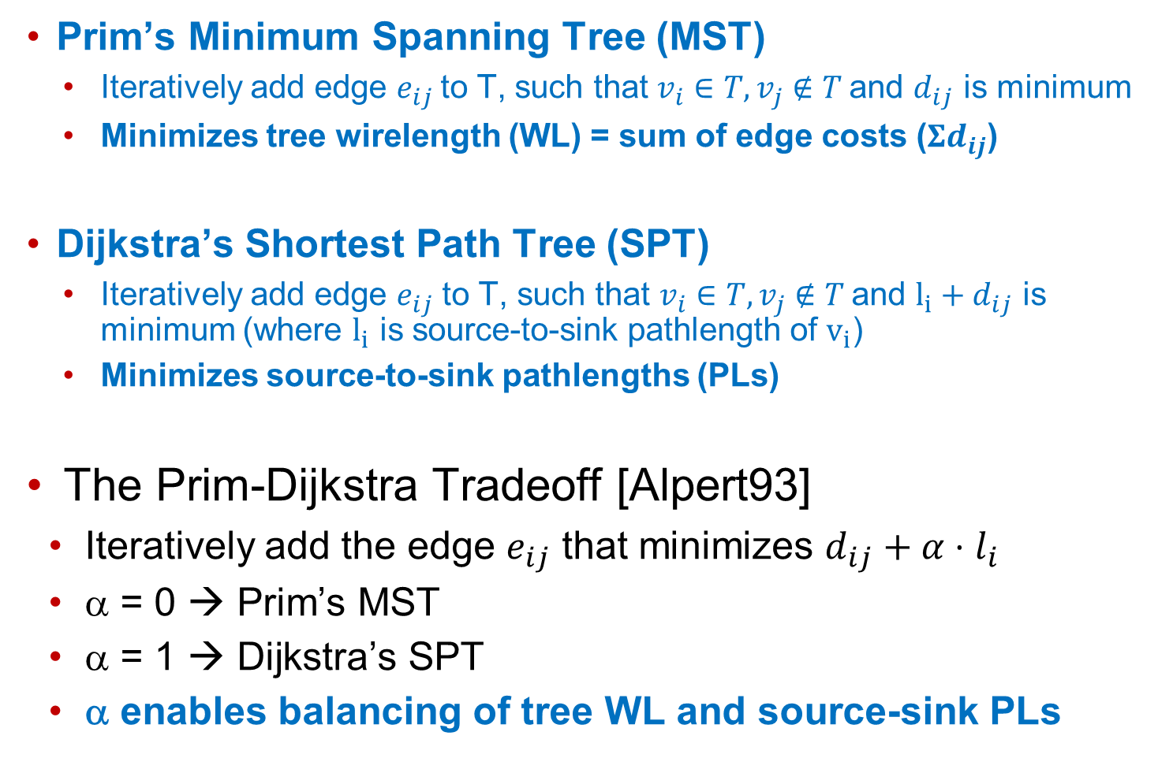
Prim’s MST and Dijkstra’s SPT
Prim’s Minimum Spanning Tree (MST)
  Iteratively add edge $e_{ij}$to T, such that $v_{i}∈T, v_{j} \text{∉} T$and $d_{ij}$ is minimum
  Minimizes tree wirelength (WL) = sum of edge costs ($Σd_{ij}$)
Dijkstra’s Shortest Path Tree (SPT)
  Iteratively add edge $e_{ij}$ to T, such that $v_{i}∈T, v_{j} \text{∉ }T$and $l_{i}+d_{ij}$ is minimum (where $l_{i}$ is source-to-sink pathlength of $v_{i}$)
  Minimizes source-to-sink pathlengths (PLs)
The Prim-Dijkstra Tradeoff [Alpert93]
Iteratively add the edge $e_{ij}$ that minimizes $d_{ij}+α⋅l_{i}$
α = 0 → Prim’s MST
α = 1 → Dijkstra’s SPT
α enables balancing of tree WL and source-sink PLs
Notes:
I’m going to quickly recap two common greedy tree constructions.
[CLICK] Prim’s algorithm constructs a MST by adding an edge e_ij to the growing tree such that the edge cost is minimum. This minimizes the tree WL.
[CLICK] Dijkstra’s algorithm adds edges to the growing tree to minimize the sum of edge cost and source-to-sink pathlength. This results in shortest-path tree.
[CLICK] If we notice the labels, we see that they are quite similar. This is 0 times li and this 1 times li.
[CLICK] This was leveraged to create the Prim-Dijkstra algorithm. This algorithm adds an edge by minimizing the weighted combination of edge cost and source-to-sink pathlength.
[CLICK] alpha 0 gives Prim’s MST, and alpha 1 gives Dijkstra’s SPT
[CLICK] alpha enables trading off WL and PL

Slide 6
Prim-Dijkstra Construction (Alpert et al. 1993)
Prim’s Minimum Spanning Tree (MST)
Minimizes wirelength (WL)
But large delay from source for nodes 3,4,5
5
Prim-Dijkstra (PD) tradeoff of Prim’s MST and Dijkstra’s SPT
4
0
5
3
4
1
2
Dijkstra’s Shortest Path Tree (SPT)
Minimizes source-sink pathlengths (PLs)
0
3
But large tree
wirelength!
5
1
2
4
Directly trades off the
Prim, Dijkstra constructions
0
3
1
2
Notes:
Here’s an example. Prim’s MST gives a tree with minimum WL, but results in large PLs to some sinks
[CLICK] Whereas Dijkstra’s SPT minimizes source-to-sink pathlengths, but gives a large tree WL
[PAUSE]
[CLICK] The Prim and Dijkstra objectives are blended together to tradeoff between WL and PL, as seen in this example.
[CLICK] Tunable parameter alpha enables easy tradeoff.

Slide 7
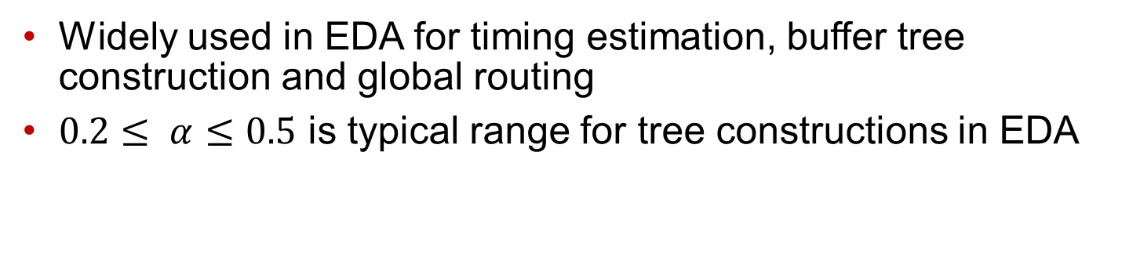
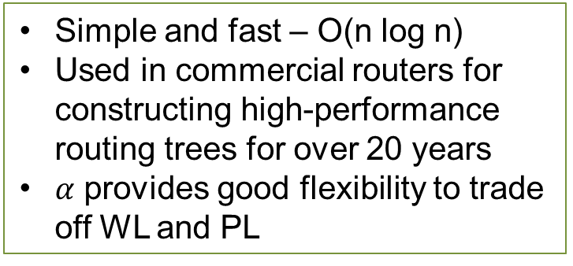
Prim-Dijkstra (PD) In Practice
Widely used in EDA for timing estimation, buffer tree construction and global routing
$0.2≤ α≤0.5$ is typical range for tree constructions in EDA
Pros
Cons
Simple and fast – O(n log n)
Used in commercial routers for constructing high-performance routing trees for over 20 years
$α$ provides good flexibility to trade off WL and PL
High PLs (routes are detoured) → large PL (large delays)
Greedy addition of edges to the tree – once edge is added, no more “repair” done to that edge
→ large WL (high power)
New challenge in advanced nodes:
Designs are significantly more power-sensitive now!
Notes:
[CLICK] PD algorithm is widely used in EDA for timing estimation, buffer tree construction and global routing. Alpha is typically set to be between 0.2 and 0.5.
[CLICK] There are numerous advantages to using the PD algorithm. Its simple, fast and flexible. It has been successfully used in commercial routers for over 20 years. The weighting factor enables easy tradeoff between WL and PL.
[CLICK] However, we have found cases where PD leads to high PLs with lots of detours, leading to large delays.
PD algorithm’s greedy addition of edges causes some suboptimalities. Once the edge is added to the tree, there is no repair done to recover WL, resulting in large WLs and increased power.
[CLICK] In recent times, we have very challenging power and frequency targets. Even a 1% reduction in power is seen as a huge win! Hence, we want to improve this construction.

Slide 8
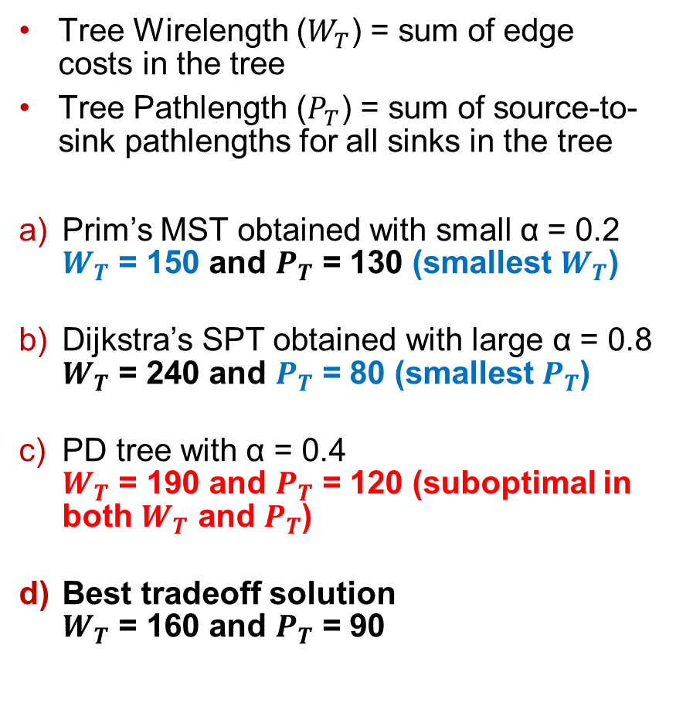
PD Suboptimality - Example
Tree Wirelength ($W_{T}$) = sum of edge
costs in the tree
Tree Pathlength ($P_{T}$) = sum of source-to-sink pathlengths for all sinks in the tree
Prim’s MST obtained with small α = 0.2
$W_{T}$ = 150 and $P_{T}$ = 130 (smallest $W_{T}$)
Dijkstra’s SPT obtained with large α = 0.8
$W_{T}$ = 240 and $P_{T}$ = 80 (smallest $P_{T}$)
PD tree with α = 0.4
$W_{T}$ = 190 and $P_{T}$ = 120 (suboptimal in both $W_{T}$ and $P_{T}$)
Best tradeoff solution
$W_{T}$ = 160 and $P_{T}$ = 90
Source
Sinks
Notes:
Here’s an example where the Prim-Dijkstra algorithm gives a less-desirable solution. I define two metrics – tree WL and tree PL
[CLICK] Figure (a) shows the PD construction with alpha = 0.2. It constructs a tree equivalent to Prim’s MST, with the smallest tree WL possible
[CLICK] Figure (b) shows the PD construction with alpha = 0.8. It constructs a tree equivalent to Dijkstra’s SPT, with the smallest possible tree PL
[CLICK] Figure shows a PD construction with alpha = 0.4 – gives a tradeoff which is suboptimal in both tree WL and PL.
[CLICK] In fact, no value of alpha produces the best tradeoff solution depicted in Figure (d). I will present our proposal to this in the next few slides

Slide 9
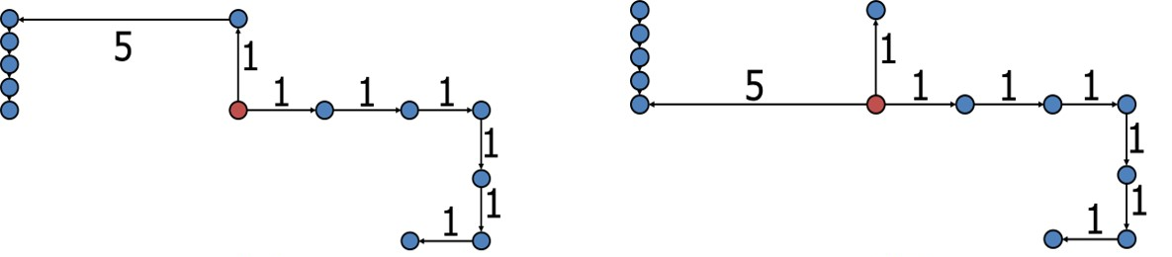
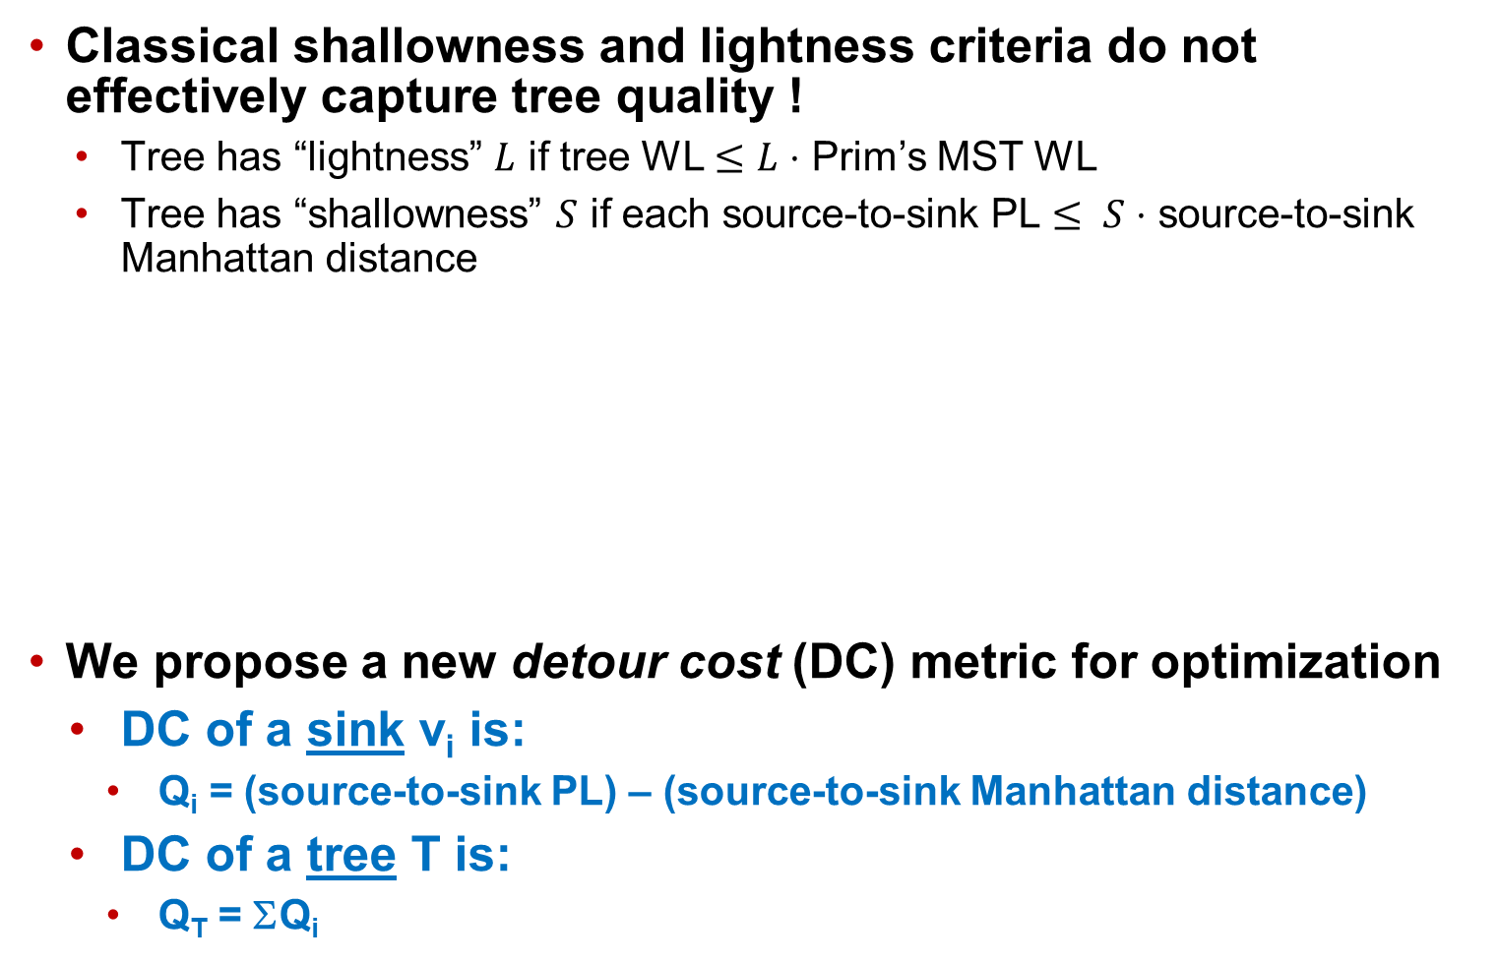
A New Metric
Classical shallowness and lightness criteria do not effectively capture tree quality !
  Tree has “lightness” $L$ if tree WL $≤L⋅$ Prim’s MST WL
  Tree has “shallowness” $S$ if each source-to-sink PL $≤ S⋅$ source-to-sink Manhattan distance
We propose a new detour cost (DC) metric for optimization
  DC of a sink v_{i} is:
    Q_{i} = (source-to-sink PL) – (source-to-sink Manhattan distance)
  DC of a tree T is:
    Q_{T} = ΣQ_{i}
Better PLs to
these sinks!
Notes:
!!! 7 minutes
Conventional shallow-light constructions bound shallowness and lightness. A tree is said to have lightness L if tree WL is at most L times the MST WL, and is said to have shallowness S if each of the source-to-sink PLs are at most S times the source-to-sink Manhattan distance
However, these metrics do not capture the quality of the tree effectively.
[CLICK] For example, both trees shown here have the same shallowness and lightness. However, it is clear that the Figure on the right is preferable to the one on the left, since the left sinks have shorter PLs
[CLICK] Hence, we propose a new metric for optimization – called detour cost. We define the detour cost of a sink as the difference between the source-to-sink PL and the source-to-sink Manhattan distance. The total detour cost of the tree is just the sum of detour costs of each sink in the tree

Slide 10
Outline
Background and Motivation
Related Work
Our Methodology
Experimental Setup and Results
Conclusion
Notes:
Now, I will review related literature briefly.

Slide 11
Related Works
Spanning Tree Constructions
[Alpert93]: Prim-Dijkstra algorithm for a “shallow-light” construction
[Cong92] and [Khuller93]: Spanning tree constructions with bounded PL and WL
Steiner Tree Constructions
Minimum WL Steiner Trees
  [Kahng92]: Iterated 1-Steiner heuristic
  [Ho90]: Optimal edge-overlapping separable MSTs
  [Chu08]: FLUTE heuristic to generate near-optimal WL Steiner trees using lookup tables
Steiner Constructions that Optimize both WL and PL
  [Elkin15] Shallow-light Steiner construction
  [Scheifele17] Steiner tree construction with bounded Elmore delays
  [Chen17] SALT – most recent academic heuristic
Spanning Tree Constructions
[Alpert93]: Prim-Dijkstra algorithm for a “shallow-light” construction
[Cong92] and [Khuller93]: Spanning tree constructions with bounded PL and WL
Steiner Tree Constructions
Minimum WL Steiner Trees
  [Kahng92]: Iterated 1-Steiner heuristic
  [Ho90]: Optimal edge-overlapping separable MSTs
  [Chu08]: FLUTE heuristic to generate near-optimal WL Steiner trees using lookup tables
Steiner Constructions that Optimize both WL and PL
  [Elkin15] Shallow-light Steiner construction
  [Scheifele17] Steiner tree construction with bounded Elmore delays
  [Chen17] SALT – most recent academic heuristic
Our Work
Iterative improvement algorithms for
spanning and Steiner constructions
Superior WL and PL tradeoffs
Notes:
There is a rich history for spanning and Steiner tree algorithms.
[CLICK] Prim-Dijkstra was one of the prominent spanning tree constructions from the early 90s. Cong et al. and Khuller et al. also proposed spanning constructions with bounded PL and WL.
[CLICK] We classify prominent Steiner constructions into 2 categories. Constructions that obtain minimum WL and constructions that optimize both WL and PL.
[CLICK] The first category includes the Iterated 1-Steiner heuristic, the optimal edge-overlapping method of Ho et al., and FLUTE which generates near-optimal WL Steiner trees using lookup tables
[CLICK] The second category includes the shallow-light Steiner construction by Elkin et al.
//that identify breakpoints and reduce detours.
Scheifele et al. give a Steiner construction with bounded Elmore delays. And Chen et al. give us SALT, a state-of-the-art algorithm with improvement over the [Elkin15] method for superior tradeoffs between WL and PL.
[CLICK] Our work includes iterative improvement algorithms for spanning and Steiner constructions, with superior WL and PL tradeoffs

Slide 12
Contributions of this Paper
Address shortcomings in PD
Minimize detour cost
objective
Iterative improvement of
both WL and PL
    PD-II algorithm for spanning tree improvement
    Detour-Aware Steinerization (DAS) algorithm for Steiner tree improvement
MST (lowest WL)
SPT
(least PL)
Notes:
Our contributions include
[CLICK] Addressing the shortcomings in the PD algorithm.
PD produces a WL-PL tradeoff curve as shown here. Each point represents the WL and PL for a tree obtained with an alpha value between 0 and 1.
[CLICK] We want to push this curve down and to the left!
[CLICK] We minimize the detour cost metric in our algorithms
[CLICK] We propose two iterative improvement algorithms - PD-II to improve WL and PL of a spanning construction, and DAS to repair the Steiner construction. Both these algorithms push the curve down and to the left!

Slide 13
Outline
Background and Motivation
Related Work
Our Methodology
Experimental Setup and Results
Conclusion
Notes:
I will now explain our methodology.

Slide 14
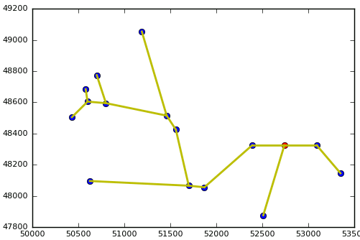
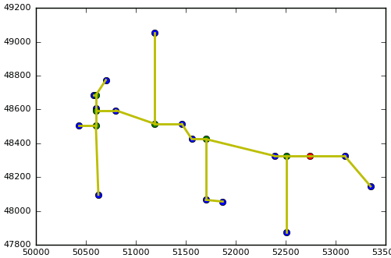
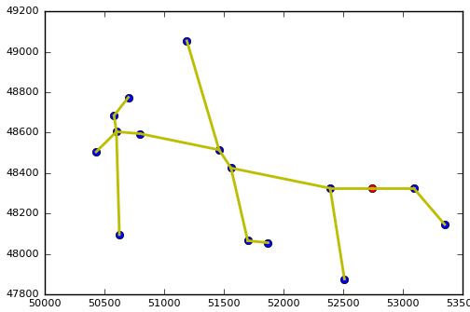
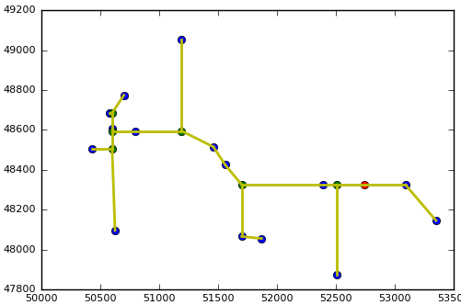
Our Algorithms
PD
  Prim-Dijkstra [Alpert93] - Spanning tree construction
PD-II
  PD-II - Iterative repair of spanning tree to improve WL and PL
HVW
  Steinerization [Ho90] – Convert spanning tree to Steiner tree through maximum edge overlapping
DAS
  Detour Aware Steinerization - Recover both WL and PL from Steiner trees
Source
Sink
Steiner point
PD
W_{Tnorm} = 1.2753
P_{Tnorm} = 1.1916
PD-II
W_{Tnorm} = 1.1641
P_{Tnorm} = 1.1074
HVW
W_{Tnorm} = 1.0438
P_{Tnorm} = 1.0549
DAS
W_{Tnorm} = 1.0109
P_{Tnorm} = 1.0433
Notes:
This is the high-level view of our methodology.
[CLICK] First, we construct the Prim-Dijkstra tree. The figure on the right shows the PD construction for an example net. The normalized values of the tree WL and tree PL are shown below.
[CLICK] Next, we add our PD-II algorithms to iteratively improve the WL and PL of the spanning tree.
[CLICK] Then, we convert the improved spanning tree into a Steiner tree using the maximal edge-overlapping algorithm of Ho et al.
[CLICK] Finally, we improve the Steiner tree using our DAS algorithm, to recover both WL and PL.
[CLICK] PD-II and DAS algorithms are our main contributions

Slide 15
Example Net
PD
W_{Tnorm} = 1.2753
P_{Tnorm} = 1.1916
PD-II
W_{Tnorm} = 1.1641
P_{Tnorm} = 1.1074
HVW
W_{Tnorm} = 1.0438
P_{Tnorm} = 1.0549
DAS
W_{Tnorm} = 1.0109
P_{Tnorm} = 1.0433
Source
Sink
Steiner point
Notes:
These figures recap how each step of our flow improves the tree.

Slide 16
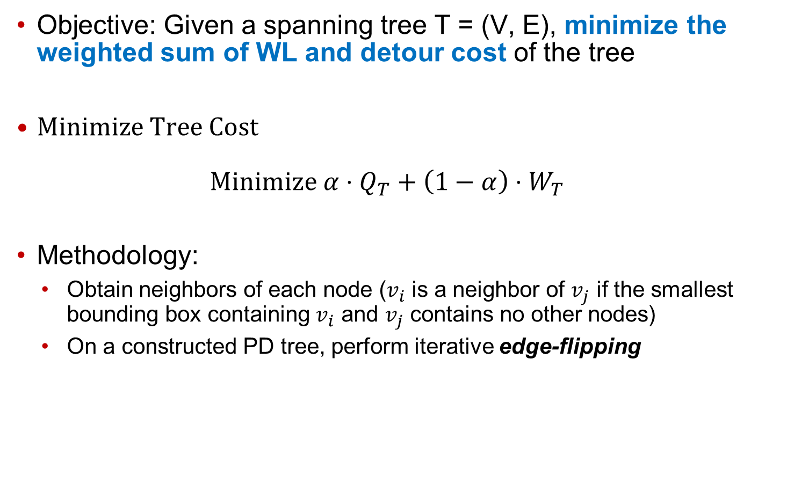
PD-II Algorithm
Objective: Given a spanning tree T = (V, E), minimize the weighted sum of WL and detour cost of the tree
$Minimize Tree Cost$
$Minimize α⋅Q_{T}+\left(1−α\right)⋅W_{T}$
Methodology:
  Obtain neighbors of each node ($v_{i}$ is a neighbor of $v_{j}$ if the smallest bounding box containing $v_{i}$ and $v_{j}$ contains no other nodes)
  On a constructed PD tree, perform iterative edge-flipping
PD
PD-II
HVW
DAS
Notes:
!!! 12 minutes
I will now describe our PD-II algorithm.
[CLICK] Our objective is to recover both WL and PL of a given spanning tree. As we have seen before, detour cost minimizes PL effectively.
[CLICK] Hence, we minimize a weighted sum of detour cost and wirelength, using the weighting factor alpha
[CLICK] To do this, we obtain the neighbors of each node in the tree. Two nodes are said to be neighbors if the smallest bounding box containing them contains no other nodes
[CLICK] Then, we perform a tree surgery procedure called edge-flipping.

Slide 17
Edge-flipping
Remove an edge + add another
edge, for max. reduction in tree cost
Change direction of other edges to
ensure well-formed rooted tree
Flipping distance, D
  Restrict number of possible flips
  Number of edges in the DAG that require a change in direction
  D = 1 in the above example
  In practice, D > 1 has little benefit, but large runtime
removed
added
direction
changed
Edge-flipping “repairs” spanning tree to
recover both WL and DC
PD
PD-II
HVW
DAS
Notes:
[CLICK] Edge flipping is a procedure where one edge is removed from the tree and another is added, while reducing the tree cost.
//[CLICK] PD-II takes an input tree and searches for edge flips that improve flip cost. If the flip cost improves, the flip is taken for the edge flip with the max improvement in flip cost.
[CLICK] This is an example rooted tree, represented as a DAG
[CLICK] Edge-flipping involves removing this edge and adding this new edge in red
[CLICK] One of the directed edges in the new rooted tree is reversed from its previous orientation in order to maintain a well-formed rooted tree.
[CLICK] Considering all pairs of possible swaps could be expensive. Hence, we use a restriction called flipping distance to restrict the number of possible flips.
[CLICK] In the above example, the flipping distance is one, since only one edge changes direction
[CLICK] In practice, we find that having a flipping distance of >1 has very little benefit, but with an added runtime penalty. This is a tunable parameter in our methodology.
[CLICK] This way, edge-flipping repairs the spanning tree to recover both WL and DC

Slide 18
PD-II Algorithm – Complexity and Runtime
Initial spanning tree construction
  PD-II can improve any input spanning tree
  Starting with PD solution beneficial (strong WL, PL starting point)
Complexity
  Neighbor calculation ~O(log n)
    Placements of net pins show much lower than O(log n) neighbors on average
  PD implementation with binary heaps has a complexity of O(n log n)
  PD-II – O(n³)
    With distance restriction - O(D.n²), and much faster in practice
Runtimes
  Industry design with 1.9 million datapath nets
    PD = 59.3 seconds, PD-II = 3.4 seconds
  PD-II costs less than 1 additional second of runtime per million nets
PD
PD-II
HVW
DAS
Notes:
I would like to stress on some of the details about PD-II.
[CLICK] PD-II can improve any input spanning tree, but starting with a PD tree is beneficial since it gives us a strong starting point w.r.t. WL and PL.
[CLICK] The neighbor calculation step has a worst case complexity of log n.
// ([Naamad84] showed that the expected number of maximal empty boxes amidst n random points in a plane – upper bound of O(n log n))
Our analysis of placements of net sinks shows the average number of neighbors is 2.58, 4.27, 6.15 and 8.24 for small, medium, large and huge nets
[CLICK] We have a PD implementation which runs in O(nlogn) time
[CLICK] The runtime complexity of PD-II is O(n^3), which reduces to D.n^2 with the distance restriction. However, in practice, converges rapidly.
[CLICK] Here, I report the runtimes of production codes of these algorithms on an industry design. PD takes …. And PD-II takes…. The runtime penalty of PD-II is negligible, taking less than 1 additional second of runtime per million nets

Slide 19
Steinerization
Convert spanning tree to Steiner tree - HVW algorithm [Ho90]
Problem: no DC awareness during HVW Steinerization
PD
PD-II
HVW
DAS
Notes:
Next up, we convert the spanning trees into Steiner trees, since Steiner trees are beneficial for timing estimation, congestion prediction and physical synthesis optimization.
We convert the PD-II trees into Steiner trees using the maximal edge-overlapping heuristic by Ho, Vijayan and Wong.
//HVW traverses the tree from the leaves and iteratively maximize overlaps with the currently visited edge and its immediate children edges.
[CLICK] However, HVW is not aware of DC. How do we recover the DC from the resulting Steiner tree?

Slide 20
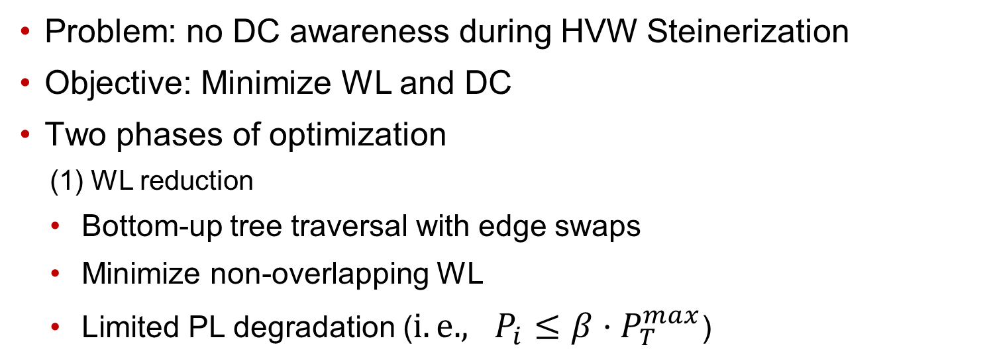
Detour-Aware Steinerization (DAS) Algorithm
Problem: no DC awareness during HVW Steinerization
Objective: Minimize WL and DC
Two phases of optimization
  (1) WL reduction
  Bottom-up tree traversal with edge swaps
  Minimize non-overlapping WL
  Limited PL degradation ($i.e., P_{i}≤β⋅P_{T}^{max}$)
v₂
v₂
v₃
v₃
v₁
5
2
v₁
PD
PD-II
HVW
DAS
Notes:
Hence, we formulate the problem of minimizing WL and DC in Steiner trees.
[CLICK] We perform two phases of optimization
[CLICK] First, a WL reduction step by bottom-up tree traversal and swapping edges to minimize WL. We remove a directed edge from the tree and add a new edge, while ensuring well-formed trees
//(by ensuring that the new parent of the edge is not in the sub-tree of the child of the edge)
[CLICK] We allow for a controlled degradation in PL to obtain large benefits in WL

Slide 21
Detour-Aware Steinerization (DAS) Algorithm
(2) DC reduction
  Top-down tree traversal with edge swaps
  No WL degradation
Complexity and runtime
  O(n²), but closer to O(n.log n) in practice
  For a million nets, DAS runtime:
  8.6 seconds for 16-terminal nets
  17.1 seconds for 32-terminal nets
  48.3 seconds for 64-terminal nets
v₃
v₃
v₂
v₂
v₁
v₁
PD
PD-II
HVW
DAS
Notes:
[CLICK] The second phase is a DC reduction step. We perform a top-down tree traversal and swap edges to reduce DC. Note that reducing the DC of sinks closer to the source will reduce the DC of all the downstream sinks
Swap edges to reduce DC, without allowing for WL degradation
[CLICK] The complexity of DAS is O(n2), but closer to O(nlogn) in practice. Runtime are shown below

Slide 22
Outline
Background and Motivation
Related Work
Our Methodology
Experimental Setup and Results
Conclusion
Notes:
I’m going to give a brief description of our experimental setup before showing results

Slide 23
Experimental Setup
Implemented in C++
Testcases: DAC 2012 contest benchmarks
  Placements done using state-of-the-art academic placer, ePlace [Lu15]
  Nets and pin locations extracted from the benchmarks
    Total 749K nets - divided into four groups based on fanouts - {small, medium, large, huge} nets
Metrics to report results
  Normalized WL (W_{Tnorm}) – (Tree WL) / (reference tree WL)
  (Reference trees = Prim’s MST for spanning / FLUTE for Steiner tree)
  Normalized PL (P_{Tnorm}) – (Sum of PLs) / (sum of source-to-sink Manhattan distance)
 | small | medium | large | huge
Fanout | 4 - 7 | 8 - 15 | 16 - 31 | 32+
#nets | 533029 | 128463 | 46486 | 20853
Notes:
!!! 17 minutes
[CLICK] Our code is implemented in C++ and can easily be added as an extension to existing tools based on PD
[CLICK] We analyze the nets of the DAC 2012 Placement benchmarks, and placed using ePlace, a state-of-the-art academic placer. Nets are extracted from these designs and are grouped into 4 clusters based on the fanouts. Here are some statistics of the number of nets in these designs
[CLICK] We report our results as normalized WL and PL, where the WL normalization is done using MST WL for spanning trees and FLUTE WL for Steiner trees. PLs are normalized by the sum of source-to-sink Manhattan distances

Slide 24
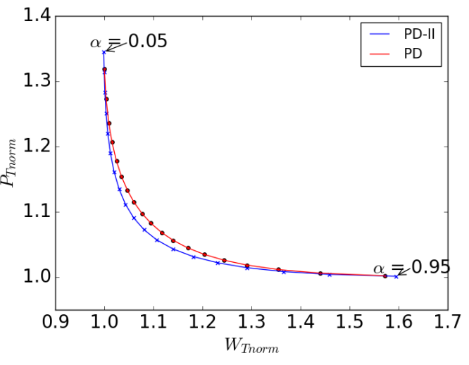

Pareto Curve Comparison PD vs. PD-II
WL and PL tradeoff curves for large nets for different $α$
PD-II reduces both WL and PL from a PD construction
Reduced delays + reduced capacitance!
Pushing the curve
left and down
Notes:
The WL and PL tradeoff Pareto curves show a good picture of the improvement due to our algorithms. The x-axis is the normalized WL and y-axis is the normalized PL. Each point in the plot depicts the (WL,PL) value for a particular value of alpha.
[CLICK] This is the Pareto curve for large nets – fanouts of 16 to 31. The red line is the result from PD, and the blue line is the result from PD-II. We see that we are able to meaningfully shift the Pareto curve towards the origin.
[CLICK] Lower WLs and PLs result in reduced delays and reduced capacitances!

Slide 25
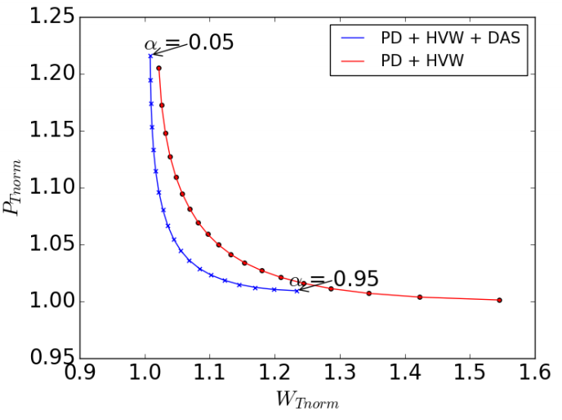
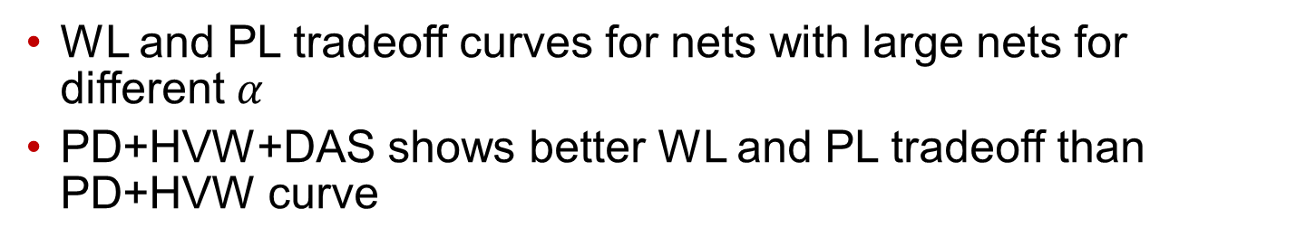
Pareto Curve Comparison PD+HVW vs. PD + HVW + DAS
WL and PL tradeoff curves for nets with large nets for different $α$
PD+HVW+DAS shows better WL and PL tradeoff than PD+HVW curve
Get lower power and better performance out of a technology node!
Pushing the curve
left and down
Notes:
Here, I show the benefit of our DAS algorithm. To do this, we compare the results from the traditional PD+HVW flow (in red) to the results with DAS added (in blue)
[CLICK] This is the Pareto curve for large nets – fanouts of 16 to 31. Again, we are able to meaningfully shift the Pareto curve towards the origin.
[CLICK] Hence, we can squeeze more out of a given technology node.

Slide 26
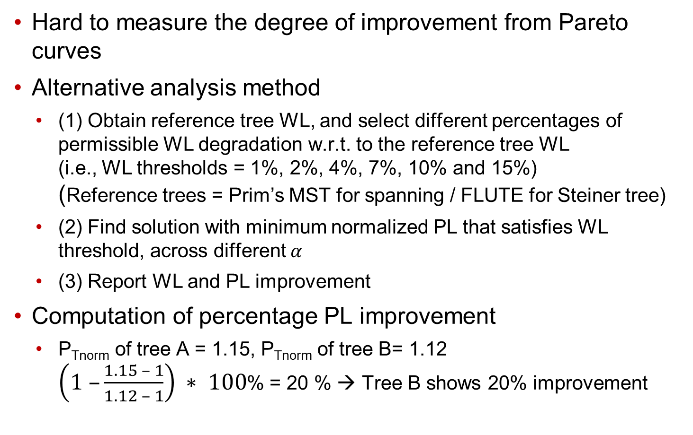
Measurement of Improvement
Hard to measure the degree of improvement from Pareto curves
Alternative analysis method
  (1) Obtain reference tree WL, and select different percentages of permissible WL degradation w.r.t. to the reference tree WL
  (i.e., WL thresholds = 1%, 2%, 4%, 7%, 10% and 15%)
  (Reference trees = Prim’s MST for spanning / FLUTE for Steiner tree)
  (2) Find solution with minimum normalized PL that satisfies WL threshold, across different $α$
  (3) Report WL and PL improvement
Computation of percentage PL improvement
  P_{Tnorm} of tree A = 1.15, P_{Tnorm} of tree B= 1.12
  $\left(1 –\frac{1.15 – 1}{1.12 – 1}\right) ∗ 100$% = 20 % → Tree B shows 20% improvement
Notes:
Pareto curves help in visualizing the direction of improvement. However, it becomes hard to quantify the improvement.
[CLICK] Hence, I am going to describe an alternative analysis method to quantify the improvements in WL and PL separately. We first choose thresholds of permissible WL degradation w.r.t. the reference tree WL
[CLICK] And then, find the minimum PL solution that meets the WL threshold across different $α$.
Here is an example. If the normalized PL of tree A is 1.15 and of tree B is 1.12, we say that tree B has 20% better PL than tree A

Slide 27
PD-II Improvement
PD-II gives better results than PD for all groups of nets
Small improvement (0.26% - 1.63%) on small nets
Large improvement (4.91% - 18.87%) on huge nets
18.87%
4.91%
0.26%
1.63%
Notes:
[CLICK] This is the percent improvement in normalized PL due to PD-II over PD. For each threshold, we see that PD-II shows better results than PD across all groups of nets.
[CLICK] Small PL improvements on nets with small fanouts, since detour cost is close to optimal for smaller nets
[CLICK] Large PL improvements on nets with large fanouts

Slide 28
DAS Improvement
DAS always obtains better results than HVW
Significant improvement from 8.36% to 83.67%
Larger improvement on small nets
83.67%
8.36%
Notes:
[CLICK] Similarly, DAS consistently results in trees with lower PL than the HVW trees.
[CLICK] Significant improvement in PL of ~83% for small nets, when WL degradation threshold dropped to 15%.
[CLICK] There is much larger improvement on small nets, suggesting that Steinerization has further scope for improvement

Slide 29
Setup for Comparison with State-of-the-art Tool
Comparison with SALT (Chen et al., ICCAD17)
  Use FLUTE as an initial input
  → For small fanout nets, FLUTE produces optimal WL solution. PL could be good as well
Metaheuristic
  Run FLUTE and our flow (PD + PD-II + HVW + DAS)
  If FLUTE {WL, PL} < (Our Flow) {WL, PL} → Use FLUTE solution
  Otherwise → Use solution from Our Flow
Notes:
Finally, we compare our results with the state-of-the-art Steiner construction, SALT.
[CLICK] In their construction, FLUTE is used as the starting tree. However, FLUTE gives optimal WL trees for fanouts less than 9.
[CLICK] In order to have an equivalent comparison, we use the following metaheuristic. We run both FLUTE and our flow. If FLUTE dominates our solution in both WL and PL, we pick the FLUTE solution. Otherwise, we use our solution.

Slide 30
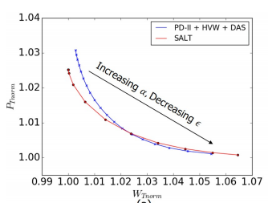
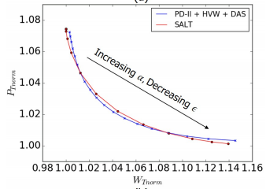
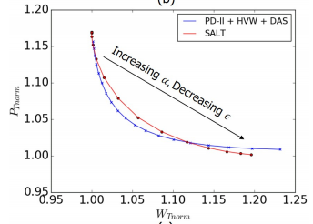
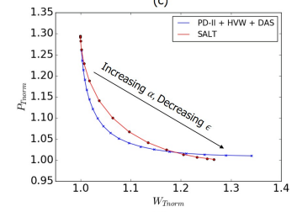
Pareto Curve Comparison with SALT
Our flow shows better WL and PL tradeoff for nets with fanout > 7
(a) Small nets
(b) Medium nets
(c) Large nets
(d) Huge nets
Notes:
With this metaheuristic approach, we see that our flow shows better WL and PL tradeoff for medium to huge nets.

Slide 31

Improvement over SALT
SALT outperforms our method for small nets with WL threshold $≤$ 10%
Our method outperforms SALT for large and huge nets
As WL threshold increases, our method shows large improvements over SALT
Notes:
[CLICK] SALT gives better PL than our method under 2 conditions – for nets with small fanout, and when WL threshold is less than 10%.
[CLICK] Our method outperforms SALT for all other cases, with the added benefit of easy-to-tune parameters.
[CLICK] As WL threshold increases, the PL improvements due to our method are significantly bigger

Slide 32
Outline
Background and Motivation
Related Work
Our Methodology
Experimental Setup and Results
Conclusion
Notes:
That brings us to the end of this presentation.

Slide 33
Conclusion
Achieve up to 18% improved PL and up to 13% improved WL for spanning and Steiner tree constructions
Lower capacitance and reduced delays (especially on unavoidable high-fanout nets) → squeeze more out of a given technology node
Better WL and PL tradeoff than from state-of-the-art academic tool
Ongoing & Future work
  Improving PD algorithm for bounded clock skew routing – with upper and lower bounds on tree cost and radius
Notes:
We have seen that, with our algorithms, PD-II and DAS, we can achieve up to 18% improved PL and up to 13% improved WL for spanning and Steiner trees
[CLICK] These benefits translate into lower capacitances and reduced delays, enabling us to squeeze more out of a given technology node
[CLICK] We achieve better WL and PL metrics than SALT, for most cases
[CLICK] And, we have plans of extending the PD algorithm for bounded clock skew routing.

Slide 34
Thank you!
Notes:
Thank you very much for listening. Any questions?

