Slide 1
Wot the L: Analysis of Real versus Random Placed Nets, and Implications for Steiner Tree Heuristics
Andrew B. Kahng, Christopher Moyes, Sriram Venkatesh and Lutong Wang
UC San Diego CSE and ECE Departments
Notes:
Good morning, everyone. The topic of my talk is Wot the L: analysis of real versus random placed nets, and implications for Steiner Tree heuristics. This work is in collaboration with Christopher Moyes, Sriram venkatech and Professor Andrew

Slide 2
Outline
Background and Motivation
L-ness definition
Related Work
Pointset Characterization
Real Pointset Generator
Our New Lookup Table for RSMT Estimation
Conclusion
Notes:
In my talk, I will first give the background and motivation of our work. In this part, we define L-ness attribute of a pointset. Then, I will briefly summarize the previous work and show an outline of our contributions. Next, I will describe our pointset characterization, pointset generator, and our new lookup table for RSMT estimations. Last, I will conclude my talk.

Slide 3
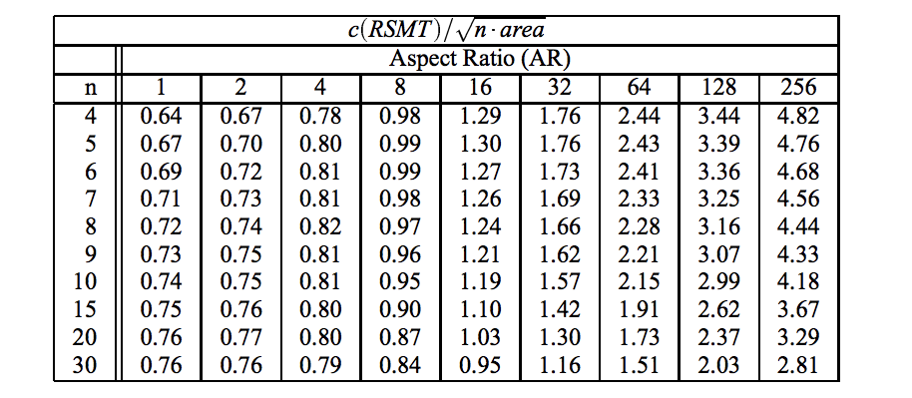
Background
RSMT Cost (Cheng 1994, Caldwell 1999)
Use AR and / or cardinality
Estimators built using random pointsets.
Tables from Caldwell et al. 1999
Notes:
The NP-hard Rectilinear Steiner Minimum Tree problem has been studied in the VLSI physical design literature for well over three decades. Fast estimators of RSMT cost are a required ingredient of modern physical planning and global placement methods.
The table shown here is from an analytic lookup table-based method from Caldwell.
[click] The LUT is based on both the number of points and the aspect ratio of the pointset in the RSMT instance. Given an aspect ratio and the cardinality of the pointset, the lookup table returns the estimated RSMT cost.
[click] As with many previous works, they obtain such lookup tables, algorithms or intuitions using random pointsets.
However, real pin placements may be far from the random pointsets. In the next slide, we show our observation with real pointsets.

Slide 4
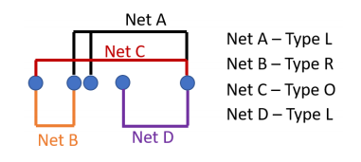
Non-Uniformity of Real Placements
Real placements
Pointsets from leon3mp and theia
Commercial P&R tool
Non-uniformity in X / Y directions separately
Three types of net
Type L
Type R
Type O
Notes:
As a motivating study, we first confirm the non-uniform distribution of real pointsets.
[click] We use real design blocks leon3mp and theia and place the netlist by a commercial P&R tool. The non-uniform distribution can be separated along X and Y directions.
[click] For each direction, we can categorize the nets into the following 3 types.
For example, net A is shown as black in the figure, and it connects three instances. All other nets incident to the three instances only have connections to the left, and no connections to the right. So we define that net A is type L. Similarly, net B is type R; All other nets are type O.
In the next slide, we show the non-uniformity for real placed pointsets.

Slide 5
Non-Uniformity of Real Placements
Figure below: superposition of 3 distributions
Type L: most pins near the left boundary
Type R: most pins near the right boundary
Type O: most pins near boundaries
Non-uniform pin distribution
#pins
Notes:
This figure shows superposition of 3 distributions of pin locations. The X-axis shows the distribution of pin locations along the X direction. The distribution is normalized to a range from 0 to 1, with step size of 0.05. The Y-axis shows the total number of pins for each normalized X coordinate. The blue columns show the distribution for type L nets. The red columns show the distribution of pin locations for type R nets. And the green columns show for type O nets.
[click] If we look at the blue columns representing the statistics for type L net, we see that a “real” placement tool will push pins toward the left boundary. If we look at the type R net, then placers will push most of the pins to the right boundary. For type O nets, most of the pins are pushed to the boundaries as well.
[click] Clearly, the pin distribution is not uniform, with more pins towards the boundaries of the bounding box. So there might be a gap if optimization algorithms are obtained using random pointsets.

Slide 6
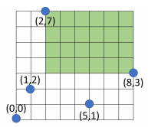
L-ness
Given a pointset P
B(P): the bounding box of P
R(P): the area of the largest empty rectangles
Inside B(P)
Contain one corner of B(P)
No points inside
R(P)/B(P) = L-ness
$$\frac{R\left(P\right)}{B\left(P\right)}=\frac{24}{56}$$
Notes:
Here we give the formal definition of L-ness attribute for a pointset. Given a pointset P,
[click] the bounding box of P is the minimum area rectangle that contains all points of P; we use B(P) to denote the bounding box area. In this figure, there are five points, and the outer boundary is the bounding box of this net
[click] R(P) is the area of the largest empty rectangle. In the figure, the green rectangle is the largest empty rectangle. The largest empty rectangle must satisfy three constraints. First, it must be inside the bounding box; Second, it must contain one corner of the bounding box; and third, it must have no points inside the rectangle.
[click] The L-ness of P is measured as R(P)/B(P). From the figure, we can tell that R(P)/B(P) should be within 0 to 1. A larger L-ness indicates that more points are distributed along two of the four boundaries of the bounding box. In this case, the RSMT cost approaches the half-perimeter wirelength. For the figure given, the L-ness value would be 24/56.
Given this definition, in this work, we try to fill the gap between conclusions drawn from random pointsets, and real pointsets.

Slide 7
Outline
Background and Motivation
Related Work
Pointset Characterization
Real Pointset Generator
Our New Lookup Table for RSMT Estimation
Conclusion
Notes:
Now I will briefly summarize the previous works.

Slide 8
Related Works
RSMT estimation using random pointsets
[Cheng94][Caldwell99]: RSMT cost depends on cardinality / aspect ratio of a pointset
Spanning and Steiner Tree Constructions
[Alpert93]: Prim-Dijkstra’s Algorithm that “blends” Prim’s MST and Dijkstra’s SPT algorithms
[Ho90]: Algorithm for optimal edge-overlapping separable MSTs to obtain Steiner trees
[Chu08]: FLUTE to generate near-optimal WL Steiner trees using lookup tables
Our work:
Propose L-ness attribute of a pointset
L-ness distinguishes real from random pointsets
New pointset generator to match real pointsets
New lookup table for RSMT cost estimation.
Notes:
We categorize the previous works into two types, RSMT estimation, and tree construction methods.
[click] For RSMT estimation, Cheng and Caldwell propose LUT-based RSMT cost estimation. They use cardinality and aspect ratio of a pointset to estimate the RSMT cost. Their conclusions were drawn using random pointsets.
[click] Others use constructive methods to build minimum spanning tree, shortest paths, or Steiner trees. The work of Alpert propose a blend of Prim and Dijkstra algorithms to estimate the tree cost. Later FLUTE create optimal Steiner tree lookup table up to net degree of 9. These works are capable to estimate the wirelength for each individual net.
[click] In our work, we explore the attribute of a pointset and propose a formal definition of L-ness attribute; we then show the statistical difference between real and random pointsets. Next, we describe how we can generate pointsets that look realistic compared to the placements; Finally, we present our new lookup table for RSMT cost estimation, and we show experimental results with accuracy and runtime.

Slide 9
Outline
Background and Motivation
Related Work
Pointset Characterization
Real Pointset Generator
Our New Lookup Table for RSMT Estimation
Conclusion
Notes:
We now present our pointset characterization methodology.

Slide 10
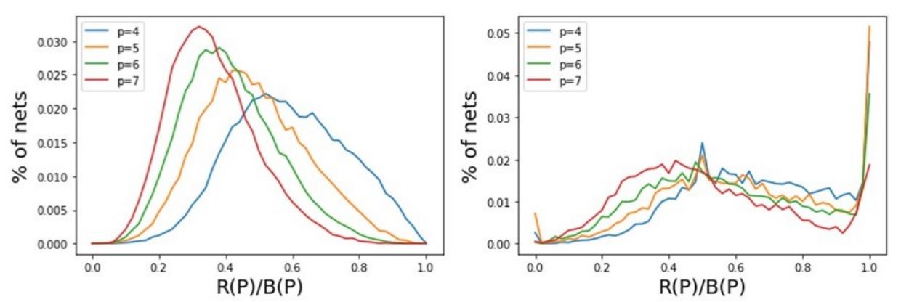
L-ness in Real versus Random Pointsets
Distributions of L-ness (R(P)/B(P))
100K pointsets, cardinality p = {4,5,6,7}
Real pointsets from 7 design blocks, two academic and two commercial placers, two technology nodes
Significantly larger L-ness for real pointsets
Random pointsets
Real pointsets
Notes:
We compare L-ness distribution of 100K random pointsets. Since the RSMT cost of two pin and three pin nets is equal to the half-perimeter wirelength, here we use pointsets with cardinality of 4 to 7. The real pointsets come from 7 design blocks, placed using two academic placers, and two commercial placers in two technology nodes.
[click] The bottom figures show the distribution for random and real pointsets. In each plot, the x-axis denotes the R(P)/B(P) ratio and the y-axis denotes the fraction of nets for each R(P)/B(P) value.
[click] From the figure, we see that real pointsets have significantly larger L-ness, especially near 1.
We believe that this large L-ness arises due to the following reasons. Given a large chip area and a relatively small bounding box (b) area for any net n, it is intuitive that the other nets incident to the cells of net n have their bounding boxes outside b. This causes the cells to get pulled towards the boundary, and extend the boundaries of net n0 due to multiple inter-related nets. Further, low net degrees usually result in a geometrically asymmetrical cell distribution, increasing the L-ness of a particular net.

Slide 11
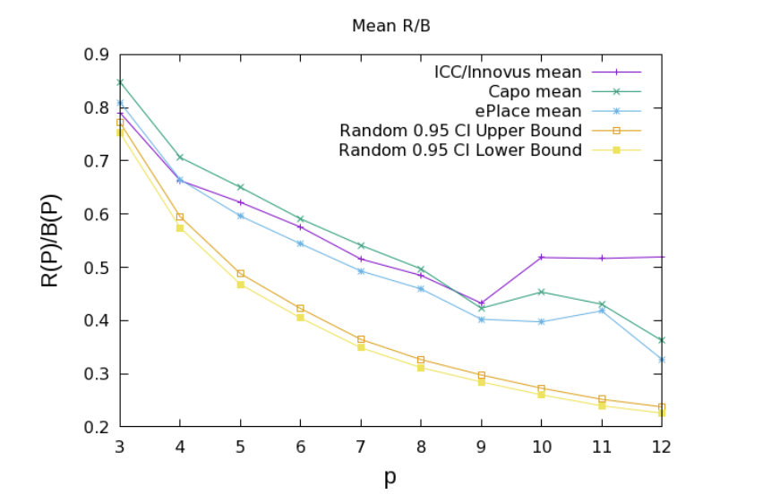
Statistical Difference (1)
Bootstrapping with 95% confidence interval
Academic and commercial placements
0.95 confidence interval lower/upper bound for random pointsets
Real pointsets are significantly different than random pointsets!
Notes:
To confirm the statistical difference, we use two methods to check the L-ness distribution for pointset cardinality from 3 to 12. This slide shows the first method. The bootstrap test provides a 95% confidence interval on the average of L-ness for 10K random pointsets.
[click] In the figure, the two yellow lines show the lower and upper bound of L-ness for random pointsets.
[click] The other three lines come from two commercial placers, and two academic placers. The figure shows that the means of real pointsets do not lie within the confidence intervals of random pointsets for any p within 3 to 12.
[click] Hence, real pointsets have a statistically significant larger L-ness compared to random pointsets.

Slide 12
Statistical Difference (2)
Two-sample Kolmogorov-Smirnov test
Statistically significant different when $D_{nm}>1.36$
$$D_{nm}=\sqrt{\frac{nm}{n+m}}⋅\sup\left(\left|F\left(x\right)−G\left(x\right)\right|\right)$$
p | KS Statistic
3 | 3.363
4 | 3.788
5 | 5.159
6 | 4.461
7 | 3.658
10 | 4.754
12 | 7.106
x: R(P)/B(P)
F(x): cumulative distribution
for real pointsets
G(x): cumulative distribution
for random pointsets
sup: maximum distance
All are greater than 1.36!
Notes:
This slide shows the second method: two-sample KS test.
[click] Given the following equation, we have a statistically significant difference if the KS statistic Dnm > 1.36. In this equation, x is the L-ness value. F(x) and G(x) denote the cumulative distribution of L-ness for real pointsets and random pointsets, separately. Sup is the maximum distance.
[click] In this table, we see that Dnm > 1.36 for all random versus real pointsets. Therefore again, we can confirm the statistically significant difference between L-ness distributions of random and real pointsets.

Slide 13
Outline
Background and Motivation
Related Work
Pointset Characterization
Real Pointset Generator
Our New Lookup Table for RSMT Estimation
Conclusion
Notes:
Since it is challenging to obtain real placement data in a large amount, to get more insight into the RSMT estimation, there is a need to generate pointsets with prescribed L-ness. In the next slide, I will show how we can generate pointsets.

Slide 14
Pointset Generation
Inputs:
cardinality $p$,
#points $k$ on bbox,
= ($p−k$) points inside bbox
Target L-ness range
$[\frac{R_{0}\left(P\right)}{B_{0}\left(P\right)}−Δ_{err}, \frac{R_{0}\left(P\right)}{B_{0}\left(P\right)}+Δ_{err}]$
Aspect ratio $AR$
Output:
Pointset P
Generate k points on the bounding box
Add a point
yes
$$\frac{R_{}\left(P\right)}{B_{}\left(P\right)}<\frac{R_{0}\left(P\right)}{B_{0}\left(P\right)}−Δ_{err}$$
Delete last point
100K pointsets generated using distribution of $p, k,\frac{R_{0}\left(P\right)}{B_{0}\left(P\right)}, AR$ from real placements
no
$$\left|P\right|==p$$
Output
Notes:
To generate a pointset with prescribed L-ness, we need to give the cardinality p, and the number of points k that define a bounding box. Knowing k points on the bounding box, we know that p-k points are inside the bounding box. For more information about why we need to separately provide the number of points on the bounding box, and the number of points inside the bounding box, please see details in our paper.
We also need to provide the target L-ness range that the generated pointset must satisfy, and the aspect ratio of the pointset.
The flow chart describes our algorithm.
[click] We first generate k points on the bounding box. Since R(P)/B(P) will monotonically decrease as we add one more point to an existing pointset,
[click] we add one point at a time inside the bounding box as long as the resulting L-ness is greater than the target L-ness lowerbound.
[click] We delete the last added point if we are below the L-ness lowerbound until we have generated p points.
[click] In our implementation, we simultaneously generate pointsets for different L-ness. Therefore, the discarded solution for a higher L-ness value can be reused for pointset with a lower L-ness value. We generate 100K pointsets using the distribution of p, k, L-ness and aspect ratio from real placements.

Slide 15
Impact of L-ness on RSMT Heuristics (1)
Use 10K pointsets per each R(P)/B(P)
$\text{0.2}≤\text{R}\text{(}\text{P}\text{)/}\text{B}\text{(}\text{P}\text{)}≤0.8$
$step=0.1$
$Δ_{err}=0.02$
Evaluation: 4 RSMT heuristics
Rectilinear MST
Prim-Dijkstra (PD) [Alpert93] (with parameter α = 0.3, 1)
Optimal edge-overlapping PD Steiner trees (HVW) [Ho90]
FLUTE [Chu15]
Notes:
In the next 2 slides, we study the impact of L-ness on RSMT heuristics.
[click] We first generate 10K pointsets for each L-ness value, from 0.2 to 0.8, with a step of 0.1, and ∆err of 0.02.
[click] We evaluate the wirelength cost of four heuristics. The first one is rectilinear minimum spanning tree. The second one is a blend of Prim’s minimum spanning tree, and Dijkstra’s shortest path algorithm. This algorithm tries to balance tree depth with wirelength tradeoff. We use 0.3, and 1.0 as the balancing parameters. The third one is optimal edge-overlapping of Steiner trees. The last one is FLUTE.

Slide 16
Impact of L-ness on RSMT Heuristics (2)
Implications
Wirelength  as L-ness 
Difference in WL among heuristics  as L-ness 
Assesments of heuristics’ benefits may have been
misguided by the use of random pointsets
Notes:
This figure shows the wirelength values vs. L-ness for different RSMT heuristics. The x-axis denotes the L-ness value, and the y-axis represents the total wirelength for all 10K pointsets per each L-ness value.
[click] We see that wirelength decreases as L-ness increases. This indicates that we should expect lower wirelength for real pointsets, because they tend to have larger L-ness values than random pointsets.
[click] Also, the difference in wirelength among heuristics decreases with increase in L-ness.
[click] Assessments of heuristics benefits may have been misguided by the use of random pointsets because random pointsets might not give sufficient insight into the benefits of RSMT heuristics.

Slide 17
Outline
Background and Motivation
Related Work
Pointset Characterization
Real Pointset Generator
Our New Lookup Table for RSMT Estimation
Conclusion
Notes:
Now I will present our new lookup table for RSMT estimation, utilizing L-ness attribute of a pointset.

Slide 18
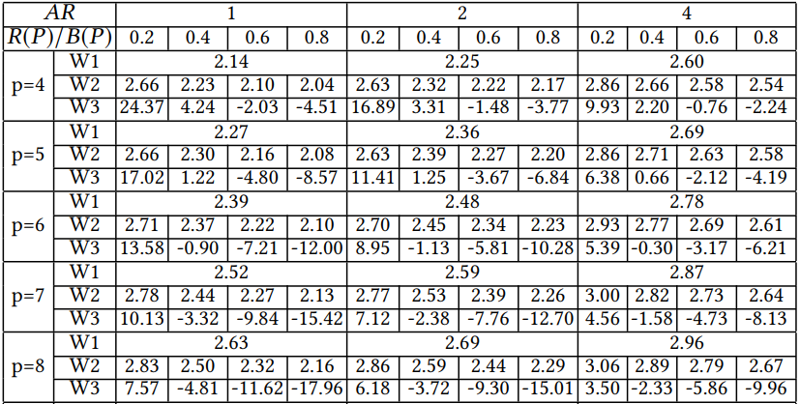
Improved WL Estimation Lookup Table
Three parameters in lookup table: AR, R(P)/B(P), p
W1: oblivious to L-ness (equivalent to [Caldwell99])
W2: our LUT
W3: %difference from W2 to W1
(1) [Caldwell99]
(2) Ours
%diff = $100⋅\frac{\left(2\right)– \left(1\right)}{(1)}$
Notes:
This slide shows our improved lookup table. Previously, Caldwell constructed a lookup table indexed with cardinality p and aspect ratio. We build upon this table and add L-ness as a third parameter.
[click] The first row W1 shows coefficients oblivious to L-ness. We generate these values using FLUTE averaged over 1000 pointsets with three different aspect ratios 1, 2 and 4. These values are equivalent to the wirelength values reported by Caldwell.
[click] The second row W2 shows the coefficients with specific L-ness values. Here we use four L-ness values, 0.2, 0.4, 0.6 and 0.8. Each value is generated using FLUTE averaged over 1000 pointsets.
[click] The third row W3 shows the difference between W1 and W2.
[click] We can see that W1 under estimates the wirelength by up to 25% for smalll L-ness values, and over estimate the wirelength by up to 18% for large L-ness values.
In the next slide, we will show the accuracy and runtime comparison.

Slide 19
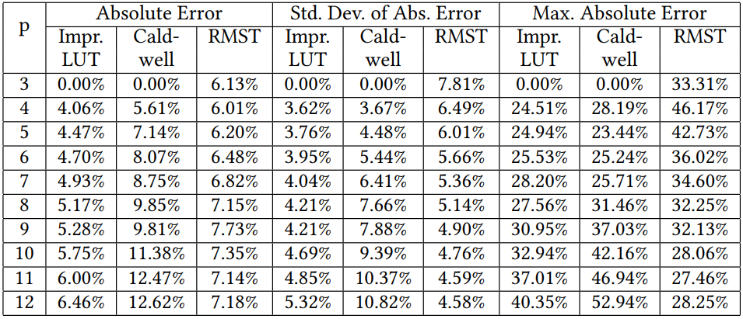
Advantages of Improved Lookup Table (1)
Accuracy
Error = $\frac{WL_{heur}− WL_{FLUTE}}{WL_{FLUTE}}⋅100\%$
The entire lookup table is available:
http://vlsicad.ucsd.edu/~sriram/Final_WL_estimate_LUT.htm
Notes:
We compare the accuracy of our improved LUT-based estimation to the work of Caldwell and RMST construction method. We use FLUTE to get the golden wirelength, and calculate the error percentage for each method.
[click] We can see that the absolute error is around 1.5% better than Caldwell when cardinality is small, and up to 6% better than Caldwell when cardinality is large.
[click] The standard deviation is always better than Caldwell, and is on average comparable to the constructive MST method. Also, our improved LUT has a smaller max absolute error compared to Caldwell.
For the complete lookup table, please find on our website.

Slide 20
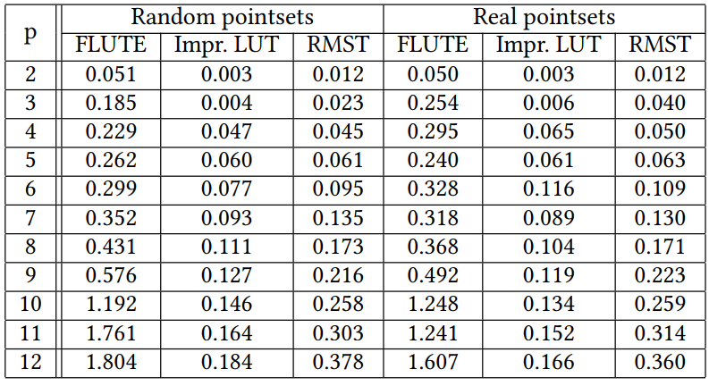
Advantages of Improved Lookup Table (2)
Runtime: FLUTE, our LUT and RMST
500k real and random pointsets
~2X faster than RMST
~10X faster than FLUTE
In terms of speed and accuracy, this new LUT is a non-dominated wirelength estimator!
Notes:
For the runtime, we run FLUTE, our LUT-based estimation and minimum spanning tree algorithm for 500K real and random pointsets. This table shows the runtime for different cardinalities of pointsets.
[click] Overall, our improved LUT is around 2X faster than RMST, and [click] on average 10X faster than FLUTE.
[click] In terms of speed and accuracy, our new LUT is a non-dominated wirelength estimator.

Slide 21
Outline
Background and Motivation
Related Work
Pointset Characterization
Real Pointset Generator
Our New Lookup Table for RSMT Estimation
Conclusion
Notes:
Now I will conclude my talk.

Slide 22
Conclusion
Formal definition of L-ness
Characterization of real and random pointsets
Pointset generator to match real pointsets
Implication to RSMT heuristics
Improved lookup tables for RSMT cost estimation, considering L-ness
Accuracy and runtime comparison to previous works.
Ongoing and future works
Direct L-ness-aware placement
Better wirelength correlation with routing
Wot the L = Know the L
Notes:
In this work, we formally define the L-ness attribute of a pointset.
We then characterize real and random pointsets and show their significant difference.
We propose an algorithm to generate pointsets that can match real pointsets, and we use our generated pointsets for comparison between different RSMT heuristics. We show that heuristics might be misguided if they are oblivious to L-ness.
We present our improved lookup table for RSMT estimation considering L-ness attribute, and give experiments showing accuracy and runtime comparison to previous works. Our new LUT is a non-dominated wirelength estimator.
Our future works include direct L-ness-aware placement, and better wirelength correlation with routing.
Last, Wot the L means know the L.

Slide 23
THANK YOU!

Slide 24
BACKUP

Slide 25
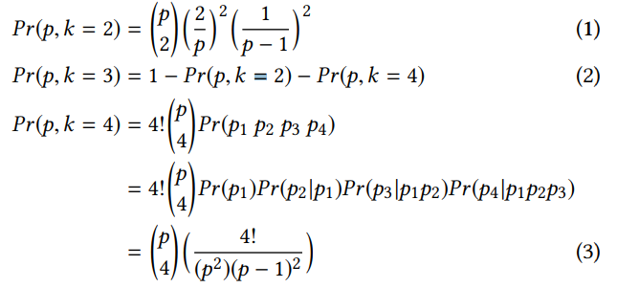
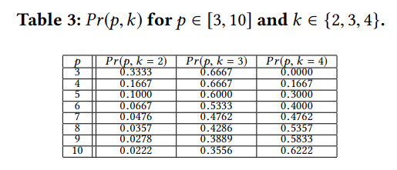
Preliminaries
Probability that k points define the bounding box
Notes:
To generate a pointset with prescribed L-ness, we have to first generate the points that define the bounding box of a pointset.
A bounding box can be represented by four extreme coordinate values, i.e., xmin, xmax , ymin and ymax . Given unique x- and y-coordinates, at most four points of a pointset can define the pointset’s bounding box, where each of the points provides exactly one of the four extreme coordinates. Further, at least two points define the bounding box, where each of the points contains one extreme x-coordinate and one extreme y-coordinate. We use Pr(p, k) to denote the probability that the bounding box of a pointset P (having cardinality p) is defined by k points (k ∈ {2, 3, 4}).
For k = 2, assume that points p1 = (x1,y1) and p2 = (x2,y2) define the bounding box. Then, x1 (resp. y1) must be xmin or xmax (resp.ymin orymax ) out of the p x-coordinates (resp.y-coordinates), and x2 (resp.y2) can only be the other extreme x (resp.y)-coordinate out of p − 1 x-coordinates (resp. y-coordinates). Thus, Equation (1) gives the probability Pr(p, 2).
For k = 4, each of four points can define only one extreme coordinate of the bounding box. Assume that these points are p1 = (xmin, ¬(ymin ∨ymax )), p2 = (xmax , ¬(ymin ∨ymax )), p3 = (¬(xmin ∨ xmax ),ymin), and p4 = (¬(xmin ∨ xmax ),ymax ). Then, the probability that four points define the bounding box is as given in Equation (3).
Table 3 provides a lookup table for Pr(p, k) for k ∈ {2, 3, 4} and p ∈ [3, 10]. We will use Table 3 when we generate real pointsets.

Slide 26
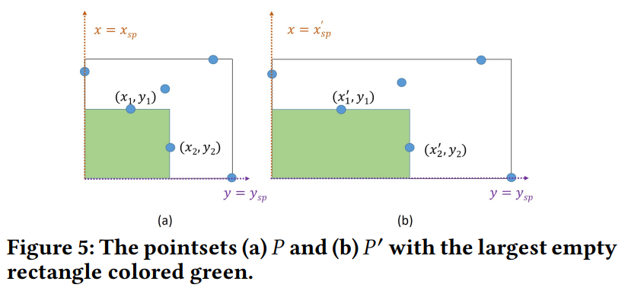
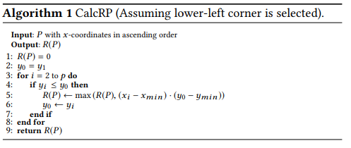
Preliminaries (2)
Independence of AR and R(P)/B(P)
Calculation of R(P)/B(P)
Notes:
Further, since we would also like to have pointsets with different aspect ratios.
This slide shows the independence of L-ness to aspect ratio. Intuitively, R(P)/B(P) is preserved when a 2D pointset P is “stretched” (by scaling of x-coordinates and of y-coordinates) into a pointset P ′ that has a different aspect ratio. In this way, we know that by generating a pointset with a square bounding box, we can always transform it into a pointset of a target aspect ratio.
[click] The algorithm below shows how to calculate L-ness. Since there are only four corners in the bounding box that can form an empty rectangle, we only show the algorithm assuming the lower-left corner is selected. We begin with pointset P sorted in ascending order of x-coordinates. Lines 1 and 2 perform initializations. In Lines 3 – 8, we check whether the current point has a smaller y-coordinate than the stored value of y0. If so, the lower-left corner will form an empty rectangle, and we update the maximum known rectangle area. The same procedure is followed to compute the largest empty rectangle at the remaining corners. We step through the sorted list of points, check if each pair of points forms an empty rectangle, and if so, update the maximum known rectangle area. The time complexity of the algorithm is lower-bounded by the implied sorting step, which gives a Θ(p log p) time complexity.

Slide 27
Experimental Setup
Real pointsets
7 design blocks: leon3mp, netcard, theia, jpeg, aes, mpeg, Arm Cortex A53
Two commercial P&R tools
Two technology nodes: 28LP and 16FF
DAC-2012 benchmark suites
Two academic placers: capo, ePlace
Notes:
Since finding a solution with optimal WL and PL is trivial for two- and three-pin nets, our experiments focus on nets with fanout larger than two. We use real pointsets from 7 design blocks, placed by two commercial P&R tools in two technologies. Also, we include placements from DAC-2012 benchmark suites by two academic placers.

Slide 28
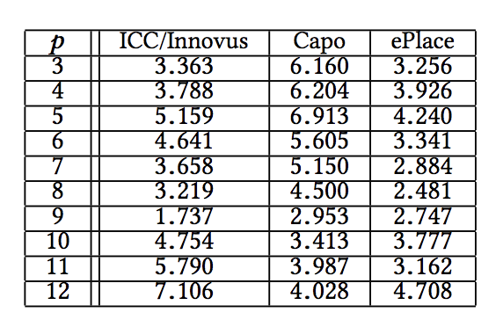
L-ness: Real versus Random Pointsets
Bootstrapping average L-ness
Sample 10k random pointsets with replacement
Find the average L-ness
Repeat 10k times
Sort the list with L-ness values
The middle 95% of sample means is the confidence interval
Kolmogorov-Smirnov Test
Generate CDFs of the L-ness distribution for each type of pointset
Where F and G are the CDFs of the L-ness distributions of random and real pointsets respectively:
Compute D_{nm} = sqrt(nm/(n+m)) max_x abs(F(x) - G(x))
If D_{nm} > 1.36 (95% CI), there is a statistically significant difference in the distributions
Both statistical tests fail, so there is a statistically significant difference between L-ness in real and random pointsets.

