Slide 1


Leveraging Thermally-Aware Chiplet Organization in 2.5D Systems to Reclaim Dark Silicon
Furkan Eris¹, Ajay Joshi¹, Andrew B. Kahng^{2,3},
Yenai Ma¹, Saiful Mojumder¹ and Tiansheng Zhang¹
¹ECE Department, Boston University, Boston, MA, USA;
²ECE and ³CSE Departments, UC San Diego, La Jolla, CA, USA
This research has been funded by the NSF grants
CCF-1716352, CCF-1564302, CCF-1149549, and CNS-1149703.

Slide 2
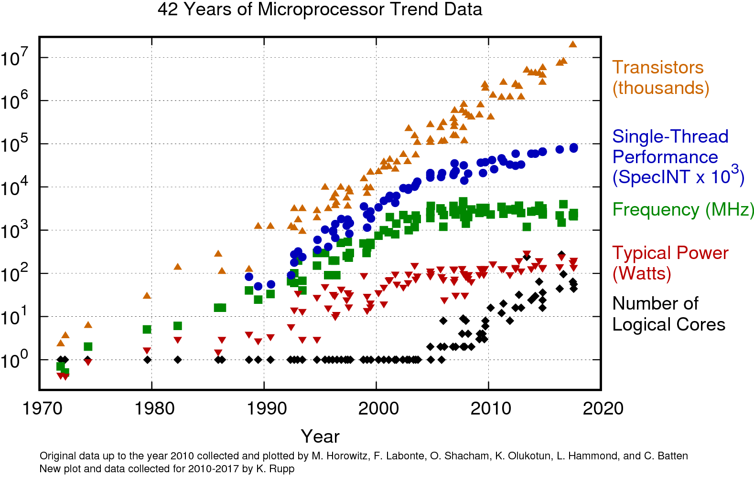
Technology Scaling Trend

Slide 3
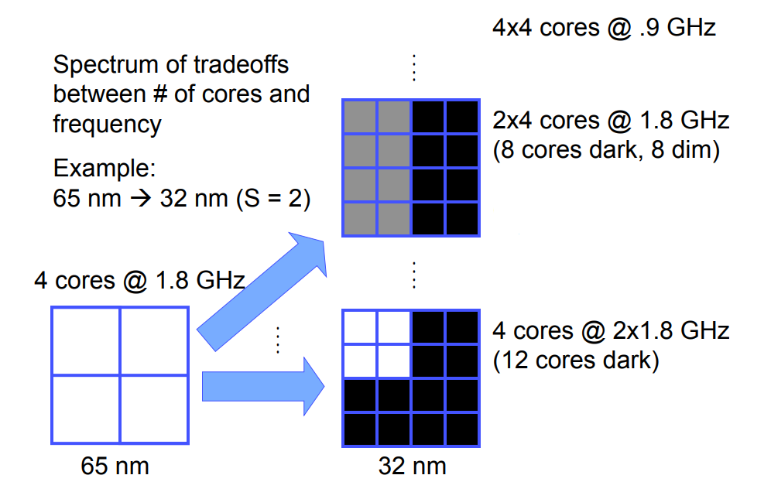
Dark Silicon Problem
Not all cores can be operated at the highest frequency or even turned on simultaneously due to today’s thermal design power (TDP) constraint.
[Taylor et al., IEEE Micro’13]

Slide 4
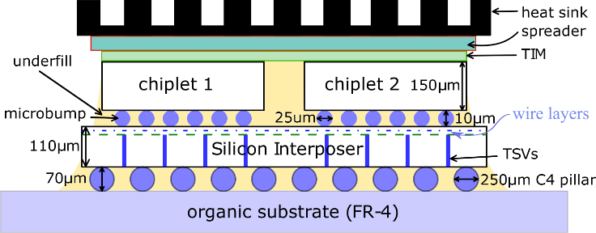
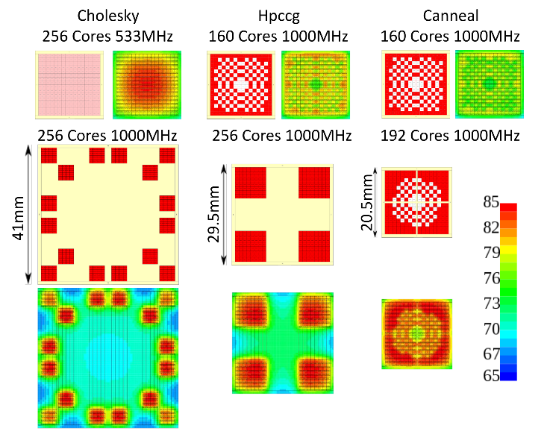
Contributions
We propose to use 2.5D integration technology and thermally-aware chiplet organization to address the dark silicon problem.
We divide a large manycore chip into chiplets and place them on an interposer with strategically inserted spacings between the chiplets.
We can then have more active cores operating at a higher frequency, which leads performance improvement.
We formulate and solve an optimization problem to determine a thermally-aware chiplet organization that jointly maximizes performance and minimizes cost.

Slide 5
Outline
Background
Thermally-Aware Chiplet Organization in 2.5D Systems
  Thermal Behavior of 2.5D Systems
  Manufacturing Cost Model
  Optimization of Chiplet Organization
  Evaluation Methodology
Evaluation Results
Conclusions

Slide 6
Background: Prior Dark Silicon Solutions
Specialized cores [Venkatesh et al., MICRO’11] | Application-specific
DVFS [Muthukaruppan et al., DAC’13] | Performance ↓
Near-threshold computing [Silvano et al., DATE’14] | Accuracy and reliability ↓
Approximate computing [Han et al., ETS’13] | Accuracy and reliability ↓
Power budgeting [Pagani et al., CODES+ISSS’14] | Not persistent
Computational sprinting [Raghavan et al., HPCA’12] | Not persistent
Our approach
2.5D Integration
Thermally-Aware Chiplet Organization
More Active Cores
Higher Frequency
Persistent

Slide 7

Background: 2.5D Systems

Slide 8
Outline
Background
Thermally-Aware Chiplet Organization in 2.5D Systems
  Thermal Behavior of 2.5D Systems
  Manufacturing Cost Model
  Optimization of Chiplet Organization
  Evaluation Methodology
Evaluation Results
Conclusions

Slide 9
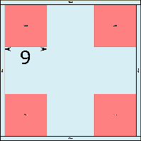
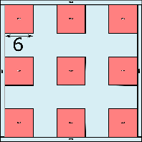
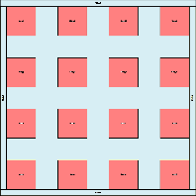
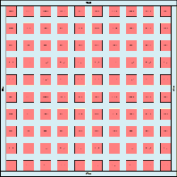
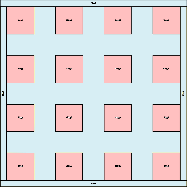
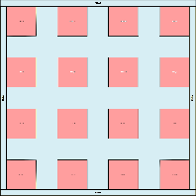
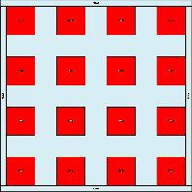
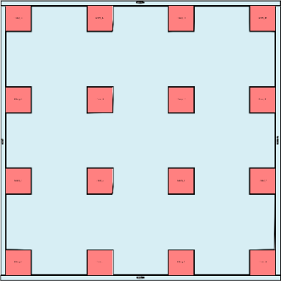
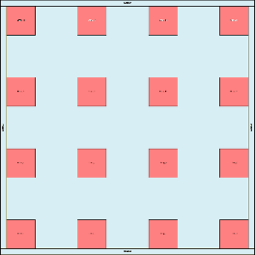
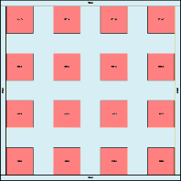
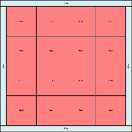
Thermal Behavior of 2.5D Systems
We split a 18mm x 18mm single chip into chiplets, and distribute them across the interposer with uniform spacing.
  Number of chiplets
    2x2 to 10x10
  Power density
    0.5 to 2 W/mm²
  Interposer size
    20mm x 20mm to 50mm x 50mm
30
…
30
20
30
40
50

Slide 10
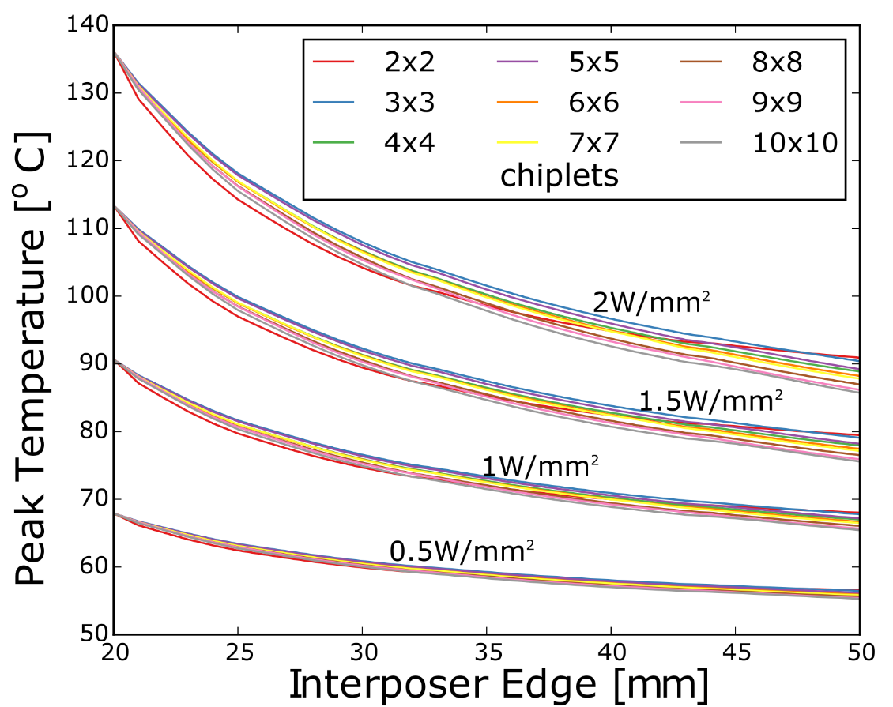
Thermal Behavior of 2.5D Systems
Observations
  Lower power density → Lower temperature
  Larger interposer → Lower temperature
  More chiplets → Lower temperature

Slide 11
Thermal Behavior of 2.5D Systems
Observations
  Lower power density → Lower temperature
  Larger interposer → Lower temperature
  More chiplets → Lower temperature

Slide 12
Thermal Behavior of 2.5D Systems
Observations
  Lower power density → Lower temperature
  Larger interposer → Lower temperature
  More chiplets → Lower temperature

Slide 13
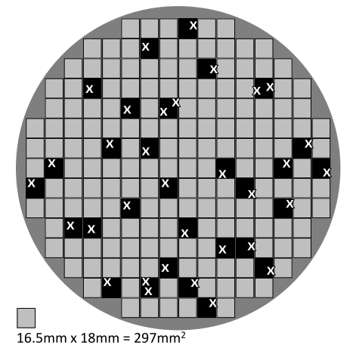
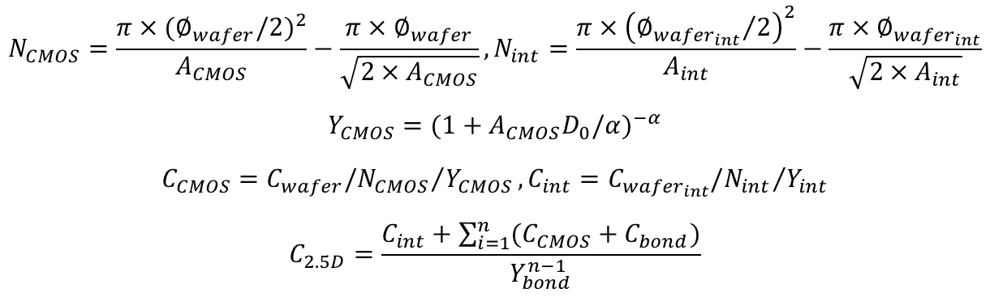
Manufacturing Cost Model
$$N_{CMOS}=\frac{π×{(∅_{wafer}/2)}^{2}}{A_{CMOS}}−\frac{π×∅_{wafer}}{\sqrt{2×A_{CMOS}}},N_{int}=\frac{π×{\left({∅_{{wafer}_{int}}}/2\right)}^{2}}{A_{int}}−\frac{π×∅_{{wafer}_{int}}}{\sqrt{2×A_{int}}}$$
$$Y_{CMOS}={(1+A_{CMOS}D_{0}/α)}^{−α}$$
$$C_{CMOS}={C_{wafer}/N_{CMOS}}/{Y_{CMOS}},C_{int}={C_{{wafer}_{int}}/N_{int}}/{Y_{int}}$$
$$C_{2.5D}=\frac{C_{int}+\sum_{i=1}^{n}{(C_{CMOS}+C_{bond})}}{Y_{bond}^{n−1}}$$
(1)
(2)
(3)
(4)
[Stow et al., ICCAD’16]
Eqn. (1): Number of CMOS dies per wafer and number of interposer dies per wafer
Eqn. (2): Yield model for CMOS chiplets
Eqn. (3): CMOS chiplet and interposer per die cost
Eqn. (4): Manufacturing cost of the 2.5D system
[Kannan et al., MICRO’15]

Slide 14
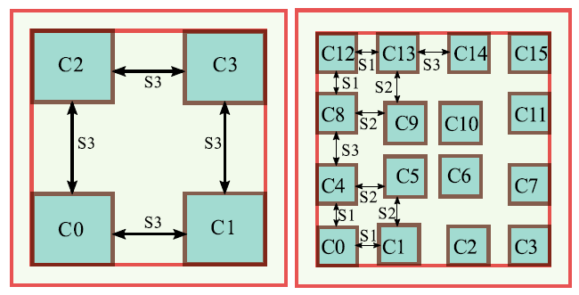

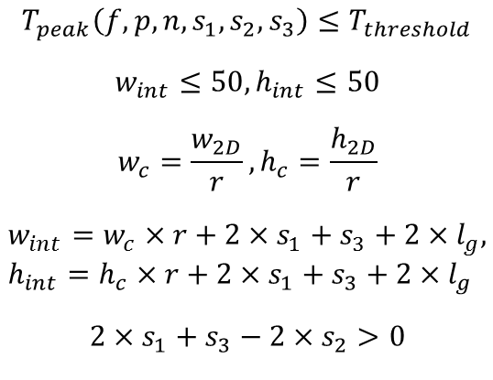
Optimization of Chiplet Organization
Minimize:
$$α×\frac{{IPS}_{2D}}{{IPS}_{2.5D}(f,p)}+β×\frac{C_{2.5D}(n,s_{1},s_{2},s_{3})}{C_{2D}}$$
Peak temperature constraint
Subject to:
$$T_{peak}\left(f,p,n,s_{1},s_{2},s_{3}\right)≤T_{threshold}$$
$$w_{int}≤50,h_{int}≤50$$
$$w_{c}=\frac{w_{2D}}{r},h_{c}=\frac{h_{2D}}{r}$$
$$w_{int}=w_{c}×r+2×s_{1}+s_{3}+2×l_{g}, \\ h_{int}=h_{c}×r+2×s_{1}+s_{3}+2×l_{g}$$
$$2×s_{1}+s_{3}−2×s_{2}>0$$
Interposer size constraint
Chiplet width and height
f | Frequency
p | Active core count
n | Chiplet count n = r x r
Interposer width and height
No overlap between chiplets
14

Slide 15
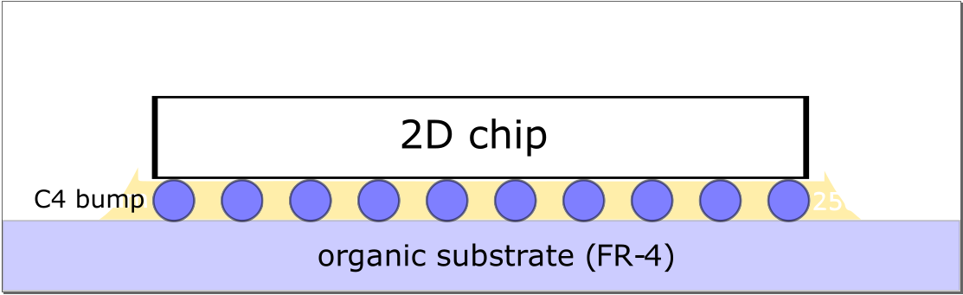
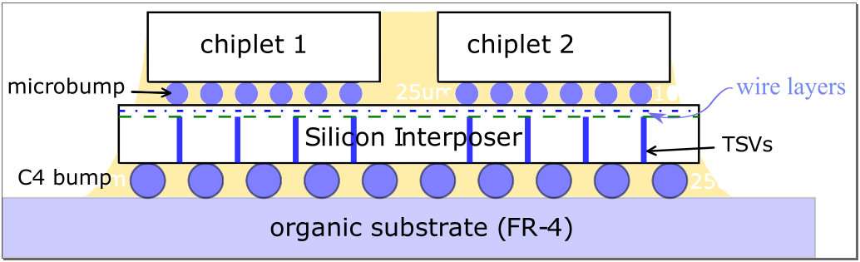
Evaluation Methodology
Target System
  256-core system (core architecture same as that of Intel SCC core)
  22nm chiplets and 65nm passive interposer
  18mm x 18mm total area (calculated using scaling rules)
  Unified mesh network for intra-chiplet and inter-chiplet communication
baseline 2D system
2.5D system

Slide 16
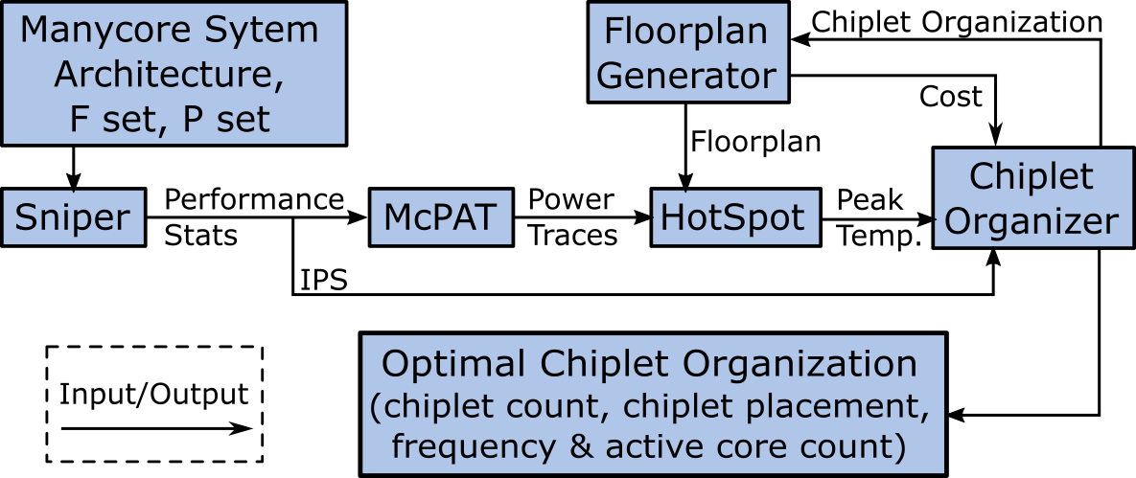
Evaluation Methodology
[Carlson et al., SC’11]
[Li et al., MICRO’09]
[Zhang et al., Tech Report’15]
Exhaustive
Search
1.5k CPU hours
180k CPU hours
182k CPU hours
400×
90×
Greedy
Approach
1.5k CPU hours
0.45k CPU hours
2k CPU hours
16

Slide 17
Multi-Start Greedy Approach
Step 1: Pre-Compute
Step 2: Sort
Ɐf
Sniper
IPS
Ɐp
Ɐn
Cost Model
Cost
Ɐw_{int}
f | p | n | w_{int} | Obj
800 | 256 | 16 | 24 | 0.69
800 | 256 | 16 | 40 | 0.9
1000 | 224 | 16 | 22.5 | 0.67
1000 | 256 | 4 | 21.5
1000 | 256 | 16 | 32.5
f | p | n | w_{int} | Obj
1000 | 256 | 4 | 21.5 | 0.62
1000 | 224 | 16 | 22.5 | 0.67
800 | 256 | 16 | 24 | 0.69
1000 | 256 | 16 | 32.5 | 0.70
800 | 256 | 16 | 40 | 0.9
increasing
17

Slide 18
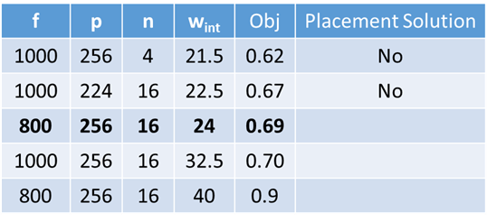
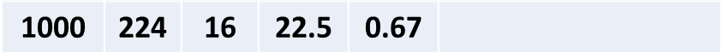
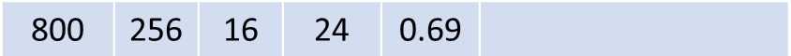

Multi-Start Greedy Approach
Step 3: Search for chiplet placement S = (s₁, s₂, s₃), which has a peak temperature lower than a predefined temperature threshold.
S₀
New start point
S₀*
S
S’
New neighbor
S*
S’
HotSpot
T(S)
T(S’)
Stop if $T<T_{threshold}$
Yes
No
Yes
Unexamined neighbor of S?
No
T(S)<T(S’)

Slide 19
Outline
Background
Thermally-Aware Chiplet Organization in 2.5D Systems
  Thermal Behavior of 2.5D Systems
  Manufacturing Cost Model
  Optimization of Chiplet Organization
  Evaluation Methodology
Evaluation Results
Conclusions

Slide 20
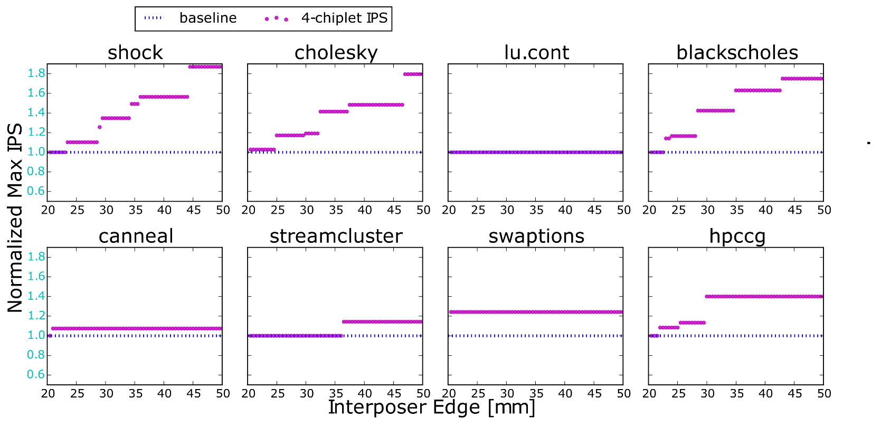


Results: Max Instructions per Second (IPS) Normalized to 2D Baseline
($\frac{{IPS}_{2.5D}}{{IPS}_{2D}}$)
87%
0%
7%
With proposed methodology, 2.5D systems achieve up to 87% (41% on average) performance improvement.

Slide 21
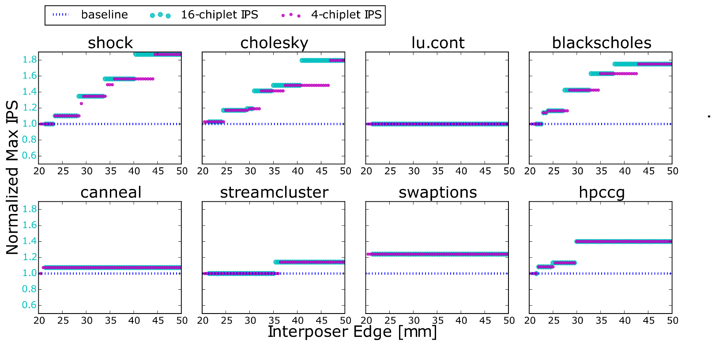

Results: Max Instructions per Second (IPS) Normalized to 2D Baseline
($\frac{{IPS}_{2.5D}}{{IPS}_{2D}}$)
Compared to the 4-chiplet case, a 2.5D system with 16 chiplets can achieve the same performance at a smaller interposer size.

Slide 22
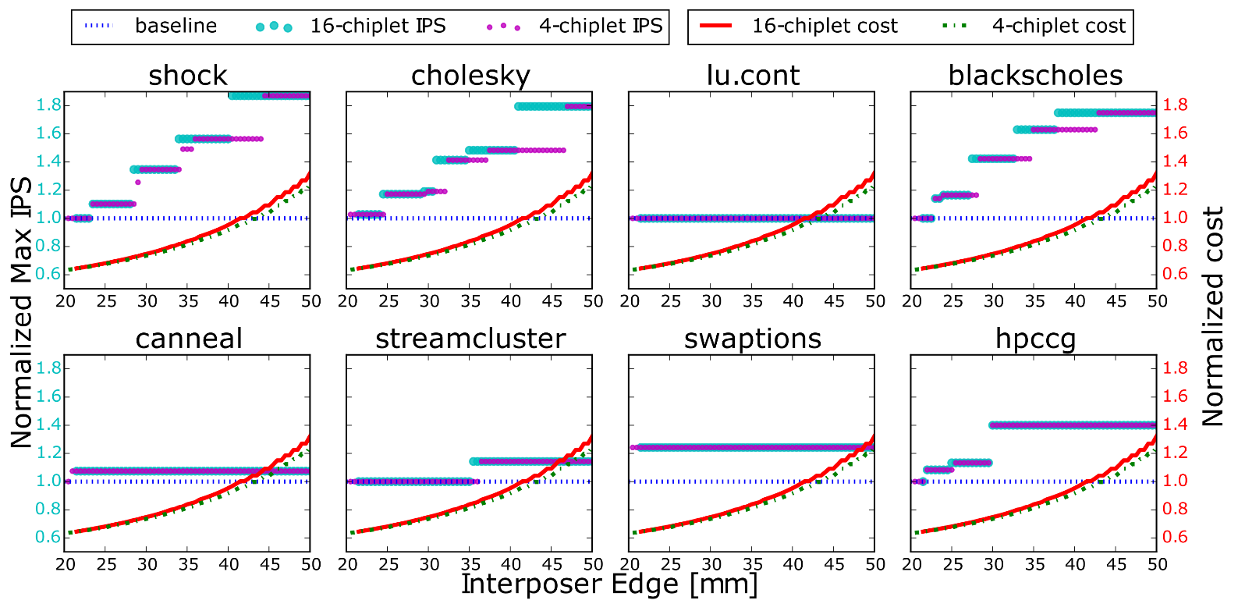


Results: Max IPS and Cost
($\frac{{Cost}_{2D}}{{Cost}_{2.5D}}$)
($\frac{{IPS}_{2.5D}}{{IPS}_{2D}}$)
With proposed methodology, 2.5D systems achieve up to 87% (41% on average) performance improvement at the same cost as 2D system, and save 36% cost without performance loss.

Slide 23
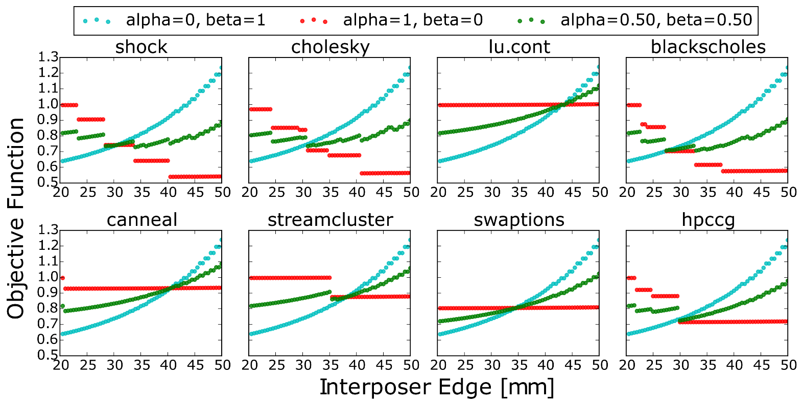
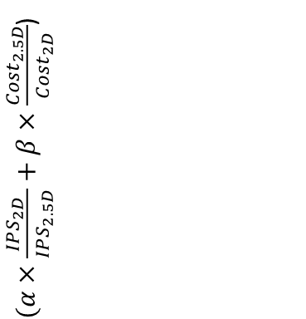
Results: Objective Function Values
$(α×\frac{{IPS}_{2D}}{{IPS}_{2.5D}}+β×\frac{{Cost}_{2.5D}}{{Cost}_{2D}}$)
The optimal chiplet organization occurs at the minimum point of the objective function for given alpha and beta.

Slide 24
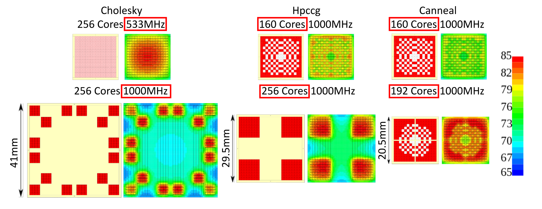
Results: Chiplet Organizations for Max Performance
Perf. ↑
Cost ↓
80%
2%
40%
28%
7%
36%

Slide 25
Outline
Background
Thermally-Aware Chiplet Organization in 2.5D Systems
  Thermal Behavior of 2.5D Systems
  Manufacturing Cost Model
  Optimization of Chiplet Organization
  Evaluation Methodology
Evaluation Results
Conclusions

Slide 26
Summary
We propose to use 2.5D integration technology with a thermally-aware chiplet organization to reclaim dark silicon and improve performance without violating thermal constraints.
We optimize the chiplet organization to jointly maximize performance and minimize manufacturing cost.
Our methodology improves performance by up to 87% (40% on average) under 85ºC without increasing cost.

Slide 27
Thank you for your attention.

Slide 28
Backup Slides

Slide 29
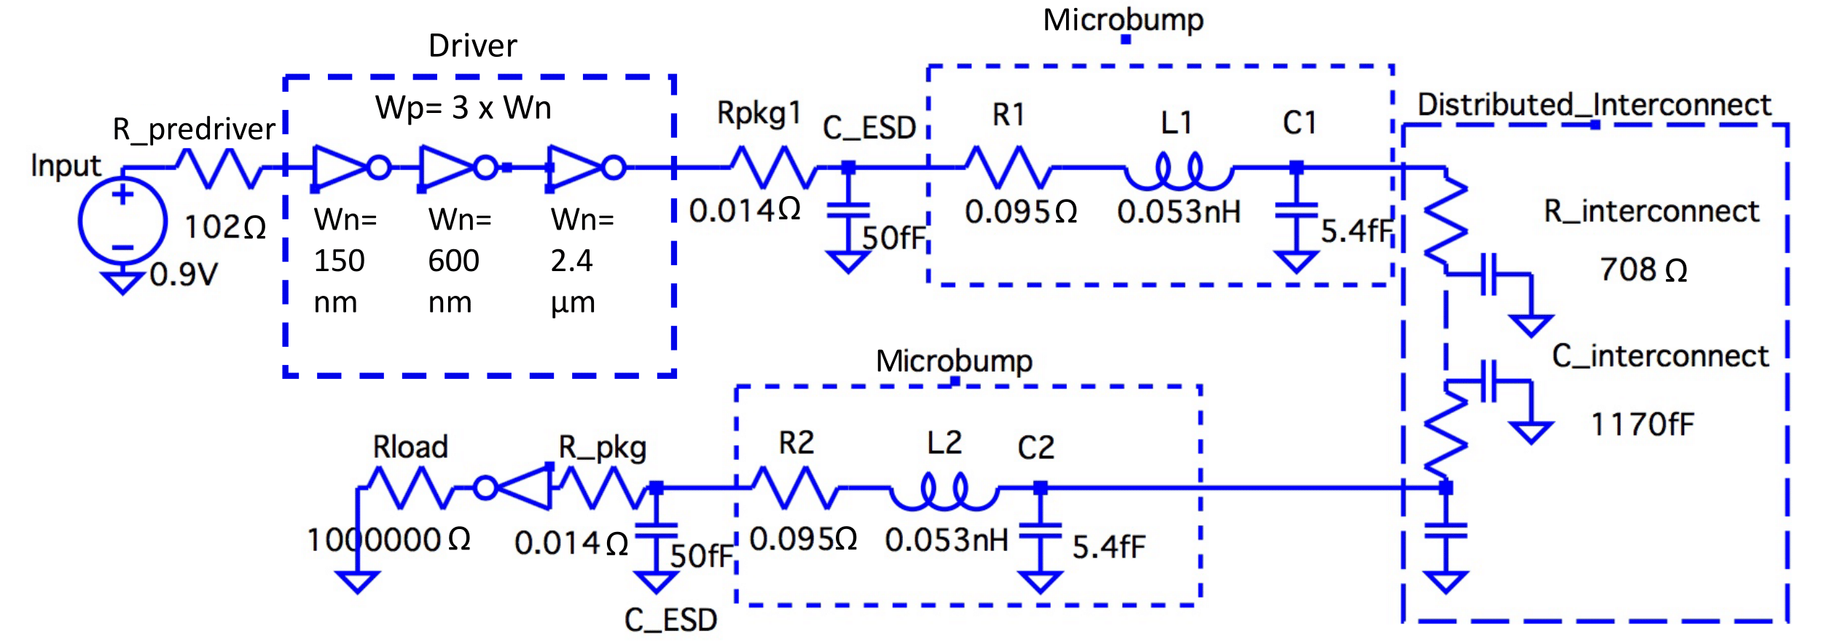
2.5D Interposer Link Model
[Karim et al., ECTC’13]
We size up the drivers to ensure single cycle latency.
Unified mesh consumes 8.4W based on real benchmark activities.

Slide 30
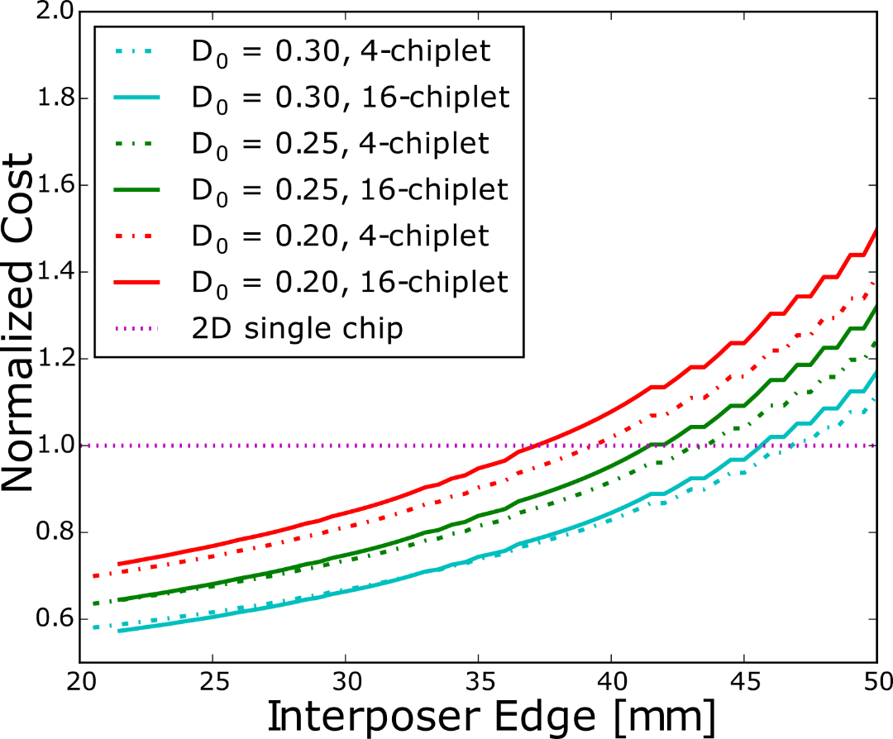
Manufacturing Cost Model
Observations
  Larger interposer, higher cost
  Higher defect density, more cost savings compared to the single-chip system
  More chiplets, higher CMOS yield and lower bonding yield
Each line is normalized with respect to a 2D single chip with the corresponding defect density D₀ (defect per unit area).

Slide 31
Manufacturing Cost Model
Observations
  Larger interposer, higher cost
  Higher defect density, more cost savings compared to the single-chip system
  More chiplets, higher CMOS yield and lower bonding yield
Each line is normalized with respect to a 2D single chip with the corresponding defect density D₀ (defect per unit area).

Slide 32
Manufacturing Cost Model
Observations
  Larger interposer, higher cost
  Higher defect density, more cost savings compared to the single-chip system
  More chiplets, higher CMOS yield and lower bonding yield
Each line is normalized with respect to a 2D single chip with the corresponding defect density D₀ (defect per unit area).
Notes:
16-chiplet costs more at a large interposer size due to lower bonding yield. While at a small interposer size, the costs of both chiplet counts are close, because the lower bonding yield of 16-chiplet is compansated by the higher CMOS yield of smaller chiplets.

Slide 33
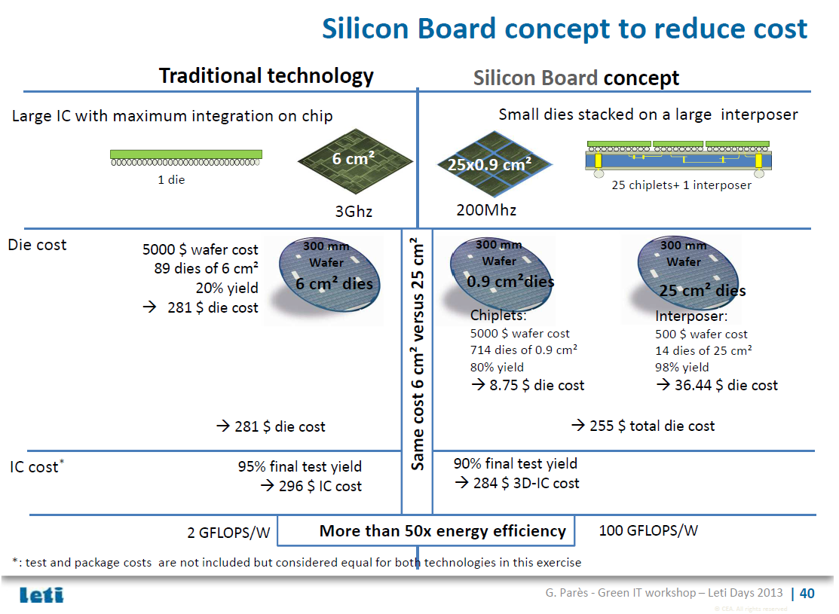

Slide 34
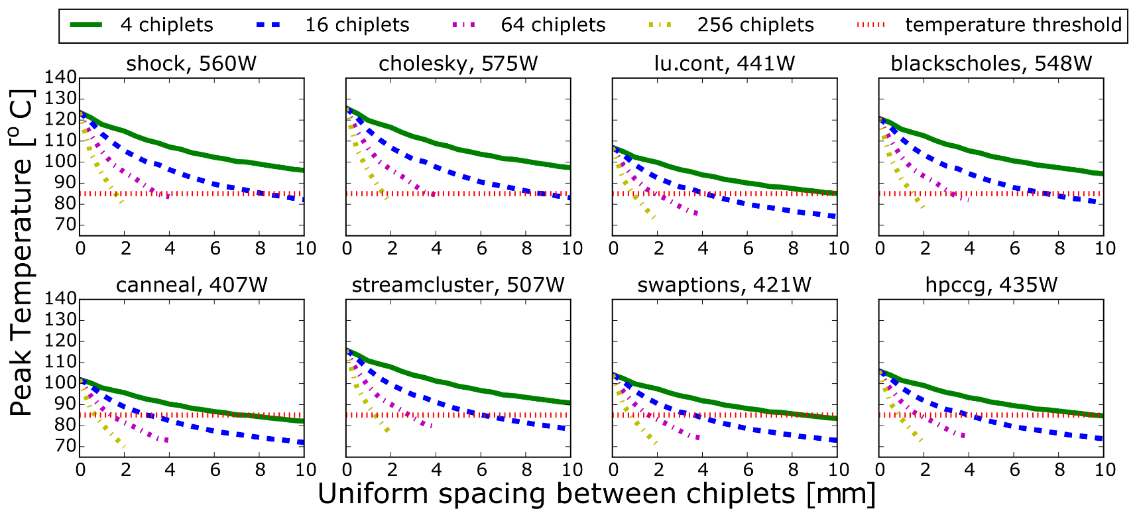
Results: Peak Temperature Reduction
A naive chiplet organization with uniform spacing can lower peak temperature by 20ºC-40ºC and provide opportunities to improve performance.

Slide 35
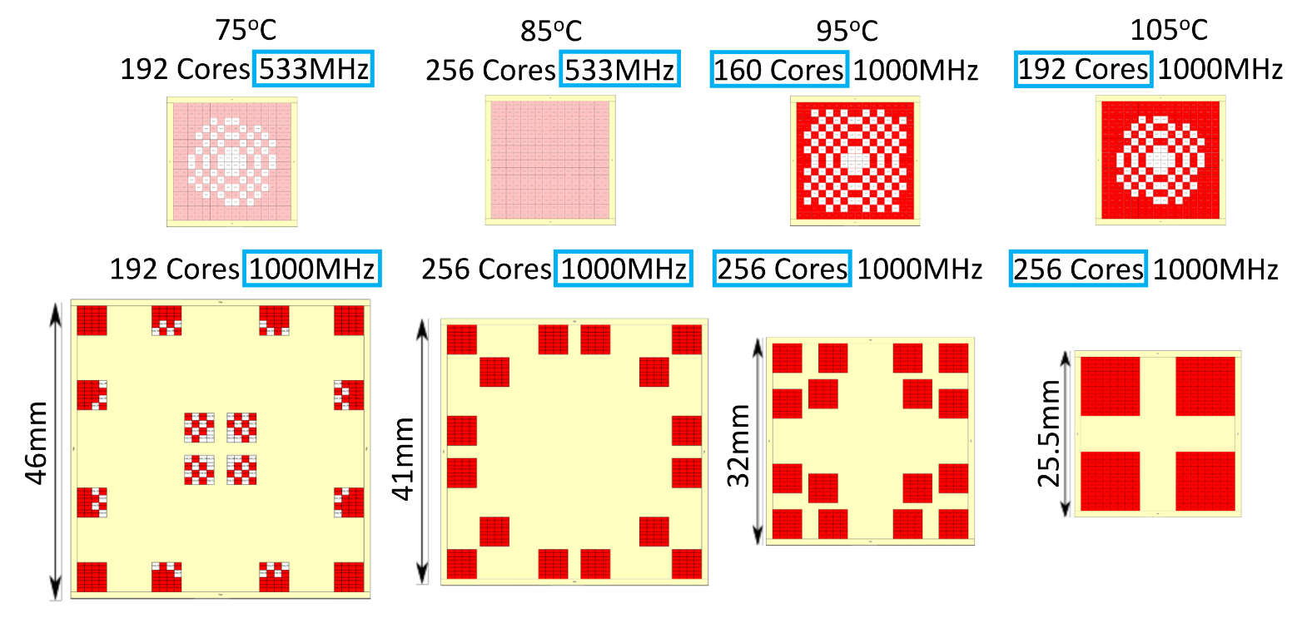

Results: Sensitivity to Peak Temperature Threshold
$$T_{threshold}$$
Perf.
Cost
85% ↑ 80% ↑ 53% ↑ 27% ↑
15% ↑ 2% ↓ 22% ↓ 31% ↓

