Slide 1
Optimal Multi-Row Detailed Placement for Yield and Model-Hardware Correlation Improvement in Sub-10nm VLSI
Changho Han, Kwangsoo Han, Andrew B. Kahng,
Hyein Lee, Lutong Wang and Bangqi Xu
UC San Diego VLSI CAD Laboratory
Samsung Electronics Co., Ltd.
Notes:
Good morning, everyone. In this presentation, I will present a detailed placement optimization to mitigate neighbor diffusion effects.
The title of my talk is optimal multi-row detailed placement for yield and model-hardware correlation improvement in sub-10nm VLSI.
This work is in collaboration with Samsung.

Slide 2
Outline
Motivation
Our dynamic programming-based placement
Single-row detailed placement
Double-row detailed placement
Experiments
Conclusion
Notes:
In this presentation, I will first explain motivation of our work, and describe our dynamic programming-based algorithm for single-row and double-row detailed placement.
Then, I will show the experimental results and conclude my talk.

Slide 3
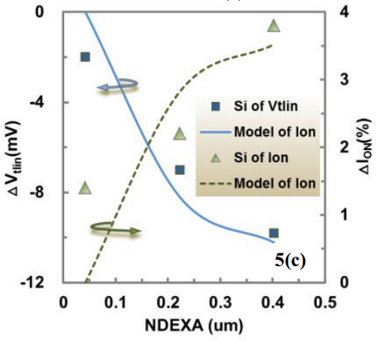
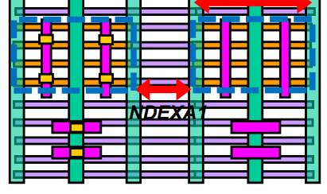
Motivation
Neighboring diffusion area creates stress on the channel [1]
NDEXA: width of neighboring diffusion spacing
Threshold voltage and on current change accordingly
PMOS/NMOS may show different characteristics w.r.t. process
[1] D. C. Chen, G. S. Lin, T. H. Lee, et al., Compact Modeling Solution of Layout Dependent Effect for FinFET Technology, Proc ICMTS, 2015, pp. 110-115.
Notes:
In sub-10nm nodes, neighboring diffusion area creates stress on the channel.
In this figure, we show two diffusion areas, with spacing equal to NDEXA.
[click] The right figure shows the change in Vt and Ion with different spacing. Clearly, this affects standard cell performance.
[click] Also, different processes, and different P/N FETs may show difference characteristics.
Overall, we can say, given a fixed process, the standard cell becomes faster, or slower.

Slide 4
Neighbor Diffusion Effect (NDE)
Diffusion step
Neighboring diffusion area height change
Model-hardware correlation issue
Inter-cell NDE cannot be captured in standard cell characterization
Different horizontal fin-to-fin spacing $d≠d^{′}$
Two fins in T2 have different drive strength
Diffusion
Fin
Diffusion height
$$d$$
Diffusion Cut
PC
$$d′$$
Cell
Diffusion break
T1
T2
T3
T4
Notes:
Diffusion step is the neighboring diffusion area height change, and causes neighbor diffusion effect.
[click] In this figure, the top and medium fins for T2 see different diffusion spacing, because of a diffusion step.
[click] If the diffusions step occurs within a standard cell, the library characterization is able to capture the effect. However, if the diffusion step occurs between two standard cells, then the impact is not captured by library, thus causing miscorrelation between model and silicon.
In the next slide, I will show how we can approach this problem.

Slide 5
Challenges and Limitations
Criticality
>60% of standard cells have inter-cell diffusion steps
Large area overhead
Filler cell of 4 placement sites needed to resolve every diffusion step
Min cell size=2
P
P
Filler
Filler
Spacing=0
Step
Spacing=4
N
N
Diffusion
Diffusion w/ NDE (not modeled in library)
Cell
Detailed placement = opportunity to reduce diffusion steps
Notes:
In our preliminary study, more than 60% of standard cells have inter-cell diffusion steps.
[Click] One trivial solution is to make space between two adjacent functional cells and insert filler cells to cancel the diffusion height difference. However, such approach would require 4 placement sites for each diffusion step. The area penalty is large!
[click] We see that during the detailed placement stage, we have the opportunity to reduce diffusion steps.

Slide 6
Previous Works / Our Work
Ordered single-row placement
⇒ Limited solution space w.r.t. cell ordering, double-height cells, etc.
Mixed integer linear programming
⇒ Long runtime
Heuristics (chain move, cell clustering, etc.)
⇒ Optimality not guaranteed
Question: Can we do better?
Our work:
Optimal single-row and double-row dynamic programming-based detailed placement to reduce diffusion steps
Support of cell relocating, cell reordering and cell flipping
Support of movable, and reorderable double-height cells;
Timing-aware optimization using intentional steps.
Notes:
Previous works can be divided into three categories, [click] ordered single-row placement, mixed integer linear programming and heuristics, with restrictions in [click]cell ordering, double-height cell support, [click] runtime, [click] or solution quality.
[click] In this work, we achieve optimal double-row placement that reduces diffusion steps. Our optimization supports cell relocating, cell reordering and cell flipping. It also supports movable and reorderable double-height cells, such as flip-flops in advanced nodes. We can also optimize timing by introducing intentional steps based on the modeled effect of NDE.

Slide 7
Outline
Motivation
Our dynamic programming-based placement
Single-row detailed placement
Double-row detailed placement
Experiments
Conclusion
Notes:
Now I will first describe the single-row dynamic programming-based detailed placement.

Slide 8
Single-Row (SR) Detailed Placement
Goal: perturb the placement to minimize the total cost
Inputs: an initial, legalized row placement; cost function
Output: optimized row placement with reduced diffusion steps
Constraints: cell non-overlapping, disp. range [−𝑥_Δ,𝑥_Δ], reordering range [−𝑟,𝑟]
$$x_{3}=7$$
$c_{1}$
$c_{2}$
$c_{3}$
$c_{4}$
Notation | Meaning
$$l$$ | Displacement, e.g., for $c_{3}$, $l=1−7=−6∈[−x_{Δ},x_{Δ}]$
$$j$$ | Position shift, e.g., for $c_{3}$, $j=1−3=−2∈[−r,r]$
0 1 2 3 4 5 6 7 8 9 10 11 12 13 14
(a) Initial row placement
$$x_{3}=1$$
$c_{3}$
$c_{2}$
$c_{1}$
$c_{4}$
(b) An example of final solution
cell
Notes:
We first give the problem statement.
[click] The input is an initial, legalized single-row placement. We perturb the placement to minimize the total cost, which includes inter-cell diffusion steps. [click] The output is an optimized row placement, with reduced diffusion steps.
[click] There are three constraints in our formulation, the cell non-overlapping constraint, displacement range and reordering range. Displacement range shows how far a cell can be moved away from its original location. Reordering range shows how flexibly a cell can be re-arranged with its neighboring cells.
[Click] We show an example initial row placement and final solution to illustrate notations. According to the initial placement, we first index all the cells c1 to c4, from left to right, sequentially. For c3, it is initially placed at placement site 7, and in the final solution, it is placed at placement site 1. Thus, the displacement of cell c3 is -6. The displacement range is the maximum displacement constraint for each cell. For position shift, initially c3 is the third cell in the row while in the final solution, it is placed as the first cell in the row, thus the position shift is equal to -2. The reordering range is the maximum position shift constraint.

Slide 9
Dynamic Programming: Optimality
Row placement cell by cell
Given a partial placement solution of $i$ ($i=0$ initially) cells, place from left to right, one cell at a time, until all cells have been placed
Optimality: at every step, explore complete solution space
Complete solution space for the $i^{th}$cell includes its cell index, location, flipping status
Question: do we need to store complete solution space for all previous cells?
To place the next cell: where? cost? which?
$c_{3}$
$c_{2}$
$c_{1}$
$c_{4}$
New cell to place
Partial placement (as input)
Illustration of partial placement
We lose the status of reordering if we only know $i^{th}$ cell
Notes:
This slide illustrate the dynamic programming idea. We do the row placement cell by cell. Given a partial placement solution of i cells, place from left to right, one cell at a time, until all cells have been placed.
This figure illustrates cell by cell placement. [click] We choose to place c3 first, then c2, c1 and c4. At each step, the existing placements on the left is a partial placement, and we place one more cell to the right to form a new partial placement.
[click] The optimality of the algorithm is guaranteed because we explore the complete solution space at each step.
The complete solution space for the i^th cell includes its index, location and flipping status. It is not difficult to store all these solutions, because the displacement range and reordering range limit the possibilities.
[click] The question is: do we need to store complete solution space for all previous cells? If so, we have exponential number of solutions to keep track of as we place more cells.
[click] To answer the question, we need to see how we place the next cell.
To place the next cell, we first need to find a legal location. This is not a problem as long as we know the location of i^th cell.
Second, we need to update the diffusion step cost. Given the diffusion step cost for a partial placement, we only need to handle the delta cost created between the i^th cell, and the new cell. So again, we are good as long as we know the i^th cell.
[click] Last, we need to determine which cell to place. Here, since cells can be reordered, we need to keep track of what cells are already placed, and what cells need to be placed. Knowing only the i^th cell results in the lost of placement status. In the next slide, I will should how we tackle this problem.

Slide 10
Dynamic Programming: Reordering
Given partial placed $i$ cells, reordering range $[−r,r]$, cells $c_{k}$
$k<i−r$ are definitely already placed
$k>i+r$ are definitely not already placed
$i−r≤k≤i+r$ may or may not be placed ($2r+1$ cells)
for $k∈\left[i−r,i+r\right]$, $(r+1 )$ cells are placed
⇒ (2r+1)-wide binary status array $s$ guarantees correctness
Assume a partial placement with $i=3, r=1$
Position: 1 2 3 4 5
Position: 1 2 3
$$c_{2}$$
$$c_{4}$$
Cell
(placed)
$$c_{1}$$
$$c_{2}$$
$$c_{3}$$
$$c_{4}$$
$$c_{5}$$
$$c_{1}$$
$$c_{3}$$
$$c_{2}$$
$$s=[1,1,0]$$
Cell
(in status array)
Place the next cell $i=4$
$$c_{3}$$
$$c_{5}$$
Cell
(unplaced)
Position: 1 2 3 4 5
Position: 1 2 3 4
$$c_{1}$$
$$c_{2}$$
$$c_{3}$$
$$c_{4}$$
$$c_{5}$$
$$c_{1}$$
$$c_{3}$$
$$c_{2}$$
$$c_{5}$$
$$s^{′}=[1,0,1]$$
(a) Initial row placement
(b) Partial placements
$$c_{4}$$
Notes:
If we assume we have placed i cells. The reordering range is from –r to r. Then cells with index i-r are definitely already placed, and cells with index i+r are definitely not already placed. A total of (2r+1) cells within reordering range may or may not be placed. So we only need to keep track of these cells.
[click] We use a binary array of length 2r+1 to indicate whether each cell has been placed or not.
[click] The left figure shows five cells, indexed c1 to c5 in the initial placement. If the reordering range is 1, then status array keeps track of 3 cells.
[click] In the right figure, we show a partial placement of 3 cells, c1, c3 and c2. Then the status array indicates the cell status around the third position from the initial placement. [click] That is , the status array indicates the status for c2, c3 and c4, so we have 1,1,0.
[click] Then, after placing the 4th cell, the status array will then indicate the cell status around the fourth cell. [click] That is, the array indicates the cell status for c3, c4 and c5.
A legal status array will have exactly r+1 elements to be one. We can guarantee correctness as long as this property is met.

Slide 11
Dynamic Programming: Recurrence
DP cost
recurrence
$d\left[i′\right]\left[j′\right]\left[v′\right]\left[l′\right][s′]=\min\left(d\left[i\right]\left[j\right]\left[v\right]\left[l\right][s]+{c(}_{i j v l }^{i^{′}j^{′}v^{′}l^{′}}),d\left[i^{′}\right]\left[j^{′}\right]\left[v^{′}\right]\left[l^{′}\right][s′]\right)$
Cost increase due to the step between the right boundary of $i^{th}$ cell and the left boundary of ${\left(i+1\right)}^{st}$ cell
Updated cost if we place the next cell $i^{′}=i+1$
Current cost when $i$ cells are placed
$i^{th}$ cell name
$i^{th}$ cell variant (flipping) and displacement from initial placement
Binary status array
Uniquely determines: last placed cell index, variant, location
$$x_{4}=11$$
$$x_{4}=10$$
$$i j v l$$
$$c_{2}$$
$$c_{4}$$
$c_{3}$
$c_{1}$
$c_{4}$
$i=3$, $d\left[3\right]\left[1\right]\left[0\right]\left[−1\right][s]$
$$s=[1,0,1,1,0]$$
$c_{1}$
$c_{2}$
$c_{3}$
$c_{4}$
$$c_{1}$$
$$c_{3}$$
$$c_{5}$$
(a) Initial row placement
(b) Partial placement: $i=3$
Notes:
This slide gives the full DP array and cost function recurrence. The dp array is indexed by i, j, v, l, s.
[click] Given a partial placement with i cells, j is the position shift, so (i+j) gives the i^th cell name;
[click] v gives the flipping status, and l gives the displacement.
[click] s is the status array.
[click] For each new partial placement solution, it can be reached from multiple previous partial placement solutions with different last placed cells, and status array. DP cost is recurrently updated by picking the partial placement solution with the minimum cost.
[click] Here is an example showing an partial placement and its DP array. From the initial placement, we know cell c4 is the forth cell in the row, [click] with x-coordinate equal to 11.
[click] In a partial placement, we have placed three cells, the last cell is c4, [click] with x-coordinate 10.
[click] The DP array is shown here. The first term i means the total number of placed cells, which is 3.
[click] The sum of i+j indicates the current cell index.
[click] v is cell variant, which can be the flipping status.
[click] l is the displacement from its initial location, which is -1.
[click] the status array shows cell placement status. If we assume the reordering range is from -2 to 2, then the status array will show 5 cells, surrounding the third cell. [click] So we have c1, c3, c4 to be 1, and [click] c2, c5 to be 0.

Slide 12
Dynamic Programming: Cost Update
From $(i,j,v,l,s)$ to $\left(i^{′},j^{′},v^{′},l^{′},s′\right)$
Non overlapping constraint: $x_{i+j}+l+w_{i+j}≤x_{i^{′}+j^{′}}+l^{′}$
$s′$ can be deduced from $s$
$ΔCost$ is determined by $i^{th}$ and ${\left(i+1\right)}^{st}$cells
Cost: ${c(}_{i j v l}^{i^{′}j^{′}v^{′}l^{′}})=c_{step}+α⋅c_{disp}+β⋅c_{flip}$
$c_{step}$: step cost between $i^{th}$ and ${i′}^{th}$cells
$c_{disp}$: displacement of ${i′}^{th}$ cell (in units of placement sites)
$c_{flip}$: flipping cost (0 = initial orientation; 1 = flipped orientation)
Step cost for two neighboring cells with $dist$ empty sites in between
Dist. | 0 | 1 | 2 | 3 | 4+
$$c_{step}$$ | 1 | $$∞$$ | 1 | 1 | 0
Notes:
This slide shows the details about cost update.
From a known partial placement solution, to reach a new partial placement, the new cell cannot overlap with any existing cell. Also, the new status array must indicate legal placement status.
[Click] The delta cost of placing cell is determined by last placed cell and next placed cell
[Click] The cost function is composed of three components, which are step cost, displacement cost, flipping cost. Each of the cost components has its own weights. Displacement and flipping cost are introduced to balance the tradeoff between step cost reduction and degradation from initial placement. Table here shows the step cost for two neighboring cells with dist empty sites in between and it is specific to the given technology of interest.

Slide 13
Outline
Motivation
Our dynamic programming-based placement
Single-row detailed placement
Double-row detailed placement
Q1: Can we move double-height cells while keeping DP optimality?
Q2: Can we allow reordering in double-row optimization?
Experiments
Conclusion
Notes:
The above is the single-row detailed placement. However, double-height cells such as flip-flops in advanced nodes, are common. These cells have to stay fixed in single-row detailed placement, which shrinks our solution space. Now, I will present our double-row optimization. We try to address two questions:
[click] Can we move double-height cells?
[click] Can we allow reordering in double-row optimization?

Slide 14
Double-Row (DR) Detailed Placement
VSS
Observation
Fully separated two-row optimization window
Fixed double-height cell ordering
⇒ Separated DP region
Q1: Can we move double-height cells while keeping DP optimality?
A: Yes.
A
B
Opt window 1
VDD
VSS
C
D
Opt window 2
VDD
VSS
Single-height cell
Double-height cell
R1
A
R2
B
R3
C
R4
D
R5
Notes:
In this slide, I will briefly describe how we handle detailed placement for two rows.
Theoretically, double-height cells may appear in any continuous two rows. [click] However, in our setup, we find that they can be fully separated in non-overlapping two-row windows. The is because for all double-height standard cells in our library, the top and bottom rails are always VSS, [click] and the middle rail is VDD. We note that this pattern depends on specific technology of interest, and is true in our case.
[click] To enable our optimization, we further assume double-height cell ordering is fixed. For example, in this figure, double-height cell A must be on the left of B, and then C and D.
[click] Now we divide the cell row into optimization regions, separated by double-height cells. This figure shows four double-height cells, with five region. Within each region, single-row optimization is used separately for the two rows, and the solutions are merged once we meet a double-height cell.
[click] The animation shows how dynamic programming is performed. The dynamic programming can be seen as a two-level optimization. In the top level, DP goes from one DH cell to the next, and in the leaf level, we call single-row DP to get the \Delta cost when placing all single-height cells in between. For the top-level DP, we still have the complete solution space for the double-height cells.
[click] Thus, double-height cells are movable.

Slide 15
Dynamic Programming: Recurrence
Top-level DP cost (recurrence)
$$d\left[I′\right]\left[v′\right]\left[l′\right]\left[j_{0}′\right]\left[s_{0}^{′}\right]\left[j_{1}′\right][s_{1}′]=\min\left( d\left[I\right]\left[v\right]\left[l\right]\left[j_{0}\right]\left[s_{0}\right]\left[j_{1}\right]\left[s_{1}\right]+cost,d\left[I^{′}\right]\left[v^{′}\right]\left[l^{′}\right]\left[j_{0}^{′}\right] [s_{0}′]\left[j_{1}^{′}\right] [s_{1}′]\right)$$
Q2: Can we allow reordering in double-row optimization?
A : Yes. Single-height cells can still be reordered with another single-height cell, or a double-height cell.
Cost increase due to the placement of all single-height cells between the neighboring double-height cells
Updated cost if we place the next DH cell $I^{′}$
Current cost when $i$ cells ($I$ = DH cell) are placed
Double-height cell displacement
DH cell and status array for row 0 and row 1, separately
Notes:
This slide shows the top level recurrence. The dp array is indexed by capital I, v, l, j0, s0, and j1, s1. Capital I is the number of double-height cells in the partial placement.
[click] v, l indicates the flipping status and its displacement. We note that double-height cells are not allowed in flipping due to power rail constraints.
[click] Then, j0, s0 indicates the reordering status for the first row. Here, position shift j0 indicates the total number of cells in the first row partial placement. So we know which cells the status array s0 indicates. Similarly, we have j1 and s1 for the second row.
[click] Since we have the entire reordering status for both rows, reordering for a single-height cell with another single-height cell, or a double-height cell, is still allowed.

Slide 16
Outline
Motivation
Our dynamic programming-based placement
Single-row detailed placement
Double-row detailed placement
Experiments
Conclusion
Notes:
Now, I will show experimental setup and results.

Slide 17
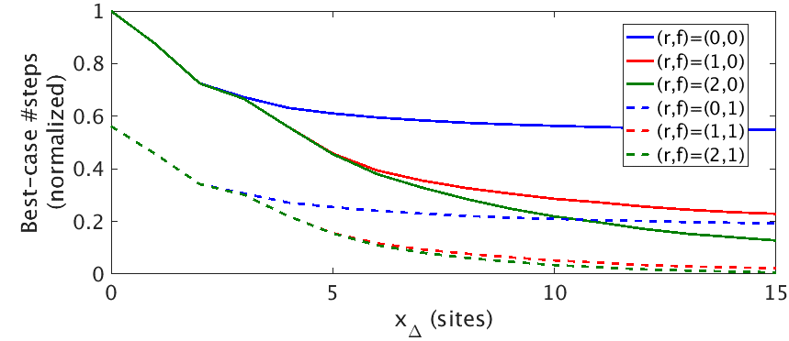
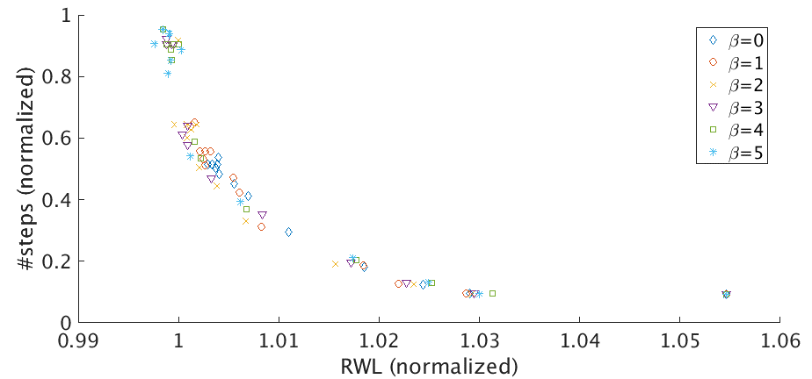
Sensitivity to Ranges, Flipping and Coefficients
Sensitivity to disp. range ($x_{Δ}$), reordering range ($r$), and flipping ($f$)
>80% step reduction
Enabling reordering = 30% more step reduction; flipping = 50% step reduction
Sensitivity to displacement coefficients $α$, and flipping coefficients $β$
Clear tradeoff between displacement, flipping and step reduction
3% RWL overhead with maximum step reduction
Flipping
50% impr.
Reordering
30% impr.
3% routed wirelength recovery
$$α>0$$
$$α=0$$
>80%
step
reduction
Notes:
This slide shows the sensitivity to ranges, flipping and coefficients.
[click] We sweep displacement range from 0 to 15, and reordering range from 0 to 2. We show the results for both flipping enabled and disabled. The left figure shows displacement range in x-axis, versus normalized diffusion steps after optimization in y-axis. Different lines show different reordering and flipping configurations.
[click] Given displacement range equal to 5, and reordering range equal to 1, 80% of diffusion steps are already eliminated.
[click] If we compare the result with and without reordering, we find there is up to 30% more step reduction with reordering enabled.
[click] Also, flipping itself can reduce half of all diffusion steps even without allowing any cell displacement.
[click] Next, we sweep the displacement and flipping coefficients.
[click] In the right figure, we see a clear tradeoff between routed wirelength and #diffusion steps after optimization. Generally, the more RWL overhead, we can get more step reductions.
[click] We found that a non-zero coefficient is good enough in keeping RWL within 3% of overhead, while still getting maximum step reduction.

Slide 18
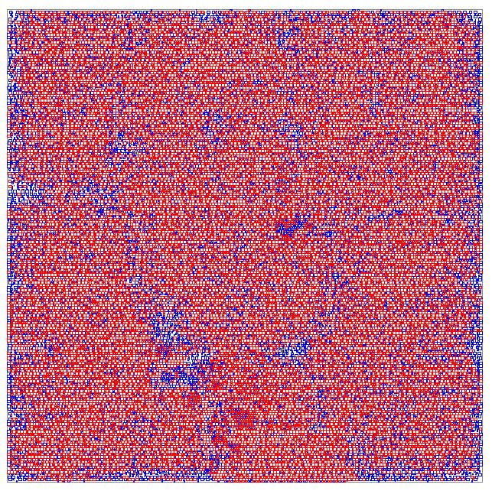
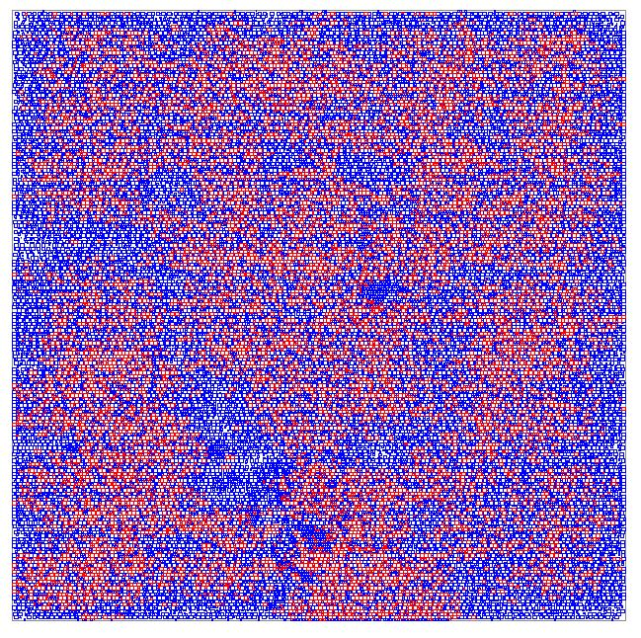
Experimental Results
SR: up to 84.0% step reduction; DR: up to 90.6% step reduction
Design | Initial |  | Single-row (SR) | Double-row (DR)
 | #steps | DH% | #steps | #steps | Runtime | Est. yield impr.
AES | 7973 | 4.3% | 1278 (-84.0%) | 750 (-90.6%) | 37s | +0.71%
M0 | 6588 | 8.4% | 1612 (-75.5%) | 842 (-87.2%) | 38s | +0.57%
JPEG | 34760 | 8.3% | 9275 (-73.3%) | 4555 (-86.9%) | 156s | +2.86%
VGA | 50766 | 24.8% | 27054 (-46.7%) | 11816 (-76.7%) | 195s | +3.59%
MPEG | 9994 | 23.0% | 5071 (-49.3%) | 2402 (-76.0%) | 25s | +0.75%
Red: cells w/ steps
Blue: cells w/o steps
VGA (orig)
VGA (opt)
Notes:
Table here shows our experimental result with various design blocks. We show the step reduction using single-row and double-row detail placement algorithm. Here, since we use reordering range 1, the single-row optimization is similar to two previous works. We achieve up to 84% step reduction. [click] With double-row optimization, we can achieve up to 90% step reduction.
[click] In design VGA and MPEG, there are up to around 25% double-height cells in the design. Single-row optimization shows poor step reduction, at around 50%. In comparison, double-row optimization is much better, achieving around 76% reduction in diffusion steps
[click] We show an illustration of step reduction of design block VGA here. Red cells have inter-cell diffusion steps and blue cells do not have inter-cell diffusion steps. We illustrate how significantly diffusion steps are reduced after double-row optimization is applied.

Slide 19
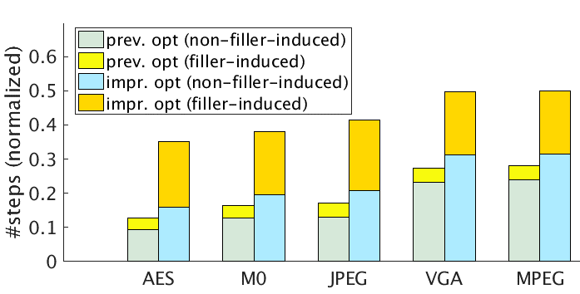
Potential for Timing Optimization
Neighbor diffusion effect = increased drive strength
⇒ Improve timing by creating diffusion steps next to timing-critical cells (insertion of filler cells w/smaller diffusion height)
Modified cost function to encourage more timing-critical filler-induced steps ($c_{fstep}$)
$cost=c_{step}+α⋅c_{disp}+αβ⋅c_{flip}+γc_{fstep}$, $γ<0$
Up to 6X increase in #diffusion steps at timing-critical cells
But, with overall > 50% diffusion step reduction
6X in crease in intentional steps
P
P
Step
N
N
Timing-critical
Filler
Timing-critical
Filler
Diffusion w/ NDE
(not modeled in library)
Faster
Diffusion
Cell
Notes:
Neighbor diffusion effect can increase drive strength. Therefore, it is possible to improve timing by inserting filler cells with smaller diffusion height and creating intentional diffusion steps next to timing-critical cells. [click] In the left figure, we show that a transistor can become faster given a diffusion step created with a neighboring filler cell.
[Click] We add one more cost component into the cost function to make our dynamic programming algorithm comprehend the benefit of such intentionally introduced steps.
[Click] We achieve up to 6x increase in intentional diffusion steps at timing-critical cells compared to the initial placement solution. Overall, we can still remove more than 50% of all diffusion steps.

Slide 20
Outline
Motivation
Our dynamic programming-based placement
Single-row detailed placement
Double-row detailed placement
Experiments
Conclusion
Notes:
Now I will conclude my talk.

Slide 21
Conclusion and Future Goals
New, optimal reorderable double-row detailed placement optimization with support of double-height cells
Up to 90% reduction of diffusion steps
Estimated ~3% yield improvement early in node
Potential timing optimization with filler-induced intentional diffusion steps
Ongoing / future works
Generic multi-row multi-height detailed placement
Tool-integrated comprehensive timing-aware optimization
Extension to other local layout effect (LLE)-aware optimizations – 2nd Diffusion Break, Gate Cut effects
Notes:
In this work, we propose a new, optimal reorderable double-row detailed placement optimization, with support of double-height cells.
We achieve up to 90% reduction of diffusion steps and 3% estimated yield improvement.
We also propose a potential timing optimization with filler-induced intentional diffusion steps.
Our future work include generic multi-row multi-height detailed placement with more comprehensive timing-aware optimization flow, and extension to other local layout effect-aware optimizations.

Slide 22
Thank you!

Slide 23
backup

Slide 24
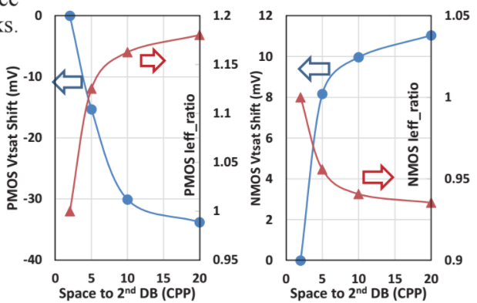
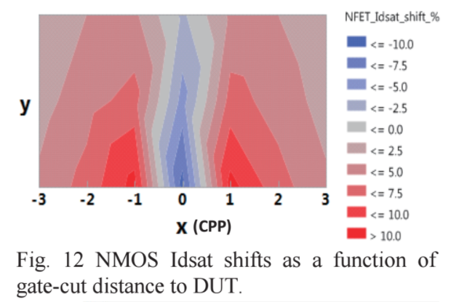
Future Extensions
2nd Diffusion Break
Vt shift as a function of spacing to the 2nd diffusion break
Gate Cut
Idsat shifts as a function of gate-cut distance to DUT
2-dimensional effect
1st DB
2nd DB
Diffusion height
DUT
Diffusion
Fin
PC
Diffusion break
Gate cut

Slide 25
Future Extensions
2nd diffusion break
Vt shift as a function of spacing to the 2nd diffusion break
SDB / DDB abutment
Metal 1 color confliction in multi-patterning
2D Gate-cut problem
Etc.

