Slide 1
Floorplan and Placement Methodology for Improved Energy Reduction in Stacked Power-Domain Design
Kristof Blutman† , Hamed Fatemi† , Andrew B. Kahng‡, Ajay Kapoor† , Jiajia Li‡ and Jose Pineda de Gyvez† ‡UC San Diego, †NXP Semiconductors

Slide 2
Outline
Background and Motivation
Related Work
Our Methodology
Experimental Setup and Results
Conclusion

Slide 3
Stacked Power-Domain Design
Battery lifetime is critical to IC designs (e.g., IoT, mobile)
Misalignment between battery and core voltages ⇒ Energy inefficiency in voltage regulator
Improve power delivery efficiency ⇒ Battery lifetime ↑
Stacked power-domain design connects two domains with balanced currents in series ⇒ Aligned voltages between battery and core (Example: battery voltage = 2V, voltage of each domain = 1V) ⇒ Recycling of current between two domains
…
2VDD
Top domain
…
VR
…
…
VDD
…
VR
…
VDD
…
…
Bottom domain
…
…
…
…
VSS
VSS
Conventional design
Stacked-domain design

Slide 4
Motivation
Battery lifetime: Conventional vs. Stacked-domain designs
Conventional design,
P_{battery_c} = P_{core} / η
Stacked-domain design,
P_{battery_s} = P_{stack} + P_{VR} / η
Assume same power consumption, i.e.
P_{core} = P_{stack} + P_{VR}
Battery lifetime ratio,
T_{s} / T_{c} = P_{battery_c} / P_{battery_s} = (2 ∙ I_{stack} + I_{VR}) / (2 ∙ η ∙I_{stack} + I_{VR})
If current is perfectly balanced (I_{VR} = 0), stacked domain provides
1.25X battery lifetime compared to conventional design, if η = 80%
2X battery lifetime compared to conventional design, if η = 50%
P_{battery_c} : Battery supply power to conventional design
P_{core} : Total power consumption of core
η : Voltage regulator efficiency
P_{battery_s} : Supply power to stacked-domain design
P_{stack} : Direct power of stacked domain from supply
P_{VR} : Input power of voltage regulator from supply
T_{s} : Battery lifetime of stacked-domain design
T_{c} : Battery lifetime of conventional design
I_{stack} / I_{VR} : Currents corresponding to P_{stack} and P_{VR}

Slide 5
Problem Formulation
Given: Netlist, timing constraints, level shifter, voltage regulator efficiency, and power information
Do: Partition netlist into two domains, define layout region of each domain, and place instances and level shifters
Objective: Maximize battery lifetime
Consideration:
Balance current across multiple operating scenarios
Region generation = Constrained layout
Level shifter ⇒ Power, area, timing penalties

Slide 6
Outline
Background and Motivation
Related Work
Our Methodology
Experimental Setup and Results
Conclusion

Slide 7
Related Works
Stacked-domain implementation
[Cabe10][Liu13] focus on specific designs (memory, IO)
[Lee15] partition cores (with no connection) into domains
[Blutman16] partition logic and memory into two domains
No fully automated, general flow for stacked-domain design
Netlist partitioning
Move-based partitioning: KL, FM and many extensions
Mathematical programming: [Shih93][Goemans95]
Flow-based approach: [Yang96][Caldwell00]
Do not directly apply to stacked-domain partitioning
Our work: flow-based partitioning with multiple extensions for general stacked-domain partitioning

Slide 8
Outline
Background and Motivation
Related Work
Our Methodology
Experimental Setup and Results
Conclusion

Slide 9
Overall Optimization Flow
Trial placement
: Estimate post-placement timing / current profile
Flow-based partitioning
: Aware of layout, timing, multi-scenario current balancing
Domain region definition
: One continuous region for each domain + minimized boundary length
Re-floorplanning
: Resize floorplan (if necessary) + power planning
Level shifter insertion
: Minimize wirelength penalty
Placement optimization
: Placement legalization + incremental timing fix

Slide 10
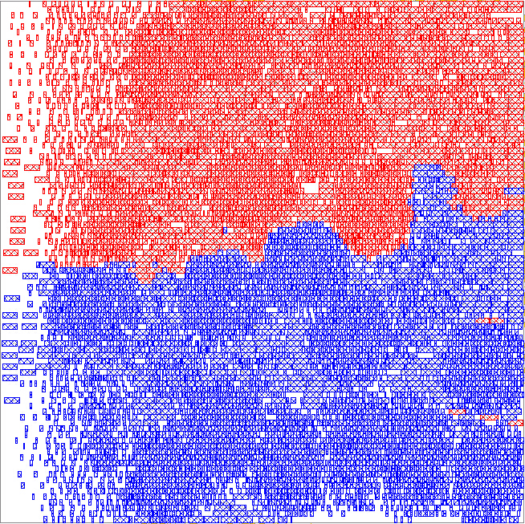
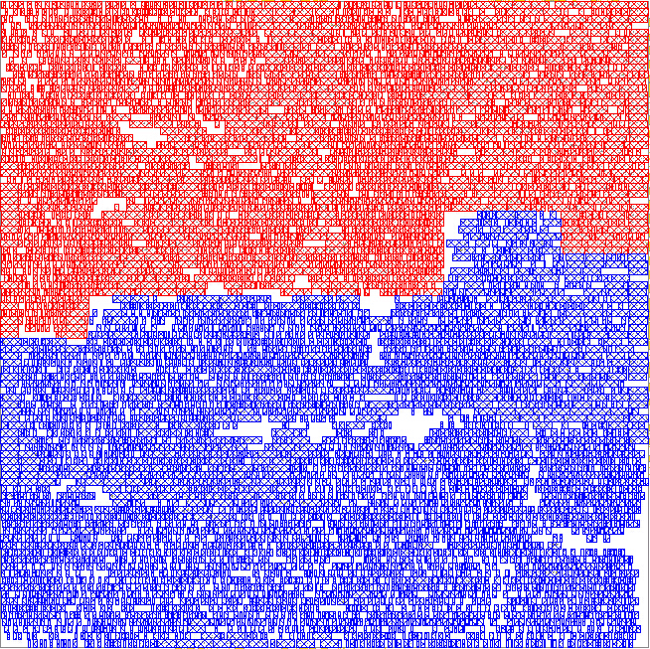
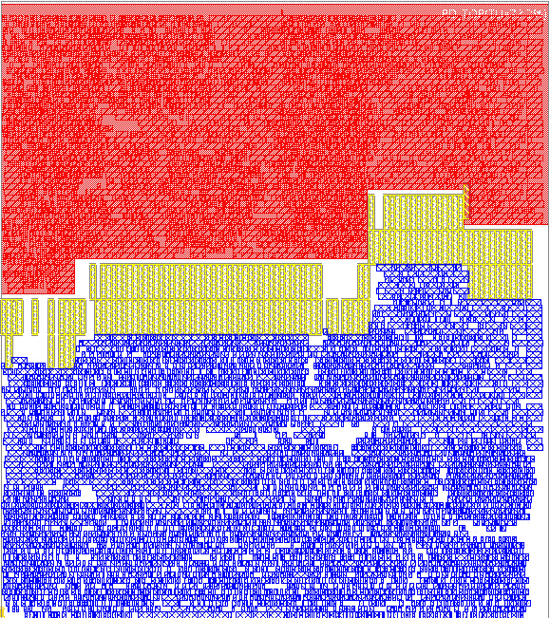
Example of Overall Flow
Flow-based partitioning
(blue = bottom domain,
red = top domain)
Domain region definition
(blue region = bottom domain,
red region = top domain)
Re-floorplanning + level shifter insertion
(yellow = level shifters)
Design: AES (11K instances)
Technology: 28LP

Slide 11
Flow-Based Partitioning
Current-balanced partitioning with minimized #cuts
Basic flow
Construct flow-network (cell / cluster → vertex, net → edge, current of cell / cluster → weight)
Perform max-flow optimization (Ford–Fulkerson)
Cluster smaller partition together with one neighbor vertex
Iterate Steps 2, 3 until the balancing constraint is satisfied
c
d
c
d
a
b
a
b
e
f
e
f
a and b are source and sink
All vertices have same weight
c
d
c
d
b
b
a, e, f
a, e
f

Slide 12
Extensions to Flow-Based Partitioning
Pre-clustering
Reduce runtime and improve scalability
Heavy-edge matching (HEM) to cluster cells with dense connections
Multiple operating scenarios
Balance current between two domains across different scenarios (e.g., function mode and sleep mode)
Use weighted sum of normalized currents
Critical-path awareness
Remove V-shaped vertices after each max-flow opt
Layout awareness
Detect and remove outliers (= instances from large-current partition, but located within small-current region) after each max-flow opt
HEM example
AES, 28LP
V-shaped vertices
Top
Bottom

Slide 13
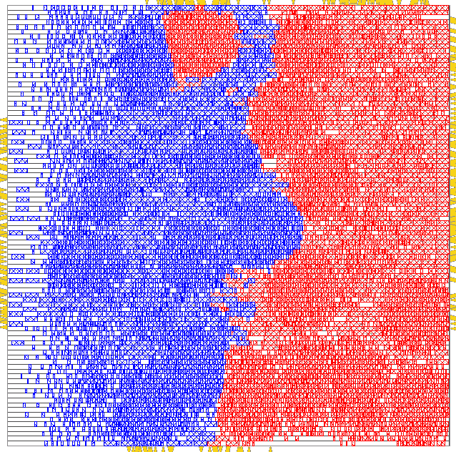
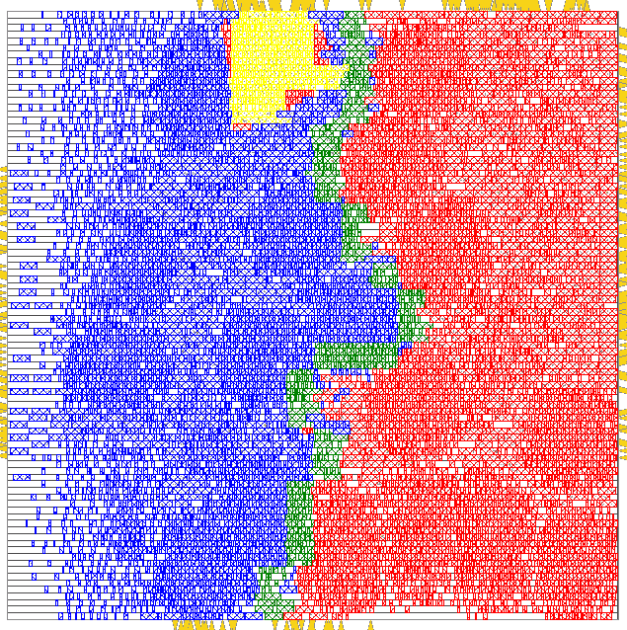
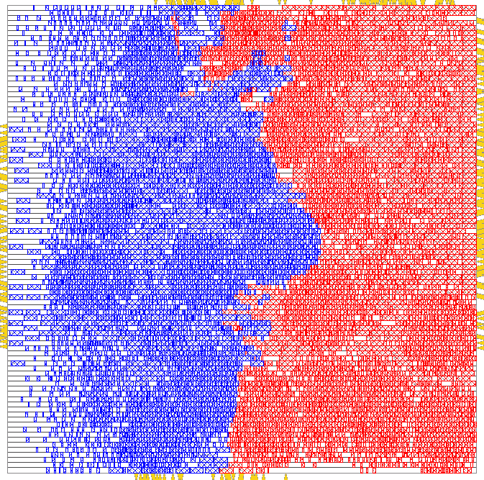
Region Definition
Separated regions for each power domain increase complexity for PDN (power delivery network) design ⇒ Want one continuous region for each power domain
Uniformly divide block area into grids
Define outliers and neighbors Outlier: Grid outside the largest continuous region of the same domain Neighbor: Grid adjacent to the largest continuous region of a different domain
Calculate cost to swap pairs of (outlier, neighbor) Cost = HPWL (half-perimeter wirelength) increase due to the swap
Select the pair with minimum cost to swap
Iterate Steps 2-4 until there is no outlier
Initial placement
Yellow = outliers
Green = neighbors
Post-optimization placement

Slide 14
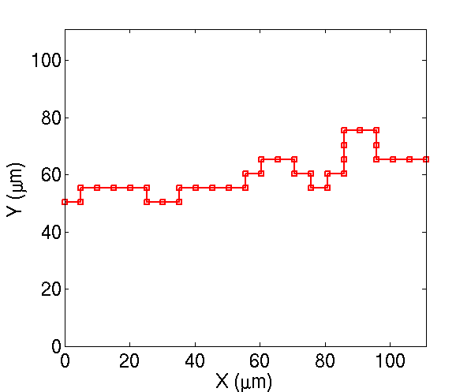
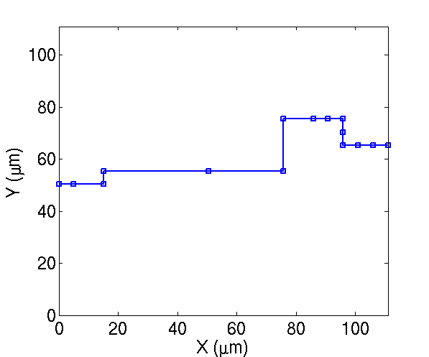
DP-Based Boundary Optimization
Gap area must be inserted along the boundary between two domains ⇒ Want to minimize the boundary length
Dynamic programming-based optimization
Constraints = (1) area of each domain remains same, (2) moved instance area should be restricted
Objective = minimize boundary length
Index turning points from left to right, then DP formulation is Sol(j) = Min(Sol(i).length + seg(i, j).length), for all i < j
Optimized segment (1, j)
Optimized segment (1, i)
Simplified segment (i, j)
Initial boundary
Optimized boundary

Slide 15
Level Shifter Insertion
Resize floorplan for space of level shifter insertion
Preserve trial placement solution
Perform matching-based optimization to insert level shifters ⇒ Minimize wirelength penalty
Enumerate candidate locations between two domains
Cost = HPWL increase to place particular level shifter at a candidate location
Re-floorplan + level shifter insertion
(red = top domain, blue = bottom domain, yellow = level shifters)

Slide 16
Outline
Background and Motivation
Related Work
Our Methodology
Experimental Setup and Results
Conclusion

Slide 17
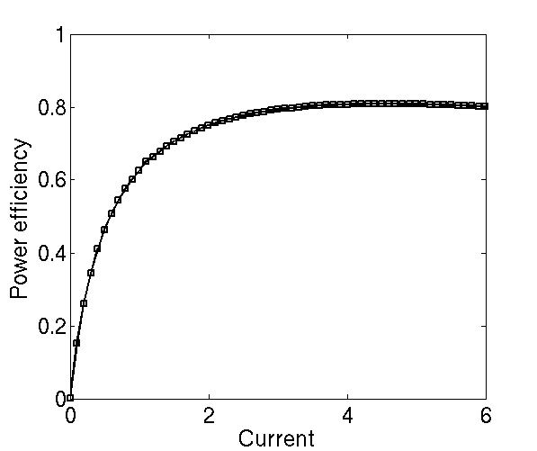
Experimental Setup
Designs
Four blocks from OpenCores website in 28nm LP AES (11K), DES (17K), JPEG (42K), VGA (58K)
Dual-core M4 (113K) industrial design in 40nm
Tools (for OpenCores designs)
Synthesis: Synopsys Design Compiler vH-2013.12-SP3
P&R: Cadence Innovus Implementation System v16.1
Power/timing analysis: Cadence Innovus Implementation System v16.1
Power efficiency of voltage regulators
Efficiency reduces with smaller current
(mA)

Slide 18
Battery Lifetime Improvement
Stacked domain achieve > 10% and 3X battery lifetime improvement in function and sleep modes
Currents are well balanced in both modes
Larger benefits in sleep mode is due to small regulator efficiency
Function mode
Normalized battery lifetime
Sleep mode
Design | #LSs | Currents (func) | Currents (sleep)
AES | 166 | 4.83/5.04 | 0.05/0.04
DES | 135 | 8.83/8.87 | 0.04/0.03
JPEG | 673 | 19.43/23.39 | 0.16/0.16
VGA | 520 | 28.69/32.65 | 0.20/0.17
M4 | 477 | 2.74/3.92 | 0.75/0.77
(top/bottom) domain current unit: mA

Slide 19
Sensitivity to Level Shifter Cost
Use pessimistic level shifter model with ~ 3X power, area and delay increase
Both delta current and total power increase due to power and delay overheads of level shifters
Optimization minimizes #LSs → Overheads are not large
ΔI (mA)
Total power (mW)
ΔI (μA)
Total power (mW)
Function mode
Sleep mode
Design: M4
Technology: 40nm

Slide 20
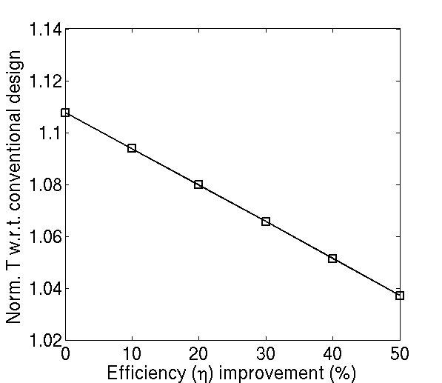
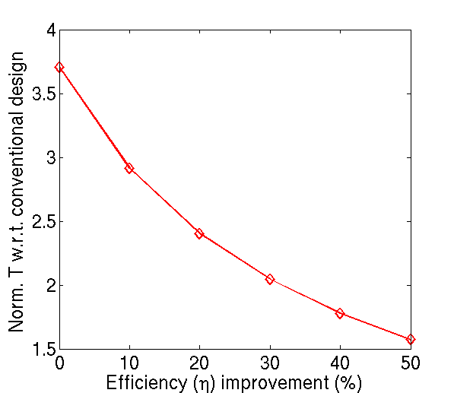
Sensitivity to Voltage Regulator Power Efficiency
Better regulator efficiency → Smaller battery lifetime benefits from stacked domain
(mA)
Function mode
Sleep mode

Slide 21
Outline
Background and Motivation
Related Work
Our Methodology
Experimental Setup and Results
Conclusion

Slide 22
Conclusion
First comprehensive framework for stacked-domain optimization
Extend flow-based partitioning with layout, timing-path awareness, and multi-scenario balancing
More than 10% and 3X battery lifetime improvement compared to conventional designs in function and sleep modes
Ongoing / Future works
Predictive methodology to determine block size
Optimization with > 2 domains and/or in 3DICs

Slide 23
Thank you!

