Slide 1
BEOL Stack-Aware Routability Prediction from Placement using Data Mining Techniques
Wei-Ting J. Chan$, Yang Du⁺, Andrew B. Kahng$, Siddhartha Nath$* and Kambiz Samadi⁺
$UC San Diego
*Synopsys Inc., Mountain View
⁺Qualcomm Research, San Diego
Notes:
Thank you for the introduction. My talk is on “BEOL Stack-Aware Routability Prediction from Placement using Data Mining Technqiues”. This is a joint work with Qualcomm Research and my colleagues at UCSD.

Slide 2
Outline
Motivation
Previous Work
Our Work
Modeling Parameters
Modeling Methodology
Results
Conclusions
Notes:
My talk today is structured as follows. I provide motivation with illustrations. Thereby, I present previous works. Next I highlight our key contributions. Thereafter, I describe our list of modeling parameters and how we have identified these, our modeling methodology. Then, I present results of our two use models and conclude the talk.

Slide 3
Routability Prediction
Very complex at advanced nodes due to multiple design rules
Fixing design rule violations (DRCs) at post-routing is costly and sometimes unfixable
Engineer resources
Disruptive changes to placement, layout contexts, constraints
Early prediction of routability is beneficial but complex
Multiple factors affect routability
No routability models exist today
Today, physical designers use congestion maps to predict routability
Can be insufficient and misleading
Maps do not comprehend design rules, timing criticality, etc.
Large QoR gap: predicted routability at placement vs. actual #DRCs at post-routing
Notes:
At advanced nodes, predicting routability is very difficult and complex as there are many electrical and layout design rules. Design rule violations are identified by a design rule checker. In the rest of the talk, I refer to design rule violations as DRCs. Fixing DRCs after routing is cost as it consumes engineer resources and may involve disruptive changes to the placement, layout contexts and constraints. Sometimes, some DRCs are unfixable. Therefore, early prediction of routability is beneficial. However, this is complex as multiple factors affect routability and no routability models exist today. Physical designers, today, use congestion maps to predict routability. These maps can be insufficient as well as misleading at times because they do not comprehend design rules, timing criticality, etc. Lack of correlating predicted routability at placement vs. actual #DRCs leaves large QoR gaps that we propose to address in this work.

Slide 4
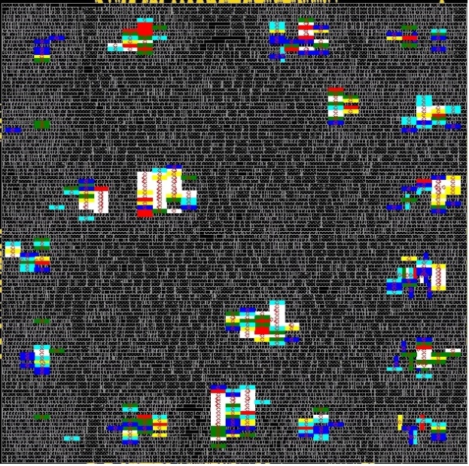
Example 1: Congestion Maps can be Misleading
Many highly congested regions result in few DRC violations
aes_cipher_top implemented in 28nm FDSOI, 8T cells
Clock period = 0.6ns, aspect ratio = 1.0, utilization = 77%
Designer may conclude that placement is unroutable, but it is actually routable!!!
Notes:
Here is a motivating example when a congestion map is misleading. This picture shows congestion map at placement of the opencores aes_cipher_top block using 28FDSOI technology and 8 track cells, implemented using 0.6ns clock period, 77% utilization and aspect ratio of 1.0. The white to red color regions have negative overflow, i.e., demand is greater than supply. Red regions are the most congested ones. From this map, a designer may conclude that the placement is unroutable as there are several patches of congestion. However, the DRC map at routing shows that there are only few DRCs as shown by white crosses and highlighted by the yellow ovals. Therefore, many highly congestion regions result in only few DRCs and the design is routable.

Slide 5
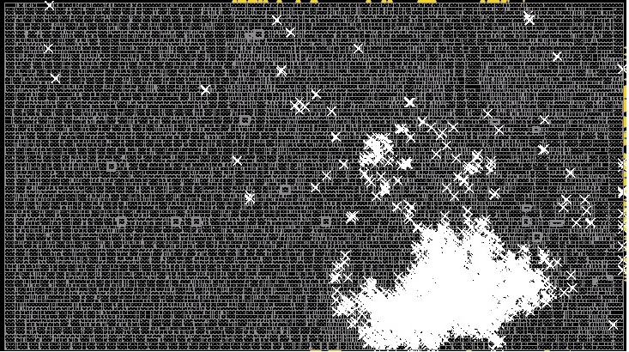
Example 2: Congestion Maps can be Misleading
Few highly congested regions result in many DRC violations
ARM Cortex M0 implemented in 28nm FDSOI, 8T cells
Clock period = 0.6ns, aspect ratio = 2.0, utilization = 77%
Designer may conclude that placement is routable, but it is actually unroutable!!!
How to predict if a BEOL stack-aware placement will be routable?
Notes:
Here is another example to illustrate that congestion maps can be misleading. This picture shows congestion map at placement of the ARM Cortex M0 block using 28FDSOI technology and 8 track cells, implemented using 0.6ns clock period, 77% utilization and aspect ratio of 2.0. From this map, a designer may conclude that the placement is routable as there are few patches of congestion. However, the DRC map at routing shows that there are many DRCs as shown by white crosses. Therefore, few highly congestion regions result in many DRCs and the design is unroutable. The key question is, how to predict if a BEOL stack-aware placement will be routable?

Slide 6
Previous Work
Early congestion estimation
At floorplan/placement
Taghavi et al. propose MILOR
Caldwell et al. estimate routed WL
At global routing
Brenner et al., Jiang et al., Wang et al., Zhing et al. develop congestion models and cure congestion
Kahng and Xu propose a statistical model that comprehends routing bends and blockage effects
Qi et al. use MARS and achieve 13% reduction in #DRCs
Zhou et al. use MARS and achieve accuracy of 80% in predicting routability
Metal layer estimation
Dong et al. study #metal layers versus instance counts
Andreev et al. patented a DP to assign net segments to layers by utilizing min #vias
Previous works do not address min #layers to make design routable, predict a Pareto frontier of aspect ratio, max util, #layers
Notes:
I review previous works now. These works can be broadly categorized as those related to early congestion estimation and those related to metal layer estimation. Works that estimate congestion at floorplan or placement stage are Taghavi et al. who propose MILOR, and Caldwell et al. who estimate routed WL at placement. Several works estimate routability at global routing stage and cure congestion. These include Brenner, Jiang, Wang, Zhing et al. Kahng and Xu propose a statistical model that comprehends routing bends and effects of blockages. Qi et al. use MARS modeling and achieve 13# reduction in #DRCs. Zhou et al. use MARS and achieve 80% accuracy in predicting routability.
In works that estimate #layers, Dong et al. estimate how #layers change with instance counts. Andreev et al. patent a DP algorithm to assign net segments to layers and minimize #vias.
Previous works do not address min #layers to make a design routable and do not predict a Pareto frontier of aspect ratio, max util and #layers that we propose in this work.

Slide 7
Our Contributions
We develop models for two use models
Given a netlist, clock period, utilization, aspect ratio and BEOL stack-specific placement, can the placement be routable?
Given very few (≤ 20) placements, predict an iso-performance Pareto frontier of #layers, aspect ratio and max utilization
We demonstrate that congestion maps from commercial tools can be insufficient to predict routability
We describe a machine learning-based methodology to develop models for our use models without using any information from global routing
Our models achieve accuracy ≥ 85.9% in predicting routability and are at most 2% pessimistic in predicting the max achievable utilization
Notes:
Our contributions include developing learning-based models for two use models. First, given a netlist, constraints, layout contexts and BEOL stack-specific placement, we predict if the placement will be routable. Second, given very few placements, we predict an iso-performance Pareto frontier of #layers, max achievable utilization, aspect ratio.
We demonstrate by way of examples that congestion maps from commercial tools can be insufficient to predict routability.
We describe a machine learning-based methodology to develop models for our use models without using any information from global routing.
Our models achieve accuracy >= 86% in predicting routability and are at most 2% pessimistic in predicting the max achievable utilization.

Slide 8
List of Modeling Parameters
We divide placement region into multiple equal-sized grids. Across all grids, we obtain
Pin density (max, coefficient of variation)
Min proximity (min, coefficient of variation)
#complex cells (max, coefficient of variation)
Sum of incoming and outgoing edges (max, coefficient of variation)
#buried nets (max, coefficient of variation)
Arithmetic, geometric mean of Rent parameter
Worst transition time of all pins at worst corner (max, coefficient of variation)
Smallest setup WNS of any pin (min, coefficient of variation)
Utilization of standard cells
Floorplan aspect ratio
P&R clock period
#H, #V tracks
Notes:
Here is a list of our modeling parameters. We propose new parameters extracted from the placement stage that enable stronger correlation with #DRCs. We divide the placement region into equal-sized grids and across all grids we obtain pin density, min proximity, #complex cells, sum of edges, #buried nets, arithmetic and geometric mean of Rent parameter, worst transition time of all pins at the worst corner, and the smallest setup WNS of any pin. Our parameters comprehend timing criticality. We also include utilization, aspect ratio and clock period to comprehend contexts and constraints, and #H and #V tracks to comprehend BEOL stack.

Slide 9
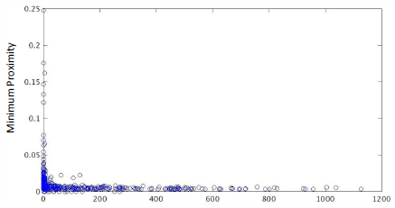
Example 1: New Parameter
Min Proximity
#DRCs
Minimum proximity of any pair of pins indicates pins of adjacent cells within a grid are placed closely
Small proximity ➔ close pin placement ➔ can cause #DRCs
R² = 0.85
Notes:
Here we show an example of our new parameter Min Proximity in the y-axis and how it correlates with #DRCs in the x-axis.
Min proximity of any pair of pins indicates how closely pins of adjacent pins are placed within a grid.
Small value of min proximity implies close pin placement which can lead DRCs for min area, min spacing violations
Our coefficient of determination is 0.85

Slide 10
Modeling Flow
Input Parameters and #DRCs
Labelling:
#DRCs ≥ 50: -1
#DRCs < 50: +1
Preprocessing
Normalizing:
All input parameters $∈$ {-1, +1}
Weighting:
w = #+ve labels / #-ve labels
Apply weight w to inputs with label -1
Apply weight 1.0 to inputs with label +1
Modeling
Learning:
SVM classification with RBF kernel
Grid search of hyperparameters C, $ξ$
for min cross-validation error
Notes:
Now I describe our modeling flow. We obtain our set of input parameters and the #DRCs for each set of input parameter. The first step is data labelling as we treat our problem as a classification problem. If the #DRCs is >= 50, we label the data as -1 and +1 otherwise. We pessimistically choose 50 as a threshold of #DRCs that are fixable by hand by a designer.
The second step is normalizing input parameters to ranges between -1, and +1. The third step is weighting. We weight data points because in subsequent slides I’ll show that #data points that are routable are much larger than the #data points that are unroutable. Without weighting, the model is biased towards routable data points, i.e., given a set of inputs, the model will be more likely to predict it as routable. To remove this bias, we calculate weight w as the ratio of #data points with +ve labels to the #data points with –ve label and apply w to all –vely labelled data points. Labelling, normalizing and weighting steps are often referred to as preprocessing data. Last, we perform modeling or learning using SVM with a nonlinear RBF kernel. We perform 5-fold cross validation and search for the set of hyperparameters that minimize cross-validation error.

Slide 11
Interpolation, Extrapolation Algorithm
Given 3 (out of ≤ 20) placements, error upper bound (UB_{error})
Extract parameter values from these 3 placements
Choose one placement from the remaining to fit a model
Initialize error to large value
While (error > UB_{error} && #remaining placements > 0)
Test model on remaining placements
Calculate error
If error > UB_{error}
Add placement to training set, retrain model
Remove placement from set of remaining placements
Notes:
To predict Pareto frontiers using few placements, we must develop an algorithm to interpolate and extrapolate parameter values. We start with 3 placements and from a fourth placement we extract parameter values of interest that we will use to fit. We create a hybrid model using MARS and SVM. Now we iterate with the remaining placements to refine this model. We initialize error to a large value and while the error is greater than an upper bound and #remaining placements are nonzero, we test our model on each placement. If the error from a placement is larger than the upper bound, we retrain our model by adding data from this placement and remove it from the set of placements that we will subsequently use for testing. We iterate until error is less than the upper bound and/or we exhaust all of the 20 given placements. Using this algorithm, we interpolate or extrapolate each of our input parameters.

Slide 12
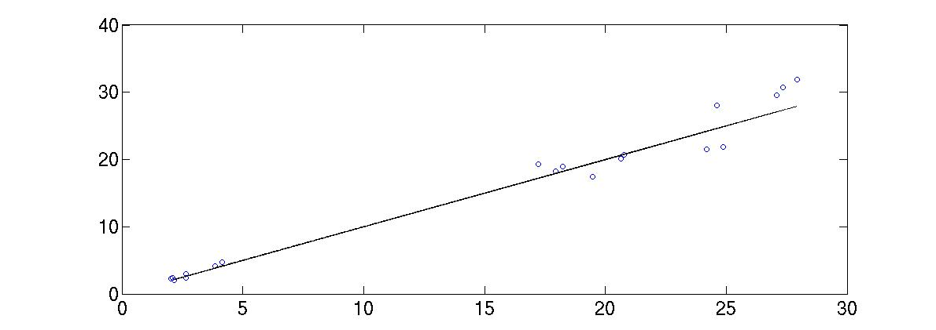
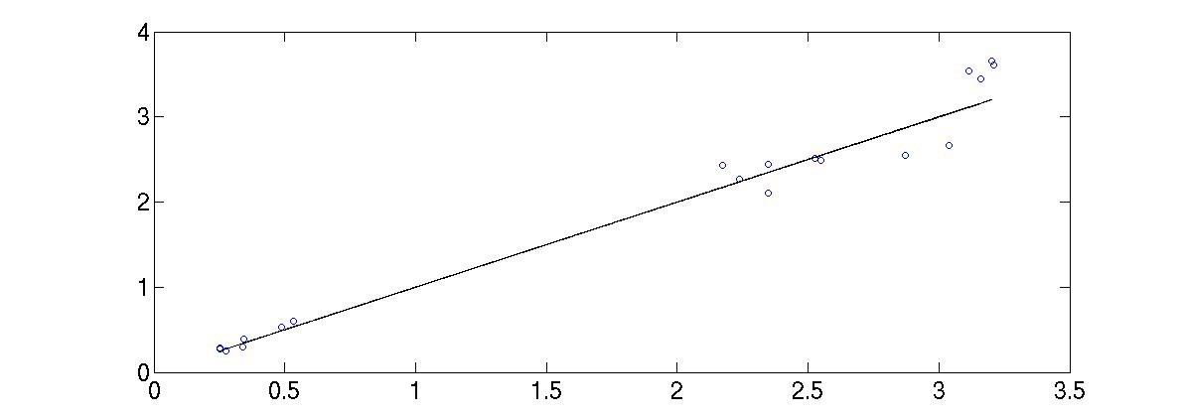
Goodness of Interpolation/Extrapolation Algorithm
Predicted Pin Density
Actual Pin Density
Predicted #Complex Cells
Actual #Complex Cells
Notes:
These plots show accuracy of our interpolation and extrapolation algorithm in predicting pin density in the top plot and #complex cells in the bottom plot. The x-axis is the actual value and the y-axis is the predicted value. We observe that our predictions have small error.

Slide 13
DoE: Training
Context | Details
Utilization (%) | {70, 71, 72, …,86}
Aspect Ratio | {1.0, 1.3, 1.8}
#Metal Layers | {6, 5, 4}
Technologies | 28FDSOI 8T, 28LP 12T, 45GS 9T
 | Tech | aes_cipher_top | aes_x2 | aes_x3
P&R Clock Period (ns) | 28FDSOI 8T | {0.6, 0.9, 1.1} | {0.6, 0.9, 1.1} | {0.6, 0.9, 1.1}
 | 28LP 12T | {0.6, 0.9, 1.1} | {0.6, 0.9, 1.1} | --
 | 45GS 9T | {1.0, 1.3, 1.8} | {1.0, 1.3, 1.8} | --
#Routable; #Unroutable | 28FDSOI 8T | 306; 153 | 306; 153 | 294; 165
 | 28LP 12T | 437; 22 | 424; 35 | --
 | 45GS 9T | 317; 142 | 311; 148 | --
Notes:
Now I describe our design of experiments used to obtain ground truth for training our models. We vary utilization from 70% to 86%, in steps of 1% choose 3 values of aspect ratios, 3 uniform BEOL stacks with 6, 5 and 4 layers and 3 technologies: 28FDSOI with 8 track cells, 28LP with 12 track cells and 45GS with 9 track cells.
We use opencores aes_cipher_top block as well as 2 other designs in which we stitch 2 and 3 instances of the aes_cipher_top block together to obtain aes_x2 and aes_x3 respectively.
Observe that the #unroutable data points are fewer compared to the #routable data points for each design and technology.

Slide 14
DoE: Testing
Context | Details
Utilization (%) | {76, 77, 78, …,90}
Aspect Ratio | {1.0, 1.5, 1.7}
#Metal Layers | {8, 7, 6, 5, 4}
Technologies | 28FDSOI 8T, 28LP 12T, 45GS 9T
 | Tech | Cortex | jpeg_x5 | leon3mp | dct | vga
#Routable; #Unroutable | 28FDSOI 8T | 900; 300 | 502; 98 | 195; 105 | 180; 90 | 177; 93
 | 28LP 12T | 508; 32 | 246; 24 | -- | 240; 30 | 235; 35
 | 45GS 9T | 277; 128 | 195; 75 | -- | -- | --
Testing data contains utilization, aspect ratio, #layers and testcases beyond training data
Testing dataset size ~1.9$×$ the training dataset size
Notes:
In our DoE used to obtain ground truth for testing, we vary utilization from 76% to 90%, in steps of 1% choose 3 values of aspect ratios, 5 uniform BEOL stacks with 8, 7, 6, 5 and 4 layers and 3 technologies.
We use new designs such as ARM Cortex M0, jpeg_x5, leon3mp, dct and vga. Note that our testing data contains utilization, aspect ratio, #layers and testcases that the trained model has not “seen”. In addition, the size of testing dataset is 1.9x the size of the training dataset, that is, we intentionally make our modeling problem difficult.

Slide 15
Choice of Grid Size
Grid sizes of 15 x 15 tracks (gcell size in P&R tool) shows poor correlation with #DRCs (R² = 0.36)
Grid sizes of 45 x 45 tracks show stronger correlation ➔ comprehends impact from neighboring gcells
Notes:
We must choose grid sizes appropriately so that the training data “sees” the correlation with #DRCs. This plot shows correlation of pin density in y-axis with #DRCs in x-axis by using the default gcell size in the P&R tool. The R2 is 0.36.
By increasing the grid size to 45x45 tracks, we observe stronger correlation as measured by R2 of 0.78. This indicates that our parameters must comprehend impact from neighboring routing gcells.

Slide 16
Routability Prediction (28FDSOI, 8T)
Training set
#Routable = 906; #unroutable = 471
Testing set
#Routable = 1954; #unroutable = 686
SVM classifier with RBF kernel, two-class classification
Training |  |  |  |  | Testing
 |  | Actual |  |  |  |  | Actual
 |  | True | False |  |  |  | True | False
Pred | True | 869 | 11 |  | Pred | True | 1790 | 173
 | False | 37 | 460 |  |  | False | 164 | 513
Dataset | Accuracy (%) | Precision (%) | Recall (%) | NPV (%)
Training | 96.5 | 98.8 | 95.9 | 92.5
Testing | 87.2 | 91.9 | 91.6 | 75.8
Notes:
I now present modeling results for 28FDSOI. Recall from our DoE that the training data set contains 906 routable, and 471 unroutable data points. The testing dataset contains 1954 routable and 686 unroutable datapoints. The table on top shows the confusion matrix and the table in the bottom shows standard classification metrics. Our modeling accuracy is 87% and >= 91% precision and recall. NPV measures the ratio of placements that are truly unroutable to the placements that are predicted to be unroutable. In our context, large NPV is good because it saves design turnaround time because the overhead of incorrectly classifying a routable placement as unroutable is high.

Slide 17
Routability Prediction w/ Congestion Maps only (28FDSOI, 8T)
Training set
#Routable = 906; #unroutable = 471
Testing set
#Routable = 1954; #unroutable = 686
SVM classifier with RBF kernel, two-class classification
Training |  |  |  |  | Testing
 |  | Actual |  |  |  |  | Actual
 |  | True | False |  |  |  | True | False
Pred | True | 833 | 66 |  | Pred | True | 1427 | 298
 | False | 73 | 405 |  |  | False | 527 | 388
Dataset | Accuracy (%) | Precision (%) | Recall (%) | NPV (%)
Training | 89.9 | 92.6 | 91.9 | 84.7
Testing | 68.8 (-18.4) | 82.7 (-9.2) | 73.0 (-18.6) | 42.4 (-33.4)
Notes:
Now I present modeling results for the same 28FDSOI by using only congestion maps. The modeling accuracy is 69%, i.e., worsened by 18% compared to our models, and NPV degrades by 33% to 42%.

Slide 18
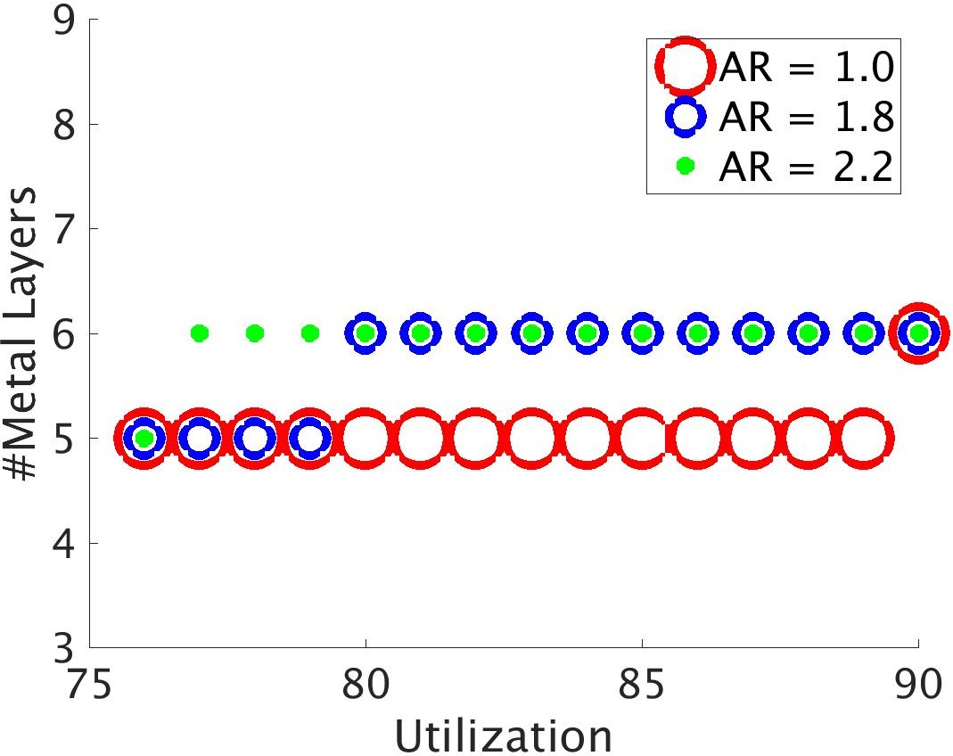
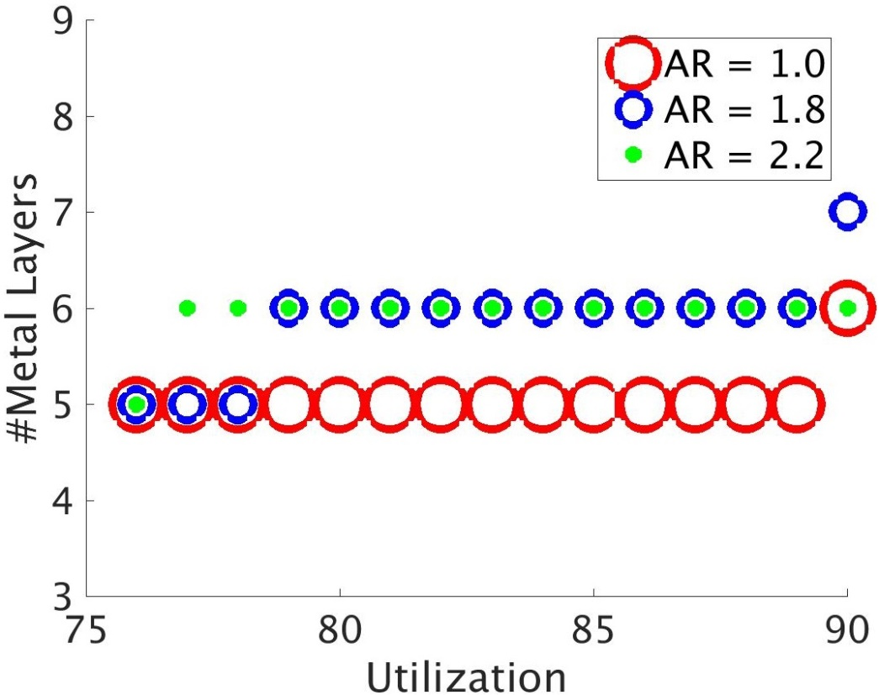
Result 1: Pareto Frontier Prediction
Predict Pareto frontier of max utilization, aspect ratio, #metal layers given ≤ 20 placements only
Actual
Predicted
Cortex M0, 28FDSOI 8T, AR = 1.8
Actual: max util of 79% with 5 metal layers is possible
Prediction: max util of 78% with 5 metal layers
Notes:
Now I present results of our Pareto frontier prediction using 20 placements. The left plot shows ground truth for the ARM Cortex M0 design and the right plot show the predicted Pareto using our methodology. Actual data shows that max util of 79% with 5 metal layers at AR 1.8 is possible. However, predicted results show that max util of 78% with 5 metal layers is possible. That is, our model predictions are pessimistic by 1%.

Slide 19
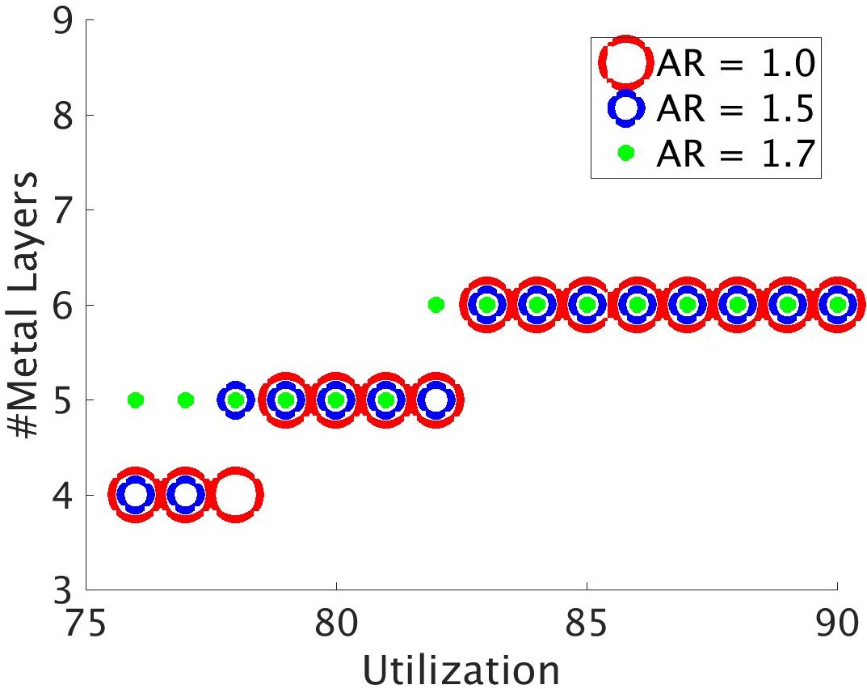
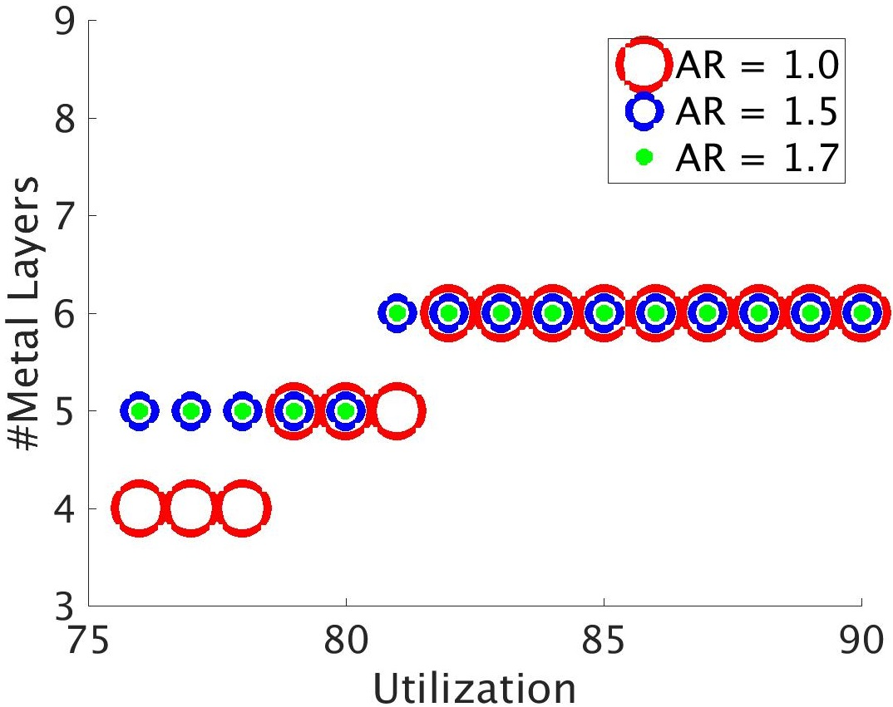
Result 2: Pareto Frontier Prediction
Predict Pareto frontier of max utilization, aspect ratio, #metal layers given ≤ 20 placements only
Actual
Predicted
JPEG_X5, 45GS 9T, AR = 1.5
Actual: max util of 77% with 4 metal layers is possible
Prediction: max util of < 76% with 4 metal layers
Notes:
Here I present another result of our Pareto frontier prediction. The left plot shows ground truth for the jpeg_x5 design and the right plot show the predicted Pareto using our methodology. Actual data shows that max util of 77% with 4 metal layers at AR 1.5 is possible. However, predicted results show that max util of < 76% with 4 metal layers is possible. We need 5 metal layers to achieve max util of 77. That is, our model predictions are pessimistic by 2%.

Slide 20
Conclusions
New parameters to predict routability by using only information from placement
Interpolation and extrapolation methodology to predict Pareto frontiers of maximum achievable utilization, aspect ratio, #metal layers at iso-performance
Methodology applicable to 2D and 3D ICs (outcomes of very different academic 3D P&R flows)
Classification accuracy ≥ 86% across multiple technologies
Prediction of maximum achievable utilization are within 2% of the actual maximum achievable utilization
Ongoing:
Predicting timing, routability with nonuniform BEOL stacks
Adding confidence intervals to our predictions
Extending our models to predict routability of 3DICs
Notes:
In summary, in this work we present new parameters to predict routability by using only information from placement. We describe an interpolation and extrapolation algorithm to predict iso-performance Pareto frontiers of max util, aspect ratio and #layers. Our methodology is applicable to different flows and can be extended to 3DICs. Our classification accuracy is >= 86% and our predictions of max util from Pareto frontiers are pessimistic by 2%. Ongoing works include predicting timing, routability for nonuniform BEOL stacks, adding confidence intervals to our predictions and extending our models to predict routability of 3DICs.

Slide 21
Acknowledgments
Work supported by Qualcomm Research
Notes:
This work is supported by Qualcomm Research.

Slide 22
Thank You!
Notes:
Thank you for your attention.

