Slide 1
Improved Performance of 3DIC Implementations Through Inherent Awareness of Mix-and-Match Die Stacking
Kwangsoo Han, Andrew B. Kahng and Jiajia Li
University of California at San Diego
http://vlsicad.ucsd.edu/

Slide 2
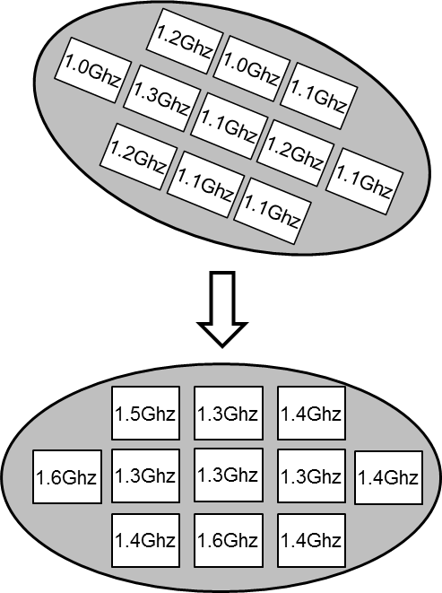
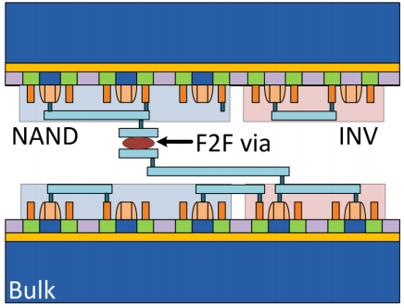
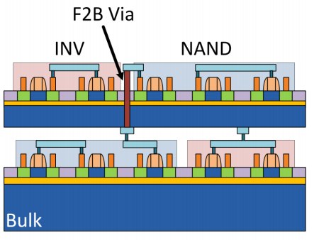
Mix-and-Match Integration
Interesting idea proposed by previous works
Integrate slow copies of tiers with fast copies of tiers to improve 3DIC parametric yield == “Mix-and-match” integration
SS Tier 1 wafer/die
Fast Tier 1
3D integration
Slow Tier 0
FF Tier 0 wafer
Wafer-to-wafer (die-to-wafer) bonding: integrate SS wafer/die with FF wafer/die (SS Tier 0 wafer/die + FF Tier 1 wafer or FF Tier 0 wafer/die + SS Tier 1 wafer)
Monolithic 3D: adapt process so that Tier 1 is fast if Tier 0 is known to be slow

Slide 3
Agenda
Motivation
Related Works
Our Methodology
Experimental Results
Conclusions

Slide 4
Mix-and-Match Needs Design-Stage Optimization
Mix-and-match integration offers performance benefits over the conventional worst-case analysis
No holistic “design for eventual integration” of 3DICs
With mix-and-match integration, blue cut has maximum slack, red cut has minimum slack
Our goal: Study design-stage optimization for mix-and-match
XX-YY = XX Tier 0 + YY Tier 1
Technology: 28FDSOI
3D netlist is bipartitioned with minimum net cut
75ps
SS (FF)
Bad setup and hold slacks
FF (SS)
SS (FF)
FF (SS)
Benefit from mix-and-match

Slide 5
Challenges in Mix-and-Match-Aware Partitioning
Examples with different optimal solutions for different objectives
Assumption: (i) Uniform stage delay (d^{SS} = 30ps, d^{FF} = 10ps) (ii) Path_{AC}: 26 stages, Path_{BC}: 30 stages (iii) Balance criteria: 50% for each die
Objective: (i) Minimize delay of Path_{AC}
(ii) Minimize delay of Path_{BC}
(iii) Minimize worst-case delay over the two paths
(iv) Minimize worst-case delay over the two paths in regime of large VI delay impact (d_{VI})
3
6
3
3
3
d_{VI} = 60ps
d_{VI} = 10ps
D_{AC} = 680ps D_{BC} = 720ps
D_{AC} = 620ps D_{BC} = 620ps
D_{AC} = 530ps D_{BC} = 680ps
A
D_{AC} = 640ps D_{BC} = 610ps
Tier 1
Tier 0
C
B
5
18
2
7
20
15
6
13
14
1
5
10
5
9

Slide 6
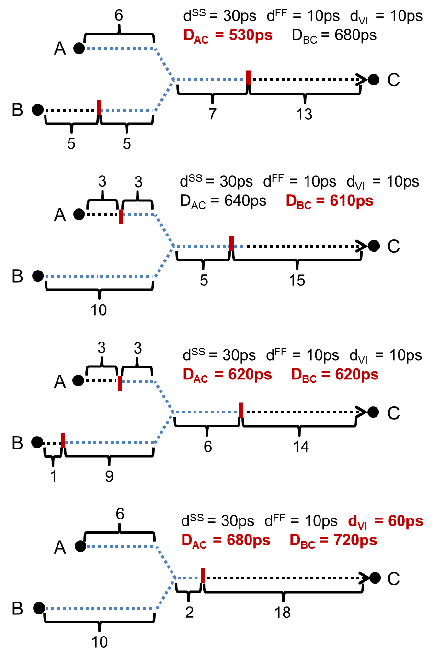
Challenges in Mix-and-Match-Aware Partitioning
Optimal cut location on one path conflicts with those on other paths
Example has different optimal solutions for different objectives
Vertical interconnect (VI) delay impact
Asymmetric path delay distribution due to process variation

Slide 7
Agenda
Motivation
Related Works
Our Methodology
Experimental Results
Conclusions

Slide 8
Related Works
Mix-and-match die stacking
[Ferri08] integrates fast (slow) CPU die with slow (fast) L2 cache die to improve parametric yield
[Garg13] formulates mathematical programming to optimize mix-and-match stacking
[Chan13] uses mix-and-match stacking to optimize reliability of 3DICs
[Juan14] performs thermal-aware matching and stacking
But no design-stage optimization has been studied
Netlist partitioning for 3DICs
[Li06] uses simulated annealing engine to partition block into tiers
[Thorolfsson10] uses hMetis to partition netlist with minimized #VIs
[Hu10] proposes a multi-level framework for 3D partitioning
[Cong07][Panth15] assign cells to tiers through transformations of a 2D placement
These do not comprehend mix-and-match die stacking

Slide 9
Agenda
Motivation
Related Works
Our Methodology
Experimental Results
Conclusions

Slide 10
ILP-Based Partitioning Method
ILP formulation
Minimize D_{max} // Minimize max path delay in regime of mix-and-match
Such that β_{i, i’} ≥ x_{i} - x_{i’} // indicators of VI insertions β_{i, i’} ≥ x_{i’} - x_{i} for all adjacent cells
Delay bound ∑(d_{i}^{j}∙(1-x_{i}) + d_{i}^{j’}∙x_{i}) + ∑ β_{i, i’}∙d_{VI} ≤ D_{max} for all paths
Area-balancing criterion ∑ a_{i}∙x_{i} - ∑a_{i}∙(1-x_{i}) ≤ α∙∑a_{i} ∑ a_{i}∙(1-x_{i}) - ∑a_{i}∙x_{i} ≤ α∙∑a_{i}
Notations
D_{max} maximum path delay
x_{i} binary indicator of cell on Tier 0 (x_{i} = 0) or Tier 1 (x_{i} = 1)
β_{i, i’} binary indicator of whether a VI (cut) exists
d_{i}^{j} cell delay at j^{th} process corner
d_{VI} delay impact of VI insertion
a_{i} cell area
α area-balancing criterion (e.g., α = 5%)

Slide 11
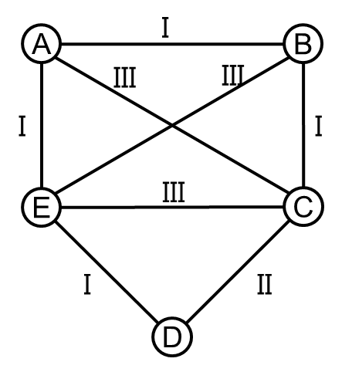
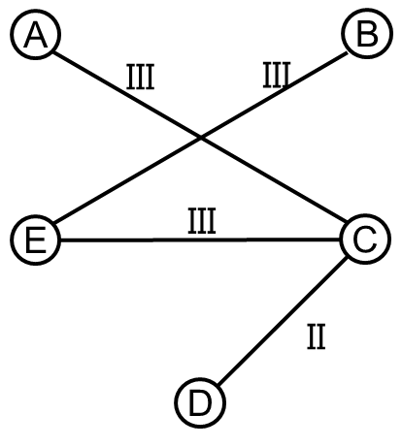
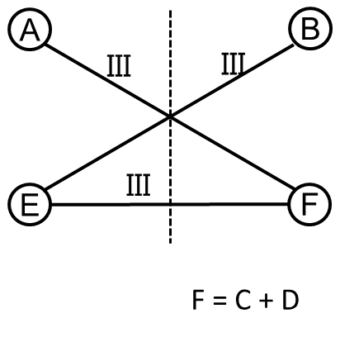
Heuristic Partitioning Method (1)
Maximum-cut on timing-critical sequential graph
Classify paths according to their slacks and VI delay impact Type-I Timing non-critical paths Type-II Timing-critical paths without tolerance of VI insertion ⇒ Impact of VI insertion ≥ timing benefit from mix-and-match Type-III Timing-critical paths with tolerance of VI insertion ⇒ Impact of VI insertion < timing benefit from mix-and-match
Extract restricted sequential graph containing only Type-II/Type-III paths
Collapse vertices connected with Type-II paths into one vertex
Perform maximum cut on updated graph

Slide 12
Heuristic Partitioning Method (2)
Timing-aware multi-phase FM partitioning
Issue: Hard to “foresee” slack benefits with existence of VI delay impact
Our solution: Cluster cells with given range of cluster size
Moving one cell degrades slack, but following moves compensate VI delay impact
Partitioning solution
Clustering with cluster size [L₂, U₂]
Clustering with cluster size [L₂, U₂]
Clustering with cluster size [L_{k}, U_{k}]
One phase
…
Timing-aware FM
Timing-aware FM
Timing-aware FM
Partitioning solution with maximum slack

Slide 13
Agenda
Motivation
Related Works
Our Methodology
Experimental Results
Conclusions

Slide 14
Design of Experiments
Testcases: ARM Cortex M0 and DMA, AES, VGA from OpenCores website
Technology: 28FDSOI, dual-VT
Tools
ILP solver: CPLEX v12.5
Synthesis: Synopsys Design Compiler H-2013.03-SP3
P&R: Cadence EDI System v12.0
Signoff timer: Synopsys PrimeTime H-2013.06-SP2
Two sets of experiments
Validation of our heuristic partitioning method
Extend existing 3DIC implementation flows with our optimization

Slide 15
Calibration of Heuristic Partitioning
ILP-based optimization leads to near-optimal solution
Vary delay impact of VI insertion, process corners
Heuristic consistently achieves < 30ps slack difference compared to ILP-based partitioning solution
Design | Clk period
DMA | 0.6ns
d_{VI} (ps) 10 30 50 10 30 50 10 30 50
3σ SS + 3σ FF 2σ SS + 3σ FF 3σ SS + 2σ FF

Slide 16
Validation of Our Method
Extend two existing 3DIC implementation flows (i) GT2012, and (ii) Shrunk2D to include our partitioning method for mix-and-match
Up to 16% performance improvement
GT2012 (orig)
GT2012 (opt)
Design | Clk period
M0 | 1.2ns
AES | 1.1ns
VGA | 1.0ns

Slide 17
Agenda
Motivation
Related Works
Our Methodology
Experimental Results
Conclusions

Slide 18
Futures and Conclusions
Design-stage optimization for mix-and-match die stacking
ILP-based and heuristic partitioning methodologies directly maximize design’s slack in the regime of mix-and-match
Up to 16% timing improvement compared to conventional 3D partitioning solution
Future works
Integration of design-stage and die- and/or wafer-level optimization
Clock tree synthesis for mix-and-match stacking

Slide 19
THANK YOU !

