Slide 1
Mixed Cell-Height Implementation for Improved Design Quality in Advanced Nodes
Sorin Dobre⁺, Andrew B. Kahng* and Jiajia Li*
* UC San Diego VLSI CAD Laboratory
⁺ Qualcomm Inc.

Slide 2
Outline
Background and Motivation
Problem Statement
Related Work
Our Methodology
Experimental Setup and Results
Conclusion

Slide 3
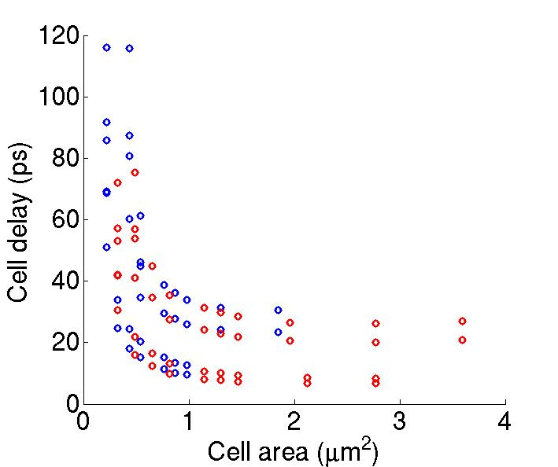
Choice of Cell Height ?
In standard cell-based implementation …
Large cell height ⇒ better timing, but larger area and power
Small cell height ⇒ smaller area and power per gate, but large delay and more #buffers, pin accessibility issue
Can we mix cell heights to have better tradeoffs between performance and area/power ⇒ better design QoR?
Technology: 28nm LP
RED: 12T cells = larger area, smaller delay
BLUE: 8T cells = smaller area, larger delay

Slide 4
Motivation of Mixing Cell Heights
Post-synthesis area and timing comparison among 12T-only, 8T-only and mixed cell heights at 28LP
12T-only tends to have large area
Weak drive strengths of 8T cells ⇒ #buffers↑ ⇒ area↑
Mixing cell heights achieves >14% area reduction
No existing flow offers sub-block level mixed cell-height optimization
Our goal: mixed cell-height implementation (!)

Slide 5
Outline
Background and Motivation
Problem Statement
Related Work
Our Methodology
Experimental Setup and Results
Conclusion

Slide 6
Mixed Cell-Height Placement Problem
Given: design (i.e., gate-level netlist), timing constraints, Liberty files, and floorplan
Place design such that each cell instance is legally placed in a row with corresponding height
Objective: minimum design area with target performance

Slide 7
Challenge 1: “Chicken-Egg” Loop
Conventional design flow
Synthesis
Heights of cell rows are defined by floorplan (site map) before placement
Choices of cell heights highly depend on placement solution
Floorplan
Floorplan
Placement
Placement
CTS/Routing

Slide 8
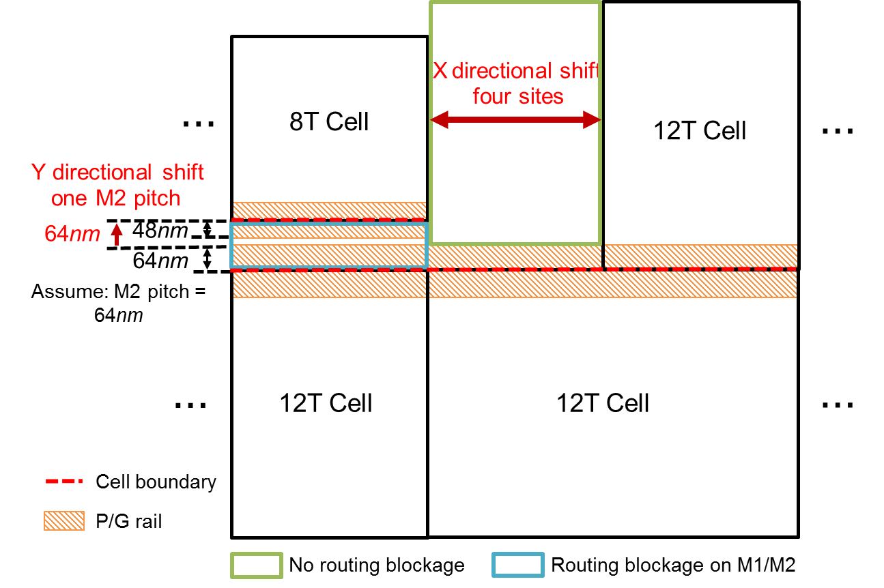
Challenge 2: Area Overheads
“Breaker cells” must be inserted ⇒ area cost
Vertical: P/G rail of a cell cannot encroach into adjacent-row cells
Horizontal: well-to-well spacing rule
Other layout constraints
N-well sharing ⇒ even number of rows in a region
Alignment with routing and poly tracks

Slide 9
Challenge 2: Area Overheads
“Breaker cells” must be inserted ⇒ area cost
Vertical: P/G rail of a cell cannot encroach into adjacent-row cells
Horizontal: well-to-well spacing rule
Other layout constraints
N-well sharing ⇒ even number of rows in a region
Alignment with routing and poly tracks
Mixed cell-height implementation must comprehend these challenges

Slide 10
Outline
Background and Motivation
Problem Statement
Related Work
Our Methodology
Experimental Setup and Results
Conclusion

Slide 11
Related Works
No previous work on sub-block level mixed cell-height design
Similarity to voltage island placement
Assign certain cell attribute with different values (height, Vdd)
Area cost (breaker cells, level shifters)
[Wu05][Ching06] propose partitioning methods to define power domains
[Wu07] considers timing constraints and cell placement
[Guo07] embeds voltage-island-aware optimization to partitioning-based placement
More challenges in mixed cell-height design
Chicken-and-egg loop
Area impact of cell height choices

Slide 12
Outline
Background and Motivation
Problem Statement
Related Work
Our Methodology
Experimental Setup and Results
Conclusion

Slide 13
Overall Flow
Logic Synthesis
: with libraries of all cell heights
Initial placement
: with revised cell LEF such that all cells have the same height (== min cell height), but scale cell width to maintain same area
Floorplan region definition
Placement Legalization
8T cell
12T cell
Floorplan Update
: based on the partition (floorplan definition) results, with cell rows of actual heights and breaker cells
Cell mapping
Routing / RoutOpt / STA
: with commercial P&R, STA tools

Slide 14
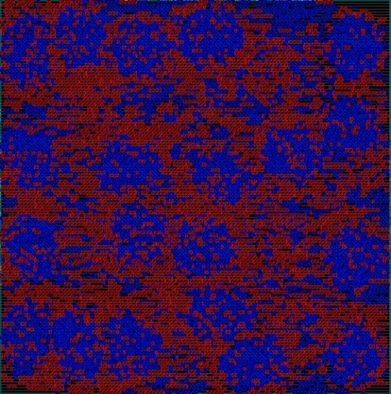
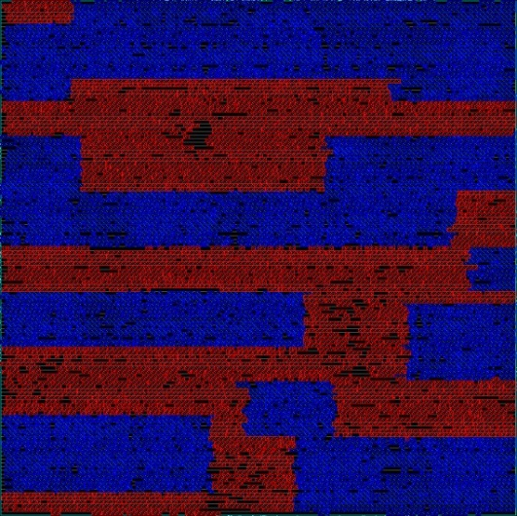
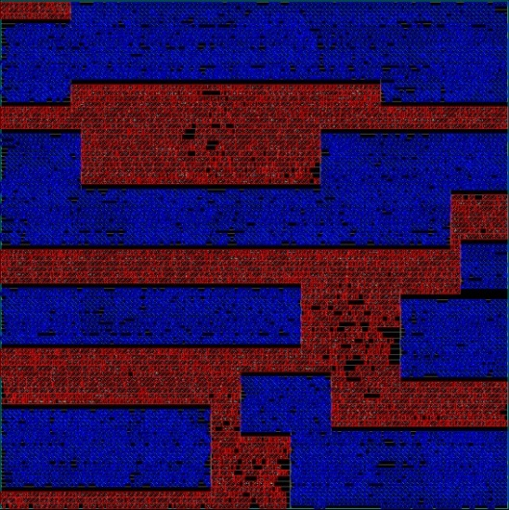
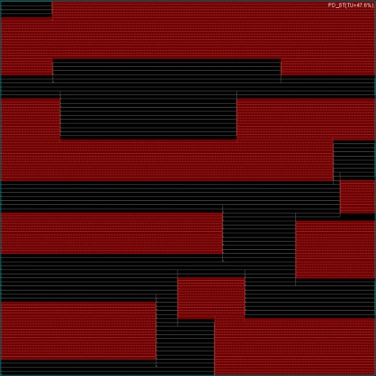
Example of Overall Optimization Flow
Initial placement
(8T/12T cells “freely” placed)
Partitioning
(Yellow blocks = regions)
Legalization
Technology: 28nm LP
Design: AES
BLUE: 8T cells
RED: 12T cells
Mixed-height placement
New floorplan

Slide 15
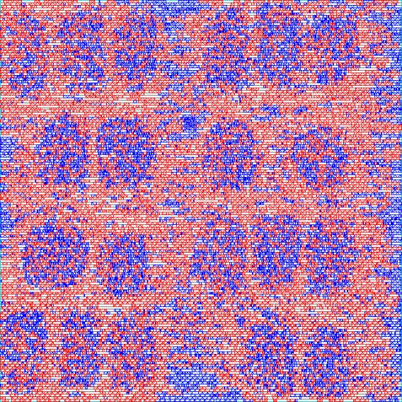
Floorplan Partitioning and Region Definition
Partition block into rectangular regions with specific cell heights
Dynamic programming formulation
cost(x₁, y₁, x₂, y₂) = total area of minority cells in region (x₁, y₁, x₂, y₂)
for k := 1 to U for x₁ := 0 to M, y₁ := 0 to N, x₂ := x₁+1 to M, y2 := y₁+1 to N cost (x₁, y₁, x₂, y₂, k) = min(x1 ≤ x ≤ x2, y1 ≤ y ≤ y2, 0 < t < k) { cost(x₁, y₁, x, y₂, t) + cost(x, y₁, x₂, y₂, k-t-1) + breaker_cell_cost , // H cuts cost(x₁, y₁, x₂, y, t) + cost(x₁, y, x₂, y₂, k-t-1) + breaker_cell_cost } // V cuts endfor endfor return min_{(1 ≤ k ≤ U)} cost(0, 0, M, N, k)
Runtime complexity = O((M+N)(M∙N∙U)²)
8T
12T
8T
12T
Example
BLUE: 8T cells
RED: 12T cells
12T
8T

Slide 16
Timing-Aware Placement Legalization
Iterative optimization with two knobs
Cell displacement (e.g., move 8T cells from 12T region to 8T region)
Cell-height swapping (e.g., size 12T cells to 8T cells in 8T region)
Optimization framework
SoC Encounter
ECOs (displacement, gate sizing, placement legalization, trial routing)
Parasitic extraction
Timing analysis
SoC Encounter
ECOs (displacement, gate sizing, placement legalization, trial routing)
Parasitic extraction
Timing analysis
Moves (= displacement & gate sizing)
Timing slack
Wire RC
Routing overflow
Cell location
TCL socket
Optimizer
Displacement of cells
Swap cells across heights
Area recovery
Timing recovery
Internal Timer
Gate delay: Liberty LUT
Gate slew: Liberty LUT
Wire delay: D2M
Wire slew: Peri
Optimizer
Displacement of cells
Swap cells across heights
Area recovery
Timing recovery
Trial
moves
Internal Timer
Gate delay: Liberty LUT
Gate slew: Liberty LUT
Wire delay: D2M
Wire slew: Peri
Slacks

Slide 17
Iterative Optimization Flow
Optimization procedure
Calculate cost function each potential move (i.e., displacement, height-swapping) $Cost=α\frac{max⁡(0, −∆slack)}{max⁡(1ps, slack_{orig})}+\left(1−α\right)\frac{\max\left(0, ∆area\right)}{\max\left(1μm^{2}, whitespace_{orig}\right)}$ Δslack/area: timing slack, area change due to the move α: tradeoff between timing and area
Apply moves with smaller costs
Incremental timing analysis
Accept/revert moves
After a given number of moves, apply ECOs in SoC Encounter and update timing/location information
Other techniques
Gate sizing/Vt swapping (maximum transition/timing violation fix)
Adaptive change of α

Slide 18
Mapping Cells to Original Heights/Widths
Recall: In initial placement, cells have the same height (== minimum cell height), but scaled widths to maintain the same cell area
In the updated floorplan (which have same area but different cell rows), we scale cells back to their original heights/widths and map them to updated cell rows
Our method (illustrated on 2D mesh)
Embed mesh graphs to larger aspect ratios based on [Ellis91]
Maximum (new wirelength / original wirelength) = r + 1 / r (r = original cell height / minimum cell height, e.g., for 12T/8T case, r = 1.5)
8T cell
12T cell
Original cell height (h_{P}) / min cell height (h_{N}) = 5/4
Partition area does not change
Due to scaled cell heights/widths a 5x4 mesh is embedded into a 4x5 mesh
Circled edge has the maximum WL increase
1
h_{p} / h_{N}
1
h_{N} / h_{p}

Slide 19
Cell Mapping Flow (General Cases)
Map cells from original floorplan to updated cell rows
Placement density on each updated row honors original average row density
Mapping procedure for each row R in the updated floorplan while cell density on R is less than required density Map cells in i^{th} row of original floorplan to updated rows // sort cells in increasing order of widths ++i endwhile place mapped cells ordered by their X-coordinates in original floorplan endfor
Average wirelength penalty on 23 implementations of four designs is 0.8%

Slide 20
Outline
Background and Motivation
Problem Statement
Related Work
Our Methodology
Experimental Setup and Results
Conclusion

Slide 21
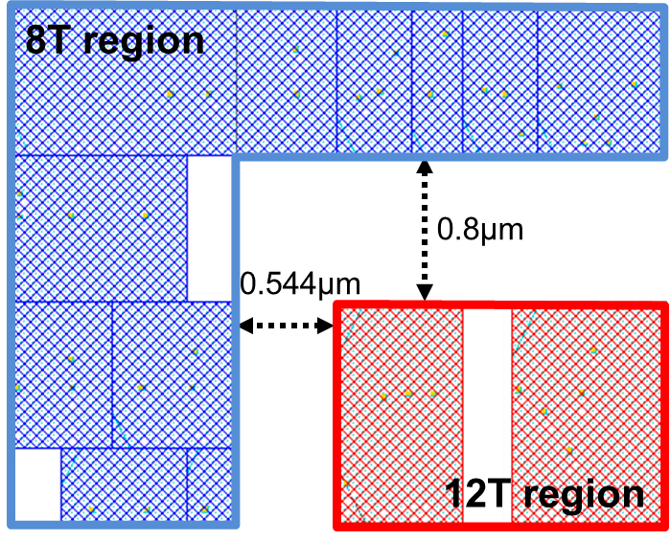
Experimental Setup
Designs: AES, MPEG (from OpenCores website)
Technology: 28nm LP, dual-VT, 8T/12T
Tools
Synthesis: Synopsys Design Compiler vH-2013.03-SP3
P&R & timing analysis: Cadence EDI System 14.1
Power analysis: Synopsys PT-PX vH-2013.06-SP2
Modeling breaker cell costs
Horizontal cost: 0.544μm (= four placement sites)
Vertical cost: 0.8μm (= eight M2 pitches)

Slide 22
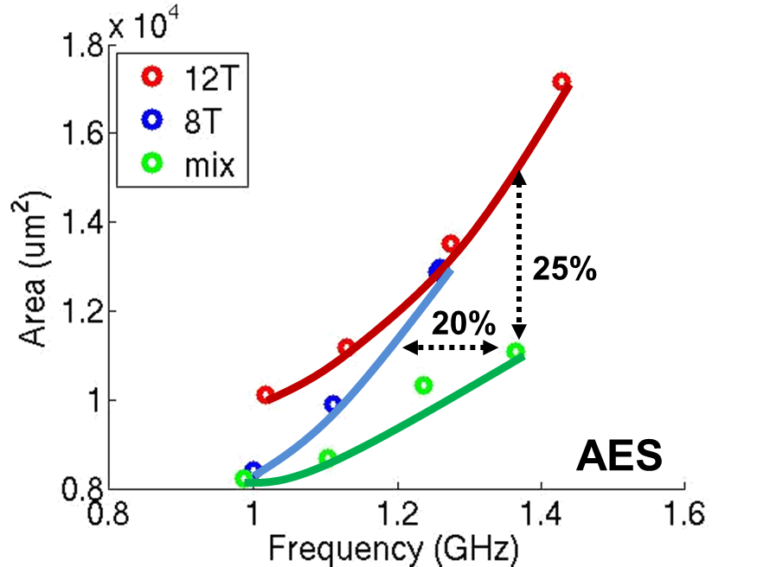
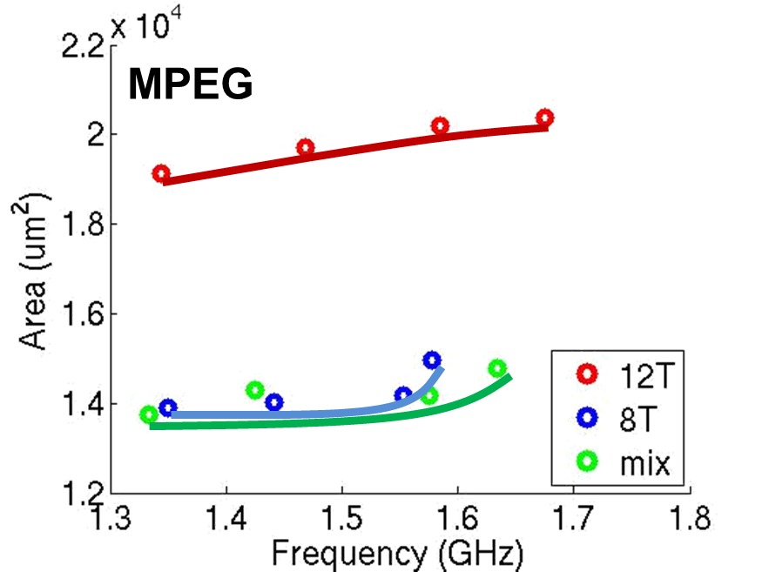
Area/Performance Benefits from Mixing Cell Heights
Pareto curves of power-area tradeoff
Up to 25% area benefit over 12T designs
Up to 20% performance benefit over 8T designs

Slide 23
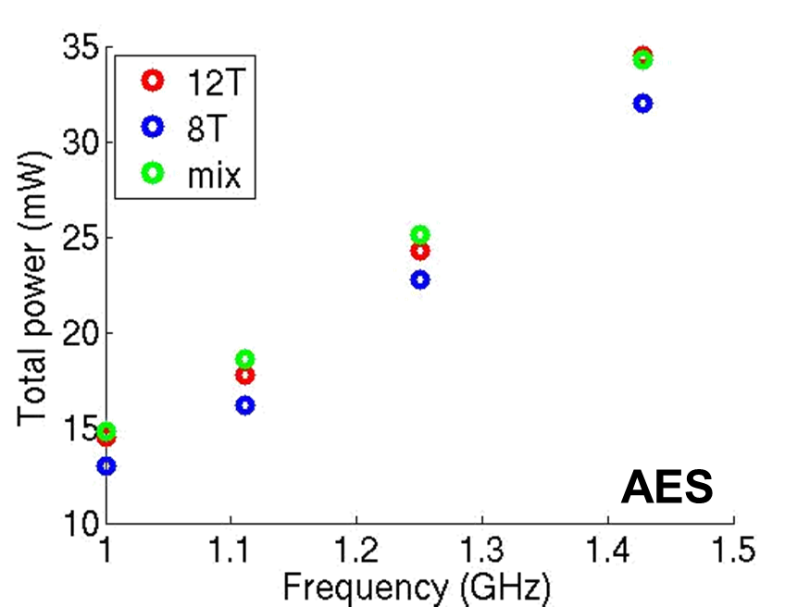
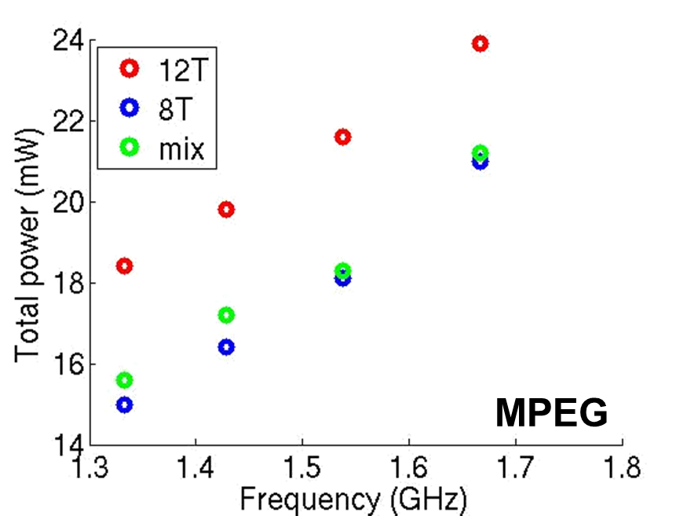
Power Benefits from Mixing Cell Heights
Iso-performance power comparison with voltage scaling
Re-optimize design if the supply voltage scaling > 30mV
Similar power with single-height designs
Mixed cell height dominates in area-frequency tradeoff (previous slide)
Power penalty is not captured in our cost function

Slide 24
Outline
Background and Motivation
Problem Statement
Related Work
Our Methodology
Experimental Setup and Results
Conclusion

Slide 25
Conclusion
Novel physical design optimization flow to mix cells with different heights within a single place-and-route block
Address the “chicken-and-egg” loop between floorplan site definition and the post-placement choice of cell heights
Comprehend “breaker cells” area overhead and layout constraints
Achieve 25% area reduction, while maintaining performance, compared to single-height design flows
Future works
Mixed cell-height clock tree synthesis flow
More comprehensive cost function to trade off performance, power, area and wirelength

Slide 26
Thank you!

