Slide 1
The ITRS MPU and SOC System Drivers: Calibration and
Implications for Design-Based Equivalent Scaling in the
Roadmap
Wei-Ting Jonas Chan¹
Andrew B. Kahng^{1,2}
Siddhartha Nath²
Ichiro Yamamoto³
¹ECE and ²CSE Departments, UC San Diego, USA
³Rohm Co. Ltd., Japan
Notes:
Thank you for the kind introduction. My name is Jonas. This talk is about the latest updates in ITRS System Drivers and Design Roadmap.
I will introduce the updates in 2013 based on the studies by design and System Drivers working groups.
WAIT!!!

Slide 2
Outline
Overview of ITRS Design and System Drivers Roadmaps
Architectural and Area Models of MPU and SOC
Design Capacity Gap and Design Equivalent Scaling
Power Modeling and Power Management Gap
Conclusions
Notes:
This is my outline for today.
Before introducing the updates of 2013 roadmap, I will revisit the mission and organization of ITRS.
WAIT!!!

Slide 3
The ITWGs
International Technology Working Groups (ITWGs) forecast technology requirements, potential solutions 15-year horizon
Emerging Devices, Emerging Materials: +10 more years outlook
Each regional working group = industry + government + suppliers + consortia + academia
    System Drivers Design
    Process Integ, Devices & Structures Front End Processes
    Emerging Research Devices Emerging Research Materials
    Lithography Interconnect
    Factory Integration Assembly & Packaging
    Test and Test Equipment Metrology
    Yield Enhancement Modeling & Simulation
    Environment, Safety & Health RF/AMS Tech for Wireless Comm
Notes:
The International Technology Roadmap for Semiconductors (ITRS) provides projections for technology requirements and potential solutions for semiconductor industry for 15 year horizon.
Here in the middle of the slide is the list of the sixteen technical chapters in the roadmap.
[CLICK] The design working group is responsible for the Design Chapter, which roadmaps technologies of the Electronic Design Automation supplier industry, and the System Drivers Chapter, which models and projects the key semiconductor product classes that create the need for continued technology innovation.
WAIT!!!

Slide 4
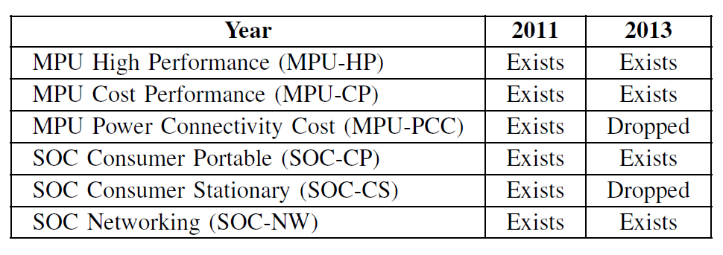
MPU and SOC System Drivers Status
System driver models:
  Semiconductor products which define the technology needs
  Drivers are added or removed due to the industry evolution
2013 update: MPU Power Connectivity Cost (MPU-PCC) is dropped (for high-mobility PCs):
  Boundary with SOC-CP is vague since SOC-CP is increasing the performance target
2013 update: SOC Consumer Stationary (SOC-CS) is dropped (for game consoles)
  Boundary with MPU-CP is vague
Notes:
The system drivers are generalized product types in different electronics product market.
Each driver drives different technology needs. For example, MPU High Performance models the high performance processors used by servers. SOC Consumer Portable models the application processors in smartphones.
System drivers are subject to change while the industry moves forward.
MPU Power Connectivity Cost, like Intel Atom, was used for high mobility notebook or netbooks.
The architecture of MPU-PCC becomes very similar to SOC-CP, so the
MPU-PCC is replaced by SOC-CP. SOC Consumer Stationary was used for game consoles.
Because the architecture of game console SOCs are very similar to PC processors now, SOC-CS is replaced by MPU-HP or MPU-CP.
WAIT!!!

Slide 5
Outline
Overview of ITRS Design and System Drivers Chapters
Architectural and Area Models of MPU and SOC
Design Capacity Gap and Design Equivalent Scaling
Power Modeling and Power Management Gap
Conclusions
Notes:
I introduce Architectural and Area Models of MPU and SOC in this part.
WAIT!!!

Slide 6
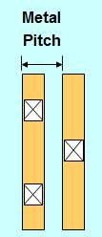
Heartbeat of the ITRS: Technology Nodes
Key metric of (density) progress: half-pitch (F)
Metal-1 (M1) half-pitch scales by 0.7x
0.7 x 0.7 = 0.49 ⇒ density doubles at each “technology node”
Layer | Normalizations to P_{M1}
 | 2009 | 2013
F | 0.50 | 0.50
M1 Pitch (P_{M1}) | 1.00 | 1.00
M2 Pitch (P_{M2}) | 1.25 | 1.00
Contacted Poly Pitch (CPP) (P_{poly}) | 1.50 | 1.50
Fin Pitch (P_{fin}) | -- | 0.75
P/G Track Width | -- | 1.50
Scaling in both X, Y dimensions
Notes:
(CLICK) (CLICK) The heartbeat of the roadmap is the Metal-1 half-pitch, which decreases by 30% at each new lithography node.
If poly pitch remains at 1.5 times M1 pitch, then we scale in both X and Y dimensions.
(CLICK) Since 0.7 squared is about one-half, twice as many gates should fit on the same-size chip as before.
(CLICK) This table shows pitch assumptions, normalized to M1 pitch, that the System Drivers working group uses to project layout density of basic logic and SRAM fabrics.
Derivations are complicated. For instance, for Mx the limiting factor is lithography and the alignment strategies used to resolve the overlay problems that cause cross-coupling, variability, and TDDB reliability issues.
Contacted poly pitch, or CPP, is 1.5 times M1 pitch.
(CLICK) If area shrink requires that the product of CPP and M1 pitch decrease by 0.5 with each new node, then below 14nm, breakthroughs in multi-patterning, self-aligned contacts, vertical devices etc. are needed to maintain this relation between CPP and M1 pitch.
Fin pitch is 0.75 M1 if metal is litho-etch-litho-etch and fin is self-aligned double-patterning.
But if both use uni-directional SADP at 10nm, fin pitch and M1 become similar.
Power-ground rail widths are projected at one and a half times M1 pitch – because higher currents come with FinFETs.
You can see there are a LOT of interlocks in this kind of modeling.
WAIT!!!

Slide 7
Logic A-factor Model with FinFET (2013)
Logic A-factor models developed using NAND2 layout (U_{NAND2}) area now use FinFET devices
New patterning limiter: P_{fin}
Assumption: P_{fin} = 0.75 P_{M1}
3×P_{poly}
Contact
WAS: NAND2 A-factor = 175 in 2011 model
IS: NAND2 A-factor = 155 in 2013 model
NWell
Poly
P/G Rail
Mx
Poly Contact
Fin
Metal VIAx
MOL
VIA0
9×P_{M2}
U_{logic} = 3P_{poly} × 9P_{M2} = 162F²
calibrated→ 155F²
Notes:
So if F is half the Metal-1 pitch, how big is a bitcell or a NAND gate, as a multiple of F squared?
These are the roadmap’s so-called “A-Factors”.
The 2013 ITRS revised its A-factors to reflect recent standard libraries and IPs.
For logic A-factor, the System Drivers working group defines a representative NAND2 gate layout of which size is
(CLICK) 9 M2 pitches in height and
(CLICK) 3 poly pitches in width.
Prevailing design rule data from industry gave M2 pitch the same as M1, poly pitch as roughly 1.5 times M1 pitch.
The area of NAND2 is calculated as 162F Squared.
This was tuned against published MPU product data and finally the System Drivers working group sets the logic A-factor to 155.
WAIT!!!

Slide 8
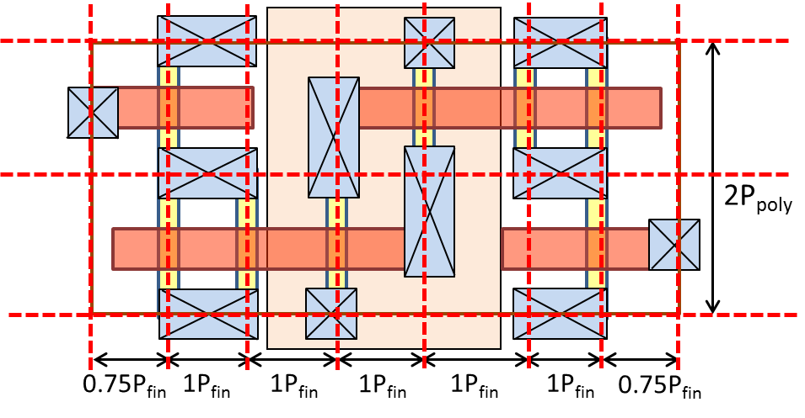
6T SRAM A-factor Model with FinFET (2013)
The ratio of transistors of pull-down / pull-up is 2 in a 6T SRAM cell.
The Spacing rule:
  (1) 0.75P_{fin} for each of bitline
  (2) 1×P_{fin} for each of pull-down N-channel transistor
  (3) 1×P_{fin} for each of P/N channel isolation
  (4) 1×P_{fin} for P-channel transistors
  The height of the cell is 2×P_{poly}, same as the ITRS 2011 model
Height = 2P_{poly}
Width = 6.5P_{fin}
Area = 2P_{poly} × 6.5P_{fin}
= 2 × (1.5 × P_{M1}) × 6.5 × (0.75 × P_{M1})
= 58.5F² (similar to bulk/SOI)
A-factor = 60 (after calibration)
(1) (2) (3) (4) (3) (2) (1)
Notes:
The SRAM A-factor was based on a representative SRAM bitcell layout,
(CLICK) 2 poly pitches in height and (CLICK) 6.5 Fin pitches in width.
The resulting A-factor of 60 is still pretty much dead-on.
WAIT!!!

Slide 9
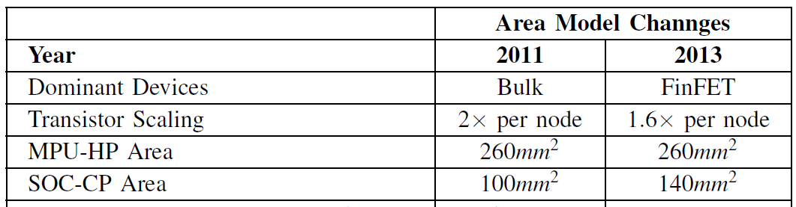
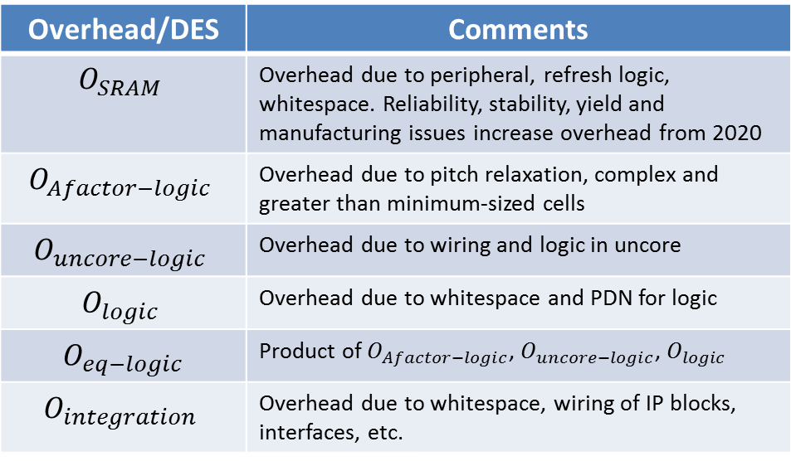
Area Model Summary
Area models for MPU and SOC are based on:
  New A-factor model
  New overheads/ Design Equivalent Scaling (DES)
  Calibration with silicon data from Chipworks
S_{logic} = O_{eq-logic} ∙ U_{logic} ∙ N_{core} ∙ N_{gate}
S_{SRAM} = O_{SRAM} ∙ U_{SRAM} ∙ N_{core} ∙ N_{bits}
S_{die} = O_{integration} ∙ (S_{logic} + S_{SRAM})
U_{{logic/SRAM}}: A-factor of logic/SRAM
Overhead/DES | Comments
$$O_{SRAM}$$ | Overhead due to peripheral, refresh logic, whitespace. Reliability, stability, yield and manufacturing issues increase overhead from 2020
$$O_{Afactor−logic}$$ | Overhead due to pitch relaxation, complex and greater than minimum-sized cells
$$O_{uncore−logic}$$ | Overhead due to wiring and logic in uncore
$$O_{logic}$$ | Overhead due to whitespace and PDN for logic
$O_{eq−logic}$ | Product of $O_{Afactor−logic}$, $O_{uncore−logic}$, $O_{logic}$
$$O_{integration}$$ | Overhead due to whitespace, wiring of IP blocks, interfaces, etc.
Notes:
System Drivers roadmap uses a bottom-up approach to construct area models of MPU and SOC.
The areas are divided into logic and SRAM because the difference of layouts and overheads
(click) The starting point is canonical layouts of logic cells and SRAMs. The layouts will generate A-factor.
This is the layout dimension related to lithography pitches.
(click) Next, gate count is calibrated from real MPU / SOC products.
Then, with the overhead summarized in the bottom table, transistor count models and area models for SOC and MPU are obtained.
WAIT!!!

Slide 10
MPU Model Revision
Key components to address different densities and overheads:
Logic
SRAM
Uncore (new in 2013 model)
New overheads
  O_{uncore-logic}
  O_{Afactor-logic}
Calibrated O_{integration}
+ Previous overheads
  O_{SRAM}
  O_{logic}
O_{logic}
O_{uncore-logic}
core1
core2
Accelerators
core3
core4
Memory Controller
I/O interfaces
SRAM1
SRAM2
SRAM5
GPUs
SRAM3
SRAM4
O_{SRAM}
O_{Afactor-logic}
O_{integration}
Notes:
A huge change to the MPU model is that it no longer doubles logic and SRAM transistors, with constant integration overheads, at each node. This figure shows how, architecturally, cores and caches in the MPU product are now joined by the UNCORE, which consists of memory and IO controllers, and accelerator components.
In calibrating to product data, integration overheads are applied to logic, SRAM and uncore components.
There are also A-factor overheads applied to core and uncore, which basically reflect a “design capability gap” that I’ll describe in next part of my talk.
WAIT!!!

Slide 11
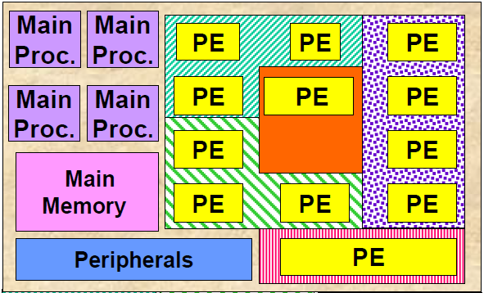
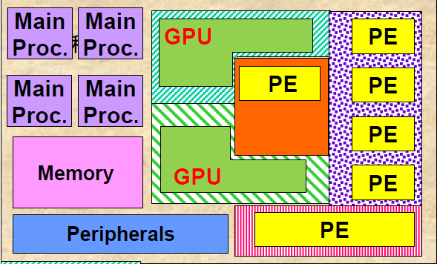
SOC-CP Model Revision
Reference application of SOC-CP is changing
  WAS: feature phones with basic applications (by processing engines, PE)
  IS: smartphones with rich multimedia/gaming applications
GPU now key component in mobile AP
Design challenge of SOC-CP → high diversity of functionalities
WAS: SOC-CP for mobile phone
Area: 100mm²
IS: SOC-CP for smart phone
Area: 140mm²
Audio
Bluetooth
Modem
Audio
Bluetooth
Multi-mode modem
2D graphics
Video
Wifi
Notes:
Japan’s STRJ-Working Group 1 has revised the SOC Consumer Portable model to reflect an updated reference application, namely, a smartphone with rich media and gaming.
Integrated GPUs take up more of the die, driven by 3D gaming.
Higher core diversity handles the explosion of interfaces, security, and other rich functionality. The die area increases from 100 to 140 square millimeters, which brings cost and power challenges.
WAIT!!!

Slide 12
SOC-CP Area Trend
WAS: PE / Memory dominate
IS: GPU dominates area (19% in 2013, 44% in 2028)
Notes:
In the updated model, PEs have a decreasing fraction of the die area, while GPU area increases from 19% in 2013 to 44% of die area in 2028.
IO and RF area are explicitly modeled.
WAIT!!!

Slide 13
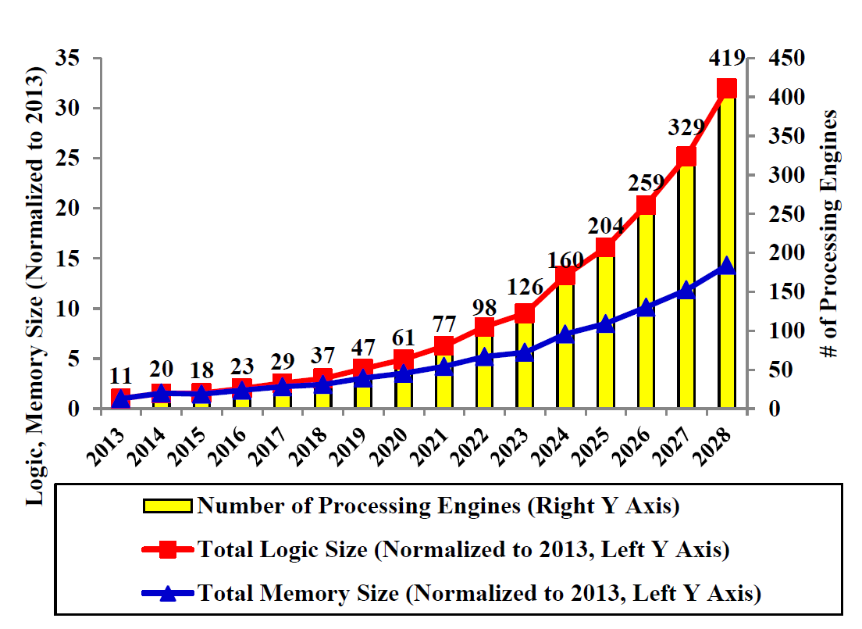
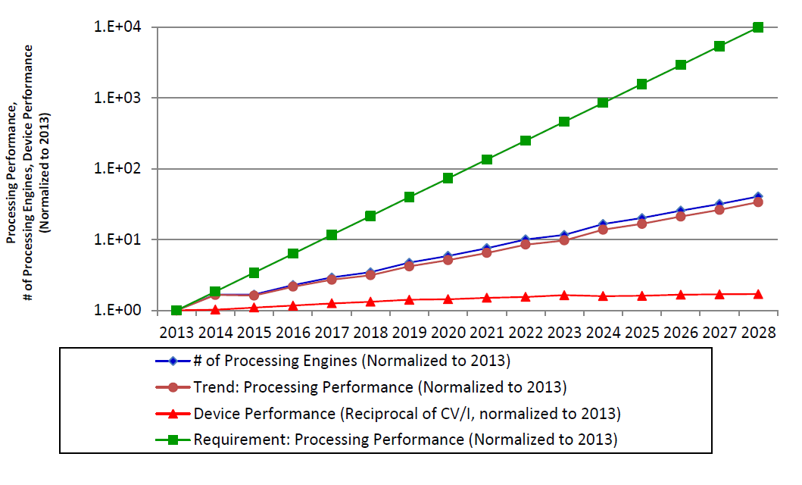
SOC-CP Performance Challenge
Performance requirement is extrapolated from historical demands
Available processing performance improvement
  Improved by faster devices
  Improved by increasing #PE and GPUs
Significant gap after 2015 calls out for desperate demand for architecture and design methodology improvements
{Processing performance} =
{#main processors}×{main processor frequency}+
{#GPUs}×{GPU frequency}
Performance
gap
Notes:
The area model is showing challenge in SOC-CP performance scaling
This performance metric of SOC-CP is defined as the product of maximum operation frequency and
the number of PEs and GPUs.
Due to the 140 squared mm area limitation and frequency scaling limitation, the performance
improvement will fall behind the requirement after 2015.
The performance gap will require architectural and design methodology innovations.
WAIT!!!

Slide 14
Outline
Overview of ITRS Design and System Drivers Chapters
Architectural and Area Models of MPU and SOC
Design Capacity Gap and Design Equivalent Scaling
Power Modeling and Power Management Gap
Conclusions
Notes:
In this part, I will introduce Design Capacity Gap and Design Equivalent Scaling
WAIT!!!

Slide 15
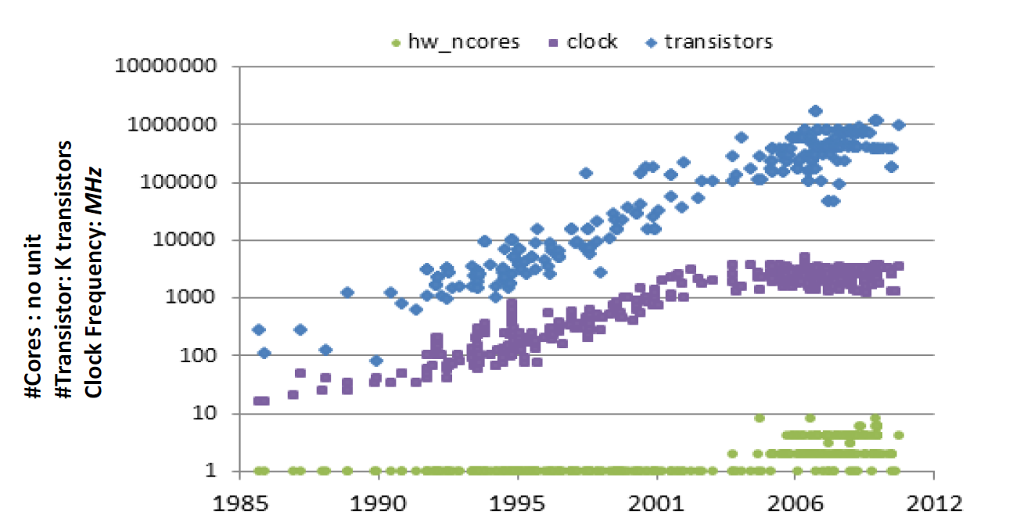
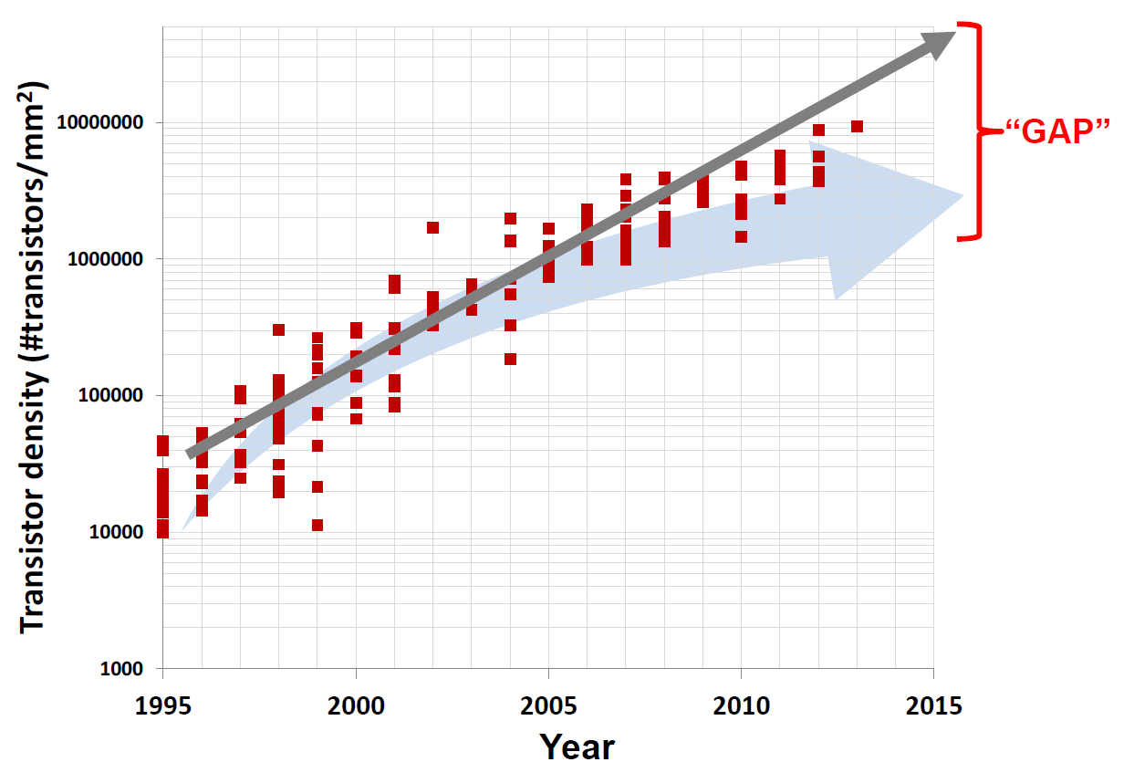
Issue: Design Capability Gap
2013 Design Capability Gap
  Available density growing at 2x/node
    Pushed by Moore’s Law
  Realizable density growing at 1.6x/node
    Resource (= area) are invested on guardband, reliability, etc.
    Designers can only comprehend part of the Moore’s Law benefits
Notes:
Today, our study of chip-level layout density reveals a Design Capability Gap where available density doubles, but design enablement and design automation only realize 1.6X improvement.
WAIT!!!

Slide 16
The “Design Capability Gap”
Uncore overheads
A-factor overheads
2x / node
(1)
DESIGN CAPABILITY GAP!
UCSD CSE Dept. Technical Report #CS2013-1002
(2)
(1) AND (2)
2^{2/3} ~1.587x / node
Notes:
In this slide, the blue line with diamonds shows 2X per node density scaling as in previous ITRS editions.
(CLICK) But there is Uncore overhead in architecture (around 30% of die area today) as well as in integration. This brings scaling to the green dotted line.
For reasons of variability, reliability, and performance, designs must use larger than minimum-sized transistors and wires.
(CLICK) This is an A-factor overhead which brings scaling to the violet dotted line.
(CLICK) Together, the Uncore and A-factor overheads reduce scaling to around 1.6x per node
WAIT!!!

Slide 17
The Design Equivalent Scaling
2x / node
Design Equivalent Scaling:
Recover the 2× per node scaling for degraded 1.6 × per node
2^{2/3} ~1.587x / node
Notes:
In 2013 roadmap, the System Drivers working group sets a requirement for “Design-based equivalent scaling” (DES).
Basically, design technology will have to pick up the margin and density that was left on the table while we were riding the long wave of 2-year cycles.
This will allow us to recover the 2x per node scaling predicted by Moore’s Law.
WAIT!!!

Slide 18
Outline
Overview of ITRS Design and System Drivers Chapters
Architectural and Area Models of MPU and SOC
Design Capacity Gap and Design Equivalent Scaling
Power Modeling and Power Management Gap
Conclusions
Notes:
In the next part, I introduce the new MPU and SOC model and a power management gap.
This presents a great challenge and opportunity for design technology to deliver enabling value to the semiconductor industry’s trajectory --- in other words, CAD research becomes very vital in the coming era.
WAIT!!!

Slide 19
Updates of Power SOC/MPU Models
Frequency roadmap keeps 1.04×/year
Device and BEOL parameters (e.g. gate/wire capacitance) are updated from PIDS/INTC ITWGs
MPU-HP max frequency resets to 5.5GHz (↓)
SOC-CP max frequency (main processors) resets to 2.4GHz (↑)
The System Drivers working group defines multiple scenarios for SOC-CP power model to reflect application-oriented power management
Year | 2011 | 2013
Power Scenario of MPU | Single Scenario | Single Scenario
Power Scenario of SOC | Single Scenario | Multiple Scenario
Frequency scaling of MPU and SOC | 1.04x / year | 1.04x /year
SOC-CP Max Frequency | 1.37GHz@2013 | 2.4GHz@2013 (main processors)
MPU-HP Max Frequency | 7.34GHz@2013 | 5.5GHz@2013
Notes:
The 2013 SOC and MPU frequency roadmap keeps at 1.04× per year because of the power/thermal challenge.
The capacitance model of device and BEOL are updated from PIDS and interconnect ITWGs.
After calibrating, the maximum MPU-HP frequency resets to 5.5GHz, this reflects the fact of slower frequency scaling.
The maximum SOC-CP frequency resets to 2.4GHz, this reflects the strong performance requirement in mobile device market.
We expect SOC-CP will have very aggressive power management techniques to shut-off unused blocks in different application contexts, so the System Drivers working group introduces multiple scenarios to the SOC-CP power model.
WAIT!!!

Slide 20
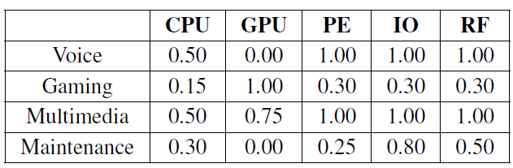
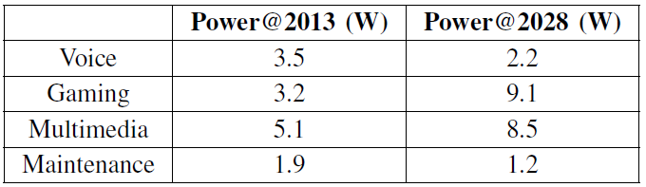
Scenario-based SOC-CP Power Model
Aggressive block-level power gating/frequency scaling are applied to SOC-CP
We define four scenarios for applications and five categories of function blocks
Total SOC-CP power for a scenario is the weighted sum of each function block
Scenario-based
power model
Gaming: major long-term power challenge
Notes:
For the multi-scenario power model, the System Drivers working group defines four different application scenarios.
They are voice, gaming, multimedia, and maintenance modes.
For each mode, the System Drivers working group assigned different weighted activity factor for different blocks.
Each block has different operation power according to the transistor counts.
The total powers of different application scenarios are calculated by the weighted sum of each function block.
Our projection shows that the gaming mode will dominate the power consumption in 2028. Both gaming and multimedia scenario will be very challenging for the smartphone design.
WAIT!!!

Slide 21
Function Block-Based Frequency Roadmap
(WAS) All function blocks scale at the same frequency
(IS) Each block scale the frequency separately
Notes:
The 2011 SOC-CP model uses single frequency scaling. Main processor, PE, and Peripherals are assumed to have the same frequency.
Because the frequency difference between function blocks are expected to be significant in new SOCs, 2013 SOC-CP model assumes different frequencies for different function blocks.
The GPU will scale the frequency more conservatively because the power limitation. Please note that the System Drivers working group assumes fixed frequencies and fixed power for IO and RF blocks in 2013 power model.
WAIT!!!

Slide 22
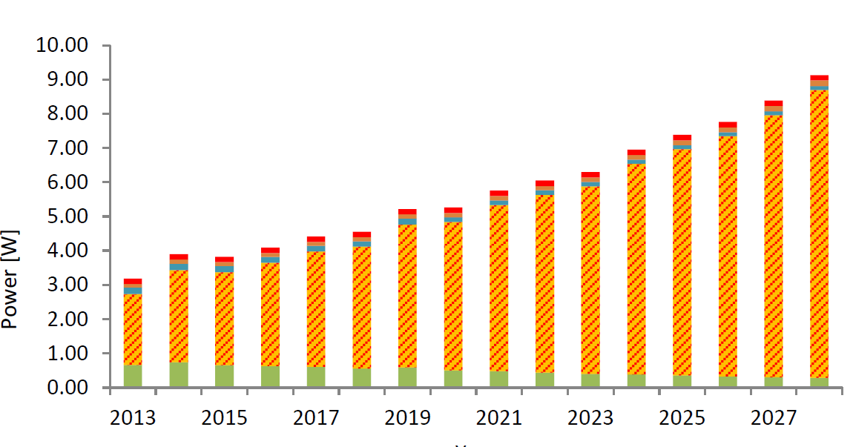
Scenario-Based SOC-CP Power Model
Dominant scenario: gaming with all 3D features enabled
Large power gap beyond 2020
Low-power technologies (both device and design technologies) will be required
Power requirement < 5W
Notes:
This plot shows the power consumption scaling of each function block when SOC-CP is running in gaming mode.
After 2020, the power consumption will exceed the requirement of 4W and achieve 9W at the end of the projection timeline.
(CLICK) For emerging low-power application requirements, the power requirement is further down to around 1W.
The power gap needs more attention and research investment to develop low-power design technologies.
WAIT!!!

Slide 23
Outline
Overview of ITRS Design and System Drivers Chapters
Design Capacity Gap and Design Equivalent Scaling
Architectural and Area Models of MPU and SOC
Power Modeling and Power Management Gap
Conclusions
Notes:
I conclude this talk now.
WAIT!!!

Slide 24
Conclusions
SRAM and logic A-factors are updated with new calibration
Area models are updated with new A-factor, and new overhead models
Design Capability Gap stands between ideal density scaling and actual (realized) density scaling
DES is required to restore the scaling to the Moore’s Law track
Power model is updated with new frequency scaling, device parameters, and new transistor density models
We have shown the low-power design challenge with the scenario-based power model for SOC-CP
Notes:
We observe a significant challenge in design scaling.
They are the design capability gap between realizable 1.6x per node transistor density scaling and available 2.0x per node scaling.
The challenge will need to be compensated by design techniques, which we refer to as Design-Based Equivalent Scaling.
This presents a great challenge and opportunity for design technology to the semiconductor industry’s trajectory.
CAD research should become very vital in this era.
We also update A-factor model of logic and SRAM. This is the core of MPU and SOC area models.
Based on the new A-factor models and overheads, the System Drivers working group updates the SOC and MPU area models.
For the SOC-CP, the System Drivers working group applied a scenario-based power model to differentiate power requirements in different applications. The low-power design of SOC-CP will be challenging.
In summary, the latest System Drivers roadmap in the ITRS points out challenges to continued pitch scaling. Many new technology innovations will be needed to address this.
THANK YOU FOR YOUR ATTENTION.

Slide 25
Thank you!

Slide 26
Backup

Slide 27

Previous Challenge: Missing Node in Physical Scaling
Problem
  Metal pitch roadmap is slowed down from 2-year to 3-year cycle (one missing node from 2013)
  Transistor density scales at 1.6$×$per node ⇒ die area explosion
Solution: Design Equivalent Scaling
  DES to recover one node of scaling from 2013 to 2019
    For MPU-HP and MPU-CP
  DES to recover one node of scaling from 2013 to 2020
    For SOC-CP
Ideal
Realistic
MPU Area exploration
One node missing
Solution: Alt-1
Solution: Alt-2
Rescued by DES
Notes:
The scaling of lithography is also challenging these days. The scaling loses one node from 2013 and the M1HP is reset to 40nm. The missing scaling node is because of the challenge in advanced BEOL process.
The solution to this is the design equivalent scaling (DES). This is to use design technology to reduce design cost while physical scaling is hard to achieve. Examples of DES are (1) DVFS to reduce timing margin and (2) better corner selection for reliability
The projection of the transistor count scaling is still 1.6x per node due to the application requirement. If the litho scaling cannot be pushed further, the MPU chip area will increase to over 400 square mm. To maintain the 260 square mm area target, designers will need DES if solution Alt-1 does not arrive in time.
However, this missing node challenge has been addressed by efforts of lithography researchers.

Slide 28
Current 2014 ITRS Status
(WAS, in our paper) missing scaling node from 2013
(IS) Litho ITWG recovers the scaling to 0.5x/4 year
(WAS, in the paper camera) missing node from 2013
(IS) Litho ITWG recovers the scaling to
0.5x/4 year
Notes:
After our paper were finalized, the Lithography ITWG has updated the pitch scaling roadmap.
The missing scaling node from 2013 has been compensated by the strong effort of lithography development.
As a result, the scaling has been recovered to the original pace which is marked as “IS” in this figure.

Slide 29
2014 SRAM A-factor Calibration
A-factor are calibrated with new silicon data
The updated 22nm/14nm silicon data indicate larger A-factor than that of previous nodes
For N10 (foundry node) SRAM, Design ITWG has the following updates:
  (WAS, 2013) SRAM A-factor was calibrated to 60
  (WAS, 2013) Cell ratio (PU:PD:PG) = 1:2:1
  (IS) SRAM A-factor is calibrated to 85
  (IS) Cell ratio (PU:PD:PG) = 2:2:2
After considering new layout of FinFET SRAM, the A-factor is updated to 85 (2013: 60)
Updated 22nm and 14nm data indicate higher SRAM A-factors than that of previous nodes

Slide 30
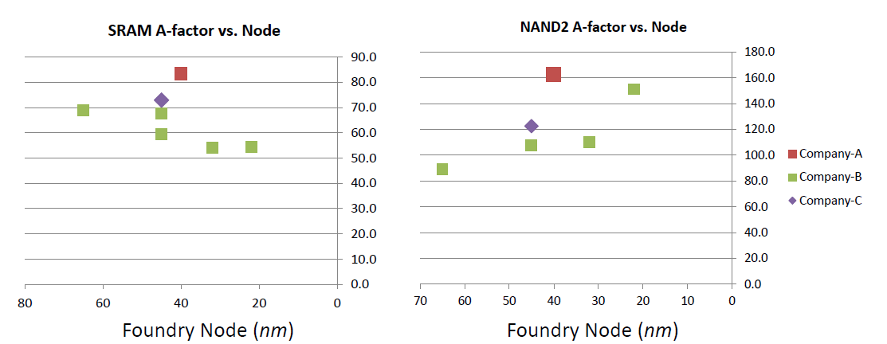
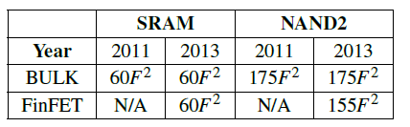
Calibration of A-factors with Silicon Data
Data extracted from products of major semiconductor manufacturers
Data collected up to 20nm foundry node
After calibration
Notes:
The System Drive ITWG is able to access the teardown reports by Chipworks.
By obtaining the 6T SRAM / NAND2 cell dimension and the metal pitches, Design working group have
collect the calibration data from A-factor from 65nm to 20nm.
The SRAM A-factor is calibrated to 60 and the logic A-factor is calibrated to 155 with the Chipworks data.

Slide 31
A-factor Density Model (2013)
Models of SRAM (U_{SRAM}) and NAND2 (U_{NAND2}) area now use FinFET
New patterning limiter: P_{fin}
Assumption: P_{fin} = 0.75 P_{M1}
2×P_{poly}
Contact
NWell
Poly
4.875×P_{M1}
Fin
U_{SRAM} = 2P_{poly} × 4.875P_{M1} = 58.5F²
calibrated→ 60F²
Notes:
The 2013 SRAM A-factor uses FinFET layout.
The pull-down / pull-up cell ratio are 2 versus 1 according to the industry inputs.
The heights of SRAM is dominated by fin pitch.
Fortunately, Fin pitch is smaller than M1 pitch due to advanced litho technology.
As a result, the A-factor of SRAM can keep at 60F^2 as the 2011 A-factor model.

Slide 32
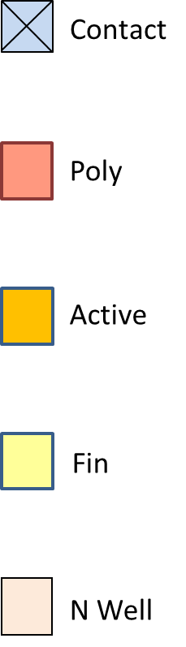
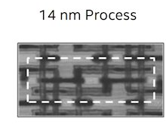
A-factor Layout Model (2014)
Assume P_{fin} = 0.75P_{M1}
Assume P_{poly} = 1.5P_{M1}
Height = 2P_{poly}
Width = 6.5P_{fin}
Area = 2P_{poly} × 6.5P_{fin}
= 58.5F² (similar to bulk)
A-factor = 60 (after calibration)
Alt-1: ITRS 2013 / Intel 22nm FinFET 6T SRAM (1:2:1)
PG
PU
PD
PD
PU
PG
Assume P_{fin} = 0.75P_{M1}
Height = 2P_{poly}
Width = 8.5P_{fin}
Area = 2P_{poly} × 9.5P_{fin}
= 85F²
(Intel 14nm SRAM = 87F²)
Alt-2: FinFET 6T SRAM (1:2:1) (Intel 14nm SRAM)
PG
PU
PD
2P_{poly}
PD
PU
PG
0.75P_{fin}
1P_{fin}
2P_{fin}
2P_{fin}
2P_{fin}
1P_{fin}
0.75P_{fin}
Notes:
Design working group observe more pessimistic spacing rules in the 14nm SRAM. For the spacing between PD/PU and PU/PU transistors, the spacing is conservative and uses two Fin pitch rule. In this layout, the A-factor increase to 87F^2.

Slide 33
Mission of ITRS Roadmap
  http://www.itrs.net/
  15-year technical outlook for 14 supplier industries and their respective technology areas
  25-year projection of technology needs for emerging research devices and materials
  Drivers for world wide research and funding agencies
  Organization divided (EU, Japan, Korea, Taiwan, USA), 1000+ participants
  Neutrality with regard to commercial considerations
Notes:
The international Technology Roadmap of Semiconductor (ITRS) is founded by major semiconductor companies around the world.
The mission of ITRS is to assess the technology needs and challenges in this industry.
Besides defining major technology needs and challenges, another major output of ITRS is the timeline of technology development.
By explicitly defining development timeline and the technology milestone, the semiconductor industry can maximize the return of investment.
The ITRS organization covers all the major suppliers from semiconductor materials to IDMs and fabless design companies.
However, it does not address individual products or equipment.

Slide 34
Interactions between ITWGs
ORTCs
Fundamental Models
INTC
max chip power
layout density
transistor count
chip size
#distinct cores
#cores
max on-chip freq
product/market drivers
CMP, R, C, MOL, Jmax
PIDS
I_{d,sat,} I_{sd,leak}
CV/I,f_{T}
Design & System Drivers
V_{t} variation
FEP
Mask cost, CD 3σ,
pitch, overlay
#IOs, max power, thermal, TSV/3D roadmap
LITHO
#cores,
max IO freq
Test
A&P
Notes:
Although each ITRS ITWG develops different technology roadmaps for different focuses,
the ITWGs need to cooperate to exchange information to integrate all the aspects across the whole
semiconductor industry. This figure is an example to show the cooperation between ITWGs when System Driver and Design Teams develop
models for processors and SOCs.
(click) PIDS provides the projections of driving current and gate capacitance for the new transistor technologies
(click) Litho provides the projections of transistor pitch scaling
(click) INTC provides the projections of wire load
By combining these projects from bottom-up, the System Driver and Design ITWGs is able to
project the design parameters of processors and SOC

Slide 35
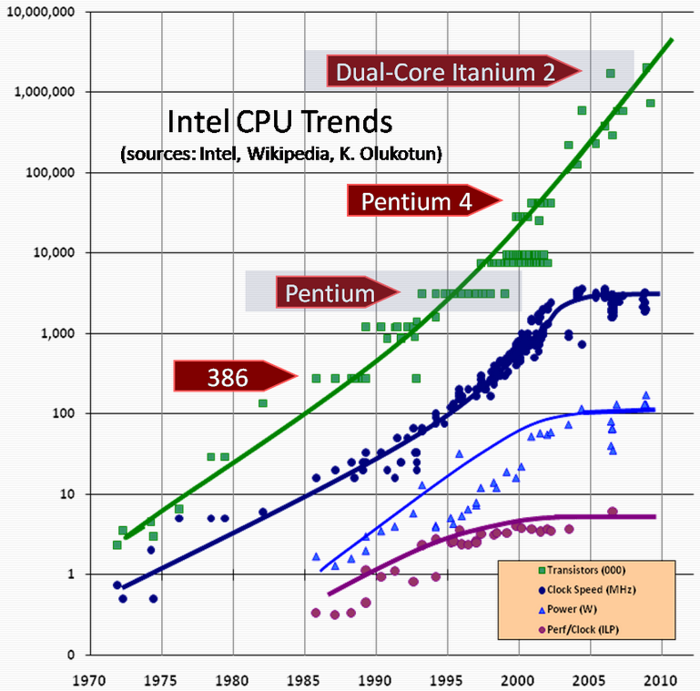
Intel MPU Scaling Trends
# of Transistors
Clock Frequency
Power
Performance/CLK (ILP)
[Sutter09]
Notes:
The semiconductor industry has been moved by Moore’s Law for several decades.
Moore’s Law drives the transistor dimension to scale at 0.7x per node.
(click) As a result, the available transistors in the same chip area budget will double for every node.
(click) Because of the dimension reduction of the metal wires and transistor gates. The clock frequency will scale up due to smaller gate and wire capacitances.
However, the frequency scaling hit the wall in the past 10 years due to thermal issue
(click) Similarly, the power becomes very challenging in the past 10 years
(click) The performance normalized to clock frequency is slowing down during the 2000 to 2010. This indicates that there are improvement space left
advance multicore architecture.

