Slide 1
A New Methodology for Reduced Cost of Resilience
Andrew B. Kahng, Seokhyeong Kang and Jiajia Li
UC San Diego VLSI CAD Laboratory

Slide 2
Outline
Background and Motivation
Problem Statement
Related Work
Our Methodology
Experimental Setup and Results
Conclusion

Slide 3
Outline
Background and Motivation
Problem Statement
Related Work
Our Methodology
Experimental Setup and Results
Conclusion

Slide 4
Background: Resilient Designs
Detect and recover from timing errors ⇒ Ensure correct operation with dynamic variations (e.g., IR drop, temperature fluctuation, cross-coupling, etc.)
Trade off design robustness vs. design quality ⇒ E.g., enable margin reduction
Improve performance (i.e., timing speculation)
Conventional design:
Worst-case signoff
No Vdd downscaling
Resilient design:
Typical-case signoff
Vdd downscaling → reduced energy
15% reduction

Slide 5
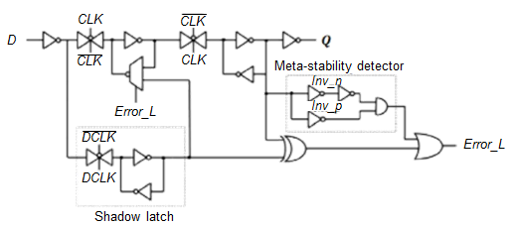
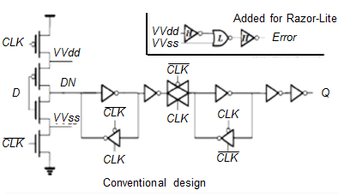
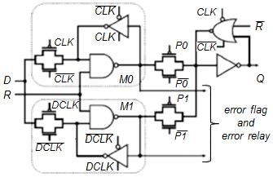
Motivation
Cost of resilience is high
Additional circuits ⇒ area / power penalty
Recovery from errors ⇒ throughput degradation
Large hold margin ⇒ short-path padding cost
Goal: benefits overweigh costs
 | Razor | Razor-Lite | TIMBER
Power penalty | 30% [Das08] | ~0% [Kim13] | 100% [Choudhury09]
Area penalty | 182% [Kim13] | 33% [Kim13] | 255% [Chen13]
#recovery cycles | 5 [Wan09] | 11 [Kim13] | 0 [Choudhury09]
Razor
Razor-Lite
TIMBER

Slide 6
Outline
Background and Motivation
Problem Statement
Related Work
Our Methodology
Experimental Setup and Results
Conclusion

Slide 7
Resilience Cost Reduction Problem
Given: RTL design, throughput requirement and error-tolerant registers
Objective: implement design to minimize energy
Estimation of design energy:
$$Energy= \frac{Power}{Throughput}$$
$$Throughput= \frac{1−ER}{T}+\frac{1−ER}{r×T}$$
Clock period
Error rate [Kahng10]
#recovery cycles

Slide 8
Outline
Background and Motivation
Problem Statement
Related Work
Our Methodology
Experimental Setup and Results
Conclusion

Slide 9
Related Works
[Choudhury09] masks timing errors only on timing-critical paths to reduce resilience cost
[Yuan13] uses a fine-grained redundant approximate circuits insertion for error masking
[Kahng10] optimizes designs for a target error rate and reduces design energy by lowering supply voltage
[Wan09] optimizes the most frequently-exercised gates for error-rate and energy reduction
Exploration of tradeoffs between cost of resilience vs. cost of datapath optimization has been ignored

Slide 10
Focus of This Work
There is tradeoff between resilience cost vs. cost of datapath optimization …
#Razor FFs
(resilience cost)
Tradeoff
Power/area of fanin circuits
Our work minimizes total energy using the tradeoffs
300 100 50 0

Slide 11
Outline
Background and Motivation
Problem Statement
Related Work
Our Methodology
Experimental Setup and Results
Conclusion

Slide 12
Overview of Our Methodology
Our flow: pure-resilience → datapath optimizations
Low-cost margin insertion (selective-endpoint optimization)
Selectively increase margin at endpoint with timing violation
Slack redistribution (clock skew optimization)
Migrate timing slacks to endpoint with timing violation
⇒ Replace error-tolerant FFs to normal FFs ⇒ Reduced resilience cost

Slide 13
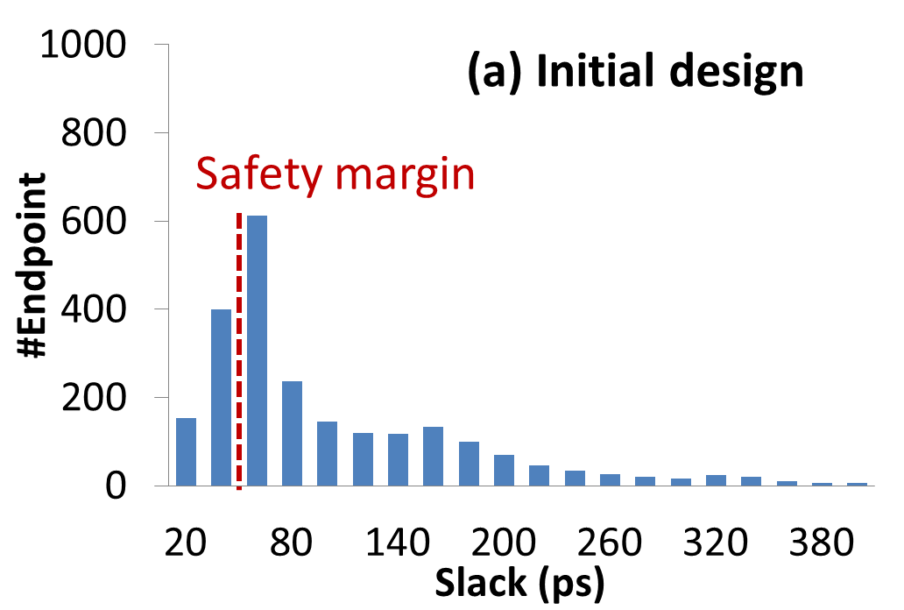
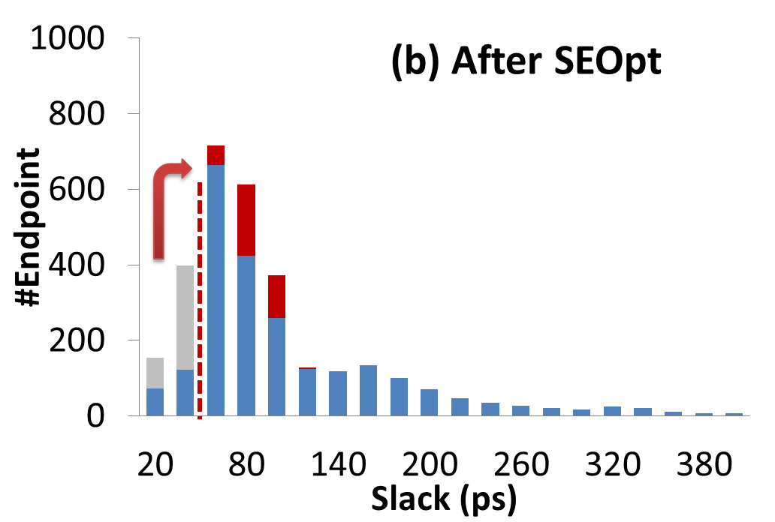
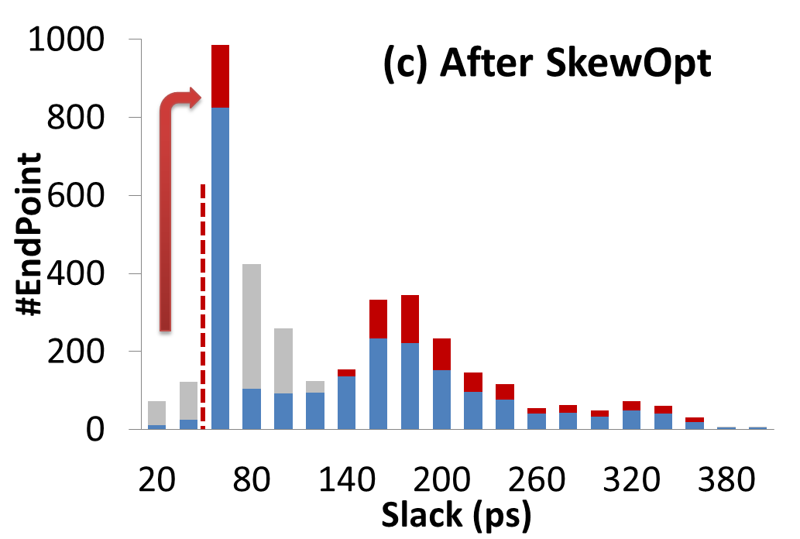
Overall Optimization Flow
Iteratively optimize with SEOpt and SkewOpt
Initial placement (all FFs = error-tolerant FFs)
Margin insertion on K paths based on sensitivity function
SEOpt
Replace error-tolerant FFs w/ normal FFs
SkewOpt
Activity aware clock skew optimization
Energy < min energy?
Save current solution

Slide 14
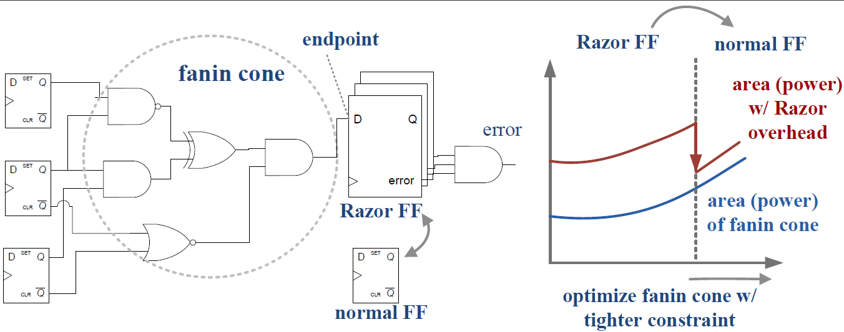
Selective-Endpoint Optimization
Optimize fanin cone w/ tighter constraints ⇒ Allows replacement of Razor FF w/ normal FF
Trade off cost of resilience vs. data path optimization
Question 1: Which endpoint to be optimized?
Question 2: How many endpoints to be optimized?

Slide 15
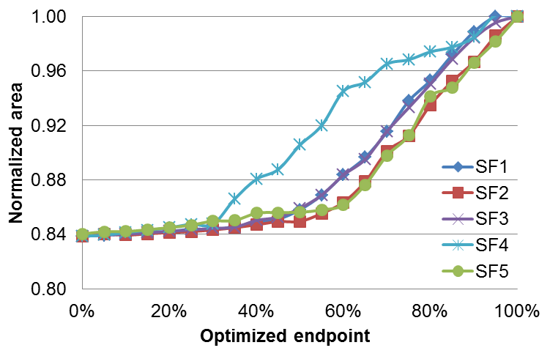
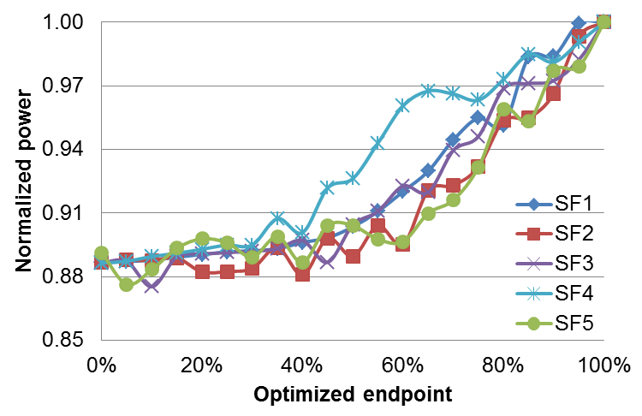
Sensitivity Function
Which endpoint to be optimized? ⇒ Pick endpoints based on sensitivity functions
Vary #endpoints → compare area/power penalty
Candidate Sensitivity Functions
$$SF1=|slack\left(p\right)|$$
$$SF2=|slack\left(p\right)|×numcri(p)$$
$$SF3=|slack\left(p\right)|×\frac{numcri(p)}{numtotal(p)}$$
$$SF4=|slack\left(p\right)|×\sum_{cεfanin(p)}{Pwr(c)}$$
$$SF5=\sum_{cεfanin(p)}{|slack\left(c\right)|}×Pwr(c)$$
p negative slack endpoint
c cells within fanin cone
Num_{cri} number of negative slack cells

Slide 16
Iterative Optimization
Question 2: How many endpoints to be optimized? ⇒ Vary #optimized endpoints→ pick minimum-energy solution
Optimization Procedure
Pick top-K endpoints with minimum sensitivity
Timing optimization on fanin cone of p if ( slack at p is positive) replace with normal FFs
Error rate estimation
Check design energy if ( energy is reduced ) store current solution
Update sensitivity functions; Goto 1

Slide 17
Clock Skew Optimization
Increase slacks on timing-critical and/or frequently-exercised paths
Generate sequential graph
Find cycle of paths with minimum total weight → adjust clock latencies → contract the cycle into one vertex
Iterate Step 2 until all endpoints are optimized
W’ = average weight on cycle
W₃₁
W’
Setup slack of path p-q
$$W_{pq}=\frac{Slackp,q}{1+β×TG(p,q)}$$
FF1
W’
FF2
W’
FF3
W₁₂
W₂₃
Weighting factor
Clock
Toggle rate of path p-q
Data path
Clock tree

Slide 18
Outline
Background and Motivation
Problem Statement
Related Work
Our Methodology
Experimental Setup and Results
Conclusion

Slide 19
Experimental Setup
Design OpenSparc T1
Technology 28nm FDSOI, dual-VT {RVT, LVT}
Tools
Synthesis: Synopsys Design Compiler vH-2013.03-SP3
P&R: Cadence EDI System 13.1
Gate-level simulation: Cadence NC-Verilog v8.2
Liberty characterization: Synopsys SiliconSmart v2013.06-SP1
Questions
How do the benefits/costs of resilience vary with safety margin?
How do the benefits/costs of resilience change in AVS context?
Module | Description | # of cells
EXU | Integer execution | 18K
MUL | Integer multiplier | 13K

Slide 20
Methodology Comparison
Reference flows
Pure-margin (PM): conventional method w/ only margin insertion
Brute-force (BF): use error-tolerant FFs for timing-critical endpoints
Proposed method (CO) achieves up to 20% energy reduction compared to reference methods
Resilience benefits increase with safety margin
EXU
MUL
Small margin
Medium margin
Large margin
Small margin
Medium margin
Large margin
Small/medium/large margin ⇒ safety margin = 5%/10%/15% of clock period

Slide 21
Energy Reduction from AVS
Adaptive voltage scaling allows a lower supply voltage for resilient designs, thus reduced power
Proposed method trades off between timing-error penalty vs. reduced power at a lower supply voltage
Proposed method achieves an average of 18% energy reduction compared to pure-margin designs ⇒ Resilience benefits increase in the context of AVS strategy
Minimum achievable energy
MUL
EXU

Slide 22
Outline
Background and Motivation
Problem Statement
Related Work
Our Methodology
Experimental Setup and Results
Conclusion

Slide 23
Conclusion
New design flow for mixing of resilient and non-resilient circuits
Combined selective-endpoint and clock skew optimizations reduce costs of resilience
Up to 20% energy reduction compared to reference methods
Future work
Unified framework for data- and clock-path optimization
Study impact of process variation on resilient design methodologies

Slide 24
Thank you!

