Slide 1
Horizontal Benchmark Extension for Improved Assessment of Physical CAD Research
Andrew B. Kahng, Hyein Lee and Jiajia Li
UC San Diego VLSI CAD Laboratory

Slide 2
Outline
Motivation
Related Work
Our Methodology
Experimental Setup and Results
Conclusion

Slide 3
Outline
Motivation
Related Work
Our Methodology
Experimental Setup and Results
Conclusion

Slide 4
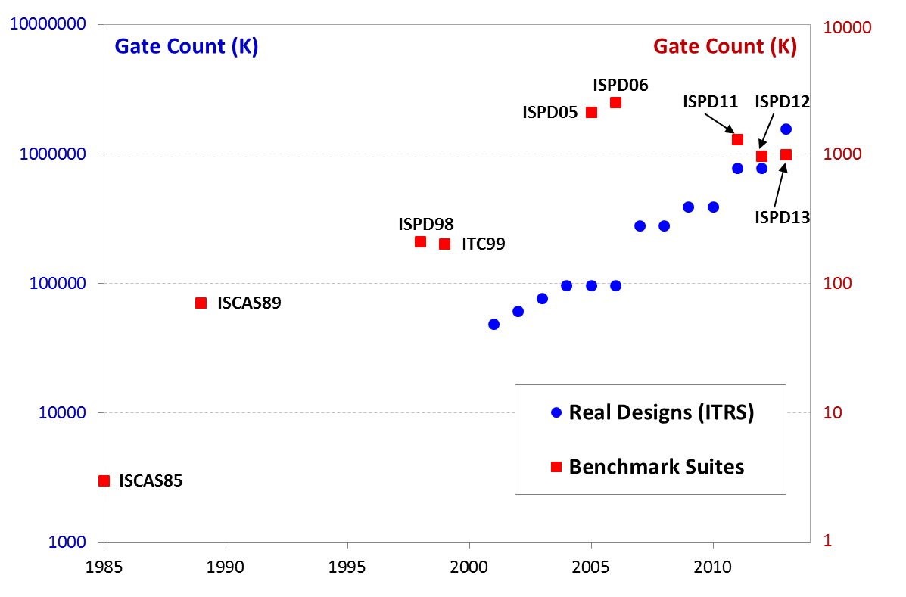
Quandary in VLSI CAD Benchmarks
“Leading-edge”, “real” benchmarks cannot be easily realized due to their high-value IP
“Old”, “artificial” benchmarks potentially drive CAD research in stale or wrong directions
How to maximally leverage available benchmarks as enablers of CAD research?
“1000x” gap of gate count between real designs and benchmarks
Year

Slide 5
Lack of Horizontal Assessment
Horizontal assessment = evaluation at one flow stage, across technologies, tools, benchmarks
Maximal horizontal assessment reveals tools’ suboptimality ⇒ guide improvements
Motivation
No previous work pursues maximal horizontal assessment
Horizontal assessments are blocked by gaps between data models, benchmark formats, etc.

Slide 6
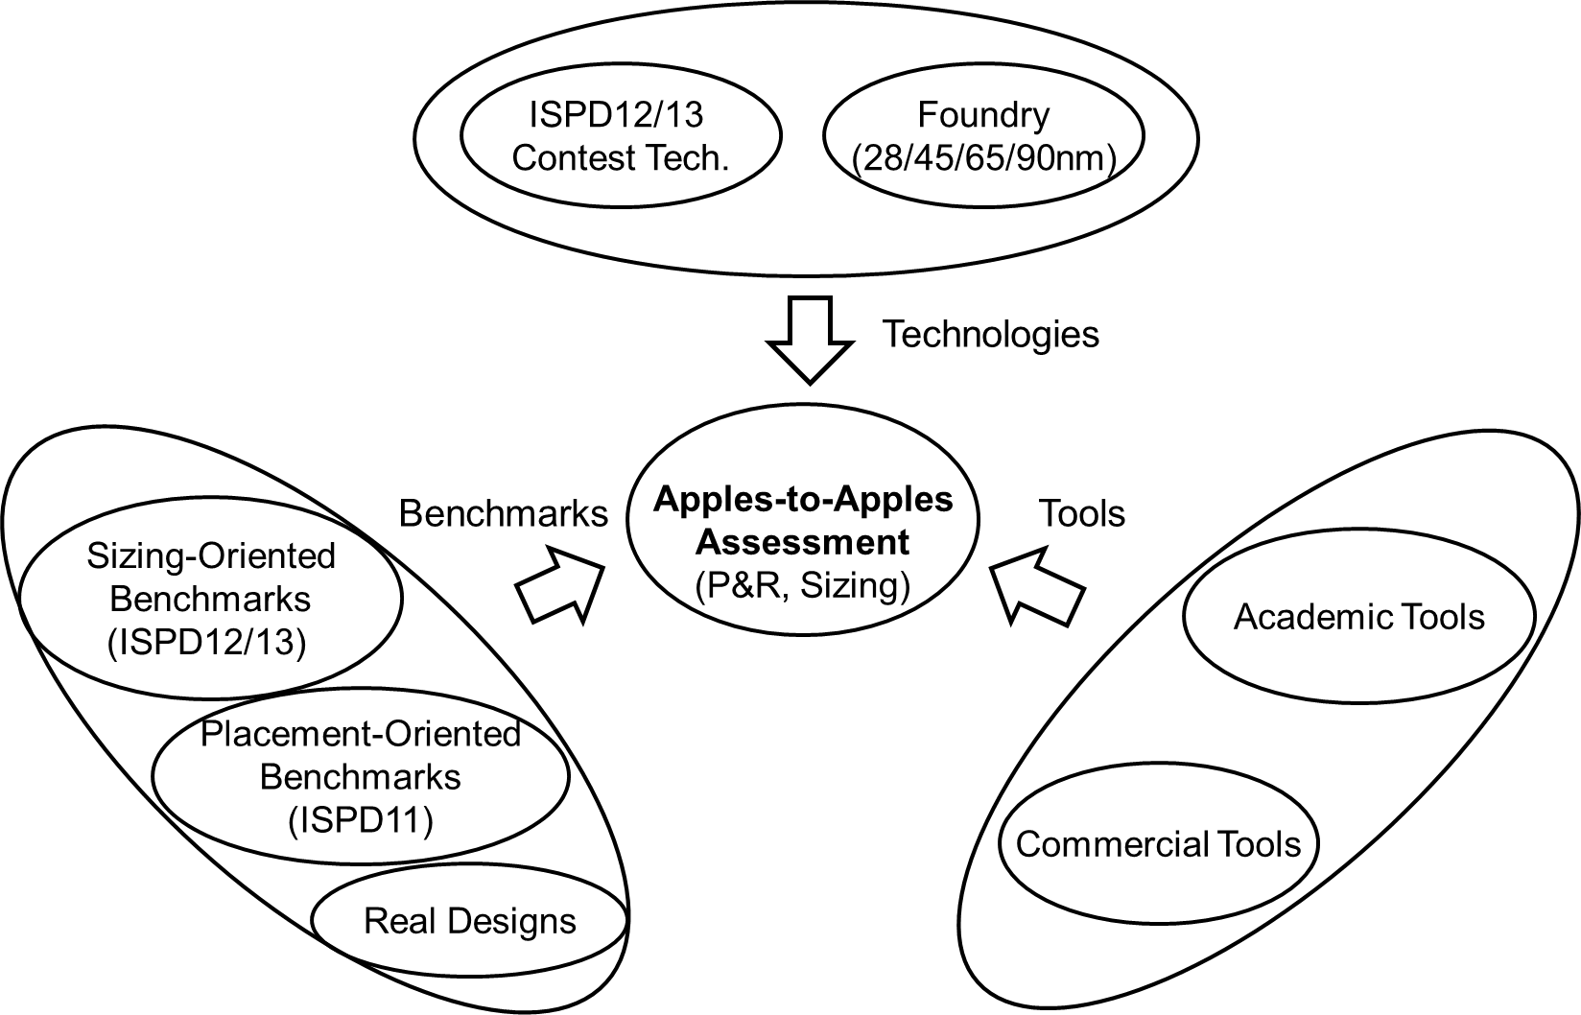
Scope of This Work
Horizontal benchmarks and benchmark extension
⇒ maximize “apples-to-apples” assessment

Slide 7
Outline
Motivation
Related Work
Our Methodology
Experimental Setup and Results
Conclusion

Slide 8
Related Work
Benchmarks based on real designs
MCNC: widely used in various CAD applications
ISPD98: netlist partitioning; functionality, timing and technology information are removed
ISPD05/06: mixed size placement, > 2M placeable modules
ISPD11: routability-driven placement, derived from industrial ASIC designs
ISPD12/13: gate sizing and Vt-swapping optimization
Artificial benchmarks
Early works: circ/gen, gnl
PEKO/PEKU: placement, w/ know-optimal solution and known upper bounds on wirelegnth
Eyechart: gate sizing optimization, w/ known-optimal solution

Slide 9
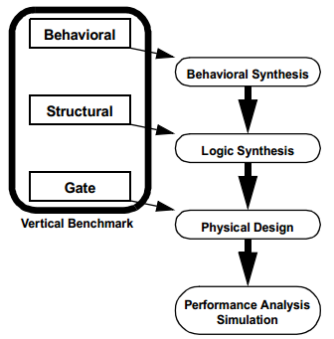
Vertical vs. Horizontal
Vertical benchmark [Inacio99]
Multiple levels of abstraction
Evaluation across a span of several flow stages
Horizontal benchmark
Focus on one flow stage
Maximize the assessment across technologies/benchmarks/tools

Slide 10
Outline
Motivation
Related Work
Our Methodology
Experimental Setup and Results
Conclusion

Slide 11
Challenges
Benchmark-related challenge
Limited information of benchmarks due to IP protection
Limited scope of target problems
Library-related challenge
Unrealistic and complex constraints or design rules
Hard to make fair comparisons across technologies due to different granularity (e.g., available sizes/Vt options)
Different tools require different formats
E.g., bookshelf format vs. LEF/DEF

Slide 12
Formats and Libraries
CAD Tools require different input formats
Bookshelf formats (academic) vs. DEF/LEF (commercial)
⇒ Our approach: Use a converter and scripts
Different libraries across technologies
Missing technology files or libraries (e.g., missing LEF in ISPD12/13)
⇒ Our approach: artificial LEF generation
Extract cell/pin area of X1 cell from reference technology
Scale cell/pin area for larger cells
Granularity of libraries differ across technologies
⇒ Our approach: Match granularity with timing/power table interpolations
Granularity
matching
Liberty (timing/
power)
Liberty (timing/
power)
Technology file
LEF generation
Technology
file

Slide 13
Enablement of P&R Assessments
Benchmark transformation: Sizing to P&R
No geometry information
No physical library (LEF)
⇒ Our approach: P&R with generated libraries (LEF)
Generate a fake LEF if needed
Run P&R with generated LEF
Assessment across academic and commercial tools
Academic tools cannot understand complex constraints / design rules (e.g., reliability constraints)
⇒ Our approach: Use simple version of technology files
Netlist w/ parasitics
Netlist w/ parasitics
P&R
Geometry information
Geometry information
Sizing-oriented benchmark
P&R-oriented benchmark

Slide 14
Enablement of Sizing Assessments
Benchmark transformation: P&R to sizing
Missing logic function / timing information (e.g., ISPD11)
⇒ Our approach: Gate mapping
Determine sequential cells from width / pin count / #blocks w/ same width
Randomly map standard cells based on widths and pin counts
Some academic sizers require complete timing graph
⇒ Our approach: Attach floating nets to ports
Generate additional ports if necessary based on Rent’s rule
Assessment across technologies
Granularities of libraries differ across technologies
⇒ Our approach: Match granularity with timing/power table interpolations
Netlist w/ parasitics
Netlist w/ parasitics
Geometry information
Gate
mapping
Geometry information
Sizing-oriented benchmark
P&R-oriented benchmark

Slide 15
Outline
Motivation
Related Work
Our Methodology
Experimental Setup and Results
Conclusion

Slide 16
Experimental Setup
Benchmarks
Technologies
ISPD, foundry (28/45/65/90nm)
Tools
Name | Benchmark suite | Gate count (P&R) | Gate count (sizing)
netcard | ISPD13 | 982258 | 982258
b19 | ISPD12 | 219268 | 219268
superblue12 | ISPD11 | 1286948 | 895309
jpeg_encoder | Real design | 83241 | 83241
leo3mp | Real design | 473986 | 473986
Flow stage | Academic tools | Commercial tools
Placement | NTUPlace3, mPL6, FastPlace3.1 | cPlacer1, cPlacer2
Global routing | BFG-R | cRouter1
Gate sizing | UFRGS, Trident | cSizer1, cSizer2

Slide 17
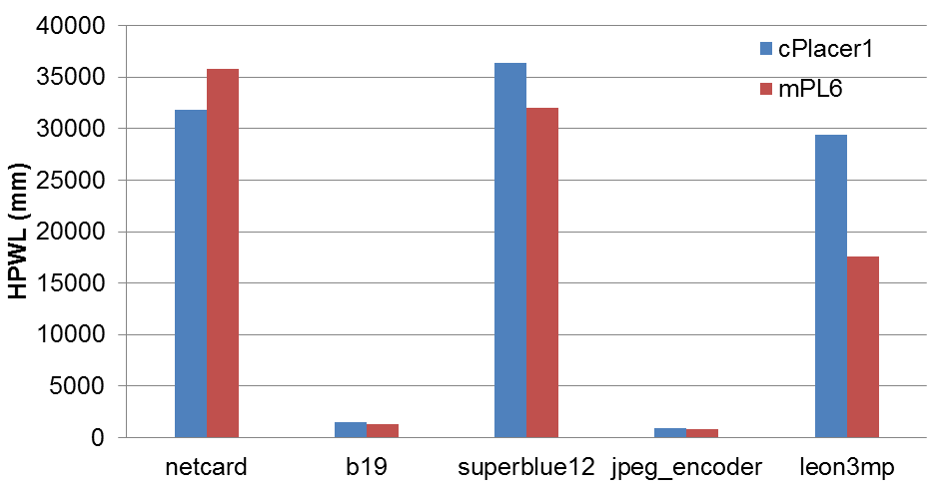
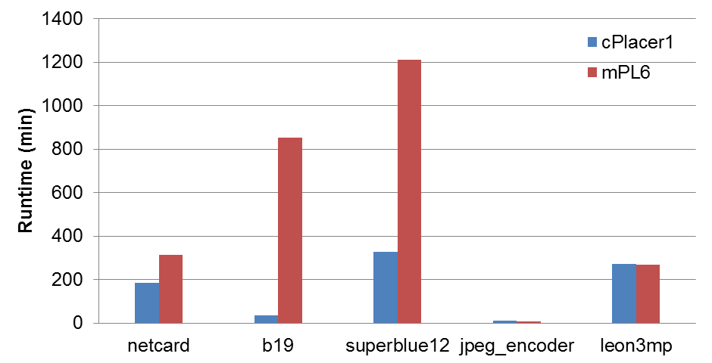
Placer Assessment (Across Benchmarks)
Academic placer achieves smaller HPWL except on netcard
At foundry 28nm, academic placer has larger runtime, especially on large testcases (e.g., superblue12)
Technology: foundry 28nm

Slide 18
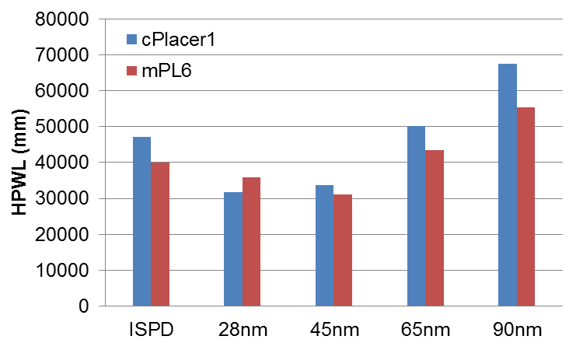
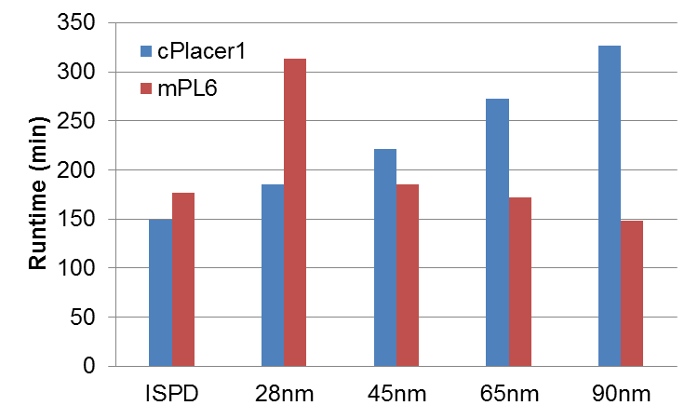
Placer Assessment (Across Technologies)
Academic placer achieves smaller HPWL except at 28nm ⇒ Comparison results are consistent across technologies
Smaller runtime of commercial placer at advanced technologies
Benchmark: netcard

Slide 19
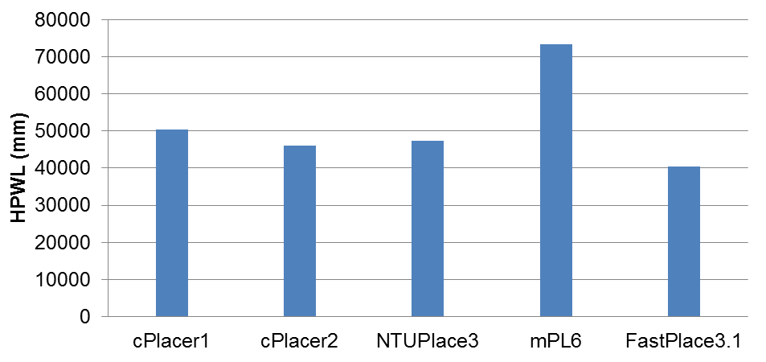
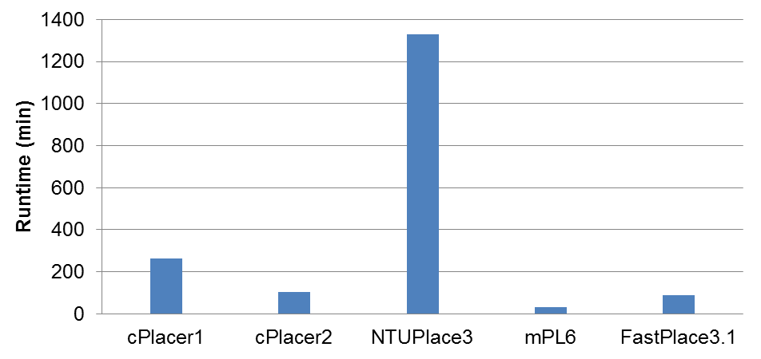
Placer Assessment (Across Tools)
Results are fairly consistent among commercial tools, but vary widely across academic tools
Maximal horizontal assessment can easily reveal tools’ suboptimality
Technology: ISPD
Benchmark: superblue12

Slide 20
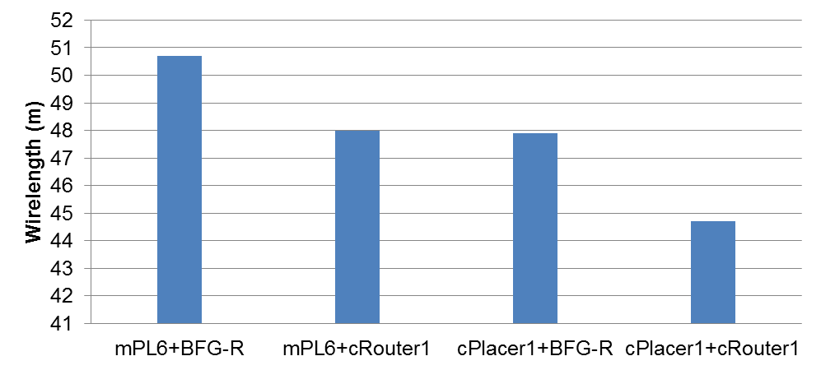
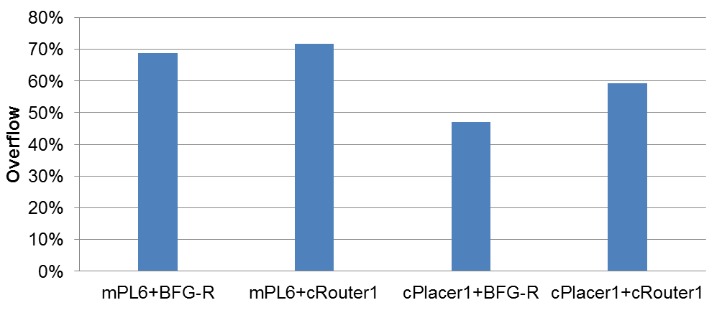
Combined Placer/Router Assessment
Global routing solutions are roughly consistent with placement solutions
Contest-induced focus on overflow reduction for BFG-R ⇒ De-emphasis of wirelength metric ⇒ larger wirelength
Example of horizontal benchmark enablement: Gate sizing benchmark is mapped to foundry 28nm, placed and global routed with both academic & commercial tools
Technology: foundry 28nm
Benchmark: netcard

Slide 21
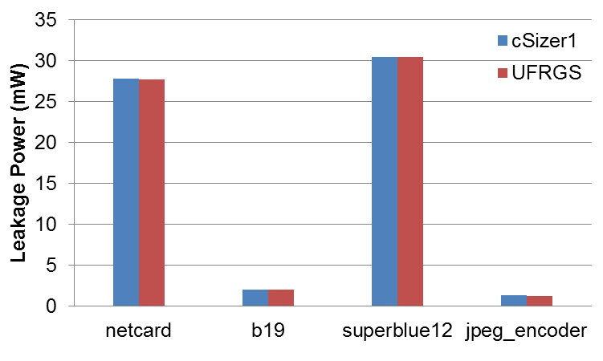
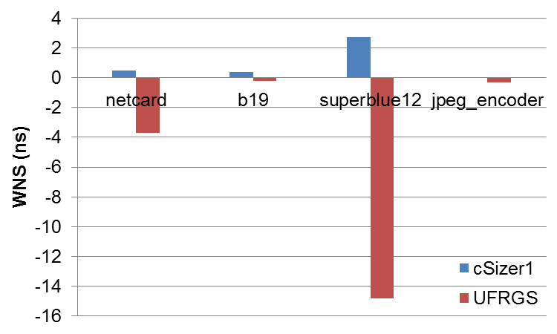
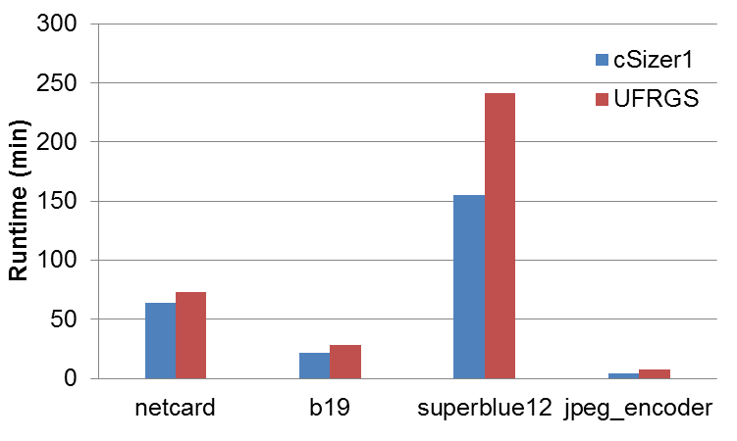
Sizer Assessment (Across Benchmarks)
Academic sizer achieves similar solution quality but larger runtime (especially on large testcases) as compared to commercial sizer
The assessed version of UFRGS only understands simple RC network → timing violation on large designs
Technology: foundry 28nm

Slide 22
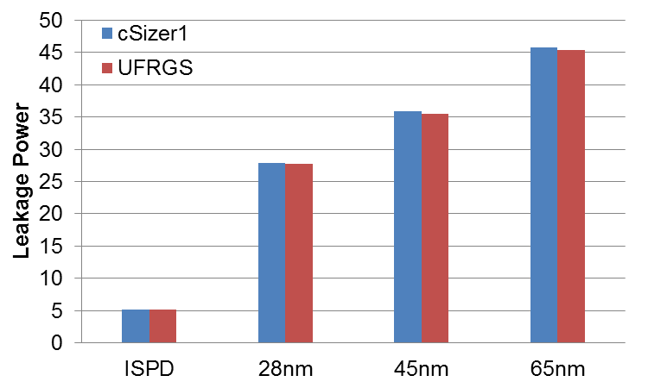
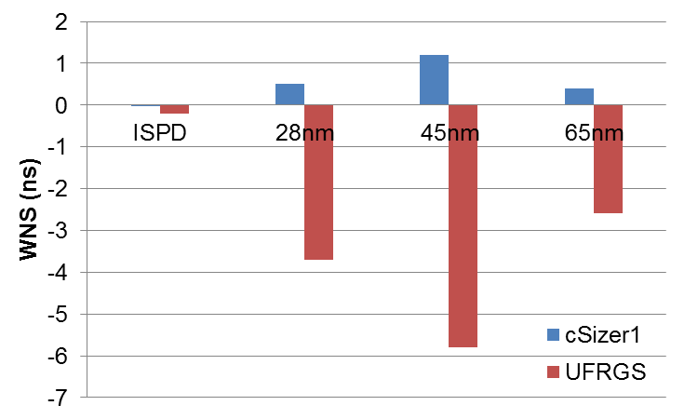
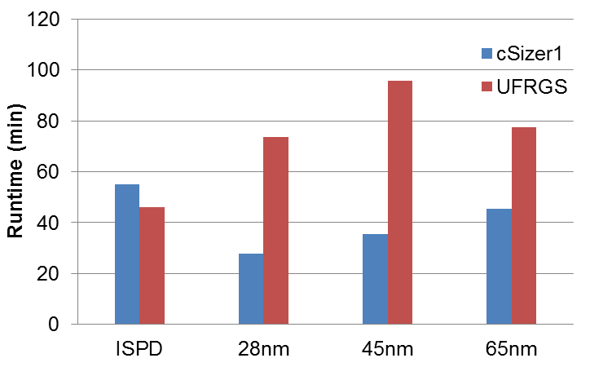
Sizer Assessment (Across Technologies)
Academic sizer achieves better solution quality and smaller runtime at ISPD technology, but worse solution and larger runtime at others ⇒ Possibility that academic sizer is specialized to the ISPD technology
Benchmark: netcard

Slide 23
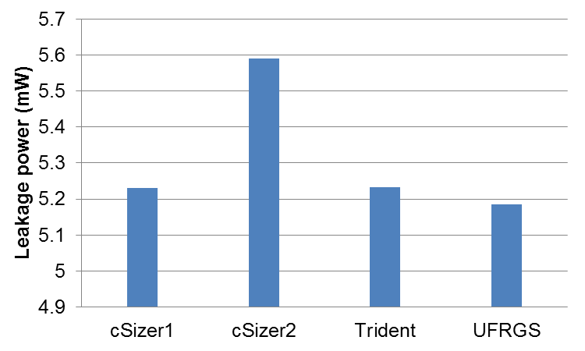
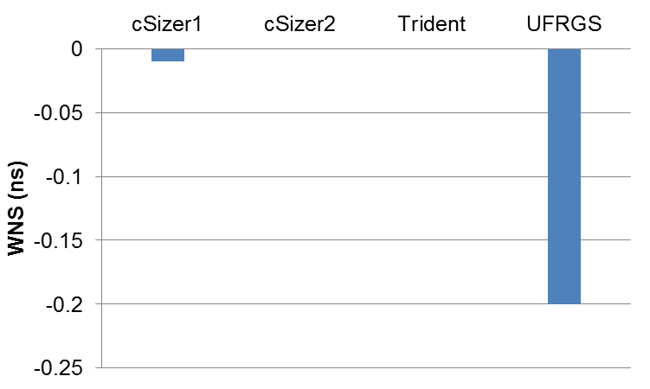
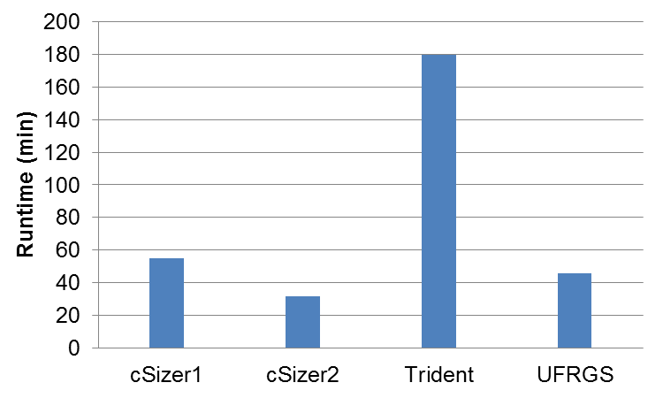
Sizer Assessment (Across Tools)
Academic sizers achieve smaller leakage, but have larger timing violation (due to inability to handle RC) and larger runtime ⇒ Indicate potential improvements for academic sizers
Technology: ISPD
Benchmark: netcard

Slide 24
Outline
Motivation
Related Work
Our Methodology
Experimental Setup and Results
Conclusion

Slide 25
Conclusion
Horizontal benchmark extension ⇒ maximally leverage available benchmark across multiple optimization domains
Enable assessments of academic research within industrial tool/flow contexts, across multiple technologies and types of benchmarks
Show potential improvements for academic tools
Possible start of ‘culture change’, similar to Bookshelf impact?
Future works
Further horizontal benchmark constructions
Explore gaps between academic optimizers and real-world design contexts
Website: http://vlsicad.ucsd.edu/A2A/

Slide 26
Acknowledgments
We are grateful to authors of academic tools for providing binaries of their optimizers for our study

Slide 27
Thank you!

