Slide 1
NOLO: A No-Loop, Predictive Useful Skew Methodology for Improved Timing in IC Implementation
Tuck-Boon Chan, Andrew B. Kahng, Jiajia Li
VLSI CAD LABORATORY, UC San Diego

Slide 2
Outline
Background and Motivation
Problem Statement
Our Methodologies
Experimental Setup and Results
Conclusion

Slide 3
Outline
Background and Motivation
Problem Statement
Our Methodologies
Experimental Setup and Results
Conclusion

Slide 4
Typical Useful Skew Flow
Useful Skew adjusts clock sink latencies to improve performance and/or timing robustness of IC designs
Clock period = 10
Min. slack with zero skew = 0
10/0
FF1
FF2
FF3
7/3
7/3
Clock
5
5
5
Data path
Clock tree
Delay/Slack/Clock latency

Slide 5
Typical Useful Skew Flow
Useful Skew adjusts clock sink latencies to improve performance and/or robustness of IC designs
Clock period = 10
Min. slack with useful skew = 2
Typical useful skew flow
RTL netlist
10/2
Synthesis
FF1
FF2
FF3
7/2
7/2
Placement/Place Opt.
Clock
CTS/CTS Opt.
Skew Opt.
7
6
5
Data path
Clock tree
Routing/Route Opt.
Delay/Slack/Clock latency

Slide 6
“Chicken-and-Egg” Problem
Typical useful skew flow synthesizes and places designs with zero skew ⇒ Benefit of useful skew is limited
RTL netlist
Synthesis
Assume zero skew
Placement/Place Opt.
CTS/CTS Opt.
Skew Opt.
Apply useful skew
Routing/Route Opt.

Slide 7
Back-Annotation Flow
Iteratively back-annotates post-placement useful skew to synthesis ⇒ Account for interactions among synthesis, placement and useful skew optimization
Issue: unacceptable large turnaround time
RTL netlist
Synthesis
Useful Skew
Our goal = predictive, one-pass (no-loop) flow
Placement/Place Opt.
CTS/CTS Opt.
Routing/Route Opt.

Slide 8
Outline
Background and Motivation
Problem Statement
Our Methodologies
Experimental Setup and Results
Conclusion

Slide 9
NOLO (No-Loop) Useful Skew Optimization Problem
Given a netlist and timing constraints
Determine clock latency for each sink (= flip-flop), using a one-pass implementation flow
Objective: minimize total negative slack (TNS)

Slide 10
Outline
Background and Motivation
Problem Statement
Our Methodologies
Experimental Setup and Results
Conclusion

Slide 11
Previous Useful Skew Optimizations
Maximize minimum slack in a circuit
[Fishburn90] formulates linear programming (LP) to optimize clock latencies
[Szymanski92] improves the efficiency of LP by selectively generating constraints
[Wang04] proposes LP-based approach to evaluate potential slacks and optimize clock skew
Maximize all slacks in a circuit
[Albrecht02] formulates useful skew optimization as maximum mean weight cycle (MMWC) problem ⇒ optimizes using graph-based method

Slide 12
MMWC-Based Skew Optimization
Construct sequential graph (vertex = flip-flop, edge = max-/min-delay path, edge weight = setup/hold slack)
Initial graph
+0
A
20/2
10/10
12/8
+0
B
C
+0
10/10
10/10
2/18
+0
D
E
+0
Clock period = 20
Delay/Slack/Clock latency

Slide 13
MMWC-Based Skew Optimization
Construct sequential graph (vertex = flip-flop, edge = max-/min-delay path, edge weight = setup/hold slack)
Iteratively find critical loop → optimize slacks → contract critical loop into one vertex → update adjacent edges → optimize the rest
Initial graph
After 1st iteration
+0
A
+0
A
20/2
10/10
20/6
10/6
12/8
12/6
+0
B
C
+0
+6
B
C
+4
10/10
10/10
10/4
10/14
2/18
2/18
+0
D
E
+0
+0
D
E
+0
Clock period = 20
Delay/Slack/Clock latency

Slide 14
MMWC-Based Skew Optimization
Construct sequential graph (vertex = flip-flop, edge = max-/min-delay path, edge weight = setup/hold slack)
Iteratively find critical loop → optimize slacks → contract critical loop into one vertex → update adjacent edges → optimize the rest
Initial graph
After 1st iteration
After 2nd iteration
+0
A
+0
A
+0
A
20/2
10/10
20/6
10/6
20/6
10/6
12/8
12/6
12/6
+0
B
C
+0
+6
B
C
+4
+6
B
C
+4
10/10
10/10
10/4
10/14
10/12
10/12
2/18
2/18
2/12
+0
D
E
+0
+0
D
E
+0
+8
D
E
+2
Clock period = 20
Delay/Slack/Clock latency

Slide 15
Simple Predictive Flow
Timing analysis at post-synthesis stage
Perform useful skew optimization
Apply resulting useful skew (clock latencies) during following implementation stages
RTL netlist
Synthesis
Maximize ∑ setup slacks
Subject to hold constraints
Predictive Useful Skew
Placement/Place Opt.
CTS/CTS Opt.
Routing/Route Opt.

Slide 16
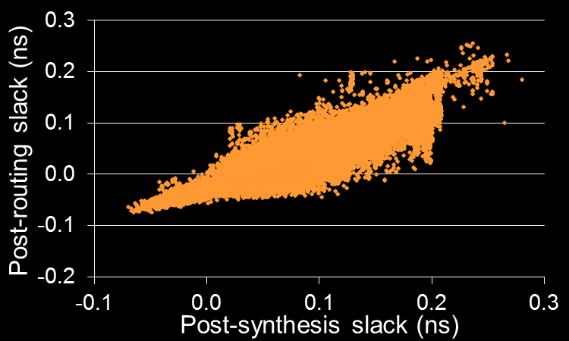
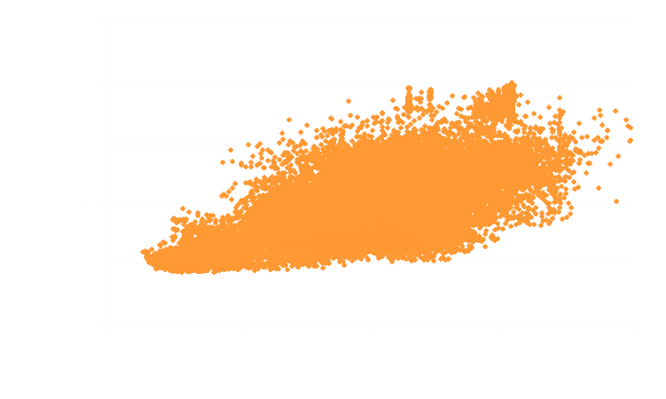
Impact of Early Optimization
Post-synthesis useful skew optimization (simple predictive) ⇒ Improved clock skew relaxes timing constraints ⇒ Correlation between post-synthesis & post-routing slacks↑
With useful skew
Without useful skew
0ps to 150ps
0ps to 250ps
Post-routing critical path corresponds to paths with 0-150 (0-250)ps slacks w/ (w/o) useful skew

Slide 17
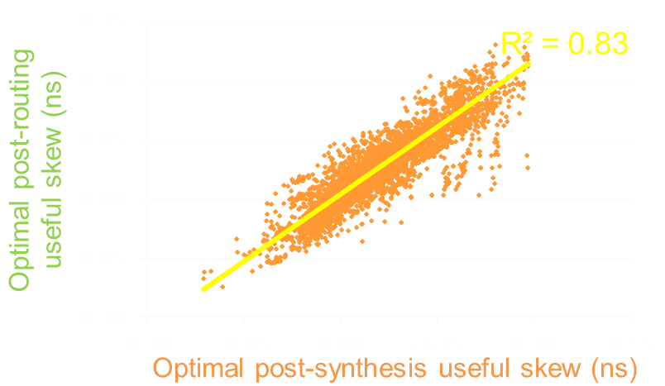
Key Observation
Will the optimization at post-synthesis stage still be valid at post-routing stage?
Recall: Improved correlation between post-synthesis and post-routing slacks
Expect: Post-synthesis optimization leads to similar timing improvement as post-routing optimization
- Yes
Synthesis
Useful Skew
P&R
Compare
Useful Skew

Slide 18
Improved Predictive Flow
Solution quality of predictive optimization is affected by timing optimizations during P&R (e.g., Vt-swapping) ⇒ Predict useful skew based on LVT-only netlist
LVT-only synthesis ⇒ estimation of achievable slacks
RTL netlist
Synthesis w/ Multi-Vt
Synthesis w/ LVT
Predictive Useful Skew
LVT-only netlist
Placement/Place Opt.
We use setup slacks from LVT-only case and hold slacks from multi-Vt case
CTS/CTS Opt.
Routing/Route Opt.

Slide 19
Outline
Background and Motivation
Problem Statement
Our Methodologies
Experimental Setup and Results
Conclusion

Slide 20
Experimental Setup
Design
Technology 28nm FDSOI, dual-Vt {SVT, LVT}
Signoff corners {125ºC, 0.9V, SS} and {-40ºC, 1.05V, FF}
Tools
Synthesis: Synopsys Design Compiler vH-2013.03-SP3
P&R: Synopsys IC Compiler vH-2013.06-SP2
Tool “denoising” execute three separate runs with small perturbation of clock period (-1ps, 0ps, +1ps), take best outcome
Design | Clk period (ns) | #Cells | #Flip-flops | #Paths
aes_cipher | 0.6 | ~23K | 530 | 16251
des_perf | 0.5 | ~11K | 1985 | 23153
jpeg_encoder | 0.6 | ~50K | 4712 | 137333
mpeg2 | 0.4 | ~11K | 3381 | 95490

Slide 21
Comparison Among Flows
Variants of back-annotation flows
SimPred = simple prediction flow
ImpPred = improved prediction flow
Flow | Back annotate from | Back annotate to
BA-W | Post-placement | Pre-synthesis
BA-I | Post-placement | Pre-placement
BA-II | Post-routing | Pre-synthesis
BA-III | Post-routing | Pre-placement
BA-IV | Post-routing | Pre-CTS

Slide 22
Experimental Results
Predictive flow (ImpPred) achieves similar / better timing, with much less runtime, compared to the average of back-annotation flow variants (BA avg)
Different back-annotation flows → timing quality varies ⇒ Cannot completely resolve the “chicken-and-egg” problem
aes_cipher
Less runtime
Smaller TNS
des_perf
jpeg_encoder
mpeg2

Slide 23
Outline
Background and Motivation
Problem Statement
Our Methodologies
Experimental Setup and Results
Conclusion

Slide 24
Conclusion
NOLO = a no-loop predictive useful skew optimization flow
Improved prediction of potential slack using LVT-only netlist
Similar or better timing, with much less runtime compared to back-annotation flows
Back-annotation flow cannot completely resolve the “chicken-and-egg” problem
Future Work
Analyze and apply useful skew across multiple PVT corners
Study tradeoff among area, power and timing of useful skew optimization

Slide 25
Acknowledgments
Work supported from Qualcomm, Samsung, NSF, SRC, the IMPACT (UC Discovery) and IMPACT+ centers

Slide 26
Thank You!

Slide 27
Backup Slides

Slide 28
Zero-skew flow
RTL netlist
Synthesis
Placement/Place Opt.
CTS/CTS Opt.
Routing/Route Opt.

