Slide 1
High-Performance Gate Sizing with a Signoff Timer
Andrew B. Kahng*, Seokhyeong Kang*, Hyein Lee*,
Igor L. Markov⁺ and Pankit Thapar⁺
UC San Diego* University of Michigan⁺
Notes:
Thank you for the kind introduction. Good afternoon, everyone.
The title of my talk is “High-Performance Gate Sizing with a Signoff Timer”. This is a joint work of UC San Diego and University of Michigan.

Slide 2
Outline
Gate Sizing in VLSI Design
Previous Work
Challenges in Gate Sizing
High-Performance Gate Sizing with a Signoff Timer
Overall Flow
Experimental Results
Conclusions and Future Work
Notes:
In this talk, I will first introduce gate sizing, previous work, and then talk about challenges.
I will present key techniques in our high-performance gate sizing with a signoff timer, and show the overall flow.
And then, I will show experimental results. Finally, I will conclude my talk.

Slide 3
Gate Sizing in VLSI Design
Effective approach to power, delay optimization
Objective: minimize Σ power
Satisfy constraints: slack, slew, max load capacitance, …
Tunable cell parameters: gate width, Vth, gate length
Select a proper library cell for each gate
gate-width (drive-strength)
INVX2
INVX4
INVX8
INVX16
multi-Vth
HVT
NVT
LVT
L_{gate}-bias
L=65nm
L=60nm
L=55nm
lower (leakage) power
lower speed
higher (leakage) power
higher speed
Notes:
Gate sizing is an effective approach to optimize power and delay.
The goal is to minimize power consumption subject to design constraints, like timing slack, slew and capacitance.
Tunable parameters for gate sizing are gate-width, threshold voltage and gate-length.
Lower power cells are slower and higher power cells are fast.
Using this tradeoff, we can select a proper library cell for each gate to minimize power under given constraints.

Slide 4
Previous Gate Sizing Techniques
Common heuristics/algorithms
Limitations
Continuous gate sizing : industrial cell libraries have discrete gate sizes, and rounding solutions may be suboptimal
Discrete gate sizing : NP-hard problem ⇒ scalability issue
Do not account for realistic delay models and constraints (capacitance, slew)
Continuous gate sizing
Linear programming
Convex optimization
Lagrangian relaxation
Discrete gate sizing
Dynamic programming
Sensitivity-based sizing
Notes:
Gate sizing has been well studied, and many techniques are available.
For continuous gate sizing problems, linear programming, convex optimization and Lagrangian relaxation-based methods are proposed.
For the discrete gate sizing problem, dynamic programming and sensitivity-based sizing methods are proposed.
However, these techniques have limitations; so they cannot be easily adapted to real designs.
Continuous gate sizing is not appropriate for discrete industrial cell libraries – and rounding of solutions may result in suboptimal solutions.
Discrete gate sizing problem is NP-hard, and it is difficult to scale with known approaches.
Also, realistic delay models and constraints including capacitance and slew are not accounted for.

Slide 5
Previous Work
Our work extends Trident 1.0 [Hu et al. Proc. ICCAD 2012]
Produced strongest results on ISPD 2012 benchmarks as of ICCAD 2012
Metaheuristic optimization with importance sampling and sensitivity-guided search
Limitation: no interconnect delay calculation ⇒ Unrealistic assumption
Notes:
Our work extends Trident 1.0 which produced the strongest result on ISPD 2012 benchmarks as of ICCAD 2012.
Their method is based on metaheuristic optimization with importance sampling and sensitivity-guided search.
However, interconnect delay calculation was not considered in Trident1.0, which is not realistic.

Slide 6
Outline
Gate Sizing in VLSI Design
Previous Work
Challenges in Gate Sizing
Issue 1: Interconnect delay
Issue 2: Inaccurate internal timer
Issue 3: Critical paths
High-Performance Gate Sizing with a Signoff Timer
Overall Flow
Experimental Results
Conclusions and Future Work
Notes:
The THREE key challenges are covered next.

Slide 7
Challenges in Gate Sizing
Sizing problem seen at all phases of RTL-to-GDS flow
Becomes more challenging at later design stages
Timing constraints are strict
Gate sizing can result in large change in interconnect delay
Gate
Sizing
Gate Level Netlist
Placement
Placed Netlist
Route
Routed Netlist
Our Problem
Interconnects
Challenging
Realistic nature in the ISPD 2013 Contest benchmarks
Routed netlists including interconnect
Use an industry signoff timer
Many near-critical paths in benchmarks
Notes:
The sizing problem arises at all phases of a RTL to GDS flow.
We solve the sizing problem for routed netlists.
Sizing problem become more challenging at the later design stages because timing constraints are strict.
Also, gate sizing can result in large change in interconnect delay for a routed netlist.
The ISPD 2013 contest benchmarks include all these realistic aspects.
Benchmarks correspond to routed netlists including interconnects.
Additionally, an industry signoff timer is used for the evaluation.
And the benchmark circuits have many near-critical paths, which makes the problem more difficult.
Specificically, …

Slide 8
Issue 1: Interconnect Delay/Slew
Gate sizing affects up/downstream gates/nets delay
Slew degradation from interconnects makes delay worse
⇒ Impact of gate sizing becomes larger with interconnects
⇒ Careful gate sizing is needed
Slew change
Pin capacitance change
Notes:
Sizing affects both upstream and downstream gates, and interconnect delay.
The slew change propagates downstream; the pin capacitance changes due to gate sizing affect upstream gate and interconnect delay.
Especially, slew degradation due to interconnects increase the delay change.
This means, the impact of gate sizing on delay becomes larger with interconnect.
So, more careful gate sizing is needed.

Slide 9
Issue 2: Inaccurate Internal Timer
Internal timer is not perfectly matched with signoff timer
⇒ Calibration to signoff timer can be used
Still, the error increases with netlist changes
Periodic timing calibration to a signoff timer is needed to avoid divergence
Error accumulation with netlist change
Error
(internal – signoff)
# cell change
Netlist change
Notes:
The second issue is that internal timer cannot be perfectly matched with signoff timer.
To compensate for errors, we can calibrate to signoff timer before gate sizing.
But, after we make netlist changes with gate sizing, the error will increase.
To avoid this divergence, periodic timing calibration to a signoff timer is needed.

Slide 10
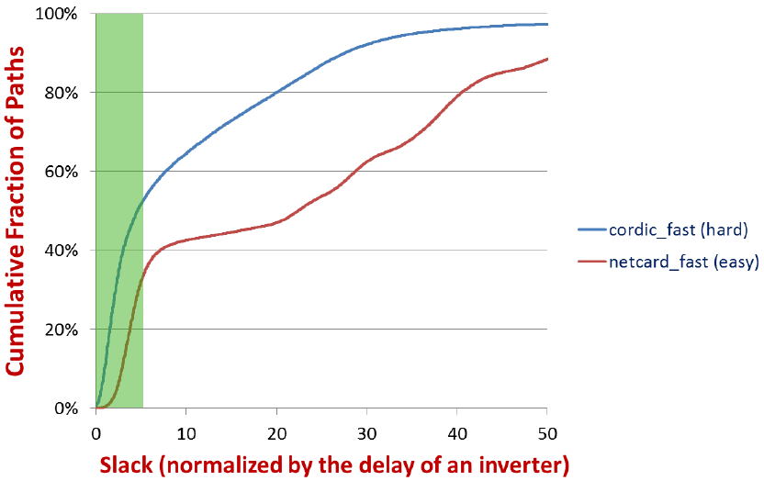
Issue 3: Critical Paths
Many near-critical paths in the given benchmarks
Challenging to obtain a timing feasible solution
Dedicated critical path optimization is needed
cordic_fast (hard)
netcard_fast (easy)
* From ISPD 2013 Discrete Gate Sizing Contest Presentation
Notes:
For ISPD 2013 benchmarks, there are many near-critical paths, it was challenging to obtain a timing feasible solution.
The chart shows the cumulative fraction of paths vs. slack of two example benchmarks.
More than 50% of paths have less slack than 5 times of an inverter delay for cordic_fast.
To obtain timing feasible solutions, dedecated critical path optimization is needed.

Slide 11
Outline
Gate Sizing in VLSI Design
Previous Work
Challenges in Gate Sizing
High-Performance Gate Sizing with a Signoff Timer
Internal Timer with Interconnect Timing Models
Calibration to a Signoff Timer
Critical Path Optimization
Sensitivity Functions
Overall Flow
Experimental Results
Conclusions and Future Works
Notes:
Next, I will present several key techniques in our sizer to solve the explained issues.

Slide 12
1. Internal Timer with Interconnect Timing Models
Internal timer is essential to estimate delay changes during gate sizing
Requirements for an internal timer
Able to calculate interconnect delay/slew
Fast enough for move-based optimization
Accurate enough to track signoff timer
Our approach: use best-performing models for interconnect delay/slew from previous work
Notes:
An internal timer is needed to estimate delay changes during gate sizing.
It should calculate interconnect delay/slew; fast enough for move-based optimization, because we may need to check timing for every cell change; and accurate enough to track signoff timer without too much divergence.
So, we empirically chose the best interconnect delay/slew models, suitable for our objective, from previous work.

Slide 13
Interconnect Delay/Slew : Pre-Existing Models
Early optimization does not require accuracy ⇒ fast interconnect models
We use pre-existing fast models
Delay models
Slew models
Elmore delay
D2M
DM1, DM2
PERI
S2M
Effective Cap. models
D2M: Alpert et al. ISPD 2000
DM1,DM2: Kahng et al. TCAD 1997
PERI: Kashyap et al. TAU 2002
S2M: Agarwal et al. TCAD 2004
McCormick: Ph.D. Thesis 1989
McCormick
Total Cap.
Notes:
We note that early optimization does not require high accuracy, as the netlists keep changing.
But, calculation should be fast.
So, we explored pre-existing models.
Elmore, D2M, DM1 and DM2 for delay models; PERI and S2M for slew models; and McCormick for effective capacitance model are evaluated.

Slide 14
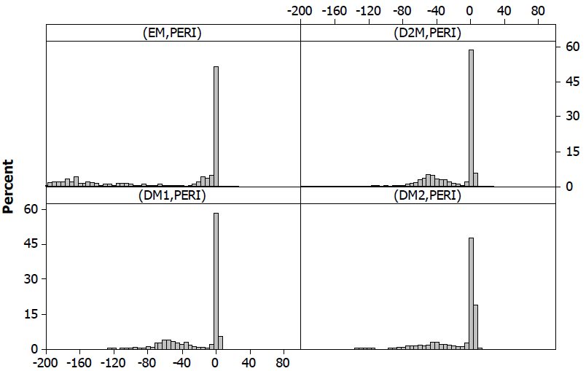
Interconnect Delay/Slew : Model Selection
Model selection criterion: endpoint slack error between the signoff timer and our estimation
The (D2M, PERI) model combination has the smallest mean and standard deviation
Endpoint slack error distribution
Normalized mean/std. of endpoint slack error
x-axis: slack error (ps), y-axis: % of #paths
(EM, PERI)
(D2M,PERI)
(DM1,PERI)
(DM2,PERI)
Notes:
We select the best models based on endpoint slack error.
Endpoint slack means the timing slack at the endpoint of a timing path, like input pin of FF or primary output.
This plot shows slack error distribution relative to the signoff timer.
On the x-axis the slack error, On the y-axis % of the number of paths are presented.
And, this figure shows the normalized mean in blue, and normalized standard deviation in red, of the errors for each delay and slew combination.
From the results, (D2M, PERI) combination shows smallest discrepancy, so we picked this combination.

Slide 15
2. Calibration to a Signoff Timer
Challenges in matching the results of the signoff timer
Timing divergence with netlist changes
The divergence can be compensated with
Offset-based slack calibration [Moon et al., U.S. Patent 7,823,098]
Periodic calibration to a signoff timer to avoid large divergence
⇒ How often should we calibrate?
offset = signoff timer – internal timer
Internal Timer
Signoff Timer
Request timing information
Notes:
Even with a good interconnect delay and slew model, it is still hard to perfectly match with the result of signoff timer because of timing divergence with netlist changes.
So, we use offset-based slack calibration from Moon’s work.
During the calibration, the internal timer requests timing information from signoff timer;
with the accurate timing information from signoff timer, the offset is calculated and stored.
Also, to avoid large divergence, we perform the calibration periodically.
For the periodic calibration, we need to decide how often we calibrate.

Slide 16
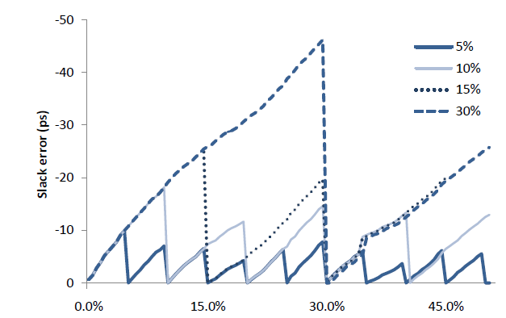
Calibration Frequency vs. Error
Impact of calibration frequency on average slack error during the optimization
Calibration frequency (X%): calibration is performed whenever X% of cells have been changed
(avg.) slack error over the signoff timer
5% threshold
<10ps slack errors
% of changed cell during leakage optimization
Notes:
We empirically decided the calibration frequency, based on experiment results.
This plot shows the impact of calibration frequency on average slack error during the gate sizing procedure.
X-axis shows the percentage of cell changed and Y-axis shows the slack error over the signoff timer.
We tested various calibration frequencies; here, X% in the label means calibration is performed whenever X% of cells have been changed during the optimization.
Right after calibration, we can see the error becomes zero instantly; but grow again with continuing cell changes.
(click) From the results, we observe that the slack error is less than 10ps with 5% calibration frequency.

Slide 17
Efficient Signoff-Timer Interface
Tcl socket interface to communicate with signoff timer
Fast and efficient for frequent query of timing info
Sizer
Signoff timer
Launch signoff timer
Open socket
Load design
Cell sizing
Cell swap list
Update cell size
Timing calibration
Timing results
incremental STA
Notes:
For the frequent timing calibration, the interface between internal timer and the signoff timer must be efficient.
We use a Tcl socket interface to enable the communication between sizer and signoff timer while both are running.
This is fast and efficient for frequent query of timing information because it does not need file interface.
To prepare the interface, we launch the signoff timer and open a socket.
After gate sizing, sizer send cell swap list to the signoff timer, so that the timer can update cell sizes in its database.
Then, the signoff timer send the updated timing results back to sizer and timing calibration is finished.

Slide 18
3. Critical Path Optimization
For a design having many near-critical paths, dedicated optimization is needed
Critical path optimization: optimize cells on the timing critical paths (critical cells) to reduce WNS*
Method 1 : Downsizing fanouts
Method 2 : Peephole optimization
* WNS: Worst Negative Slack
Notes:
For a design which has many near-critical paths, dedicated optimization is needed.
Thus, we implemented critical path optimization, which optimizes cells on the timing critical path to reduce worst negative slack.
We suggest two methods: downsizing fanout cells and peephole optimization.
I will explain these next.

Slide 19
Critical Path Optimization: Downsizing Fanouts
Downsizing fanouts of critical cells ⇒ Improve delay of the target cell by reducing load
Select the target critical cell with highest sensitivity score ⇒ small gate with large fanout loads
Downsizing to reduce input cap.
Speed up the target cell with reduced output load
Speed
Target critical cell
Critical cells
Fanout cells
$$SFdown =\frac{Cout(c) }{size(c) }$$
*c : critical cell
Notes:
Downsizing fanouts of critical cells improves the delay of the target critical cell.
In this figure, the RED-colored gates are critical cells; and the BLUE-colored gates are fanout cells of critical cells; and
the GREEN-colored gate is the target critical cell.
By downsizing fanout cells of the target critical cell, we can speed up the target with reduced output loads.
We select the target critical cell with sensitivity score; if a gate is small with large fanout loads, it is selected first with a high sensitivity score.

Slide 20
Critical Path Optimization: Peephole Optimization
Exhaustive search for the best solutions of k critical cells
All possible combinations are listed in order of Gray code ⇒ minimize the overhead of incremental STA (iSTA)
current window
Critical path
N(# trial) = {#size option}^{k}
Enumerate all possible combination w/ Gray code
trial1
iSTA
pick the best move
trial2
...
trialN
* STA: Static Timing Analysis
Notes:
In peephole optimization, we exhaustively search for the best solution for selected k critical cells.
All possible combinations are listed in a Gray code order, so as to allow only one cell change for each transition.
This reduces the overhead of incremental STA.
The sizer tries all possible combinations and pick the best move, which reduce WNS the most.
And then, we move the window along the critical path.

Slide 21
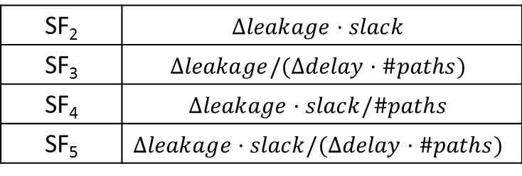
4. Sensitivity Function
Sensitivity function (SF): guide to identify the most promising cells to size
SF for timing recovery ⇒ impact of sizing on total negative slack (TNS) relative to leakage penalty
$∆slack$, $∆leakage_power$: slack, leakage power change after cell sizing
$\#paths$: the number of paths passing through the cell
$α$: leakage exponent parameter
$$SF =\frac{∆slack·\#paths }{∆leakage_powerα }$$
SF for leakage reduction
⇒ impact of sizing on leakage reduction relative to timing penalty
SF₂ | $$∆leakage·slack$$
SF₃ | $$∆leakage/(∆delay·\#paths)$$
SF₄ | $$∆leakage·slack/\#paths$$
SF₅ | $$∆leakage·slack/(∆delay·\#paths)$$
$$SF1 =\frac{∆leakage}{∆\text{delay} }$$
Notes:
Our overall optimization is based on sensitivity function;
sensitivity function can give a guide to identify the most promising cells to size.
We have two kinds of SF.
SF for timing recovery quantifies the impact of sizing on total negative slack relative to leakage penalty.
Here, alpha is a leakage exponent, which is a configuration parameter for SF. This alpha is a tuning knob for timing recovery stage;
I will explain how we tune alpha, in a few minutes.
SF for leakage reduction quantifies leakage reduction relative to timing penalty. The timing penalty is calculated differently as shown in the table.

Slide 22
Outline
Gate Sizing in VLSI Design
Previous Work
Challenges in Gate Sizing
High-Performance Gate Sizing with a Signoff Timer
Overall Flow
Global Timing Recovery
Power Reduction with Feasible Timing
Experimental Results
Conclusions and Future Work
Notes:
Now, I will explain the overall flow.

Slide 23
Overall Optimization Flow
Overall flow: Timing Recovery (TR) + Power Reduction with Feasible Timing (PRFT)
Routed Netlist, SPEF
Set to minimum size
TR w/o signoff timer
Find the best parameters for SF
Timing Recovery
TR w/ signoff timer
Find timing feasible solution
PRFT SGGS
Leakage reduction with Sensitivity-Guided Gate Sizing
Power Reduction
w/ Feasible Timing
PRFT Kick-Move
Further leakage reduction
Sizing Solution
*SF : Sensitivity Function
Notes:
The overall optimization flow consists of two stages: timing recovery and power reduction with feasible timing, or PRFT.
In a given routed netlist, we set all gates to minimum size. And we perform timing recovery to get a timing feasible solution.
In the first stage, best parameters for the sensitivity function are obtained by making many parallel runs using different configurations, and WITHOUT the signoff timer.
In the second stage, a timing feasible solution is obtained WITH the signoff timer.
After finding a timing feasible solution, sizer performs PRFT to reduce leakage power.
First, it tries to reduce leakage with sensitivity-guided gate sizing or SGGS; and then, in the second PRFT stage, it tries to achieve further leakage reduction using a kick-move technique that is inspired by the large-step Markov Chain metaheuristic.
I will review details of each stage in the next slides.

Slide 24
Timing Recovery: Overall Procedure
Objective: find timing feasible solution
Global Timing Recovery (GTR) : core procedure in this stage
Phase 1: multi-threaded coarse search to find the best (α,γ)
Phase 2: feasible solution search with accurate timing info
Two parameters in GTR
α : leakage exponent in SF
γ : commit ratio (% of upsizing)
<GTR procedure>
STA
Calculate sensitivity (α)
$$SF =\frac{∆slack·\#paths }{∆leakage_powerα }$$
Upsize γ% of promising cells
No
Timing met?
Notes:
This slide shows the timing recovery flow to find a timing feasible solution.
This figure on the right shows the GTR , which is the core procedure in timing recovery flow.
Recall the form of our sensitivity function, GTR has two parameters, alpha and gamma.
In GTR, after STA is performed, sensitivity is calculated with alpha; and then we upsize gamma percent of promising cells based on the sensitivity values.
This loop is repeated until the timing is met.
With this GTR, in phase 1, we find the best configuration of alpha and gamma with multi-threaded coarse search. This phase is just a quick search for a good configuration without using a signoff timer. Then, phase 2 finds a timing feasible solution with a signoff timer. If feasible solution is not found, additional timing recovery procedure, which includes critical path optimization, is performed.

Slide 25
Timing Recovery: Overall Procedure
Objective: find timing feasible solution
Global Timing Recovery (GTR) : core procedure in this stage
Phase 1: multi-threaded coarse search to find the best (α,γ)
Phase 2: feasible solution search with accurate timing info
GTR(α,γ) w/o signoff timer
<GTR procedure>
Multi-threaded
STA
No
Guardband (GB)↑
Feasible?
Feasible?
Yes
Calculate sensitivity (α)
Best parameter (α,γ)
GTR(α,γ) w/ signoff timer
Upsize γ% of promising cells
No
Local
Timing Recovery
Feasible?
No
Timing met?
Yes
Timing feasible solution
Notes:
This slide shows the timing recovery flow to find a timing feasible solution.
This figure on the right shows the GTR , which is the core procedure in timing recovery flow.
Recall the form of our sensitivity function, GTR has two parameters, alpha and gamma.
In GTR, after STA is performed, sensitivity is calculated with alpha; and then we upsize gamma percent of promising cells based on the sensitivity values.
This loop is repeated until the timing is met.
With this GTR, in phase 1, we find the best configuration of alpha and gamma with multi-threaded coarse search. This phase is just a quick search for a good configuration without using a signoff timer. Then, phase 2 finds a timing feasible solution with a signoff timer. If feasible solution is not found, additional timing recovery procedure, which includes critical path optimization, is performed.

Slide 26
PRFT: Sensitivity-Guided Gate Sizing
Objective: reduce leakage of timing feasible solution
Sensitivity-guided gate sizing (SGGS)
Various sensitivity functions are tried
Repeat SGGS with kick-move
SGGS procedure
SGGS(SF_{i})
STA
Timing recovery
Calculate sensitivity (SF_{i})
No
Feasible?
Downsize a promising cell C
Revert
the sizing
Yes
Next Sensitivity Function (SF_{i})
slack (C ) < 0
Kick-Move
Best solution
Yes
No
Notes:
After finding a timing feasible solution, PRFT is performed to recover leakage power from the solution.
Sensitivity-guided gate sizing is used;
This flow chart illustrates the SGGS procedure.
After STA, sensitivity is computed; and then we downsize the most promising cell based on the sensitivity score.
If slack is less than zero, which means, not feasible, the SGGS procedure reverts the sizing.
With SGGS, various sensitivity functions are tried to obtain the best solution;
For further leakage reduction, SGGS is performed again with kick-move.

Slide 27
Outline
Gate Sizing in VLSI Design
Previous Work
Challenges in Gate Sizing
High-Performance Gate Sizing with a Signoff Timer
Overall Flow
Experimental Results
Conclusions and Future Work
Notes:
Now, I will present experimental results and conclusion with future work.

Slide 28
ISPD 2013 Gate Sizing Contest
ISPD 2013 Benchmarks : realistic circuits and constraints
Netilst (Verilog), parasitics (SPEF), timing constraint (SDC)
Max slew/load constraint
Library: 11 logic functions, 30 cell types (three multi-V_{th} and ten different sizes) → 330 cells
Leakage power of violation-free solutions are compared
Final timing evaluation with a commercial signoff tool
Notes:
We have tested our sizer with the ISPD 2013 benchmark framework. In the contest benchmarks, netlist, parasitics, timing constraint, and maximum slew and load constraints are provided. In the library, there are 11 different logic functions and 30 cell types. Leakage power of violation-free solutions are compared, and Final timing is evaluated with a commercial signoff tool.

Slide 29
Experimental Results: Power and Runtime Result
Power and runtime comparison vs. contest best result
9% leakage, ~3X runtime improvement on average in fast mode
7% leakage degradation in normal mode (runtime comparison is not available in normal mode)
Normalized leakage power and runtime in normal/fast mode
Leakage
Runtime
Source: http://www.ispd.cc/contests/13/ISPD_2013_Contest_Final.pdf
Notes:
This chart shows power and runtime comparison versus best contest result in fast and normal mode.
The x-axis is each testcase, the y-axis is relative delta leakage or runtime.
All numbers represent normalized delta values according to the results from our sizer.
The red bars show the delta leakage in fast mode,
the green lines show the corresponding delta runtime,
and the blue bars show the delta leakage in normal mode.
The positive value means our result was better.
In fast mode, 9% leakage and 3X runtime improvement are achieved.
In normal mode, the leakage is worse by 7% in our sizer.

Slide 30
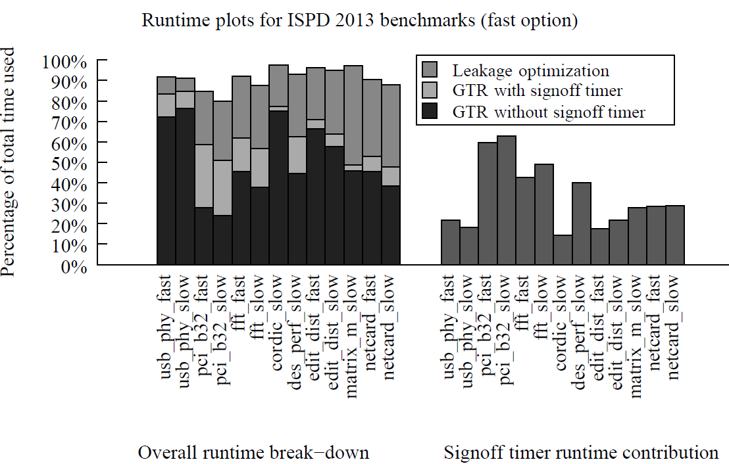
Experimental Results: Runtime Breakdown
Signoff timer runtime contribution : 20~60%
Overall runtime breakdown
Signoff timer runtime contribution
Notes:
We now analyze the runtime breakdown (point); and the right chart shows signoff timer runtime contribution which varies from 20% to 60%.
When directly compared to total runtime, the signoff timer runtime occupies the total by the amount of blue bars.

Slide 31
Experimental Results: Optimization Trajectories
Normalized TNS* and leakage power change over timing recovery (TR) iterations
After timing calibration, TNS increases due to discrepancy between internal timer and signoff timer
* TNS: Total Negative Slack
Normalized TNS
After timing calibration
Normalized Leakage
# TR iteration
TR without signoff timer
TR with signoff timer
Notes:
This chart shows the normalized total negative slack and leakage power over timing recovery iterations.
The x-axis is the number of timing recovery iteration, the y-axis represents leakage or total negative slack.
The red line shows leakage change over the timing recovery iteration,
the blue line shows the normalized total negative slack.
the first 20 iterations of timing recovery do not use the signoff timer. After the 20th iteration, the signoff timer is used.
After timing correlation, total negative slack increases due to discrepancy between internal and signoff timer.

Slide 32
Experimental Results: Impact of Timing Inaccuracy
Inaccurate timing with the internal timer at optimization ⇒ leakage increase at final signoff stage
Compensate inaccuracy : calibration, margin (guardband)
Periodic calibration with 5% calibration frequency ⇒ minimum leakage without timing violation
Result of pci_b32_fast
Notes:
We also study the impact of timing inaccuracy.
Inaccurate timing at optimization stage may result in leakage increase at final signoff stage, due to the timing error.
To compensate for the errors, we can calibrate to signoff timer or put extra margin.
We have tested three calibration scenario and two guardbands.
The left chart shows normalized leakage and the right chart shows total negative slack at optimization and final signoff stage.
From the result, we observe that the minimum leakage without timing violation is achieved with calibration for every 5% cell change. This shows our periodic calibration method is a good approach to compensate for the timing error.

Slide 33
Conclusions and Future Work
Trident2.0: high-performance gate sizing
Fast interconnect models with reasonable accuracy for an efficient internal timer
Calibration to a signoff timer with an interface to improve timing accuracy
Dedicated critical path optimization with heuristics
ISPD 2013 gate sizing contest
Trident 2.0 took 2nd and 1st places in two contest categories, respectively
Future work
See if Lagrangian relaxation helps
Additional industry benchmarks
Notes:
In this talk, we propose Trident 2.0, which is a high-performance gate sizing;
We achieve high-performance with fast interconnect models with reasonable accuracy for an efficient internal timer, calibration to a signoff timer with an interface to improve timing accuracy,
and dedicated critical path optimization with heuristics.
In ISPD 2013 gate sizing contest, Trident 2.0 took 2nd and 1st places in two contest categories, respectively.
For future work,
we are going to study Lagrangian relaxation method to combine it with our method; and test our method with additional industry benchmarks.

Slide 34
Thank you!

